Slide 1
Swarm Driving With Deep Learning
Luca Brodo – Winter Semester 2021
Deep Learning

Slide 2
Swarm Robotics and Swarm Intelligence
Swarm robotics is a branch of robotics which deals with the coordination of multiple, usually simple, robots in order to achieve a common goal
Swarm intelligence indicates to the general set of algorithms which make swarm robotics possible
Notes:
relatively simple

Slide 3
Why are we talking about swarms?
We live in an interconnected world
Devices can communicate with each other
Communication allows cooperation
Cooperation is common in nature (bees, ants, etc…)

Slide 4
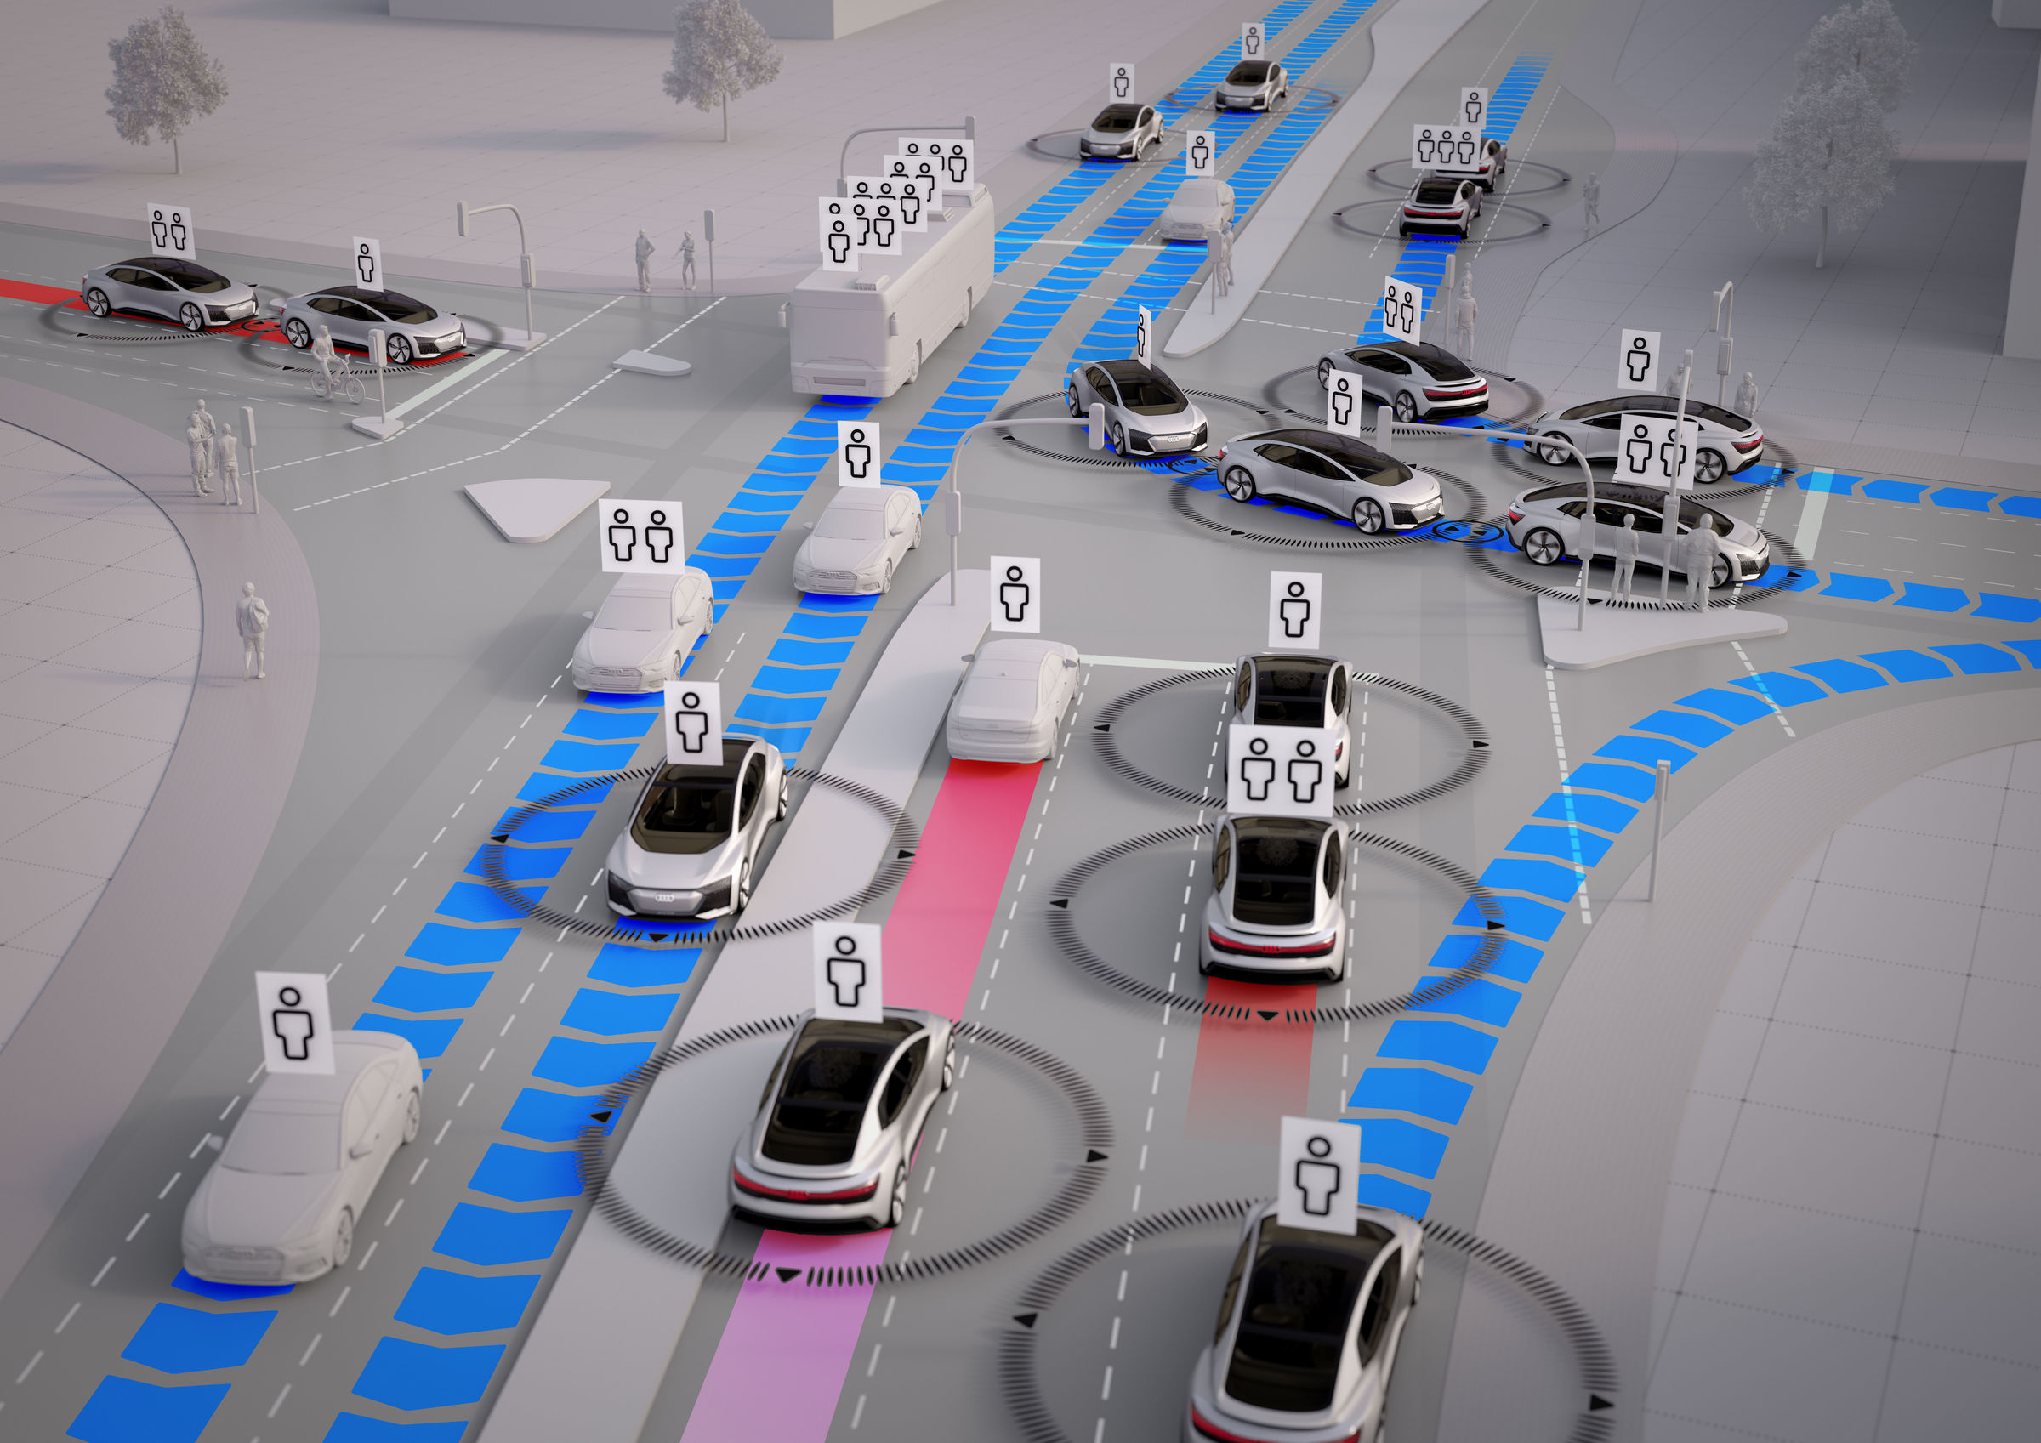
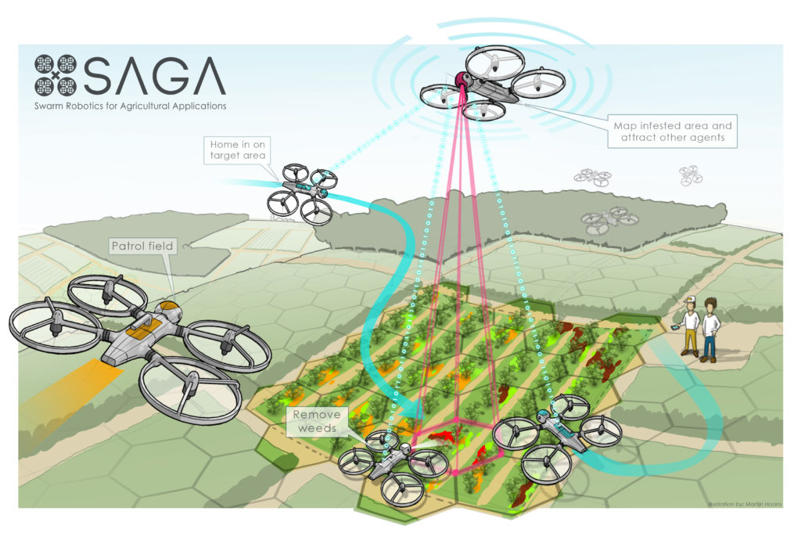
Why are we talking about swarms?
(1)
(2)

Slide 5
Why are we talking about swarms?
Swarms are:
Flexibility
Robustness
Scalability
Swarms are decentrilized
Each robot should be autonomous
Each robot should be self-organized

Slide 6
We are talking about swarms because:
Simple devices can cooperate to solve complex tasks (but not exclusively)
But is it applicable in the real world?

Slide 7
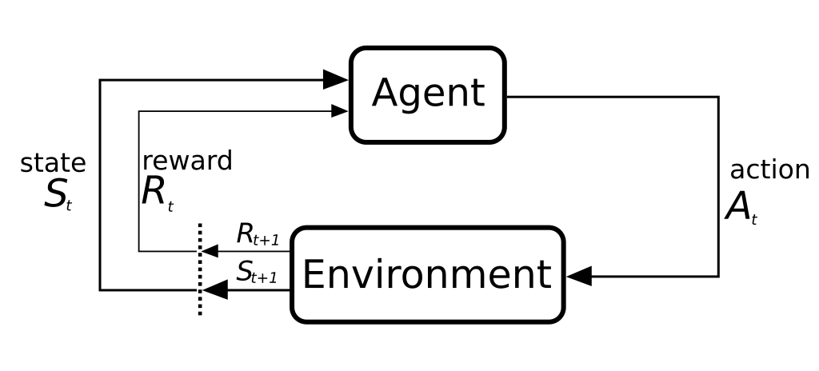
Reinforcement Learning
(3)

Slide 8
Reinforcement Learning
The purpose of the agents is to learn a policy π(a|s)
Every Agent has:
A representation of a value function
a direct representation of the policy
(3)

Slide 9
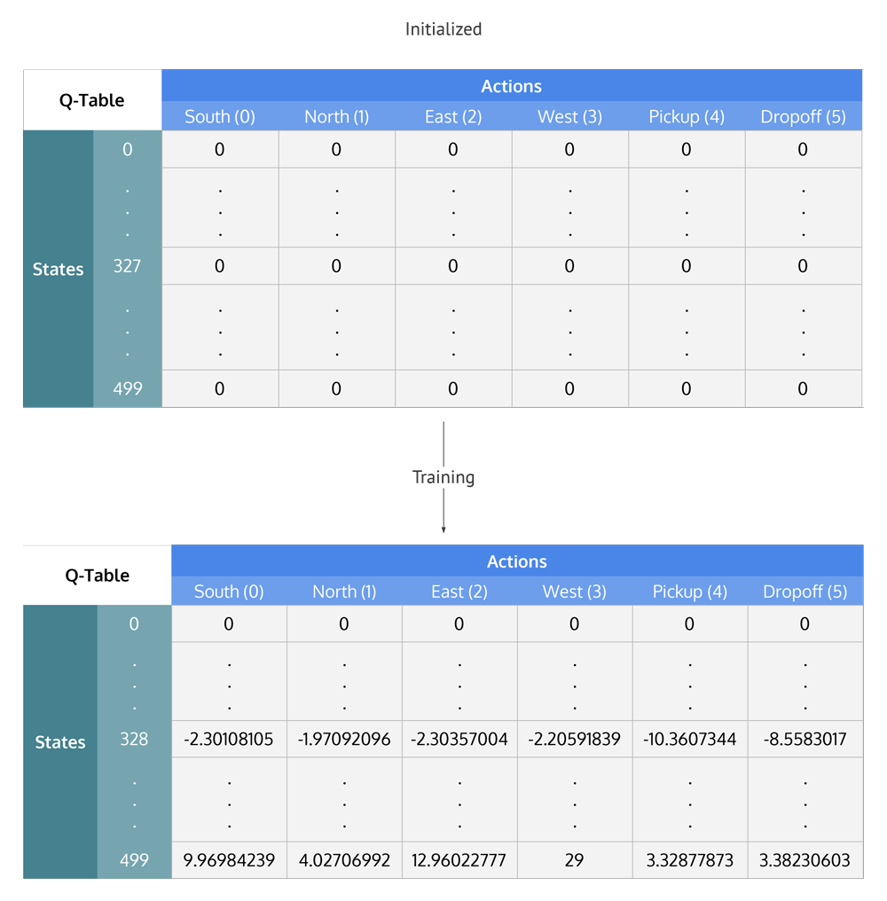
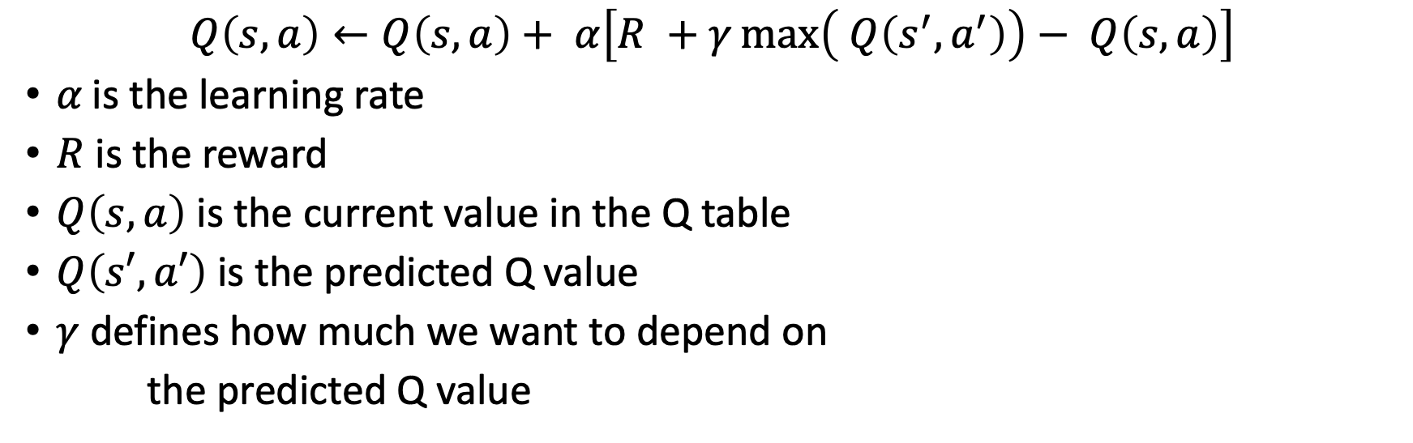
Q-Learning
$$Q\left(s,a\right)←Q\left(s,a\right)+ α\left[R +γ\max\left( Q\left(s^{′},a^{′}\right)\right)− Q\left(s,a\right)\right]$$
𝛼 is the learning rate
$R$ is the reward
$Q\left(s,a\right)$ is the current value in the Q table
$Q\left(s′,a′\right)$ is the predicted Q value
$γ$ defines how much we want to depend on
the predicted Q value
(4)

Slide 10
Q-Learning
Simple and elegant solution
Not effective in real-world solutions
The permutation-state actions is immense
We might not have experienced this action. What is it going to happen?
We do not have enough memory to store the table
Solution?
Deep Learning

Slide 11
Deep Q-Learning
Developed by Google Deep Mind
Use of a CNN to solve the problem of memory in large environments.
CNN as an approximation function when it becomes too difficult to express the value function for every state

Slide 12
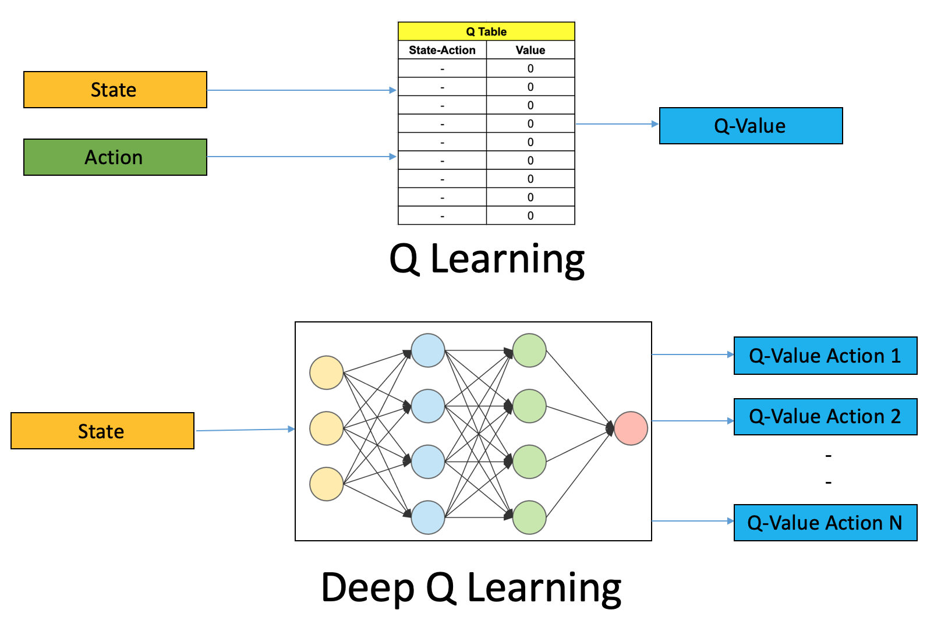
Deep Q-Learning

Slide 13
Deep Q-Learning
Might result in too much instability
Two Solutions:
Replay memory
Target Q-technique

Slide 14
Let’s simulate an application
Our goal: Coordination
We want the agents to group themselves avoid obstacles

Slide 15
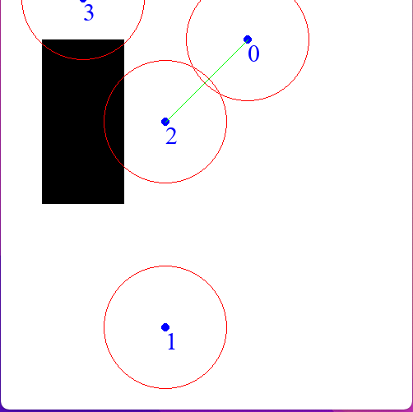

Our Simulation
Discrete Environment (10x10)
9 possible moves (including not moving)
CNN to update our Q-Table
No-Go Area
Agents are in communication
Agent
Communication Range

Slide 16
Is it applicable in the real world?
Researchers are still answering this question
Cooperation (Swarms) helps developing otherwise impossible solutions
Deep Learning is necessary
Very promising results in a very promising field

Slide 17
References
https://echord.eu/saga.html)
Audi, “Swarm intelligence: The car-to-x principle.”
Wikipediacontributors,“Markovdecisionprocess—Wikipedia,thefree encyclopedia,” 2021. [Online; accessed 4-January-2022].
Wikipediacontributors,“Deepreinforcementlearning—Wikipedia,the free encyclopedia,” 2021. [Online; accessed 4-January-2022].

