Slide 1
Gradient Descent
Luca Brodo – Summer Semester 2021
Deep Learning

Slide 2
What is it and why do we need it?
Algorithm for optimization of Machine Learning models
We need it because:
Performance plays a huge role when it comes to training models
By knowing how it works, ad – hoc solutions can be implemented

Slide 3
What is it and why do we need it?
This algorithm is usually attributed to Cauchy, who first suggested it in 1847
Basic idea:
Finding local minimum through an iterative process
The step opposite direction of the gradient of the loss function is taken

Slide 4
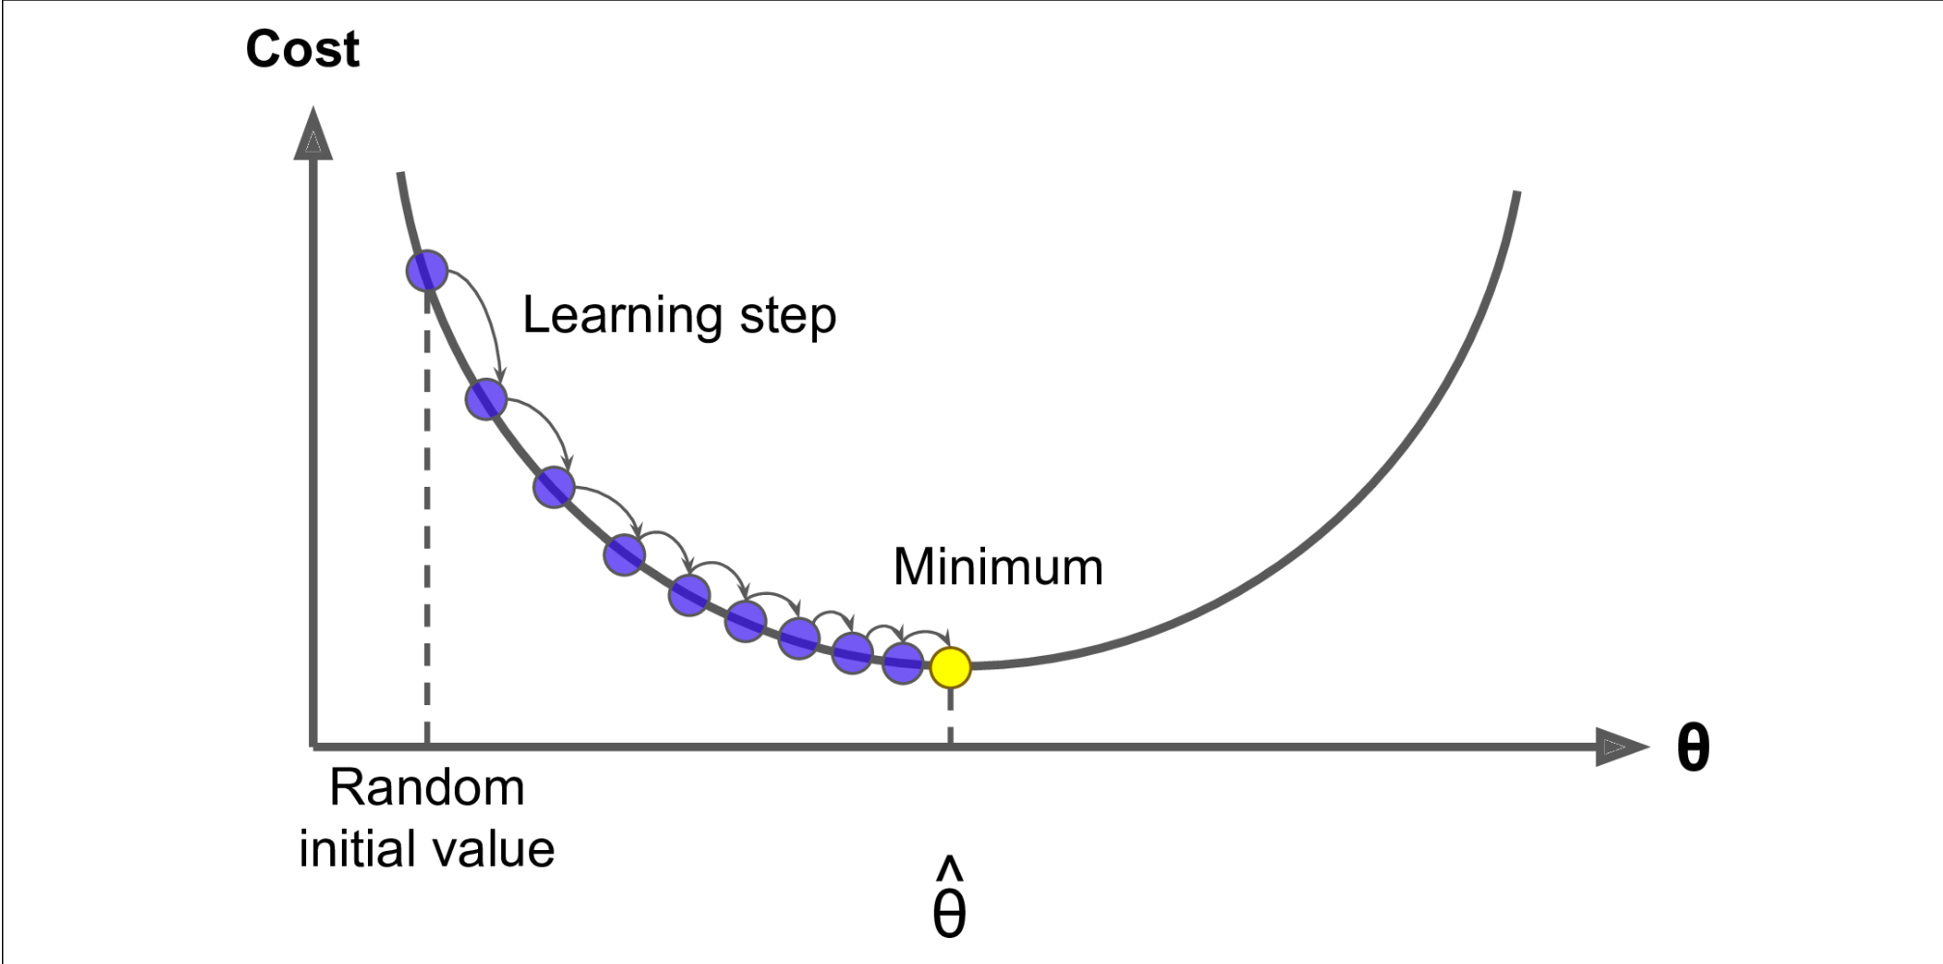
Functioning
Calculate the minimum of the cost function
Steps = Learning Rate
(1)

Slide 5
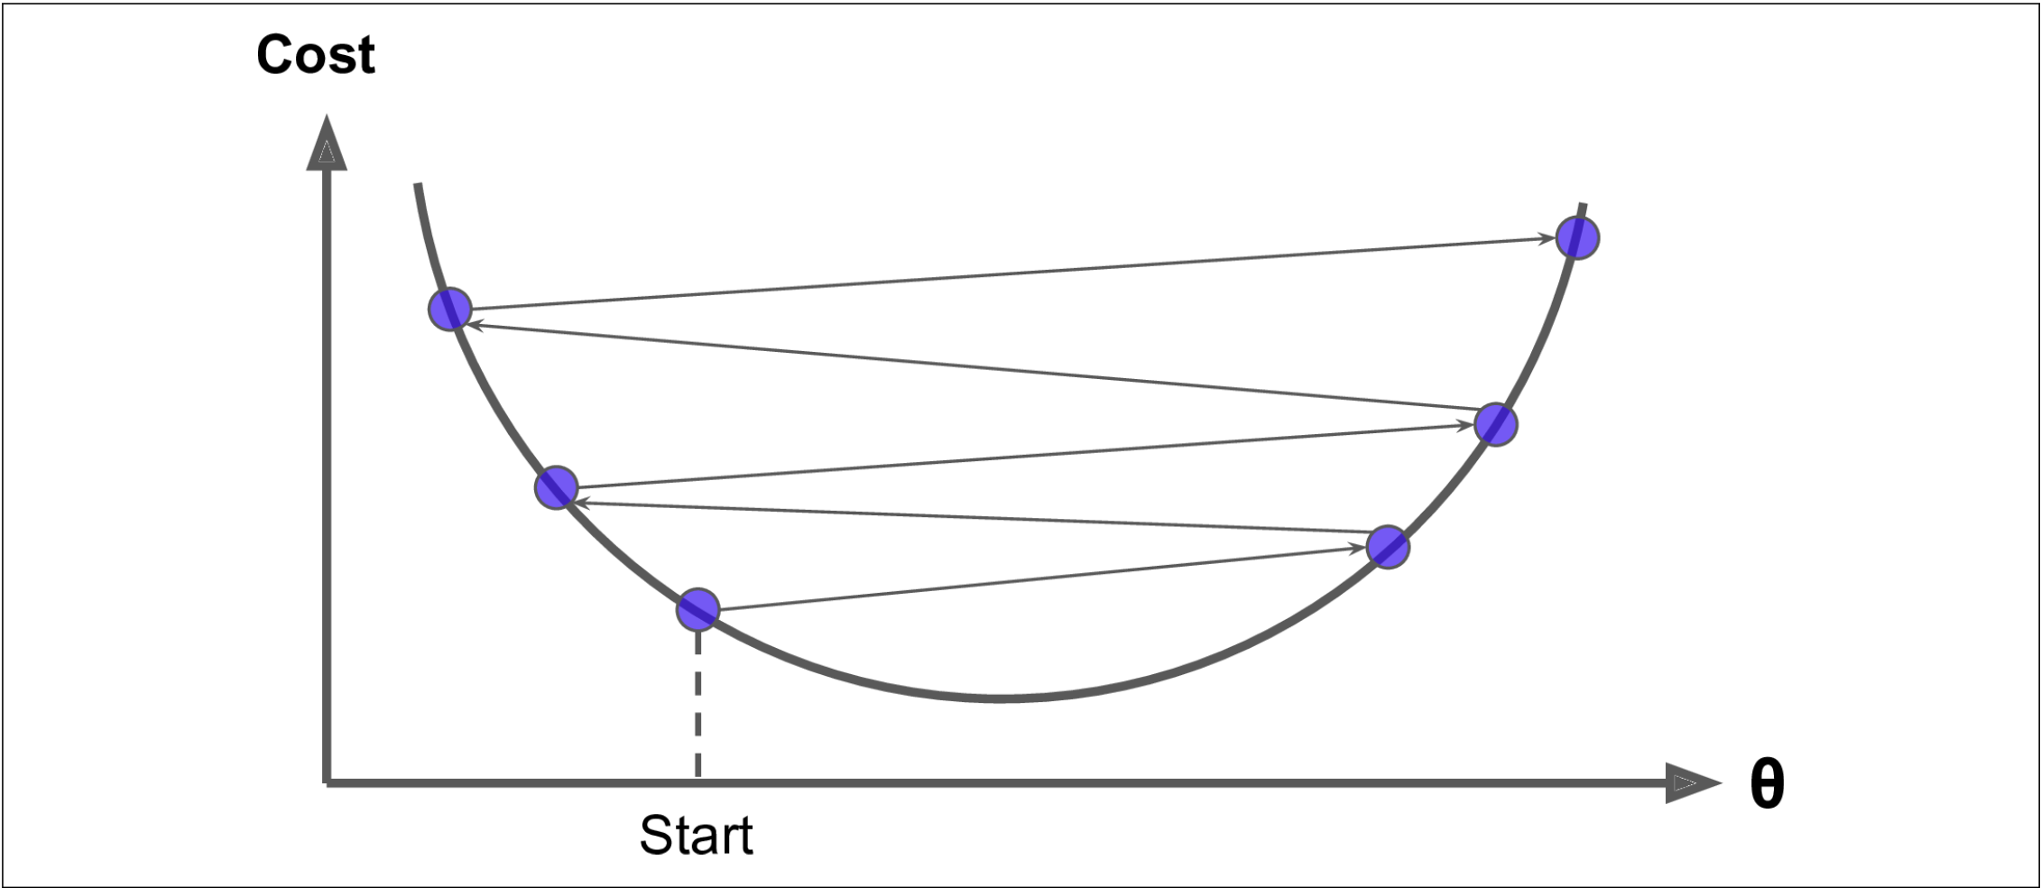
Incorrect Value for the learning rate
Overshooting:
(1)

Slide 6
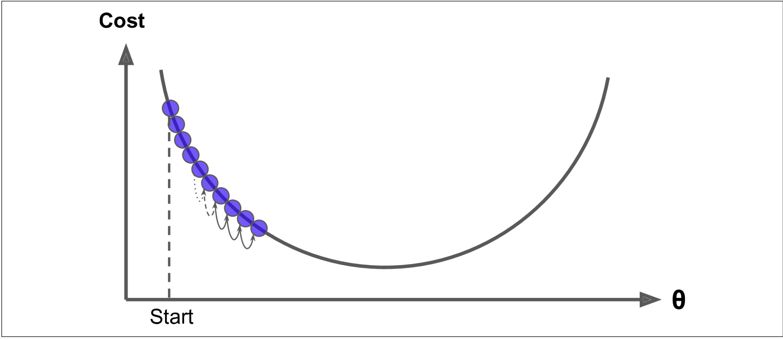
Incorrect Value for the learning rate
Undershooting
(1)

Slide 7
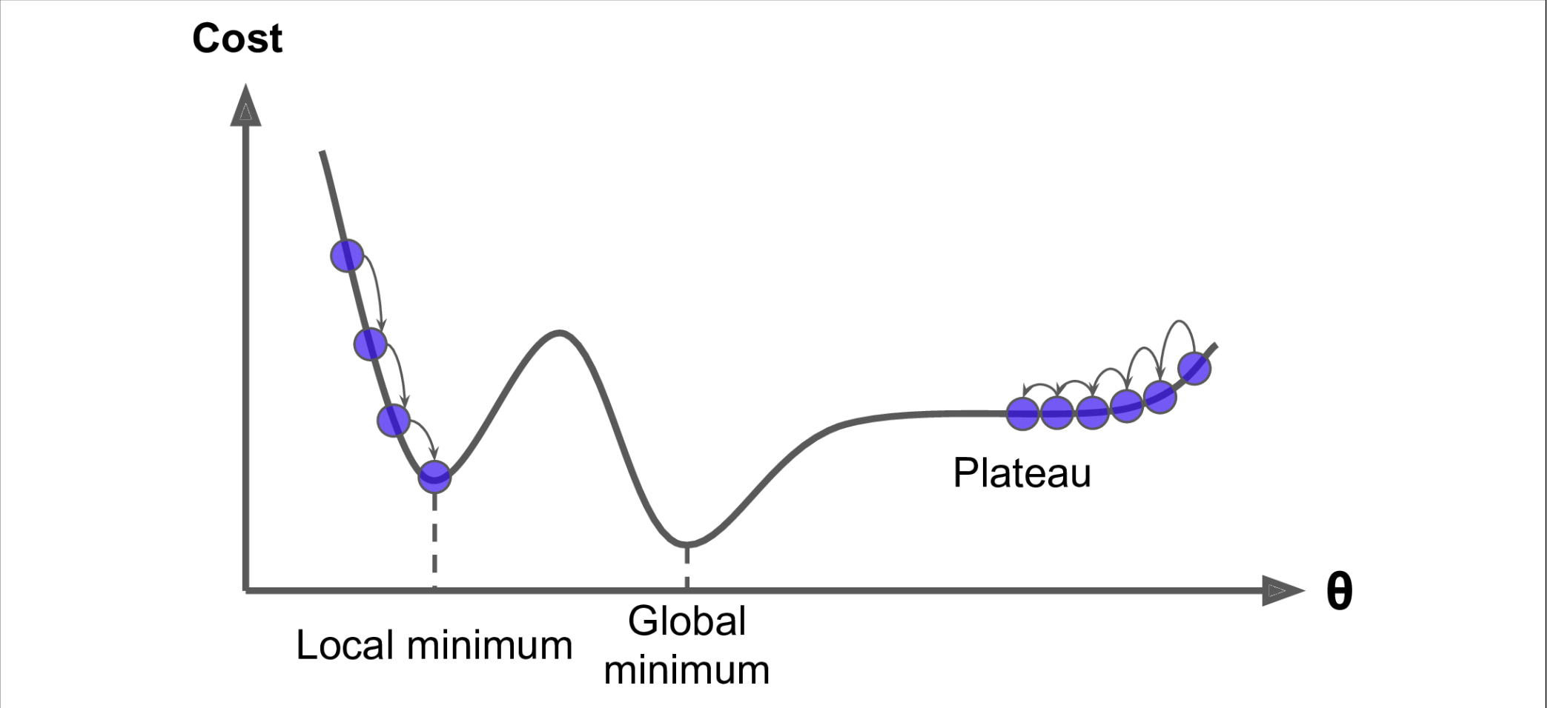
Gradient Descent Pitfalls
(1)

Slide 8
3 Variations:
Batch Gradient Descent
Stochastic Gradient Descent Application
Mini-Batch Gradient Descent Application

Slide 9
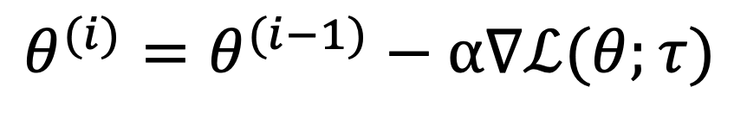
Batch Gradient Descent
$$θ^{(i)}=θ^{(i−1)}−α∇ℒ(θ;τ)$$
Optimizes the parameters using the whole data set at every iteration
Slower than the other variants
0(1/ℇ) iterations to reach the optimum => ℇ depending on the shape of the cost function

Slide 10
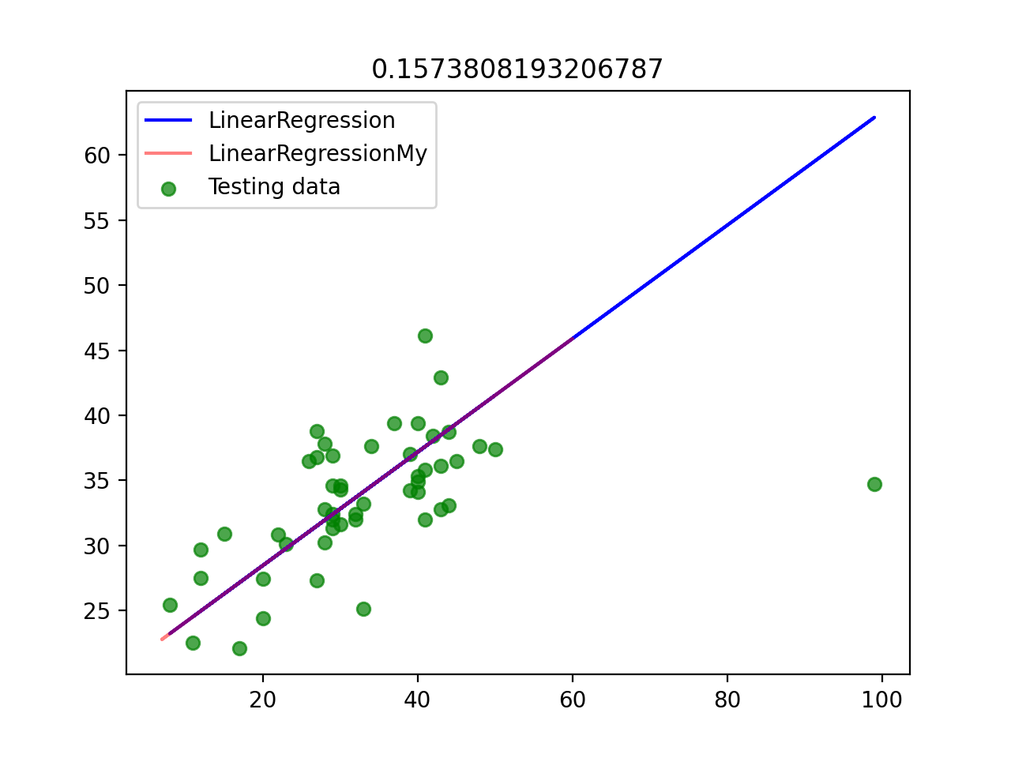
Result

Slide 11
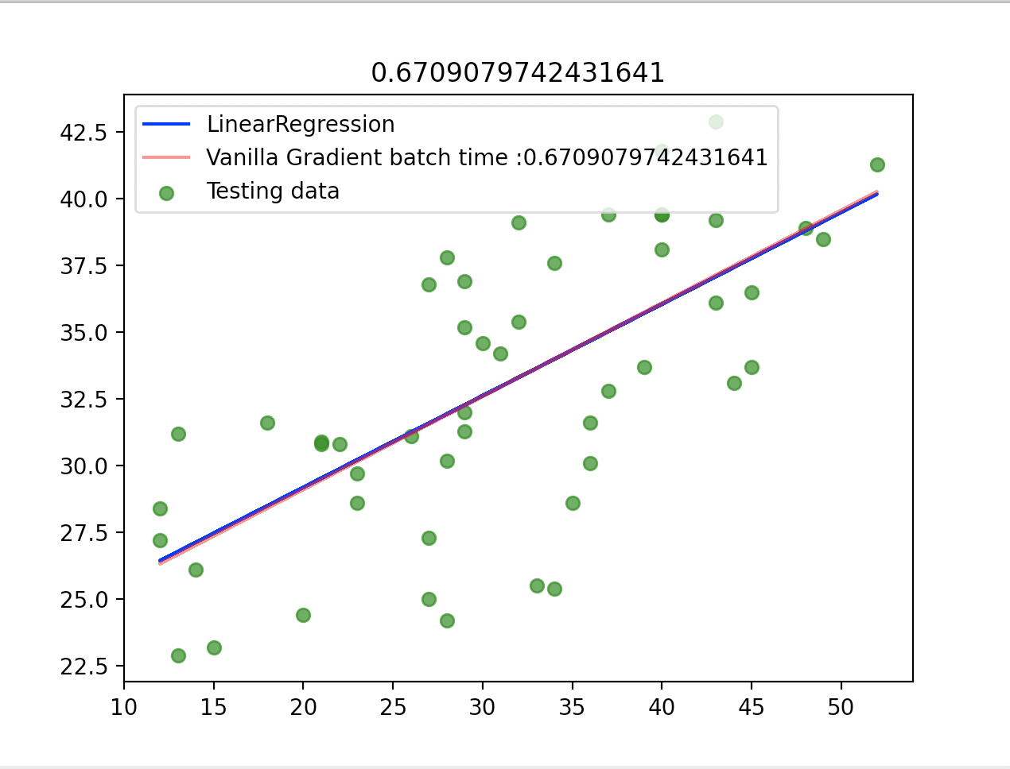
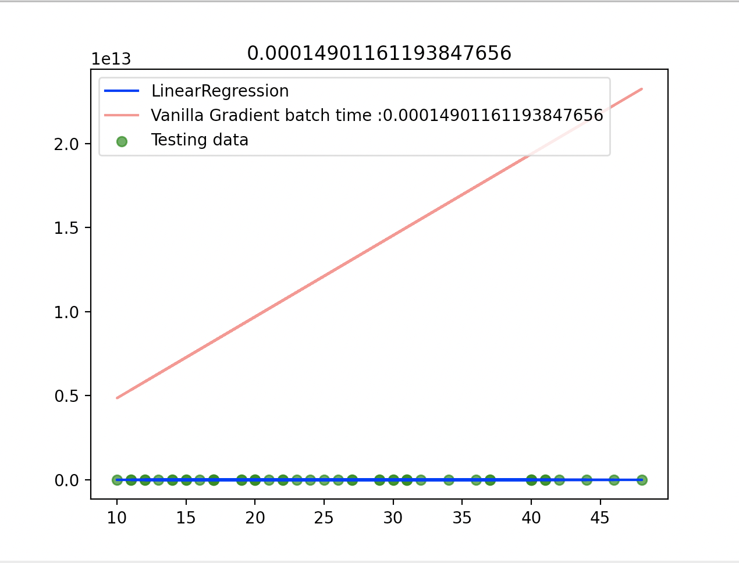
Smaller learning rate
Bigger learning rate

Slide 12
Characteristics
The optimal minimum is guaranteed to be found
Very solid
Works with all type of loss functions
But:
Slow
Not suitable for large datasets

Slide 13
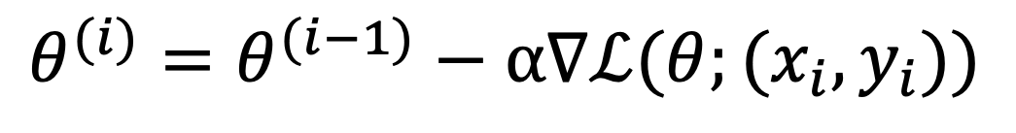
Stochastic Gradient Descent
$$θ^{(i)}=θ^{(i−1)}−α∇ℒ(θ;(x_{i},y_{i}))$$
Batch version too slow
Using the entire dataset introduces unwanted redundancy
Solution →
Use only one instance of the dataset
At every iteration, select one instance randomly

Slide 14
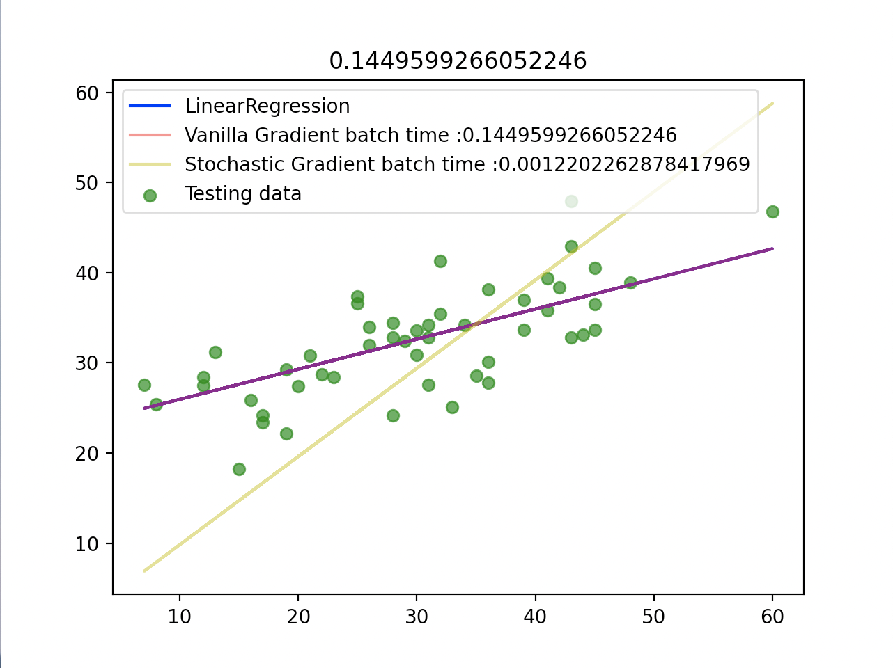
Result

Slide 15
Drawbacks
Randomness → much less solid
Possibility to jump out of the local minimum
Depends on the type of cost function
One possible solution
Reduce the learning grade gradually at every iteration

Slide 16
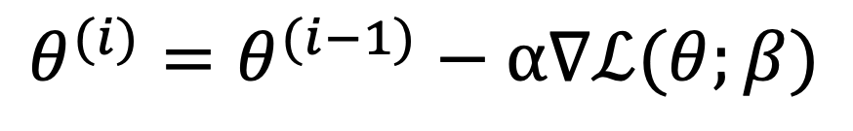
Mini-Batch Gradient Descent Application
$$θ^{(i)}=θ^{(i−1)}−α∇ℒ(θ;β)$$
Select batch from the dataset
Use this batch for the optimization

Slide 17
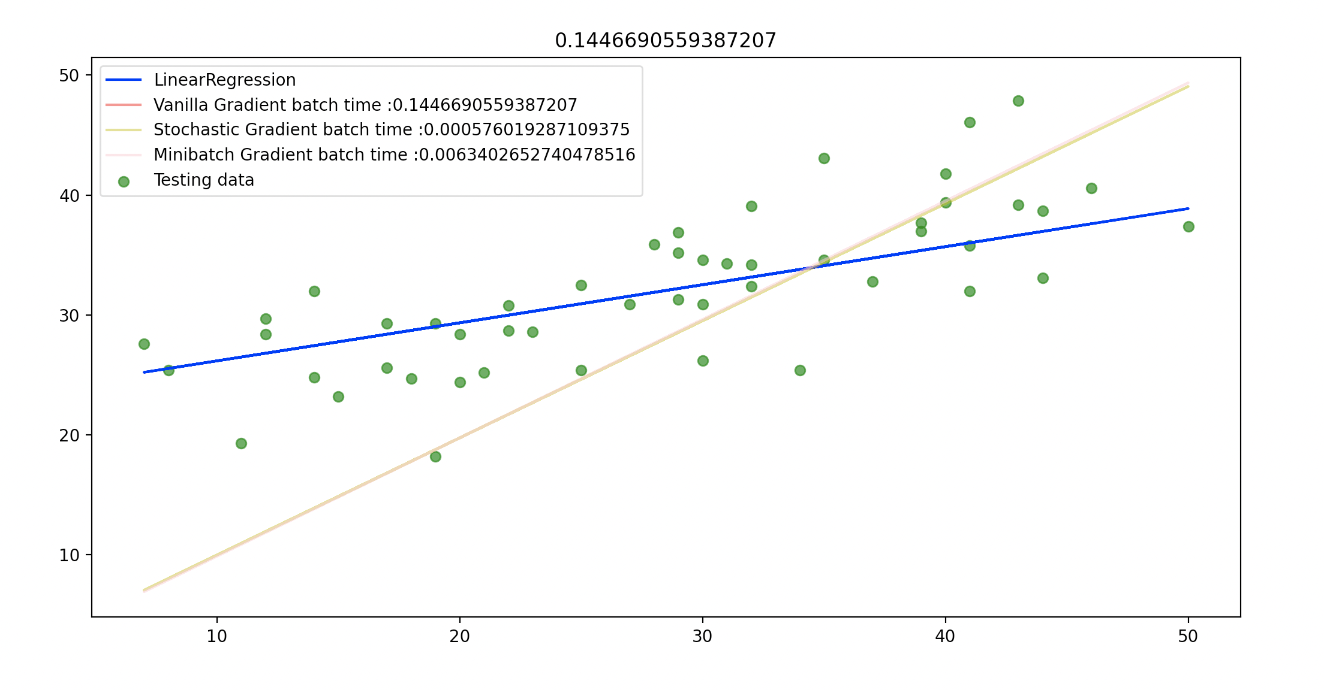
Result

Slide 18
Characteristics
Randomness still plays a major role
Faster than the batch version, more stable than the stochastic
The form of the loss function has an impact on the performance
Suitable for large dataset

Slide 19
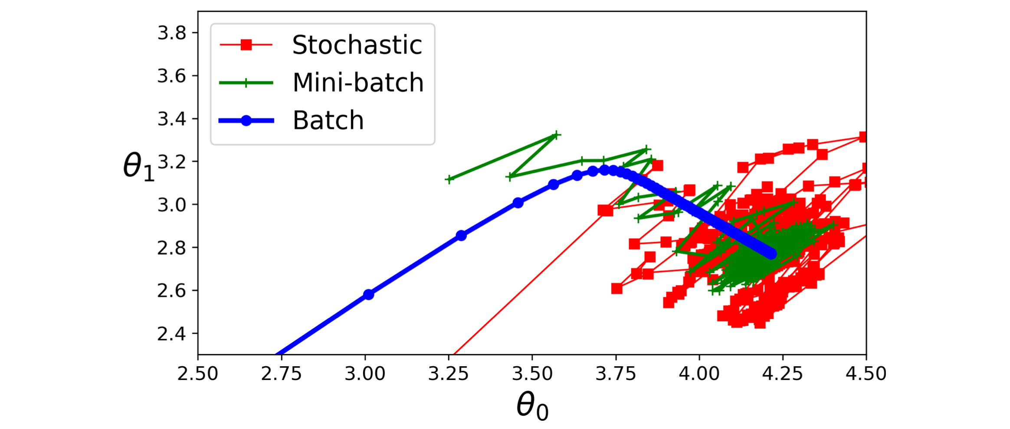
Comparison and conclusion

Slide 20
Comparison and conclusion
Very solid optimization algorithm
Huge room for improvements for ad-hoc solutions
Not a work-for-all solution
Important trade off to consider:
By introducing randomness, faster solutions but higher possibility to overshoot

Slide 21
References
A. G ́eron. Scikit-Learn,Keras, and TensorFlow :concepts, tools, and techniquestobuildintelligentsystems. CA: O’Reilly Media,Inc, 2019

