Slide 1
Visual Arts Standard 3.V.R.1: Contemplate about the processes an artist uses to create a work of art, and determine messages communicated by an image.
Lesson Objective:
When presented with artwork, students will be able to interpret messages communicated by the piece, providing at least two specific details or elements from the artwork to support their interpretation.
Narrative Writing
and
Narrative Art
Notes:
Hello Class! We have been working on writing narrative pieces and you are doing a great job! Today we are going to integrate art as a way to enhance and inspire your narrative writing skills. When we look closely at art, we can often find a message or story. In this lesson will learn how to look critically at art, ask questions, and interpret the messages we see. This will help you learn to pay close attention to details and describe what you see. This is a great skill for young writers to practice because it can help you to create vivid and detailed descriptions in your own writing, and maybe even in your own artwork. Lets get started!

Slide 2
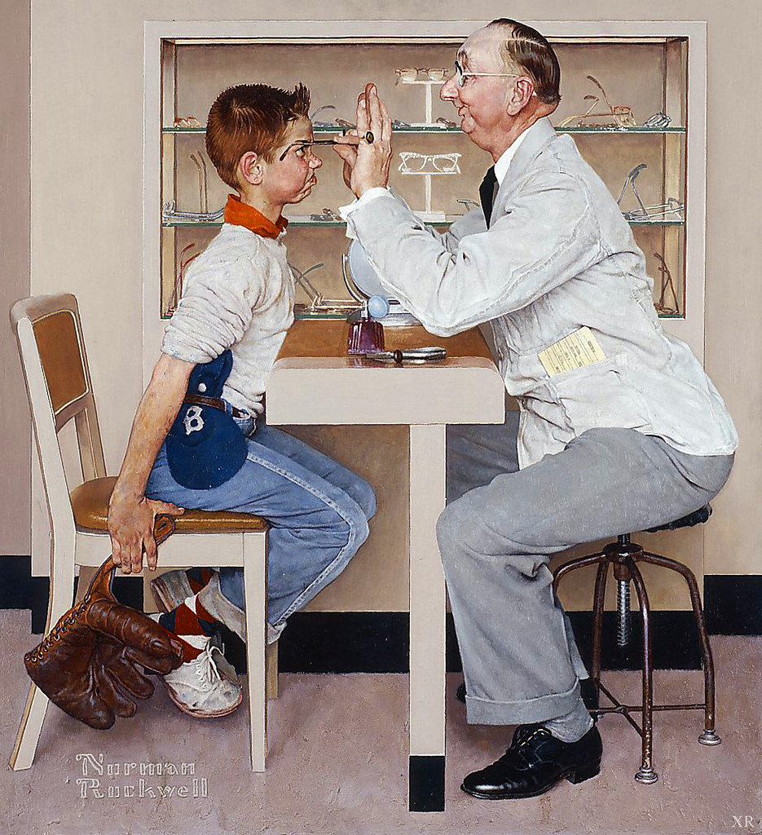
Norman Rockwell
His artwork has left a lasting imprint on American culture, and his ability to tell stories through his paintings.
"1956 At the optometrist by Norman Rockwell" by cartoonpinup is marked with Public Domain Mark 1.0.
Notes:
We are going to look at artwork done by a man named Norman Rockwell. He is a prominent American Illustrator and painter who is known for his iconic depictions of American Life.
His artwork has left a lasting imprint on American culture, and his ability to tell stories through his paintings.
In this painting Rockwell shares the memories he felt as a boy getting a new pair of glasses. Does his artwork tell you how he feels? Notice that the boy is leaning forward in his seat while also holding himself back. This tells me that he knows he needs the glasses, but he does not like them or want them. How would you describe the expression on his face? Could you write about what it looks like and create the same emotions in your writing?

Slide 3
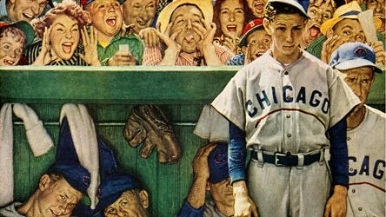
"Norman Rockwell's 'The Dugout' - 1948" by delusionalcubsfan is licensed under CC BY 2.0
Notes:
In this painting, Rockwell expresses the anguish the Chicago Cubs were feeling during a losing season in 1948. Without using any words, he gives us a glimpse of the agony of defeat by the slumped and body shapes and facial expressions in the players. What story is being told behind the forlorn players above the dugout? The expressions and shapes paint a completely different emotion. Think about how you might put these contrasting emotions into words. Read more: http://www.best-norman-rockwell-art.com/1948-the-dugout.html#ixzz8HGrmPsWD

Slide 4
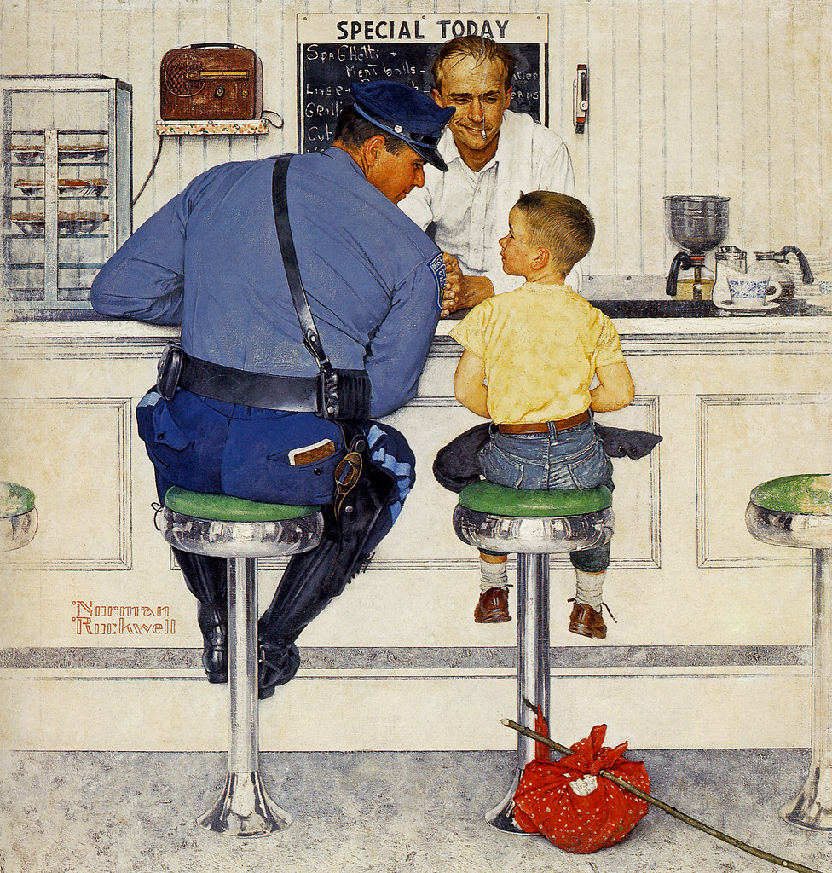
1958 The Runaway by Norman Rockwell" by cartoonpinup is marked with Public Domain Mark 1.0.
Notes:
At first glance we see a young boy, a police officer, and a man behind a counter at what looks to me like a diner. What do their facial expression tell you? Now look closer, what is the bundle on the floor? Could you create a story from what you see here? In this painting, Norman Rockwell illustrated a little boy who is running away from home. Think about how you might feel if you had made a decision to leave home. I know that I would feel very sad and worried about being alone. But the expression on the boys face tells me that he feels comfortable and safe. Why do you think that is? Can you think of a good ending for this story?

Slide 5
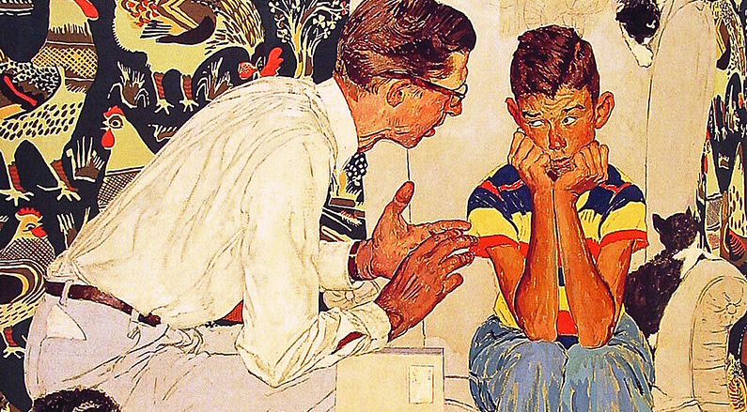
"The Facts of Life by Norman Rockwell" by cartoonpinup is marked with Public Domain Mark 1.0.
Notes:
Okay, now its your turn. Take a close look at this Rockwell painting. Use the Art Reflection handout I provided and put your observations and ideas into words. And then tomorrow we will discuss the painting together. I can’t wait to hear what you think about this painting. It will be fun to share and compare the different stories that each of us find.
These are some questions to help you get started:
What are some words you would use to describe this artwork?
Does this scene remind you of anything?
What interests you the most?
What do you think this artwork is about?

Slide 6
References
Norman Rockwell Facts for Kids. Kiddle Encyclopedia.
"At the optometrist by Norman Rockwell" by cartoonpinup is marked with Public Domain Mark 1.0.
”The Dugout by Norman Rockwell" by delusionalcubsfan is licensed under CC BY 2.0
“The Facts of Life by Norman Rockwell" by cartoonpinup is marked with Public Domain Mark 1.0.
“The Runaway by Norman Rockwell" by cartoonpinup is marked with Public Domain Mark 1.0.

