Slide 1
Graph Isomorphism
And the Subgraph Isomorphism Problem
By
Brandon Rodriguez

Slide 2
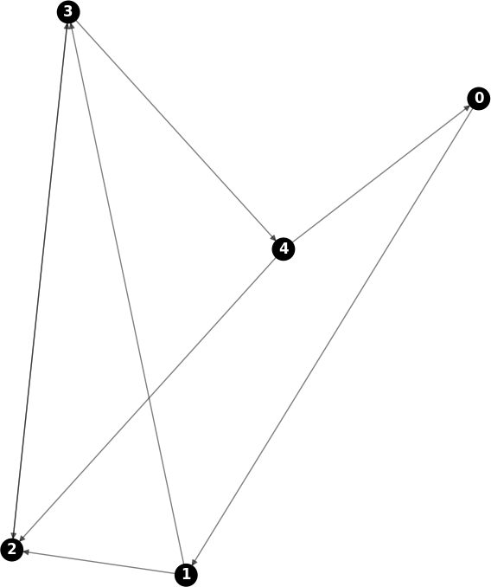
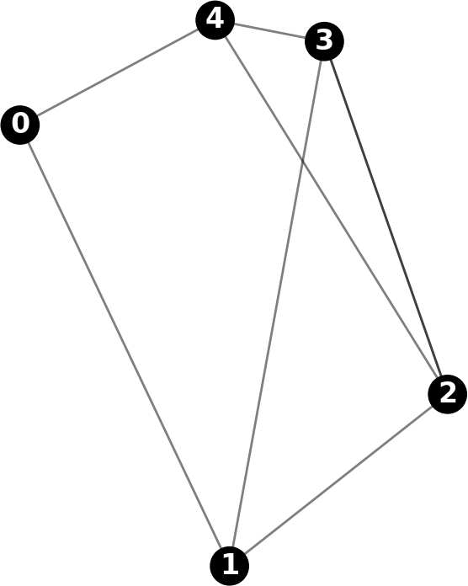

Slide 3
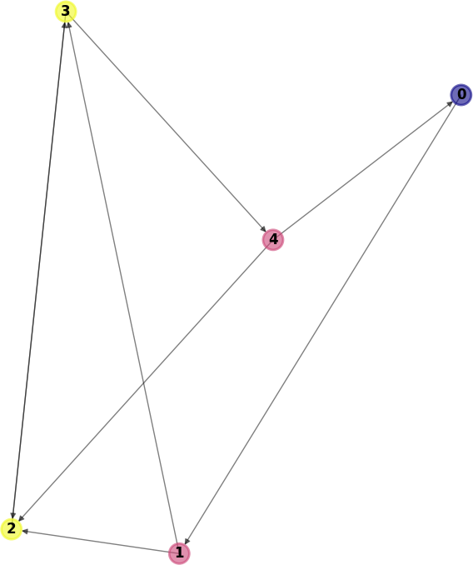
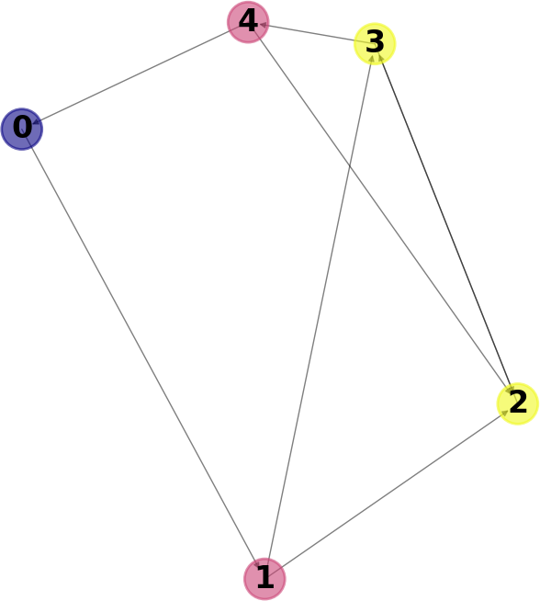

Slide 4
Graph Isomorphism
“Two graphs which contain the same number of verticies, connected in the same way are said to be isomorphic.”
Aka, comparing two graphs to see if they are identical.

Slide 5
Subgraph Isomorphism
Given two graphs (G and H)
Determine if H, or a subsection of H, is equivalent to G.

Slide 6
Complexity

Slide 7
Applications
Used to help machines encode structural information, such as computer vision and pattern recognition.
Used in the chemistry field to identify chemical compounds against a known substance database.
Used in electrical engineering to help automate and verify circuit design/creation.

Slide 8
How Does It Work?
Due to complexity, there tends to be a lot of comparison loops.
My specific algorithm can be boiled down to two major sections:
  “Greatest Constraints First”
  “Matching”

Slide 9
Greatest Constraints First
Create a list of already “compared” nodes, referred to as “C”.
Create a list of all nodes, ordered by edge count.
If graph is directed, then each direction counts as a separate edge.
Iterate through all nodes in this list, starting with the highest count first and working downward.

Slide 10
Greatest Constraints First Cont.
For each node (m), look at all other connected nodes (N). Ascribe N to one of three lists:
  Visited – N is directly connected to any node in C.
  Neighbor – N is indirectly connected to C with one node in between.
  Unvisited – Neither of the above two apply to N.
Define a “rank” of [visited, neighbor, unvisited] for m, based off of the above lists.

Slide 11
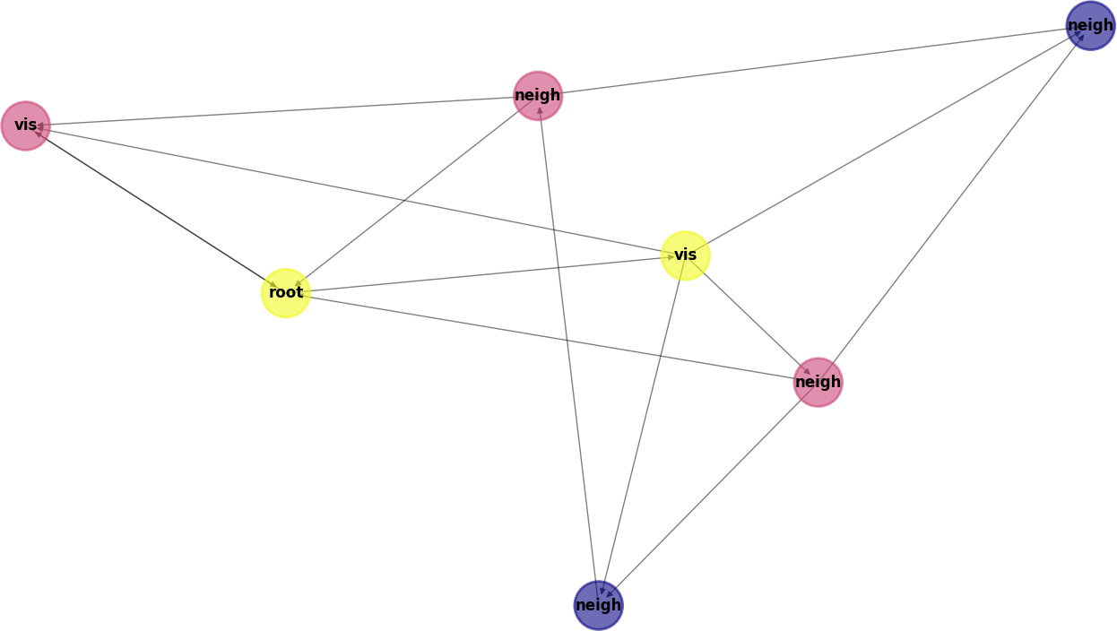

Slide 12
Matching
Given “original” graph G and “target”/”comparison” graph H.
Create List M of (g_i, h_j) node matches, defaulting to null.
For every node in G, compare against all nodes in H until match is found or no nodes left.

Slide 13
Matching Cont.
For every node:
  Check that neither g nor h has already been matched.
  Check that “verticies are compatible”.
  Check that edges in h >= edges in g.
  Check that “topological constraints have been met”.
If all of the above hold true, then nodes g and h can safely be considered a match.

Slide 14
My Experiment/Data
???
To discuss with teacher.

Slide 15
Sources
Last Checked on 04-04-2018
Published Report:
https://bmcbioinformatics.biomedcentral.com/articles/10.1186/1471-2105-14-S7-S13
Slide 4 (Isomorphism definition):
http://mathworld.wolfram.com/IsomorphicGraphs.html
Slide 8 (Applications):
https://en.wikipedia.org/wiki/Graph_isomorphism_problem

