Slide 1
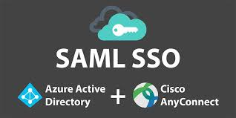

Slide 2
Option 1 Cisco Firepower Threat Defense Dynamic Access Policy
Pros | Cons
Supported way by Cisco to deploy SAML with several Tunnel groups | Old way of tunnel group policy wont work as it used to
Easy to deploy and maintain
Native configuration and no need for workarounds to make it work (FTD and Azure)
DAP provides a new feature that is not in the enviroment right now as it can help on hosts scan which provide a new security advantage for policies of how an endpoint will be allowed to connect For example: block users that wants to join the VPN from a windows 7 machine or Antivuris is not updated and so on

Slide 3
Option 2 SAML with LDAP
Pros | Cons
Supported way by Cisco to deploy SAML with several Tunnel groups | No adding a new security capability to the enviroment
The existing Tunnel groups configuration will work as it is | Hard to deploy and maintain as each grup will need its own Azure app and SSO server which will make it more complicated.
 | Adding another step in the authentication flow as now Authentication will go to Azure and Autorization will need to go to the LDAP server waiting a reponse back with the Autorization group
 | LDAP traffic will traverse the network and if is not encrypted can be a security concern

