Slide 1
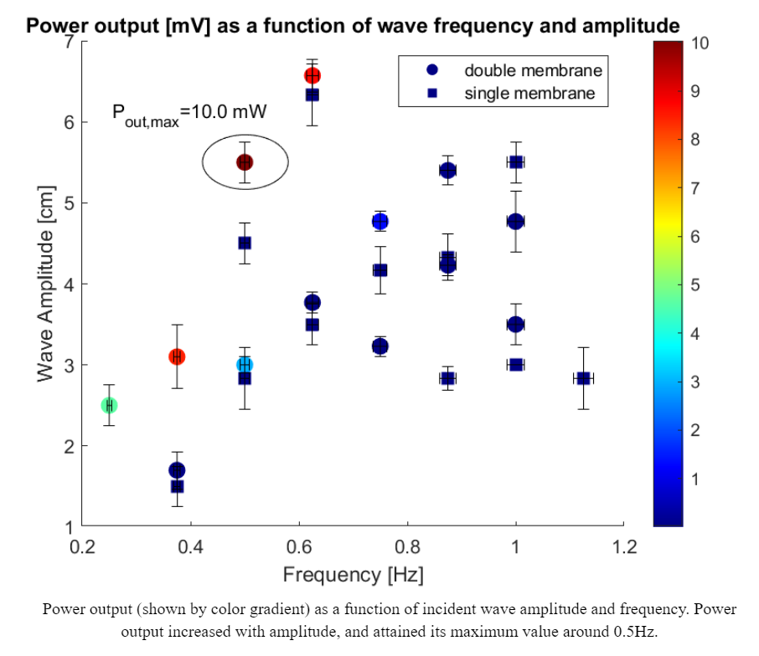
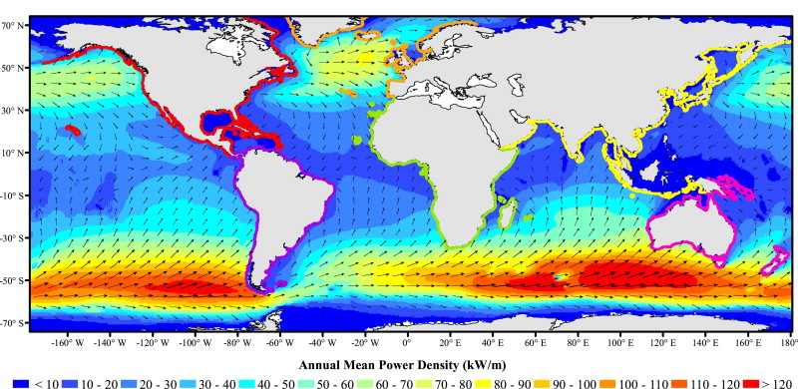
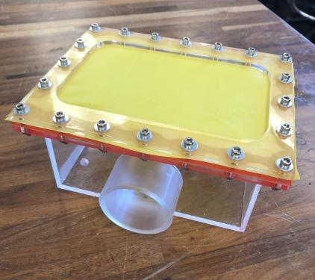
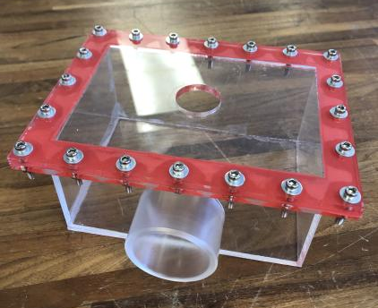
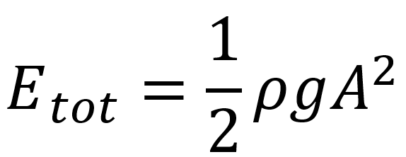
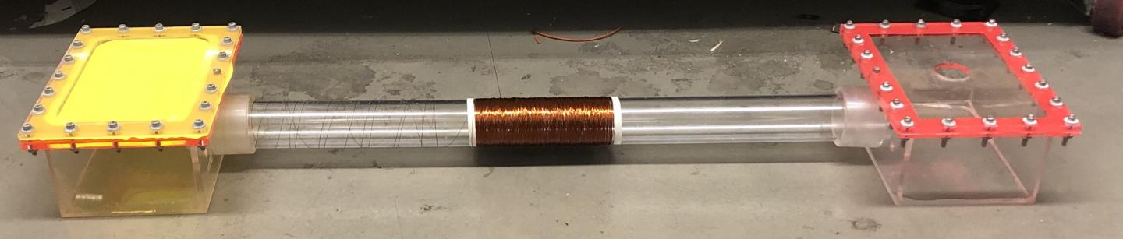
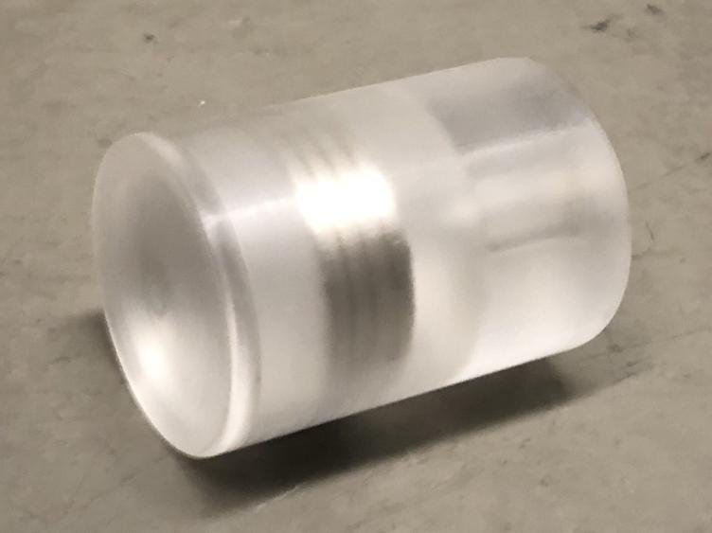
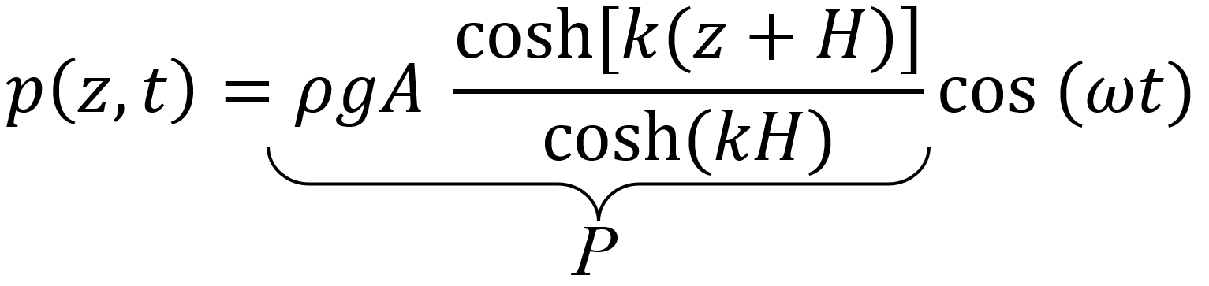
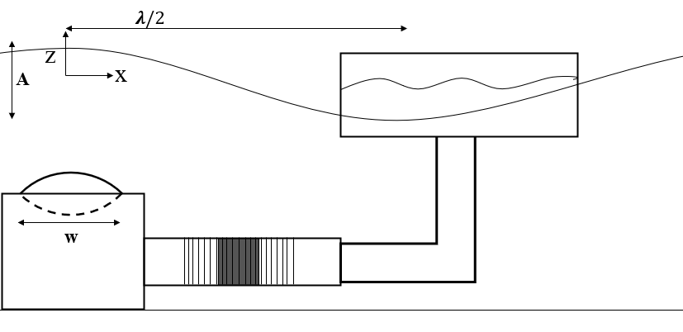
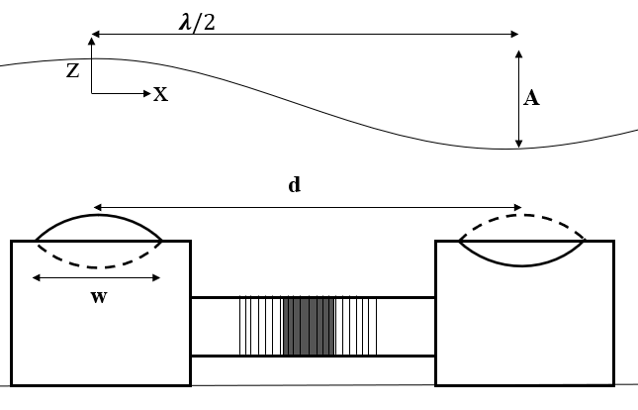
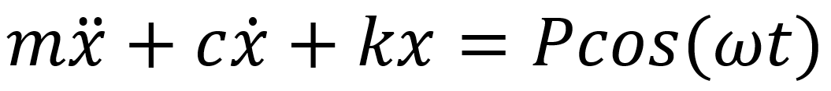
Design and Evaluation of a Two-Membrane Wave Energy Converter
Bryce Rogers, David Armendariz, Yifan Xue
Motivation
Project Goals
Results & Analysis
Problem: Commercially viable WECs have not been established; lack of scalability in current technology
Main goal: design and test a novel, scalable double membrane WEC system
Wave energy is abundantly available but underutilized. Compared with fossil fuels, ocean wave energy is cleaner with lower emissions. Each year 2.11 ± 0.05 TW of wave power are available globally, producing abundant opportunities to expand global renewable energy portfolio [1].
Experiment & System Design
System – Two acrylic boxes with flexible membrane tops, connected by tube. Magnetic piston in tube oscillates due to wave pressure fluctuations. Solenoid wrapped around the tube converts the mechanical energy of the magnet into electrical energy.
To evaluate the benefit of the two membrane system, single membrane and double membrane configurations were tested inside a water tank under constant waves.
A
B
Wave energy availability [1].
Theory
Boxes with (A) flexible and (B) rigid tops
Energy of an ideal ocean wave of amplitude A [2]:
Dynamic pressure at depth z:
The system was modelled as linear and second order:
x – piston displacement
k – membrane elasticity
c – magnetic and viscous damping
m – total inertia (piston + moving water mass)
P – pressure wave amplitude
piston
Single Membrane Case
Double Membrane Case
References
[1] Gunn K, Stock-Williams C. (2012). Quantifying the global wave power resource. Renew. Energy 44, 296–304. (doi:10.1016/j.renene.2012.01.101)
[2] Techet, A.H. Hydrodynamics. MIT, 2005.
Wave pressure
Membrane deformation
Piston displacement
Current generation
Notes:
Sections:
Motivation, Project Goal, Theory, System Design, Experimental Design, Results, References

