Slide 1
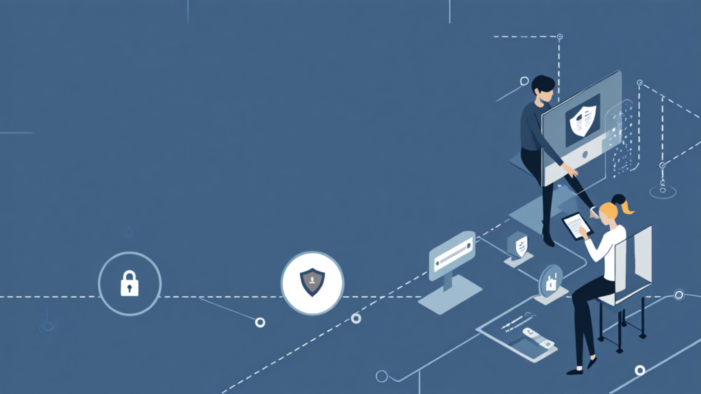
CYBERPULSE
Empowering Digital Safety in Our Communities
A Community-Driven Cybersecurity App for Everyone

Slide 2

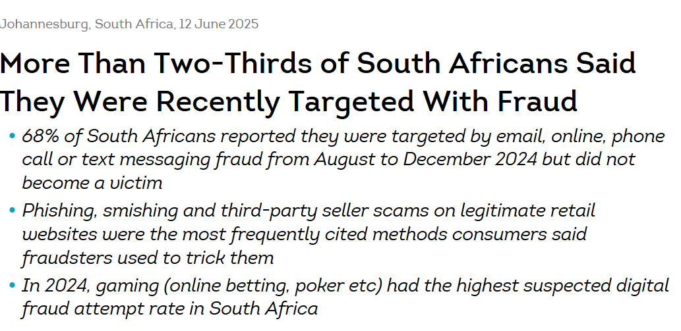
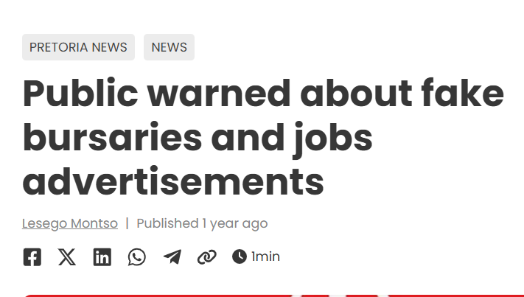
Scams Are Getting Smarter
and We’re Falling for Them
The Problem: We’re Not Equipped to Spot the Threats

Slide 3

Meet CyberPulse: Your Scam-Shield
Empowering Safe Browsing.
CyberPulse is designed to assist novice internet users in identifying and verifying suspicious online resources. This helps enhance digital safety, educate users, and foster a community-driven approach to cybersecurity awareness and protection.
Transforming users from Victims to Cyber-Defenders.

Slide 4



Key Features of CyberPulse:
01
02
03
Phishing Detection alerts users to potential scams in emails and links, ensuring greater online protection.
Cyber Safety Quizzes engage users in learning about online threats, boosting their cybersecurity awareness and skills.
WHOIS Analysis provides detailed insights into domain ownership and registration information for safer browsing.

Slide 5



What inspired CyberPulse?
We saw friends and classmates fall for bursary scams, fake job offers, and phishing links
and we knew something had to change.
Our Vision
What starts as a tool for students can scale to any novice internet user,
empowering everyone to stay safe online,
no matter their experience level.
The Opportunity
By combining detection, education, and gamification,
we can create a safer online community and reach users across universities, workplaces, and even households.

Slide 6
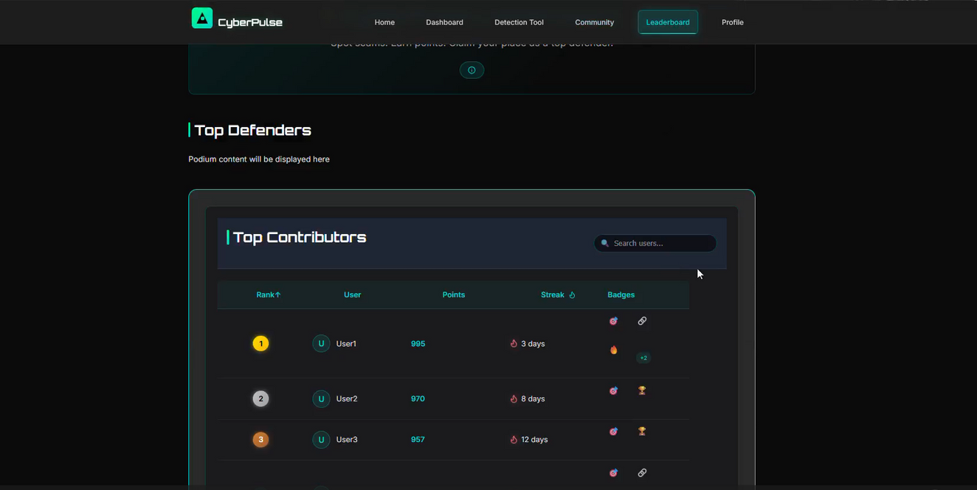
Gamification & Rewards: Making Cyber Safety Fun
CyberPulse turns cybersecurity awareness into a challenge to beat, not a chore to complete.
Earn Points
Unlock Badges
Track Streaks
Climb the Leaderboard
Join the community

Slide 7
Future Enhancements for CyberPulse
01
02
03
04
IMEI Tracking will enhance device security by enabling users to monitor their devices' locations.
Group Accounts will allow families to manage and protect multiple users under one plan.
Enhanced Phishing Tools will offer advanced detection methods to combat evolving online threats effectively.
Increase in Community Involvement will encourage user participation in reporting scams and sharing safety tips.

Slide 8

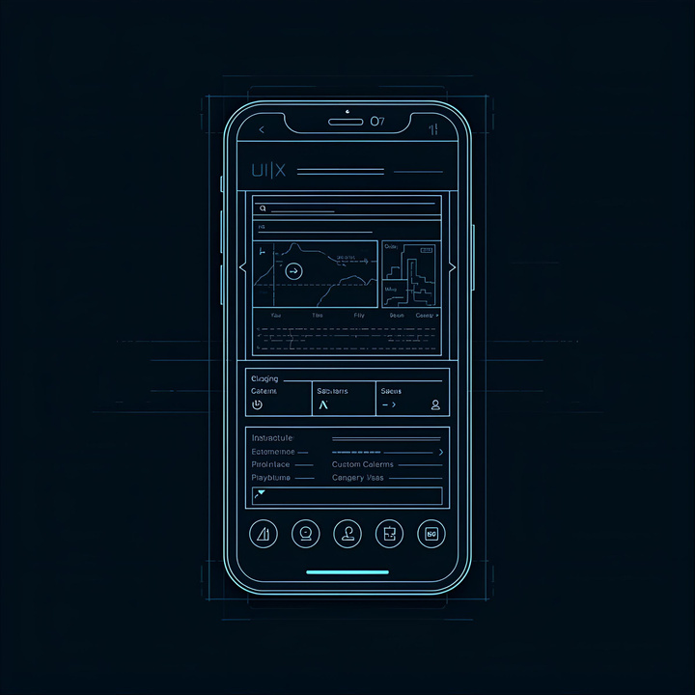


Meet the Ciphernova Team
Ntokozo
Vane’
Lead Developer focused on creating secure and user-friendly features for CyberPulse.
UI/UX Designer dedicated to enhancing user experience and interface for seamless interactions.
Nigel
Taku
Integration engineer responsible for ensuring the seamless connectivity of the application components.
Community Outreach specialist working to educate users and foster a safer online environment.

Slide 9


“The best defense against phishing is awareness. Stay informed, stay safe, and empower yourself with knowledge to navigate the digital world securely.”
– Cybersecurity Expert

Slide 10


Thank You for Exploring CyberPulse!

