Slide 1
SDWAN Disaster Recovery Automation
Secondary Cluster taking over Control Connections from Primary Cluster Automatically
Rohan Dev (rodev)
Consulting Engineer | Advanced Services | ASEAN
Thursday, August 8, 2024

Slide 2
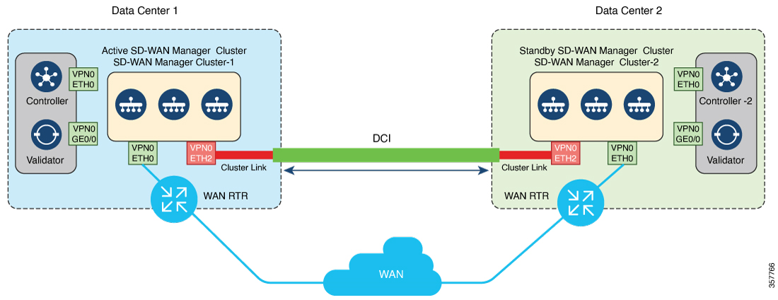

How Disaster Recovery Should be Setup
An OOB link must be configured between the primary and secondary managers
Both validators must be accessible by all cEdge routers
All cEdge routers must have underlay connectivity to the SD-WAN controllers
SDWAN cEdge

Slide 3


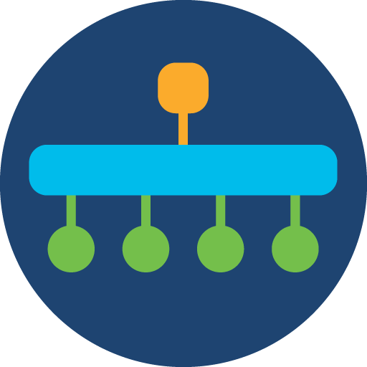

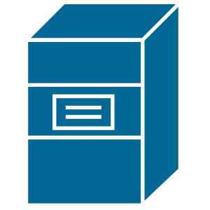
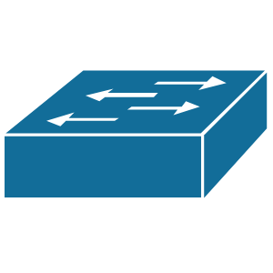
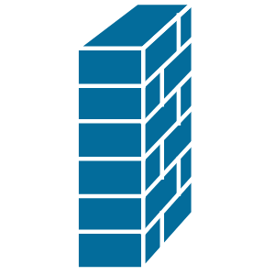
Disaster Recovery Lab POC Setup
vBond
vSmart
vManage
vManage
vSmart
vBond
Arbitrator
Machine
Data Center
Interconnect
LDC
HEIDI
SCDF cEdge
MPLS
Underlay
SPF cEdge

Slide 4
Expected Outcomes after a Successful Disaster Recovery
vBond
vSmart
vManage
vManage
vSmart
vBond
Arbitrator
Machine
Data Center
Interconnect
DTLS Connections to Primary
LDC
HEIDI
SCDF cEdge
MPLS
Underlay
Persistent
IPsec Tunnel
SPF cEdge

Slide 5
Expected Outcomes after a Successful Disaster Recovery
vBond
vSmart
vManage
vManage
vSmart
vBond
Arbitrator
Machine
Data Center
Interconnect
DTLS Connections to Secondary
LDC
HEIDI
SCDF cEdge
MPLS
Underlay
Persistent
IPsec Tunnel
SPF cEdge

Slide 6
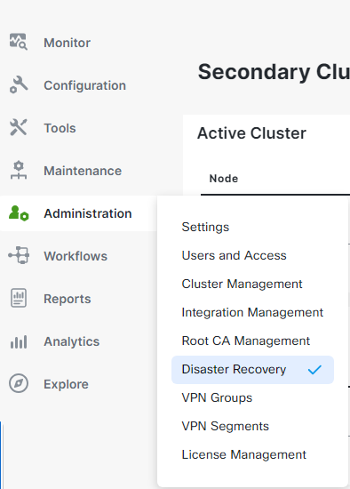
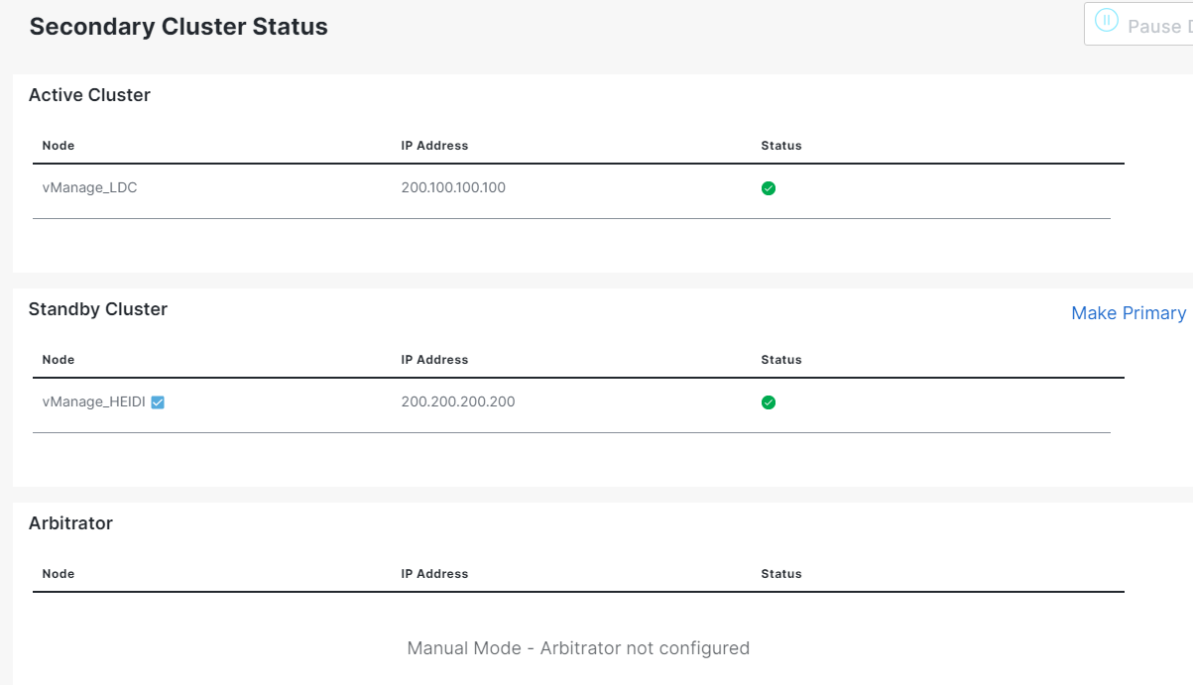
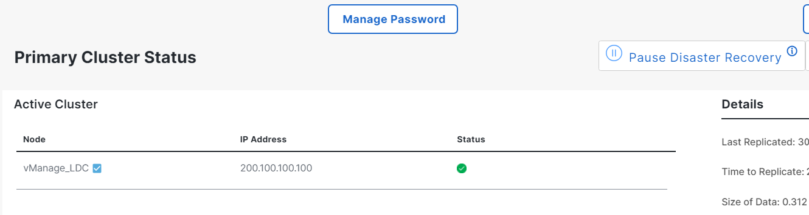
Current Disaster Recovery Process | Manual
Navigate to Administration > Disaster Recovery
Pause Disaster Recovery on primary vManage GUI
Click ‘Make Primary’ on the secondary vManage GUI
Resume Disaster Recovery on former secondary/new primary vManage

Slide 7
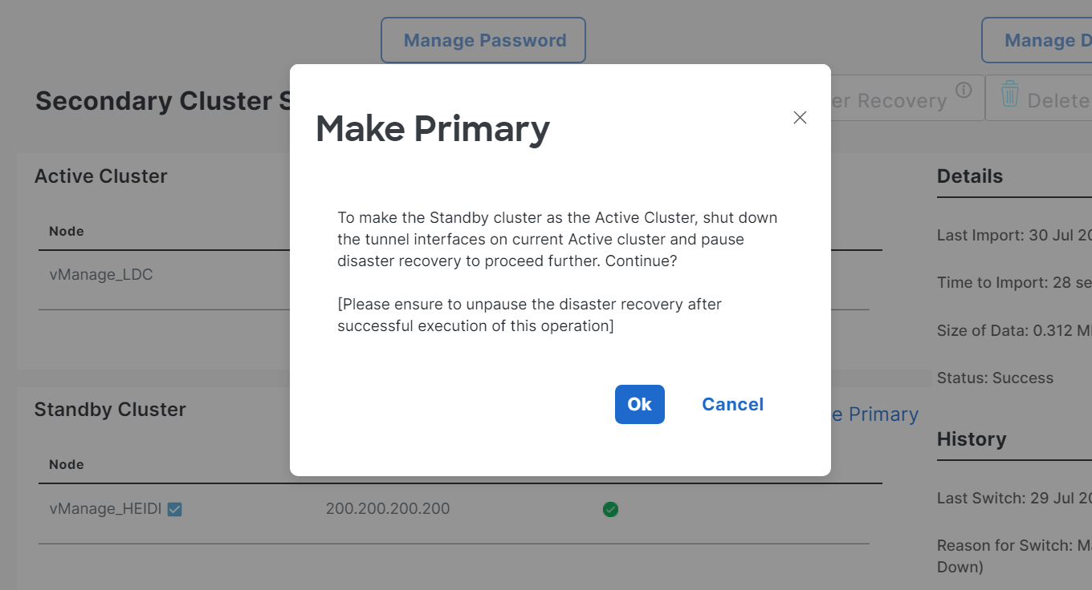
Current Disaster Recovery Process | Manual

Slide 8
Current Disaster Recovery Process | Automated
Upon total failure of an intermediate node layer in the network path to the data center hosting the primary vManage, programmatically:
Pause DR telemetry from primary vManage to secondary vManage.
Make secondary vManage the new primary vManage.
Resume DR telemetry on the new primary vManage.
Test expected outcomes for a successful DR failover
Ensure that the old DTLS connections between the cEdge routers and the former primary controllers are torn down, and new connections are established with the new primary controllers.
Ensure that the IPsec tunnel between cEdge routers are never down.

Slide 9
Live Demonstration
Automated Disaster Recovery of SDWAN Controllers

