Slide 1
A
APEXPLANET SOFTWARE PVT. LTD.
ApexPlanet Sales & Customer Analytics
From Raw Data to Revenue Strategy:
A 60-day data analytics capstone turning 1,000 transactions into a ₹139.4M growth roadmap.
Data Wrangling → EDA & BI → RFM Segmentation → Statistical Validation → Strategy
▣
→
↗
→
◉
→
✓
→
◎
DATA
EDA
RFM
VALIDATE
STRATEGY
Prepared by: Brojo Mohan Dutta
Reporting Period: Jan 2025 – Jan 2026

Slide 2




Project Objective & Roadmap
Four structured phases turned messy transactional data into a validated, actionable growth strategy.
01
02
03
04
DATA IMMERSION
EDA + BI
RFM
VALIDATE
→
→
→
Data Immersion
& Wrangling
Exploratory Data
Analysis & BI
Segmentation &
Dashboarding
Statistical Validation
& Storytelling
Python / Pandas
SQL / BigQuery + Python
Power BI
Statistics
CREDIBILITY BACKBONE
Clean → Explore → Segment → Stress-test → Recommend
ApexPlanet Software Pvt. Ltd. • Data Analytics Internship
02
Notes:
Each phase builds on the last — cleaned data fed the SQL/BI
layer, which fed the RFM model, which was statistically
stress-tested before being turned into the recommendations
that close this deck. This sequencing is the credibility
backbone of the presentation.

Slide 3
Executive Summary — The Business in Numbers
₹139.4M in revenue across 947 customers reveals a healthy but concentration-exposed and re-engagement-ready customer base.
TOTAL REVENUE
TOTAL ORDERS
AVERAGE ORDER VALUE
UNIQUE CUSTOMERS
₹139.4M
1,000
₹139.4K
947
THE BUSINESS SIGNAL
REVENUE CONCENTRATION
Electronics = 36.4%
of total revenue
Electronics
₹50.78M
Education
₹25.03M
₹50.78M
largest single category
Grocery
₹22.23M
Furniture
₹21.52M
476 customers across At Risk + Lost segments represent ₹41.6M in exposed historical revenue.
Fashion
₹19.84M
ApexPlanet Software Pvt. Ltd. • Data Analytics Internship
03
Notes:
This is the so-what slide. Before diving into methodology,
give the business the headline numbers. Flag early that
Electronics concentration and the At-Risk/Lost segments are
the two threads the strategy section will resolve with
specific campaigns.

Slide 4
Building a Trustworthy Data Foundation
Systematic cleaning turned a 1,000×12 raw extract into a fully auditable 1,000×19 analytical dataset with zero records lost.
BEFORE • RAW EXTRACT
AFTER • ANALYTICAL DATASET
!
AGE
20 missing
2.0%
Customer_ID
Order_Date
Category
Sales
CUST001
2025-01-12
Electronics
₹145K
!
CITY
13 missing
1.3%
CUST002
2025-02-04
Education
₹92K
→
!
ORDER_ID
9 collisions
ORD100050
CUST003
2025-03-18
Grocery
₹74K
CUST004
2025-04-21
Furniture
₹181K
!
ORDER_DATE
Text format
Needs parsing
ENGINEERED FIELDS
!
DUPLICATES
0 found
Verified
Order_Year • Order_Month • Age_Group • Avg_Price_Check
1,000 rows × 19 columns • 100% population retained
ApexPlanet Software Pvt. Ltd. • Data Analytics Internship
04
Notes:
Emphasize the decision logic, not just the actions: City nulls
were labeled rather than guessed to avoid fabricating geography,
and the Order_ID collision was repaired rather than dropped to
avoid silently deleting real sales. Both choices preserved
100% of the transaction population for analysis.

Slide 5
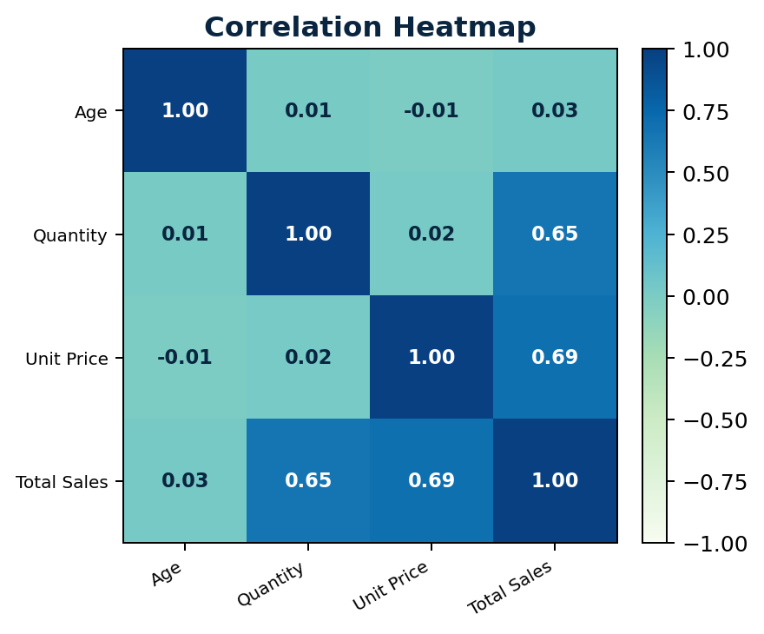
What Actually Drives a Transaction's Value
Transaction value is driven by price and volume, not by customer age or gender.
THE TWO STRONGEST SIGNALS
r = 0.69
Unit Price ↔ Total Sales
r = 0.65
Quantity ↔ Total Sales
Age: |r| ≤ 0.03
Quantity ↔ Unit Price: r = 0.02
● Pricing and basket-size mechanics matter more than demographic targeting for AOV.
● Bundles, thresholds and tiered offers are therefore more data-supported levers.
ApexPlanet Software Pvt. Ltd. • Data Analytics Internship
05
Notes:
This finding directly informs the recommendations later in
the deck. Campaigns should focus on price and quantity
mechanics such as bundles, thresholds and tiered discounts
rather than age-based personalization, since age has almost
no relationship to spend.

Slide 6
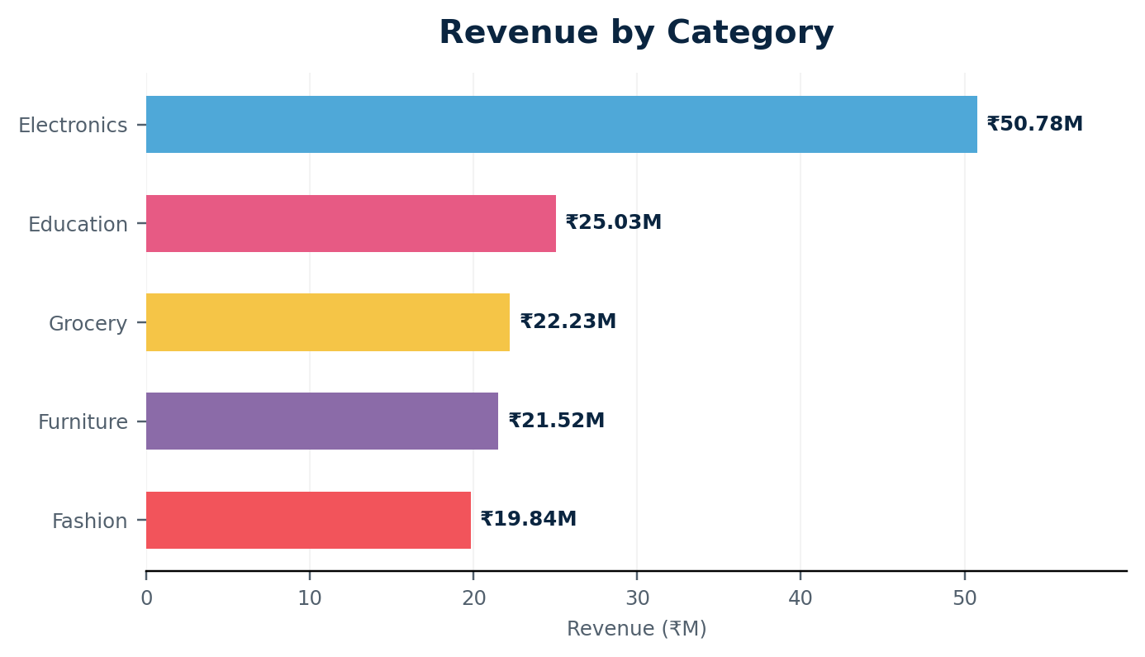
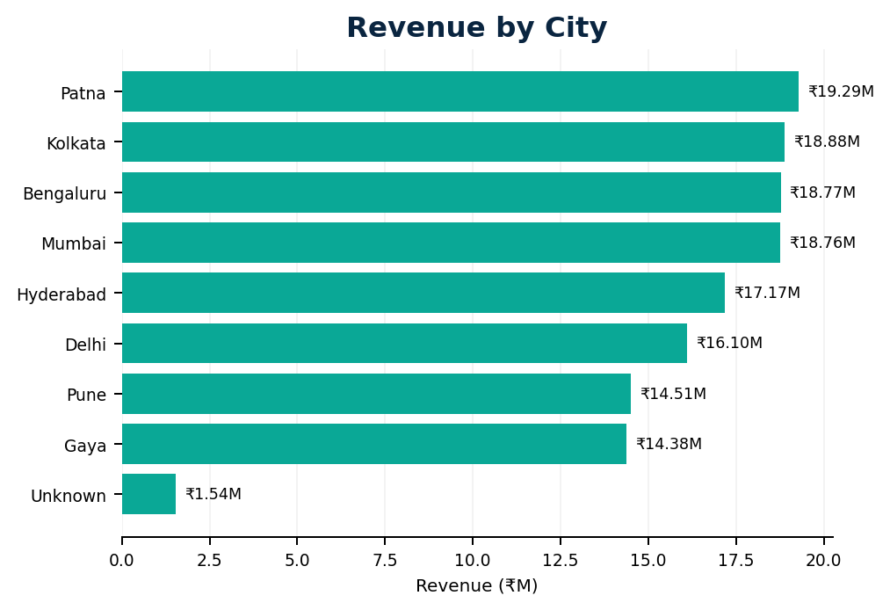
Revenue Concentration Across Category and Geography
Revenue is broad-based across 8 cities but concentrated in one category — Electronics.
CATEGORY REVENUE
GEOGRAPHIC REVENUE
Electronics ₹50.78M = 36.4% • No single city exceeds 14% of revenue
ApexPlanet Software Pvt. Ltd. • Data Analytics Internship
06
Notes:
Contrast the two distributions deliberately. Cities are
relatively evenly spread, which reduces geographic
concentration. Electronics, however, represents 36.4% of
revenue and is therefore the major category concentration
risk addressed by the later bundling initiative.

Slide 7
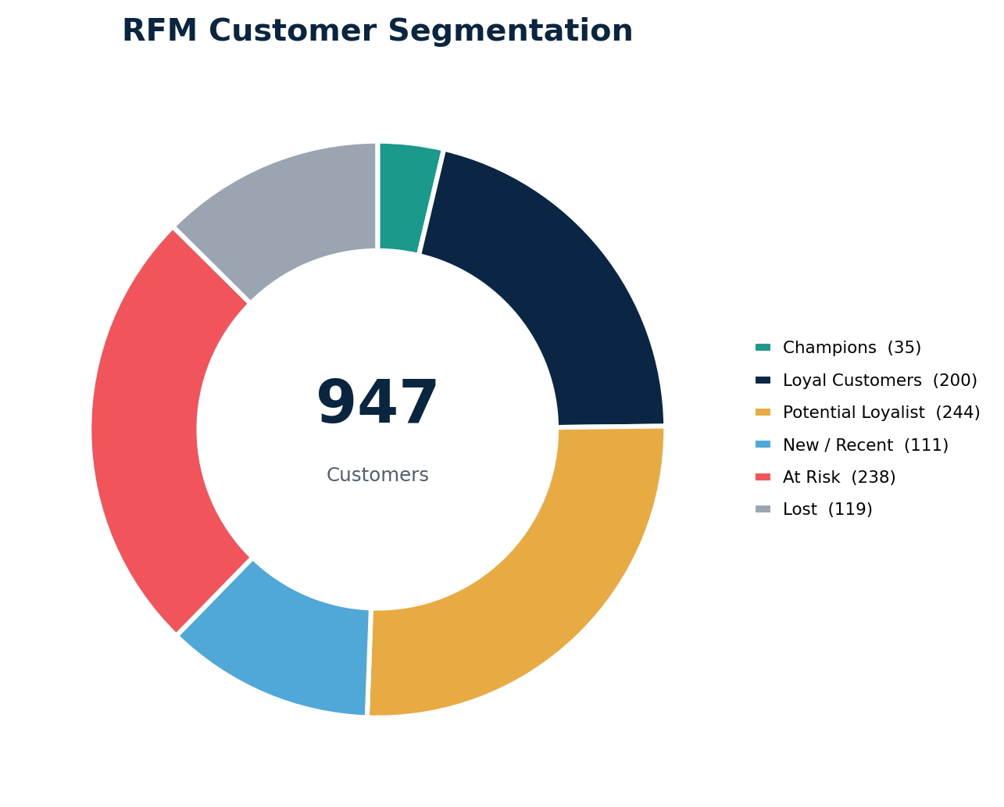
Segmenting 947 Customers by Recency, Frequency & Monetary Value
RFM segmentation splits the customer base into six behaviorally distinct groups, each requiring a different strategy.
Champions
Loyal Customers
35 customers
200 customers
₹12.30M
₹29.19M
Potential Loyalist
New / Recent
244 customers
111 customers
₹40.59M
₹15.74M
At Risk
Lost
238 customers
119 customers
₹35.38M
₹6.19M
Average RFM Score: 7.50 • Scale: 3–12
ApexPlanet Software Pvt. Ltd. • Data Analytics Internship
07
Notes:
RFM Monetary reconciles exactly with sales revenue:
₹139,399,439.65 on both sides. Frequency also sums to exactly
1,000 orders. The segmentation is therefore validated against
the source ledger rather than being a rough directional model.

Slide 8
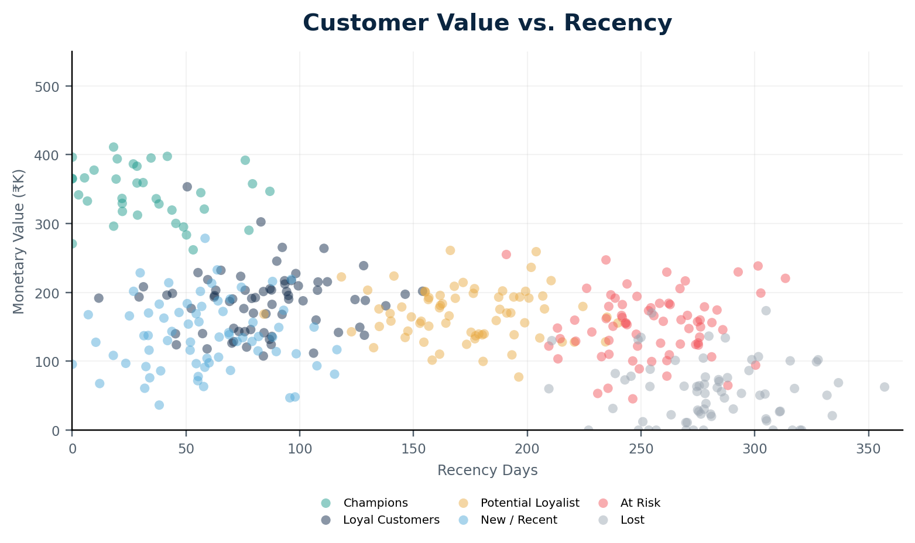
Where the Value Sits — and Where It's at Risk
₹41.6M in customer value sits in the At-Risk and Lost segments — the single largest business exposure in the dataset.
VALUE EXPOSURE
₹41.57M
At Risk + Lost
357 customers
historical value at risk
AT RISK
238 customers
CHAMPIONS
35 customers
POTENTIAL LOYALIST
₹40.6M pool
FREQUENCY
Mostly one-time
ApexPlanet Software Pvt. Ltd. • Data Analytics Internship
08
Notes:
This is the pivot point from analysis to strategy. Every
number here maps directly to one of the recommendation tracks:
At Risk for immediate action, Champions for short-term loyalty,
New/Recent for medium-term conversion, and Potential Loyalists
for strategic reactivation.

Slide 9
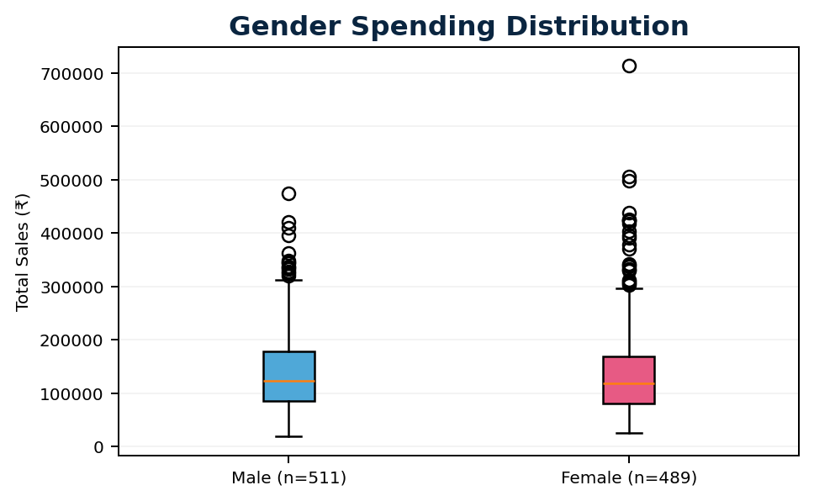
Testing the Assumptions: Gender-Based Spending
No statistically significant difference in spending between male and female customers.
INDEPENDENT TWO-SAMPLE T-TEST
t = 0.6820
p = 0.495389
NOT SIGNIFICANT
Male mean
Female mean
₹141,807
₹136,883
95% CI for difference: −₹9,214.68 to ₹19,062.94
Decision: Fail to reject H₀ at α = 0.05
ApexPlanet Software Pvt. Ltd. • Data Analytics Internship
09
Notes:
This is a guardrail slide. It prevents the business from
over-investing in gender-specific campaigns. Pair this result
with the earlier finding that age is also weakly correlated
with spend. The data supports behavioral RFM targeting more
directly than demographic spend targeting.

Slide 10
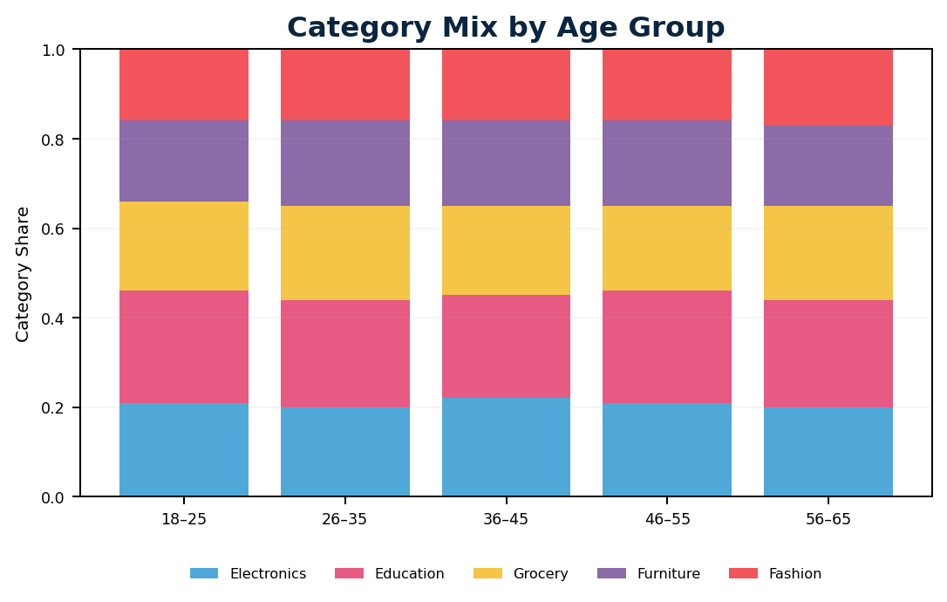
Testing the Assumptions: Do Age Groups Prefer Different Categories?
Product category preference is independent of customer age group.
CHI-SQUARE TEST OF INDEPENDENCE
χ² = 10.5361
df = 16
p = 0.837174
NOT SIGNIFICANT
Cramér's V = 0.0513
Negligible association
Decision: Fail to reject H₀
ApexPlanet Software Pvt. Ltd. • Data Analytics Internship
10
Notes:
Both hypothesis tests came back non-significant. This is
useful because it tells the business that age and gender do
not provide strong evidence for differentiated spend or
category targeting in this dataset. The recommendation layer
therefore emphasizes RFM behavior instead.

Slide 11
Immediate Action: Win-Back the At-Risk Segment
A 14-day, 3-touch win-back sequence can recover ₹3.6M–5.4M from 238 At-Risk customers at a 3:1–5:1 ROI.
14-DAY WIN-BACK SEQUENCE
EXPECTED RETURN
₹3.6M–5.4M
DAY 1
DAY 7
DAY 14
incremental revenue
10–15%
✓
✓
✓
expected re-purchase rate
Recommendation
Email
15% Coupon
Loyalty + Free Ship
3:1–5:1 ROI
Personalized
product picks
Limited-time
re-purchase
Final retention
trigger
High spend ≥₹200K: phone + ₹500 off
Low spend <₹50K: email + ₹100 off
Target: 238 customers • Exposure: ₹35.4M • Investment: ₹2M–3M
ApexPlanet Software Pvt. Ltd. • Data Analytics Internship
11
Notes:
Position this as the quick win — lowest time horizon, clear
cost/benefit, and directly addresses the largest exposure
identified on the RFM analysis. It is the recommendation to
lead with when asked what should happen first.

Slide 12
Short-Term: Lock In Champions, Upsell Loyal Customers
Protecting 35 Champions and upgrading 200 Loyal Customers can add ₹2.7M–4.7M in incremental annual spend.
TRACK A
TRACK B
Champions VIP
Loyal Cross-Sell
35 customers • ₹12.3M historical value
200 customers • ₹29.2M historical value
● Platinum tier
● 5% cash back
● Dedicated account manager
● Early product access
● 1% / 3% / 5% cash-back tiers
● Birthday triggers
● SMS engagement
● Cross-category offers
+₹1.2M–1.8M
ROI 2:1
+₹1.5M–2.9M
ROI 1.5:1–2:1
Combined investment: ~₹2.8M–3.6M • Focus: retention + lifetime value
ApexPlanet Software Pvt. Ltd. • Data Analytics Internship
12
Notes:
Distinguish this from the At-Risk recommendation. This isn't
about winning back lapsing revenue; it is about protecting
and growing the healthy base. Champions have strong value
density, while Loyal Customers provide a larger cross-sell
pool.

Slide 13
Medium-Term: Convert First-Time Buyers into Repeat Customers
A low-cost, automated second-purchase nudge for New/Recent customers delivers the highest ROI of any initiative — up to 130:1.
SECOND-PURCHASE CONVERSION FUNNEL
LOW-COST / HIGH-RETURN
₹3.1M–4.6M
111 NEW / RECENT CUSTOMERS
expected revenue
₹35K–45K
DAY 7 • EMAIL + 20% OFF
estimated campaign cost
DAY 14 / 21 • SMS
ROI 85:1–130:1
22–33 SECOND ORDERS
Offer: ₹500–₹1K off
Minimum order: ₹5K
Conversion window: 30 days
ApexPlanet Software Pvt. Ltd. • Data Analytics Internship
13
Notes:
Flag the unusually high ROI explicitly. The projected ROI is
high because the cost is almost entirely automated messaging,
not a large media or acquisition budget. This makes the
initiative relatively low-cost to test.

Slide 14
Strategic: Reactivate Potential Loyalists, De-Risk Electronics Concentration
Reactivating dormant Potential Loyalists and diversifying away from Electronics protects ₹40.6M in value and reduces category concentration risk.
TRACK A • POTENTIAL LOYALIST REACTIVATION
↻
₹8.6M–10.2M
244 customers • ₹40.6M historical value • 6.8+ months dormant
Loyalty relaunch + retroactive points + 48-hour early access
ROI 2.6:1–3.1:1
TRACK B • ELECTRONICS BUNDLING
↗
₹2.5M–5M
Electronics + Education bundles • Cross-category recommendations
incremental revenue
Target Electronics share: 36.4% → 32%
~₹4.8M–5.8M combined investment
ApexPlanet Software Pvt. Ltd. • Data Analytics Internship
14
Notes:
This is the protect-the-future slide. It closes the loop on
the two structural risks introduced earlier: the dormant
Potential Loyalist pool and the Electronics concentration.
The strategy therefore addresses both customer value risk
and category concentration risk.

Slide 15
THE ROADMAP
Four Initiatives, One Sequenced Strategy
Sequenced correctly, these four initiatives can generate ₹16.8M–25.1M in incremental revenue against ~₹10.6M–13.7M in combined investment.
✓
✓
✓
✓
0–30 DAYS
30–90 DAYS
60–90 DAYS
90–180 DAYS
AT-RISK
WIN-BACK
CHAMPIONS /
LOYAL
NEW / RECENT
SPRINT
POTENTIAL +
ELECTRONICS
₹3.6M–5.4M
₹2.7M–4.7M
₹3.1M–4.6M
₹11.1M–15.2M
ROI
3:1–5:1
ROI
1.5:1–2:1
ROI
85:1–130:1
ROI
2.6:1–3.1:1
PARALLELIZE: New/Recent automation + At-Risk win-back • THEN: Loyalty expansion • FINALLY: Dormant reactivation + category diversification
15
Notes:
Use this as the single slide a time-constrained executive
could act on alone. It summarizes timing, target segment,
incremental revenue and ROI for all four tracks. The New/Recent
automation can run in parallel with the At-Risk win-back because
both are relatively low-cost and automatable.

Slide 16
THANK YOU
From data wrangling to a validated,
ROI-ranked growth strategy.
Questions welcome.
CAPSTONE DELIVERABLES
Clean analytical dataset • SQL + Python EDA • Power BI dashboards • RFM model • Statistical validation
Brojo Mohan Dutta
Data Analytics Intern • ApexPlanet Software Pvt. Ltd.
Full technical workflow, SQL, Python notebooks and Power BI dashboard available on request
Notes:
Close by re-anchoring the audience on the three core deliverables:
a cleaned and validated analytical dataset, a two-page interactive
Power BI model, and four statistically-informed ROI-based
recommendation tracks. Then open the floor for questions.

