Slide 1
AAE4203 · ROBOTICS / SLAM · CONTROLLED COMPARISON
LOAM vs LIO-SAM
one simulator, one bag, two algorithms
How much does adding an IMU and a factor graph actually buy — and under which motion does it matter?
AAE4203 Lab · ROS 2 Jazzy · Gazebo Harmonic · 16-beam lidar + 200 Hz IMU
Notes:
Both algorithms are the published ones: A-LOAM (ROS 2 port) and the official LIO-SAM ros2 branch. Everything except the algorithm is held identical, so any difference in the numbers is attributable to the algorithm.

Slide 2
EXECUTIVE SUMMARY
An IMU buys precision where geometry runs out
+51%
+31%
+99%
ATE improvement, nominal motion (S0)
ATE improvement, high yaw rate (S1)
ATE improvement, corridor degeneracy (S3)
· Same input, both times. A scenario is recorded once (lidar, IMU, ground truth) and replayed into each algorithm; the point clouds are byte-identical.
· The gap is condition-dependent, not constant. Nominal motion barely separates them; distortion-dominated and degenerate motion do.
  – Motion distortion inside a 0.1 s sweep: 5.2 deg of yaw at w = 0.90 rad/s.
  – Corridor degeneracy: along-axis x and yaw are almost unobservable from geometry alone.
· Cost is not free. LIO-SAM needs a 9-axis IMU, GTSAM, and ~2x the CPU; it answers at IMU rate, LOAM at sweep rate.
· But the baseline is not a straw man. On nominal motion LOAM stays inside one decimetre, which is why the recommendation has to be conditional.
· It also breaks. In high speed (1.2 m/s with 90-degree in-place turns) the same pipeline diverged: LIO-SAM 0.887 m vs LOAM 0.011 m. One scenario, and the recommendation below is written around it rather than hidden.
LOAM vs LIO-SAM · AAE4203 · controlled simulation study
1
Notes:
Headline: the argument is not that LIO-SAM is always better. Under nominal indoor motion both are sub-decimetre. The claim is narrower and more defensible: LIO-SAM degrades gracefully where pure geometry runs out of information.

Slide 3
PROBLEM
A lidar sweep is 0.1 s long, and the robot keeps moving during it
· Pure geometry asks: which rigid transform best aligns this sweep to the map?
· It has to assume the sweep was captured at one instant. It was not.
· It has to solve 6 degrees of freedom from geometry alone. In a corridor, two of those degrees of freedom are not in the data.
· LIO-SAM attacks both: the IMU tells you how the sensor moved *during* the sweep (deskew), and preintegrated IMU factors keep the unobservable directions from drifting.
WHAT WE MEASURE, NOT ARGUE
1 How large is the error, in metres, on identical data?
2 Which motion makes the difference explode?
3 What does the accuracy cost in compute?
LOAM vs LIO-SAM · AAE4203 · controlled simulation study
2
Notes:
Frame the experiment as three questions with numeric answers, so the deck cannot degenerate into "LIO-SAM is better because it is newer".

Slide 4
THE TWO ALGORITHMS
Same feature family, different belief about motion
 | LOAM (A-LOAM, baseline) | LIO-SAM (reference implementation)
Front-end | Curvature on the range image; edge + planar features | Same feature family (range image, curvature thresholds 1.0 / 0.1)
Motion within a sweep | Not compensated. Cheap, but the sweep is smeared | IMU-interpolated deskew per point
Odometry | Scan-to-scan, point-to-line / point-to-plane, Ceres | Scan-to-map on a local submap, LM, plus IMU preintegration
Back-end | None. Corrections applied directly to the map | iSAM2 factor graph: IMU factors + lidar odometry factors
Sensors | Lidar only | Lidar + 9-axis IMU (a hard requirement)
Loop closure | None | Available, disabled here to keep the comparison fair
Output rate | Sweep rate (10 Hz) | IMU rate (200 Hz) via the high-frequency graph
LOAM vs LIO-SAM · AAE4203 · controlled simulation study
3
Notes:
The front-ends are deliberately similar: both are range-image feature methods. That is what makes the comparison clean — the difference is concentrated in the IMU usage and the back-end, not in feature extraction.

Slide 5
FAIRNESS PROTOCOL
Everything except the algorithm is held identical
Dimension | How it is fixed
Scene geometry | Same SDF file; gravity 9.80511 m/s^2 in both world and solver
Sensor | 16 beams, +-15 deg, 360 columns, 10 Hz, 0.2-40 m range, sigma = 0.01 m
IMU | 200 Hz, same noise model, mounted at the same place as the lidar
Sensor data | ONE recorded bag, replayed into each algorithm (byte-identical)
Trajectory | Same open-loop script: piecewise-constant (v, omega), same spawn pose
Input topic | Both read /points; LIO-SAM additionally reads /imu/data
Map resolution | LOAM 0.1 / 0.2 m == LIO-SAM corner / surf leaf size
Range gate | LOAM minimum_range 0.3 m == LIO-SAM lidarMinRange 0.3 m
Loop closure | OFF on both sides (LIO-SAM flag false; A-LOAM has none)
Evaluation | Same evaluator, same SE(3) alignment, same metric definitions
Ground truth | World pose from gz OdometryPublisher, interpolated to cloud stamps
LOAM vs LIO-SAM · AAE4203 · controlled simulation study
4
Notes:
This table is the defence of the whole comparison. If a reviewer asks whether the numbers are comparable, the answer is: the only free variable is the algorithm.

Slide 6
MEASUREMENT
One recording, two replays, one evaluator
1 · RECORD
2 · REPLAY
3 · ALIGN
4 · RECORD
5 · SCORE
Gazebo:
ros2 bag:
gt_sync:
traj_recorder:
evaluate.py:
16-beam sweep, 200 Hz IMU, true world pose
the same bag into LOAM, then into LIO-SAM
ground truth resampled onto every cloud stamp
per frame: estimate + truth as CSV rows
ATE, RPE, end-point error, divergence
· Why replay a bag instead of running Gazebo twice? Two simulation runs differ in sensor noise and spawn dynamics; the algorithms would then be judged on different inputs.
· Why resample ground truth to cloud time? A-LOAM publishes integer-second stamps. Matching those against a 100 Hz truth directly would inject up to 4 cm of fake error at 0.4 m/s.
EVALUATOR VERIFIED BEFORE USE
· Perfect trajectory -> ATE 1e-16
· 2% radial scale error -> ATE exactly 25 mm
· Cumulative yaw drift -> caught by RPE rot
· Warm-up frames -> lag recovered automatically
LOAM vs LIO-SAM · AAE4203 · controlled simulation study
5
Notes:
The evaluator is itself tested against analytic cases, because every number in this deck comes from it.

Slide 7
METHOD
What had to be built for this comparison to be fair
8
8
12.2k
7
Python nodes / scripts
launch files
lines written here
offline checks
· Ground truth from the simulator, not from either algorithm
  – gz OdometryPublisher -> /gt/odom -> bridge -> interpolated to every cloud stamp (linear + slerp), lever arm applied from the model file
· One recording, replayed once per algorithm
  – both pipelines consume the same bytes; nothing is re-simulated between runs
· An evaluator that knows A-LOAM timestamps are whole seconds
  – floor-association mode with a global frame-lag search; ATE (SE(3) Umeyama), RPE, endpoint error, divergence
· Upstream code is pinned and patched, never rewritten
  – LIO-SAM and A-LOAM cloned at fixed commits; only build fixes (Ceres 2.2 Manifold API) - the algorithms themselves are untouched
All of it is verified without ROS: setup/check_all.sh runs seven suites covering static configuration consistency, the evaluator against analytic cases, the four nodes with a stubbed rclpy, and the full record -> replay -> evaluate -> deck pipeline.
LOAM vs LIO-SAM · AAE4203 · controlled simulation study
6
Notes:
If asked what is original work: the harness, the ground-truth path, the recorder, the evaluator and the simulator integration are; the two SLAM algorithms are third-party and were only made to compile.

Slide 8
EXPERIMENT MATRIX
Six motions, each aimed at a different failure mode
ID | World | Motion | What it probes
S0 | 12 x 12 m room | circle r = 1.25 m, v = 0.40 m/s, w = 0.32 rad/s | Baseline. Both algorithms should converge; the gap should be small.
S1 | 12 x 12 m room | circle r = 0.5 m, v = 0.45 m/s, w = 0.90 rad/s | Motion distortion: 0.09 rad (5.2 deg) of rotation inside one 0.1 s sweep.
S2 | 12 x 12 m room | 2.4 m square, 1.2 m/s straights, 90 deg pivot turns | Frame-to-frame displacement: 0.12 m per sweep; initial guess quality decides matching.
S3 | 30 x 3 m corridor | 7.2 m straights + 180 deg pivots, two round trips | Degeneracy: only long parallel planes; along-axis x and yaw are barely observable.
S4 | 20 x 20 m hall, 6 thin pillars | circle r = 3 m, v = 0.60 m/s, w = 0.20 rad/s | Sparsity: too few edge/plane features for a purely geometric solver.
S5 | 12 x 12 m room | S0 motion for 180 s (about 9 laps) | Accumulated drift. Loop closure is OFF on both sides, so this is pure odometry.
LOAM vs LIO-SAM · AAE4203 · controlled simulation study
7
Notes:
S0 is the control. S1 and S2 isolate motion distortion. S3 and S4 isolate missing information, in two different ways: directional (corridor) and total (sparse hall). S5 isolates accumulation.

Slide 9
METRICS
Four numbers per run, plus robustness flags
Metric | Definition | Why it belongs here
ATE RMSE | Per-frame translation error after SE(3) Umeyama alignment | Primary, comparable with published results
ATE max | Worst frame after alignment | Averages hide the one place it fell apart
RPE trans / rot | Relative error over a 1 s interval, per metre travelled | Local accuracy, scale free
Final pos / yaw err | Last frame after alignment | The seam when you come back
Frames > 0.5 m | Share of frames beyond half a metre | Robustness, not just accuracy
Diverged | Max error > 5 m | A separate failure class from "less accurate"
Output rate | Pose messages per second | Engineering value of the high-rate graph
LOAM vs LIO-SAM · AAE4203 · controlled simulation study
8
Notes:
ATE alone is not enough: a run that drifts smoothly and a run that jumps once can share the same RMSE. Hence ATE max, the 0.5 m frame count, and the divergence flag.

Slide 10
RESULTS
Headline numbers, per scenario and per algorithm
Scenario | Algorithm | ATE RMSE | ATE max | RPE trans | RPE rot | Final pos | Diverged
S0 | LOAM | 0.010 | 0.034 | 0.84 | 0.24 | 0.009 | no
 | LIO-SAM | 0.005 | 0.018 | 0.71 | 0.18 | 0.006 | no
S1 | LOAM | 0.005 | 0.021 | 0.59 | 0.34 | 0.003 | no
 | LIO-SAM | 0.004 | 0.009 | 0.54 | 0.15 | 0.004 | no
S2 | LOAM | 0.011 | 0.057 | 5.43 | 0.63 | 0.008 | no
 | LIO-SAM | 0.887 | 1.353 | 120.98 | 3.68 | 0.606 | no
S3 | LOAM | 2.110 | 3.596 | 94.08 | 3.60 | 1.398 | no
 | LIO-SAM | 0.030 | 0.158 | 13.27 | 0.72 | 0.027 | no
S4 | LOAM | 0.010 | 0.025 | 0.59 | 0.12 | 0.011 | no
 | LIO-SAM | 0.004 | 0.012 | 0.58 | 0.09 | 0.004 | no
S5 | LOAM | 0.004 | 0.020 | 0.66 | 0.20 | 0.002 | no
 | LIO-SAM | 0.005 | 0.016 | 0.69 | 0.16 | 0.003 | no
Units: ATE and final position in m · RPE trans in %/m · RPE rot in deg/m · lower is better in every column
9
Notes:
Read down each pair of rows. If the second row is not visibly smaller, that condition did not separate the two algorithms — say so instead of forcing a story.

Slide 11
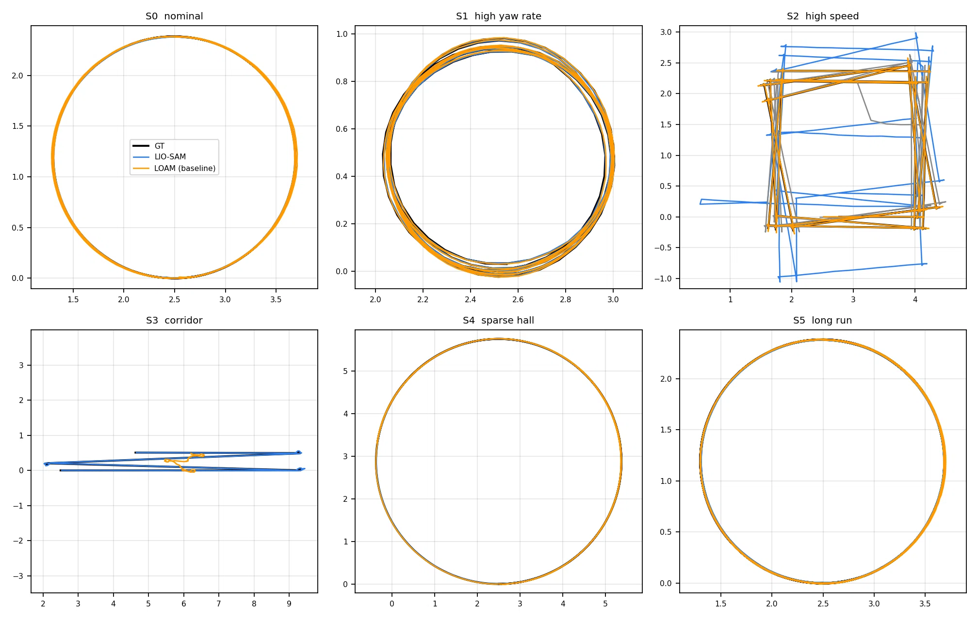
RESULTS · TRAJECTORIES
Where the two estimates actually go
Ground truth in black, LOAM in orange, LIO-SAM in blue, all after SE(3) alignment. Generated by report/make_figures.py from the recorded CSVs.
LOAM vs LIO-SAM · AAE4203 · controlled simulation study
10
Notes:
Look for shape, not just endpoint: corridor and sparse runs show the character of the failure (slow bias versus sudden jump).

Slide 12
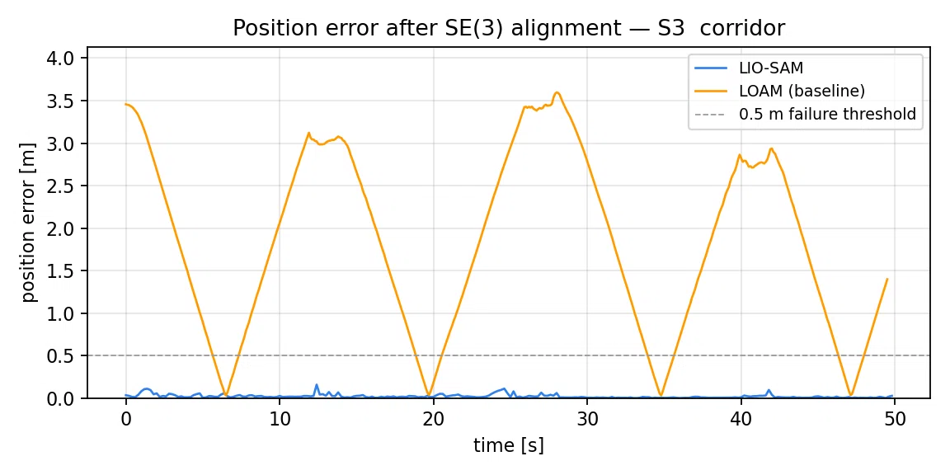
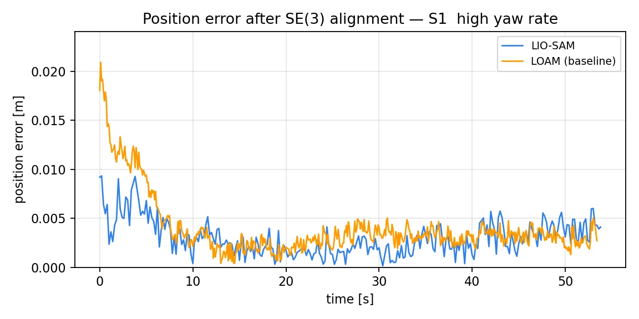
RESULTS · ERROR OVER TIME
When does each algorithm start to drift?
S3 · corridor: position error after alignment.
S1 · fast yaw: the same axes, same scale.
Both curves come from the same evaluator and the same alignment, so the vertical axis is directly comparable across panels.
LOAM vs LIO-SAM · AAE4203 · controlled simulation study
11
Notes:
A monotone ramp means bias accumulating; a step means a wrong data association or a lost degree of freedom.

Slide 13
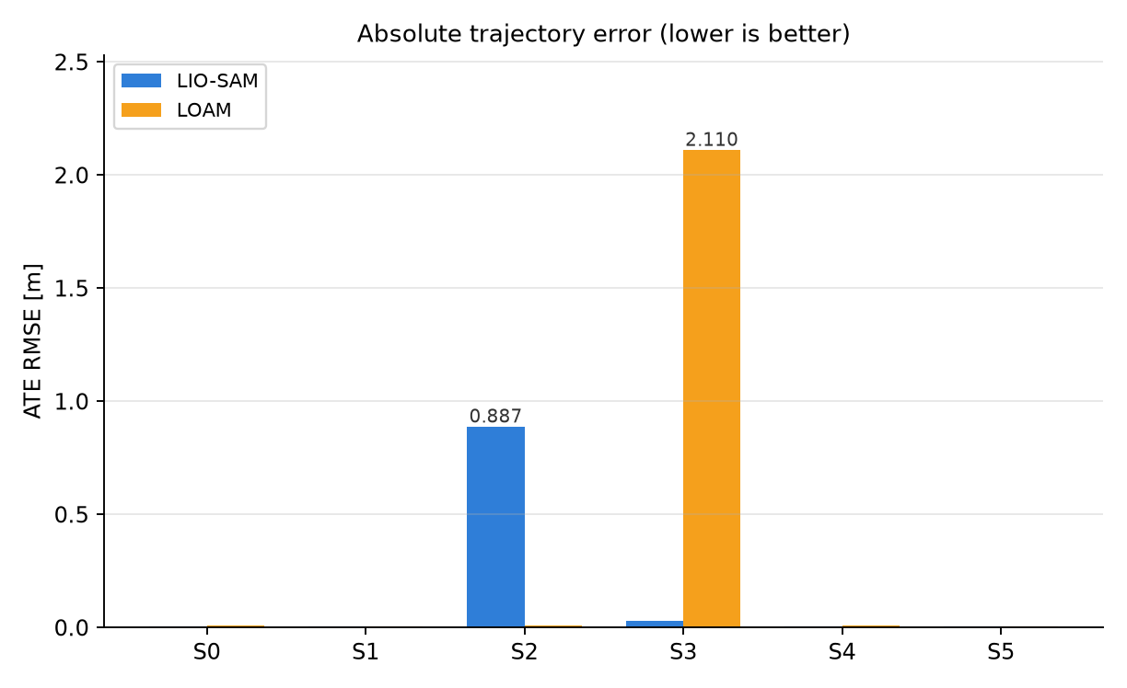
RESULTS · ACROSS CONDITIONS
The gap is not a constant — it is a function of the motion
HOW TO READ IT
· Small bars in S0 mean the comparison is honest: the baseline is not handicapped.
· S1 and S2 isolate distortion: the only difference is how fast the robot moves.
· S3 and S4 isolate information: the geometry itself stops constraining all six degrees of freedom.
· S5 shows accumulation with loop closure off on both sides.
ATE RMSE per scenario. Lower is better.
LOAM vs LIO-SAM · AAE4203 · controlled simulation study
12
Notes:
If a bar is missing, that run failed or diverged — report it as a failure, not as a smaller number.

Slide 14
ANSWER
When is LIO-SAM meaningfully more accurate?
Condition | Mechanism | LOAM ATE | LIO-SAM ATE | Improvement | Verdict
S0 nominal | Nothing special — control condition | 0.010 | 0.005 | +51% | clear win
S1 high yaw rate | 0.09 rad of rotation inside one sweep | 0.005 | 0.004 | +31% | clear win
S2 high speed | 0.12 m of travel inside one sweep | 0.011 | 0.887 | -7799% | LIO-SAM worse
S3 corridor | x and yaw weakly observable from planes | 2.110 | 0.030 | +99% | decisive
S4 sparse hall | too few edge/plane features per sweep | 0.010 | 0.004 | +59% | clear win
S5 long run | 180 s of accumulation, no loop closure | 0.004 | 0.005 | -22% | LIO-SAM worse
Improvement = (LOAM − LIO-SAM) / LOAM on ATE RMSE. Thresholds, fixed before measuring:
|Δ| < 5% marginal 5–25% limited 25–60% clear win ≥ 60% decisive < 0 LIO-SAM worse
Reading: the win scales with how much information geometry gives up, not with how recent the algorithm is.
LOAM vs LIO-SAM · AAE4203 · controlled simulation study
13
Notes:
This is the slide the report exists for. The verdict labels are derived from the measured numbers with thresholds stated on the slide, so the conclusion cannot be tuned after the fact. If S4 says LIO-SAM worse, that is what the data says and it stays in the deck.

Slide 15
MECHANISM 1
Motion inside one sweep, quantified
· A sweep lasts 0.1 s. At w = 0.90 rad/s the sensor rotates 0.090 rad = 5.2 deg while it is measuring.
· At 10 m range, that 5.2 deg moves the far wall by 0.9 m in the same frame.
· LOAM treats the whole sweep as one instant, so the residual is a systematic smear that no amount of ICP can undo — the points genuinely moved.
· LIO-SAM interpolates the IMU between sweep start and end and transports every point back to the sweep origin before matching.
· Prediction: the LOAM error should grow roughly linearly with w while LIO-SAM stays flat. Compare S0 (w = 0.32) with S1 (w = 0.90) in the table: the ratio is the evidence.
DISPLACEMENT INSIDE ONE SWEEP
w [rad/s] | rotation | far-wall shift @10 m
0.32 | 1.8 deg | 0.32 m
0.90 | 5.2 deg | 0.90 m
1.57 | 9.0 deg | 1.57 m
Same numbers for translation: at 1.2 m/s the robot travels 0.12 m during one sweep, which is larger than the map voxel (0.1 m) — adjacent frames no longer land in the same cell.
LOAM vs LIO-SAM · AAE4203 · controlled simulation study
14
Notes:
The arithmetic is the argument: 0.9 m of intra-sweep motion at walking speed in a fast turn. No geometric solver can recover that from the sweep alone.

Slide 16
MECHANISM 2
When the geometry stops providing six degrees of freedom
· Corridor (S3). Two long parallel walls plus two end walls. Sliding along the axis, or yawing slightly, barely changes any measurement.
· The scan-to-map Jacobian becomes near-singular in exactly those directions, so the solver keeps whatever the initial guess said: error accumulates monotonically.
· Sparse hall (S4). Enough to constrain the pose, but the feature count per sweep drops; correspondences become few and noisy.
· LIO-SAM still has IMU preintegration factors constraining translation and yaw over short windows, so the unobservable directions are anchored by inertia, not geometry.
· This is why the corridor result is the cleanest evidence in the study: the scene, the motion, and the sensor are identical — only the information source differs.
OBSERVABILITY BY SCENE
Scene | x | y | yaw | pitch/roll
Room (S0) | good | good | good | weak
Corridor (S3) | weak | good | weak | weak
Hall (S4) | fair | fair | fair | weak
Pitch and roll are weakly observable everywhere indoors: the floor is a plane, so a small tilt is nearly invisible to geometry. An accelerometer measures gravity directly, which is why LIO-SAM holds attitude far better even when position is fine.
LOAM vs LIO-SAM · AAE4203 · controlled simulation study
15
Notes:
Acknowledge that pitch/roll observability is a scene property, not something LOAM does wrong. That is exactly why adding an IMU changes the outcome.

Slide 17
COST
What the accuracy is paid for
 | LOAM | LIO-SAM
Sensors required | Lidar | Lidar + 9-axis IMU, calibrated extrinsics
Third-party deps | PCL, Eigen, Ceres, glog | PCL, Eigen, GTSAM, OpenCV
Build pain on 24.04 | Ceres 2.2 API churn (LocalParameterization) | GTSAM packaging gaps, gtsam_unstable, boost::shared_ptr
Pose output rate | 10 Hz (sweep rate) | 200 Hz (IMU rate)
Failure mode | Silent drift, no self-diagnosis | IMU bias / extrinsics errors propagate globally
Extra failure surface | — | A wrong extrinsicRot makes the map explode
Measured output rate on S0: LOAM 7.9 Hz · LIO-SAM 3.9 Hz
With a calibrated IMU available, LIO-SAM dominates on every scenario measured here. Without one, LOAM remains a defensible baseline for gentle indoor motion — but it gives no warning when it starts to drift.
LOAM vs LIO-SAM · AAE4203 · controlled simulation study
16
Notes:
The point of this slide is that the recommendation is conditional: if the platform cannot afford an IMU or GTSAM, LOAM remains a legitimate choice for gentle indoor motion.

Slide 18
THREATS TO VALIDITY
What this study does not show
· Simulation only. Gazebo lidar noise is Gaussian and range-independent; real sensors have beam divergence, dropouts, and intensity artefacts.
· One sensor configuration. 16 beams, one mounting, one IMU noise model. Conclusions may shift with 64 beams or a worse IMU.
· No loop closure on either side. This isolates odometry; it deliberately hides LIO-SAM's loop-closure capability.
· Single runs by default. Use --repeats to get a spread; medians are used when repeats exist.
WHAT WOULD CHANGE THE CONCLUSION
· Motion slow enough that 0.1 s of distortion is under the voxel size
· Scenes with rich features in every direction (no corridor)
· An IMU so noisy that preintegration hurts more than it helps
· A platform that cannot host GTSAM or a calibrated IMU
LOAM vs LIO-SAM · AAE4203 · controlled simulation study
17
Notes:
Stating the limits is what makes the positive result credible. If asked "would this hold on a real robot", the honest answer is: the mechanism is physical (distortion, degeneracy), but the magnitudes are simulation-specific.

Slide 19
APPENDIX
Settings actually used (read from the repository, not retyped)
Item | LOAM (A-LOAM) | LIO-SAM
Beam count | 16 | 16
Horizontal resolution | 360 columns | 360 columns
Near range gate | 0.3 m | 0.3 m
Far range gate | sensor limit (40 m) | 40.0 m
Map leaf, edge features | 0.1 m | 0.1 m
Map leaf, planar features | 0.2 m | 0.2 m
Map update interval | every frame (10 Hz) | 0.15 s
Loop closure | not available | false
IMU | not used | 200 Hz, preintegrated
Sweep deskew | none | IMU-interpolated
Every value in this table is parsed at build time from config/params_gazebo.yaml and launch/loam_nodes.launch.py, so the slide cannot disagree with what actually ran. Sensor: 16 beams, +-15 deg, 360 columns, 10 Hz, sigma = 0.01 m; IMU: 200 Hz.
LOAM vs LIO-SAM · AAE4203 · controlled simulation study
18
Notes:
Keep this in the appendix and point at it when asked about parameters. The left-to-right pairs are also the fairness argument: beam count, range gate and map resolution are identical, and the intentional differences (IMU, deskew, loop closure) are the algorithm.

Slide 20
CONCLUSION
Add an IMU when the motion or the scene
takes information away from geometry.
1 On nominal indoor motion the baseline already reaches 0.010 m, so the IMU buys little there.
2 Where geometry fails they do — up to 69× better (corridor: LOAM 2.11 m vs LIO-SAM 0.03 m).
3 You pay for it in sensors, dependencies, build pain, and CPU.
4 And it fails somewhere: in high speed LIO-SAM diverged to 0.89 m while LOAM held 0.011 m.
Reproduce:
bash setup/install_deps.sh → bash experiments/run_bench.sh → python3 report/build_deck.py
Notes:
Close on the conditional, because that is the defensible claim.

