Slide 1
READ ME FIRST — delete this slide before you submit
How to use this template
  Replace every grey or bracketed text with your own content
  Keep the slide order; add or remove slides where it helps
  Speaker notes under each slide explain what to put there
  Gold tag on each slide: name of the member presenting it
File name: Gxx_Topic-No_AAE4203.pptx (e.g. G05_T12_AAE4203.pptx)
Rules
18 min in total: about 15 min talk + 3 min Q&A
Every member presents one part (about 3.5 min each)
No reading from a script or phone; cue cards are fine
Font size ≥ 18 pt for body text
At most 30 slides (40 is the absolute limit); videos and demos welcome
The “Link to AAE4203” slide is mandatory
Cite every figure and number you did not produce yourself
Email the final slides to the instructor 24 h before your session
Notes:
This slide is for your group only. Delete it before submitting or presenting.

Slide 2
Outline
Presenter: ZHANG Wenxi
01 Introduction, Background and Motivation
02 Technical Principle
03 Link to AAE4203
03 Case Study / Demo and Results
04 Limitations and Future Trends
05 Conclusion
Notes:
Keep the outline short. You may add the presenter name next to each part.

Slide 3
Part 1 Background and Motivation
Presenter:
Notes:
Divider for part 1. Put the presenter's real name here. Dividers are optional; delete them if you are short of time.

Slide 4
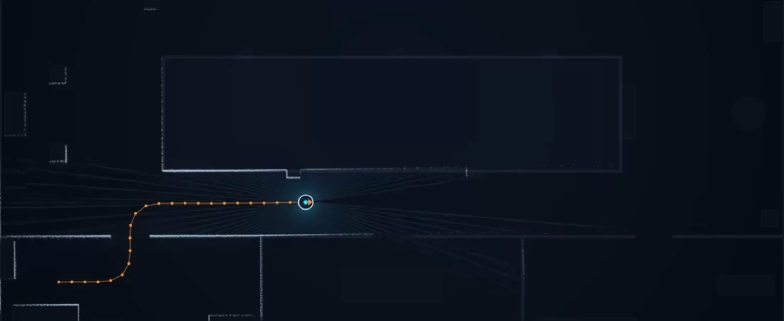
Background and Motivation
What problem does it solve?
Presenter: ZHANG Wenxi
No map. No GPS signal. Where am I?
GNSS-denied environment
  Tunnels
  Underground
  Dense urban canyons
Poor-lighting conditions
LiDAR SLAM
(Simultaneous Localization and Mapping)
Build a real-time 3D map of an unknown environment.
Track the robot’s or sensor's location & orientation.
Simultaneously
Notes:
Start with a concrete scene or question that the audience can picture. One strong example is better than a long history.
Intro: 1. problem it solves 2. Simple intro about the functions 3. Examples

Slide 5
Background and Motivation
How does it achieve such functions?
Presenter: ZHANG Wenxi
Localization
  LiDAR:
  Emit laser pulses, measure the time of flight of reflected signals
  Calculate dense distance of surroundings
  Return a stream of 3D point clouds
  Algorithm:
  Extract geometric features—corners, edges and surfaces
  Align and match with point clouds from the successive scans
  Compute the robot’s relative movements to estimate its
2. Mapping
  Each point in the point cloud is transformed into a unified global coordinate frame.
  Registered point clouds are combined to construct a 3D map of the unknown environment.
---- Localization and mapping are interdependent and operate simultaneously.

Slide 6
Background and Motivation
Does it matter?

Slide 7
Background and Motivation
Who uses this technology?

Slide 8
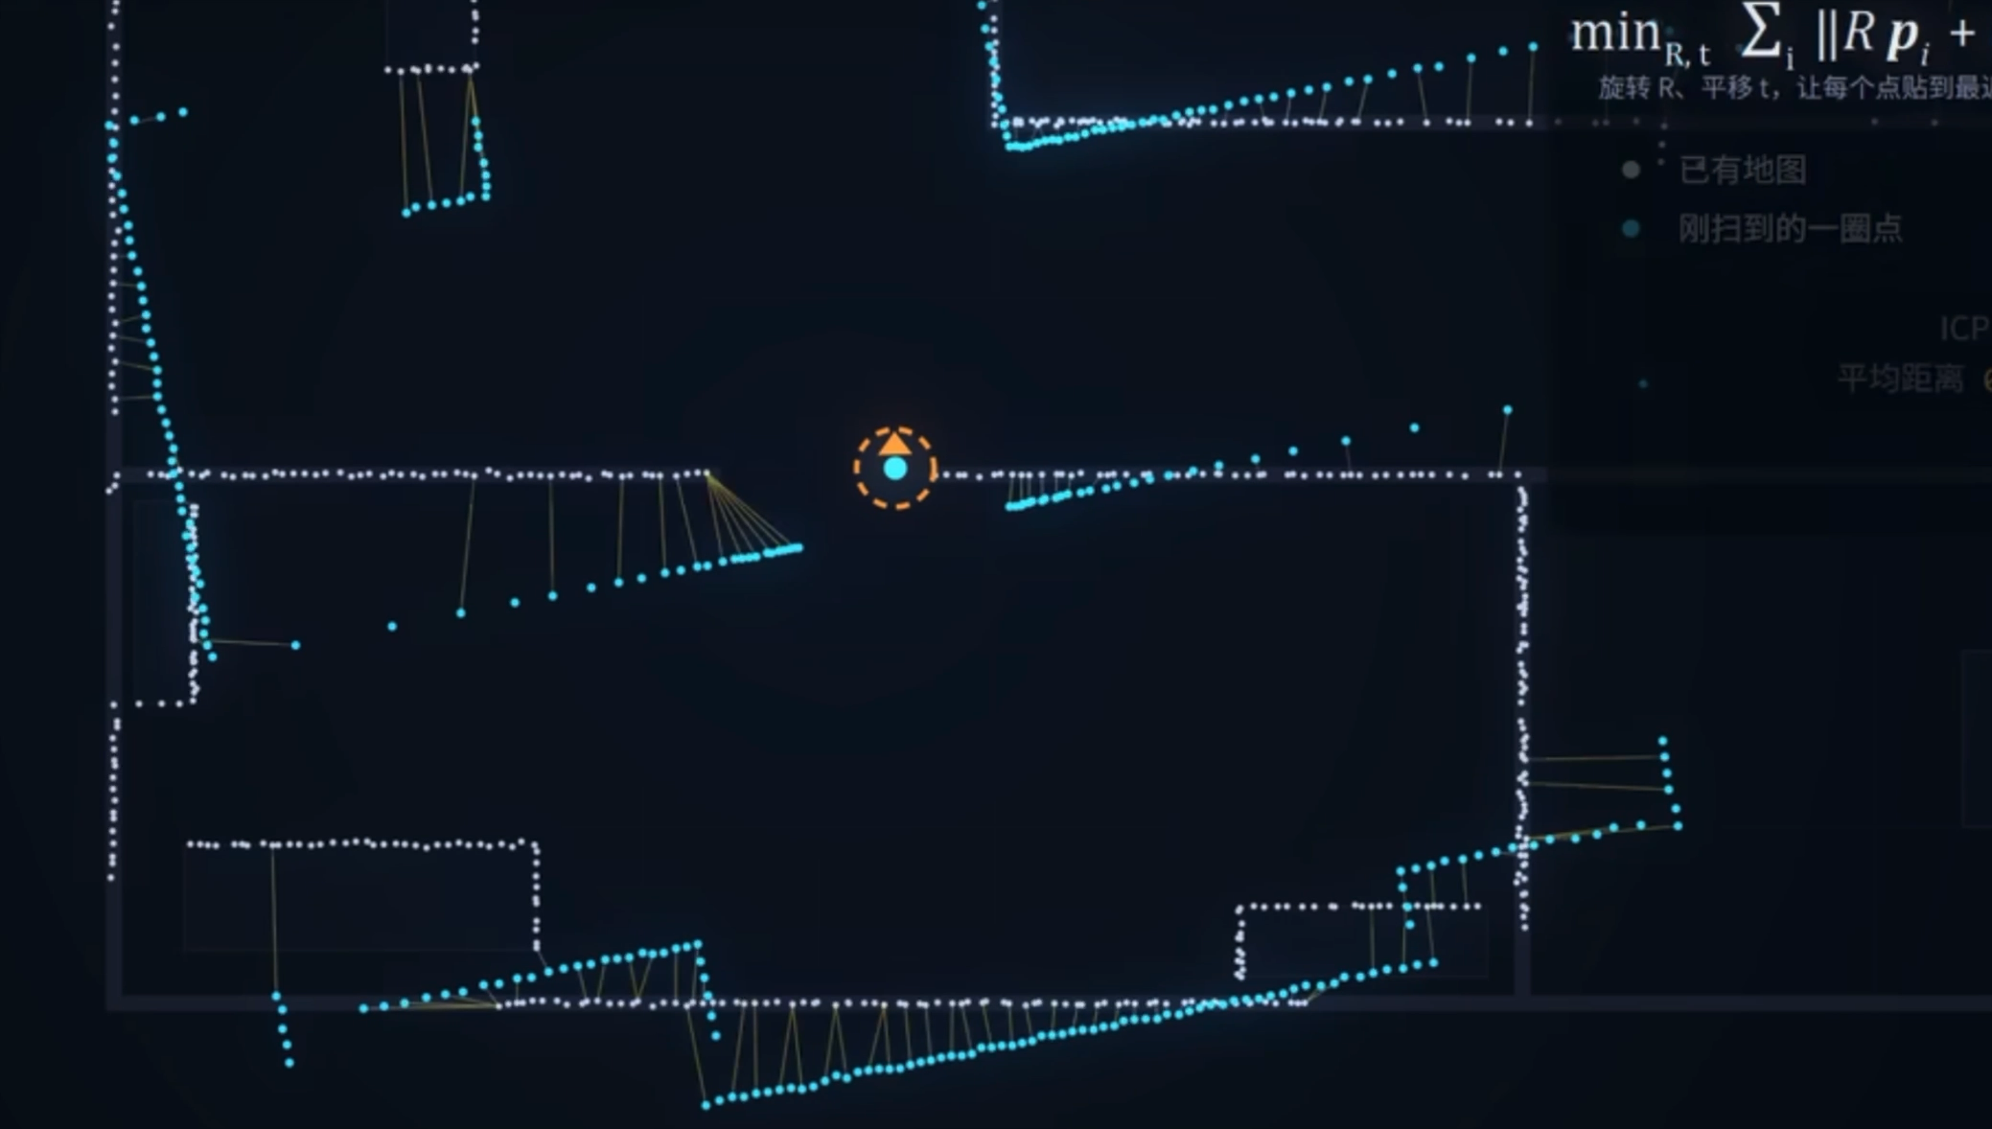
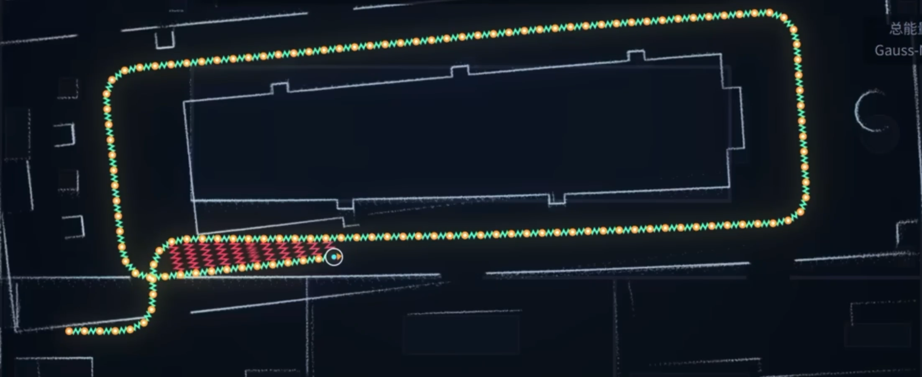
State of the Art
Presenter: ZHANG Wenxi
Notes:
Optional slide. A small timeline or comparison table works well. Do not spend more than one minute here.

Slide 9
Part 2 Technical Principle of LIO SAM and Link to AAE4203
Presenter: Yang Yuqi
Notes:
Divider for part 2. Put the presenter's real name here. Dividers are optional; delete them if you are short of time.

Slide 10
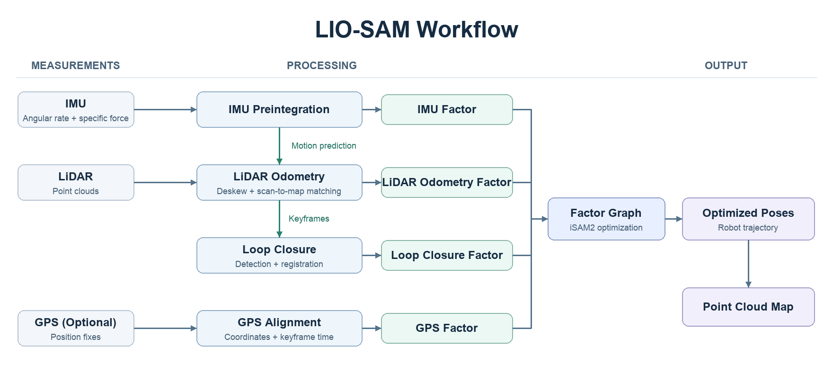
Technical Principle (1): How It Works
Presenter: Yang Yuqi
LiDAR–inertial odometry, or LIO
Shan, T., Englot, B., Meyers, D., Wang, W., Ratti, C., & Rus, D. (2020). LIO-SAM: Tightly-coupled lidar inertial odometry via smoothing and mapping. In 2020 IEEE/RSJ International Conference on Intelligent Robots and Systems (IROS) (pp. 5135–5142). IEEE. https://doi.org/10.1109/IROS45743.2020.9341176
Notes:
From left to right, the system processes sensor measurements, combines the resulting constraints in a factor graph, and outputs the robot’s trajectory and a point cloud map.
There are four types of factors in the graph. They come from IMU preintegration, LiDAR odometry, loop closure, and GPS (optional). The red box is the focus of our speech. The first two work together as LiDAR–inertial odometry, or LIO. The IMU predicts motion, and LiDAR scan matching refines the pose. Loop closure uses saved keyframes to check for revisits and helps correct accumulated drift.

Slide 11
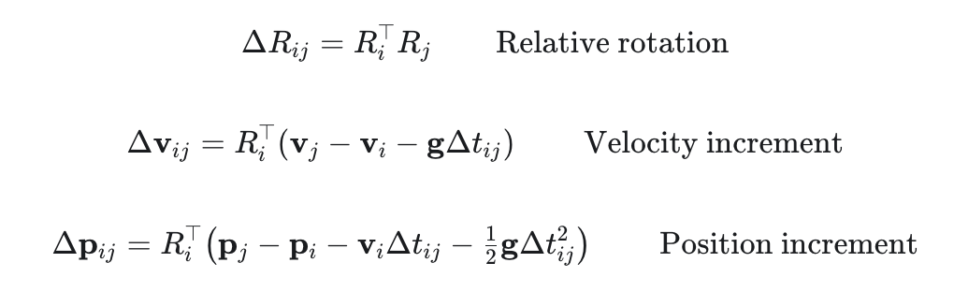

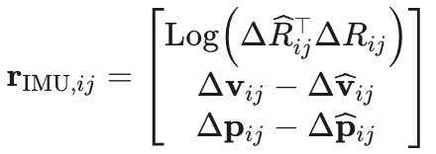
Technical Principle (2): Key Equations or Algorithm
Presenter: Yang Yuqi
1.IMU Preintegration Equations - IMU factor
Symbol | Meaning
i, j | Start and end keyframes
Δtᵢⱼ | Elapsed time between keyframes
Rᵢ, Rⱼ | Body-to-world rotations at frame i and frame j
Rᵢᵀ | World-to-body rotation at i
vᵢ, vⱼ | Velocities in the world frame
pᵢ, pⱼ | Positions in the world frame
g | Gravity vector in the world frame
ΔRᵢⱼ | Relative rotation from frame j to frame i
Δvᵢⱼ | Velocity increment after removing gravity, expressed in frame i
Δpᵢⱼ | Position increment after removing initial-velocity and gravity terms, expressed in frame i
ΔR̂ᵢⱼ | IMU-preintegrated relative rotation from frame j to frame i
Δv̂ᵢⱼ | IMU-preintegrated velocity increment expressed in frame i
Δp̂ᵢⱼ | IMU-preintegrated position increment expressed in frame i
predicted increments from j to i
measured increments
Function: Compares predicted and measured IMU increments to form residuals for keyframe optimization.
Advantage: Reuses preintegrated increments across optimization iterations.
Shan, T., Englot, B., Meyers, D., Wang, W., Ratti, C., & Rus, D. (2020). LIO-SAM: Tightly-coupled lidar inertial odometry via smoothing and mapping. In 2020 IEEE/RSJ International Conference on Intelligent Robots and Systems (IROS) (pp. 5135–5142). IEEE. https://doi.org/10.1109/IROS45743.2020.9341176
Notes:
The first set of formulas is IMU Preintegration Equations. The first three equations predict rotation, velocity, and position increments from the current keyframe states. Preintegrating IMU readings between those same frames gives the measured increments. The IMU factor residual then can be calculated as the difference between the predicted and measured increments.

Slide 12

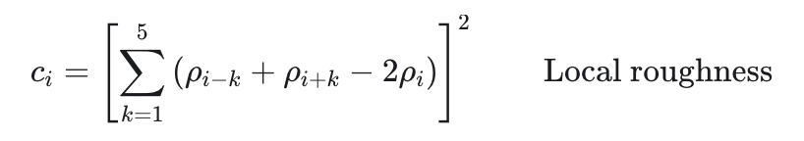
Technical Principle (2): Key Equations or Algorithm
Presenter: Yang Yuqi
2.LiDAR Processing Equations - LiDAR odometry factor—3 steps
Deskew--Calculate the coordinates of each frame point
Symbol | Meaning
tᵢ, tᵣ | Point acquisition time and scan reference time (same frame, same tᵣ)
Lᵢ, Lᵣ | LiDAR frames at tᵢ and tᵣ
p̄ | LiDAR point in homogeneous coordinates
T_WL(t) | LiDAR-to-world transform at time t
ρᵢ, ρᵢ₋ₖ, ρᵢ₊ₖ | Range of point i and its neighboring points
i, k | Point index and neighbor offset in the roughness equation
cᵢ | Local roughness score of point i
Function: Deskew uses IMU motion estimates and rigid transformations to express all points in a scan at the same reference time.
Advantage: This reduces distortion caused by motion during the scan.
Feature Extraction--Select some feature points
Cᵢ≈0 planar points
Cᵢ>0 edge points
Function: Feature extraction uses local range roughness to select edge and planar features.
Advantage: This gives scan matching useful geometric features without having to match every point.
These two steps allow us to obtain motion-corrected edge and planar feature points P for scan-to-map matching.
Shan, T. [TixiaoShan]. (n.d.). LIO-SAM [Source code]. GitHub. https://github.com/TixiaoShan/LIO-SAM
Notes:
LiDAR processing has three steps: deskew, feature extraction, and scan-to-map matching. Deskew uses the IMU motion estimate to transform each point from its capture-time frame to a common reference frame. Feature extraction calculates a local roughness score from neighboring range measurements to select edge and planar points. We use these points for scan-to-map matching.

Slide 13
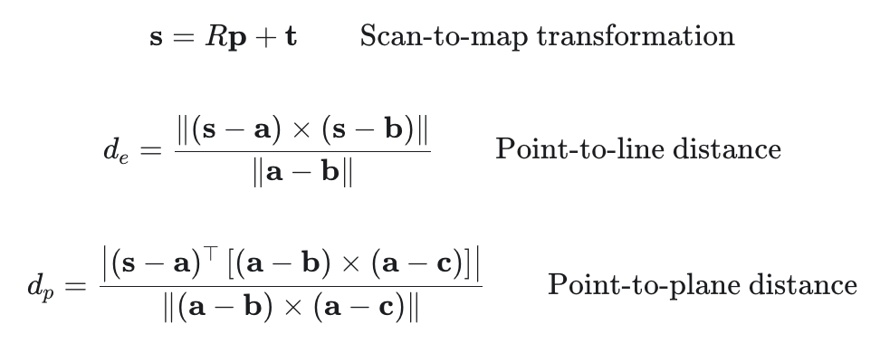
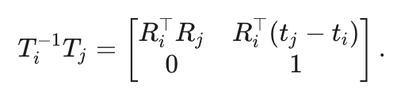

Technical Principle (2): Key Equations or Algorithm
Presenter: Yang Yuqi
2.LiDAR Processing Equations
Symbol | Meaning
i, j | Previous and current keyframe indices
X | Current state estimates in the factor graph
Rᵢ, Rⱼ, tᵢ, tⱼ | Keyframe-to-map rotations and translations from X
Tᵢ, Tⱼ | 4 × 4 keyframe-to-map pose matrices
Tᵢ⁻¹Tⱼ | Predicted relative pose that transforms coordinates from frame j to frame i
ΔT̂ᵢⱼ | Relative pose measurement from LiDAR odometry
Log | SE(3) logarithm that maps a relative pose error to a 6D vector
rᵢⱼ(X) | 6 × 1 LiDAR odometry factor residual
Scan-to-Map Matching--Scan-to-map matching estimates the rotation and translation by aligning the current scan’s feature points with corresponding lines and planes in the local map, then uses that transformation to bring the entire point cloud into the map coordinate system.
Feature points obtained in the previous step
target≈0
frame i--j
Notes:
In scan-to-map matching, we start with the pose predicted by the IMU. The first equation uses that rotation and translation to place the scan points in the map. The next two equations measure the perpendicular distance from each transformed feature point to its matching edge line or plane in the local map. These distances tell us how well the scan fits. Gauss–Newton uses these errors to calculate small updates to both rotation and translation. This gives us a better-aligned scan. Finally, The blue-box equation compares that prediction with the relative pose measured by LiDAR odometry, form the residual.

Slide 14

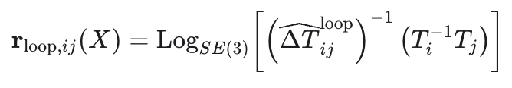
Technical Principle (2): Key Equations or Algorithm
Presenter: Yang Yuqi
3.Loop Closure Equations - loop closure factor
Symbol | Meaning
i, j | Historical and current keyframes
pᵢ, pⱼ | Estimated positions in the map frame
‖pⱼ − pᵢ‖ | Euclidean distance between the estimated positions
r_search | Search radius for historical candidates
Tᵢ, Tⱼ | Keyframe-to-map rigid transformations
Tᵢ⁻¹Tⱼ | Relative pose from frame j to frame i, predicted by the trajectory
ΔT̂ᵢⱼ | Relative pose from frame j to frame i, measured by loop registration
Function: Loop closure searches for nearby historical keyframes and matches the current scan to a historical submap to estimate their relative pose.
Advantage: Adding this constraint helps correct accumulated drift in the trajectory and map.
Notes:
The third step is loop closure. The first equation finds nearby past keyframes. A successful scan match gives a relative pose measurement. The second equation compares it with the trajectory’s prediction to produce loop closure residual. The factor graph uses this residual to reduce drift.

Slide 15
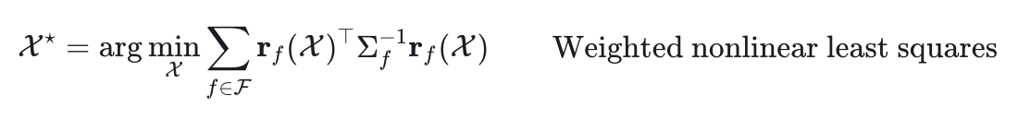

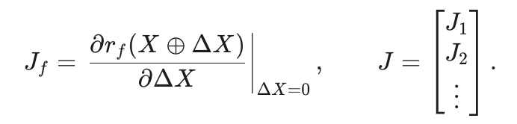

Technical Principle (2): Key Equations or Algorithm
Presenter: Yang Yuqi
4 factors:
IMU Factor
LiDAR Odometry Factor
Loop Closure Factor
GPS Factor (Optional)
Symbol | Meaning
X, X* | Keyframe states and their optimized estimates
f, F | An individual factor and the set of active factors
r_f(X) | Difference between the factor’s measurement and the prediction from the states
Σ_f | Measurement error covariance. Its inverse gives the weight.
Function: Finds the trajectory that minimizes the weighted sum of squared errors across all factors.
Advantage: Gives more reliable measurements greater influence, so the estimate balances the different constraints according to their uncertainty.
solution
Shan, T., Englot, B., Meyers, D., Wang, W., Ratti, C., & Rus, D. (2020). LIO-SAM: Tightly-coupled lidar inertial odometry via smoothing and mapping. In 2020 IEEE/RSJ International Conference on Intelligent Robots and Systems (IROS) (pp. 5135–5142). IEEE. https://doi.org/10.1109/IROS45743.2020.9341176
Notes:
The factor graph combines four types of constraints. We use weighted nonlinear least squares to find the keyframe states that minimize the weighted sum of squared residuals. Each residual measures the difference between a measurement and what the current states predict. The weight matrix W gives more influence to measurements with lower uncertainty. To solve the problem, we linearize the residuals around the current estimate. The Jacobian J tells us how those residuals change when we adjust the states. The bottom equation gives the correction for one iteration. We apply that correction, then recompute the residuals for the next iteration.

Slide 16
Link to AAE4203 (required)
Presenter: Yang Yuqi
AAE4203 Week&topic | Course Equations | LIO-SAM Equations & Use | What LIO-SAM Adds
Week 1, p. 45 Position transformation | p_{target} = p_{aircraft} + R_{body}^{ECEF}r^{body} | Scan matching: s = t + Rp Transforms a scan point into the map frame. | The lecture uses a known aircraft pose. LIO-SAM estimates the pose by aligning scan features with the map.
Week 1, pp. 37–38 Rotation and transform composition | R⁻¹ = R^{T} T_{A}^{C} = T_{B}^{C} T_{A}^{B} | IMU: ΔR_{ij} = R_{i}^{T}R_{j} Deskew: p̄^{Lʳ} = T_{WL}(t_{r})⁻¹T_{WL}(t_{i})p̄^{Lⁱ} Loop closure: T_{i}⁻¹T_{j} ≈ ΔT̂_{ij}^{loop} | Composes transforms to constrain IMU motion, align scan timestamps, and link revisited keyframes.
Weeks 4–6, SPP least squares | Original objective: x* = arg min ‖y − h(x)‖². Linearized objective: Δx = arg min ‖δy − HΔx‖² Solve for the update: (HᵀH)Δx = Hᵀδy. | Original objective: X* = arg min ∑ᵢ [rᵢ(X)ᵀΣᵢ⁻¹rᵢ(X)] Linearized objective:ΔX = arg min ‖W¹ᐟ²(r + JΔX)‖² Solve for the update: (JᵀWJ)ΔX = −JᵀWr. | LIO-SAM weights each factor’s residual using its inverse covariance (matrix W). LIO-SAM jointly optimizes multiple keyframe states in a factor graph that combines IMU, LiDAR odometry, loop closure, and GPS (optional).
Notes:
This connects to AAE4203 in three ways. First, Week One uses a known pose to transform a point. Scan matching uses the same relationship to estimate the pose. Second, inverse rotations and transform composition let us compare poses across frames. Finally, SPP linearizes a least-squares problem and solves for an update. LIO-SAM uses the same approach to update multiple keyframes jointly, with a weight matrix W that gives more weight to measurements with lower uncertainty.

Slide 17
Part 3 Comparison between LOAM and LIO-SAM under ROS2 Jazzy
Presenter:
Notes:
Divider for part 3. Put the presenter's real name here. Dividers are optional; delete them if you are short of time.

Slide 18
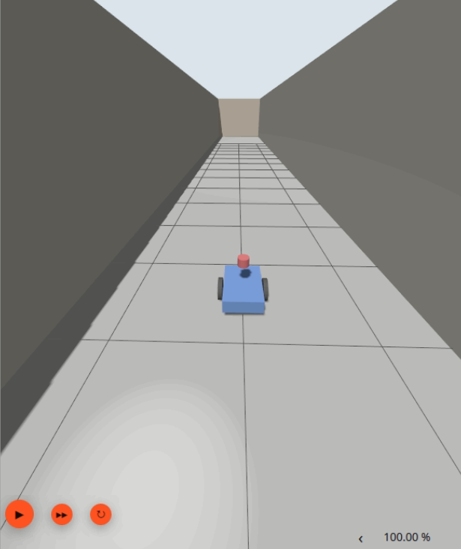
Runtime Environment
Presenter: Member 3
Where the numbers were produced
Item | Value
Base | 0.50 × 0.34 × 0.12 m
Mass | 6.1 kg total
Wheels | r 0.10 m, track 0.40 m
LiDAR | 16 × 360, 10 Hz
 | ±15°, 0.2 – 40 m
IMU | 200 Hz, 9-axis
 | co-located with LiDAR
Hardware
NVIDIA Jetson Orin Nano 8 GB (aarch64), Ubuntu 24.04 LTS
Middleware
ROS 2 Jazzy · Gazebo Harmonic 8.15 (ros_gz) · RViz2
Algorithms
LIO-SAM (upstream ros2 branch): C++17, GTSAM 4.2, Ceres 2.2, iSAM2
A-LOAM (baseline): ROS 2 port at a pinned commit — laser only, no IMU, no factor graph
One board runs the simulator and both pipelines, so the real-time factor is 0.78 and every sensor delivers ~78 % of its nominal rate.
Sensors share one frame, so the extrinsic is the identity and neither algorithm gets a lever-arm advantage.
The robot used in S3

Slide 19
Workflow: record once, replay twice, compare
Presenter: Member 3
2a Replay → LIO-SAM
LiDAR + IMU + GTSAM
1 Record once
Gazebo Harmonic
3 topics → one bag
3 Localisation
one 6-DoF pose
per sweep
4 Analysis
ATE / RPE /
robustness
same bag
2b Replay → LOAM
LiDAR only (baseline)
One recording, two consumers
Step 1 runs the scenario once in Gazebo and writes /points, /imu/data and /gt/odom to a bag. Steps 2a and 2b replay that same bag into each algorithm, so the point clouds are byte-identical — a difference in the table cannot come from a difference in data.
Localisation
Each algorithm publishes its own pose sequence; the recorder stores it beside the interpolated ground truth, one CSV per scenario and algorithm.
Analysis
Only at the end are the two CSVs aligned and scored — ATE, RPE, endpoint error, poses beyond 0.5 m, output rate. Thresholds were fixed before measuring and a sanity check rejects truncated or identical runs.

Slide 20
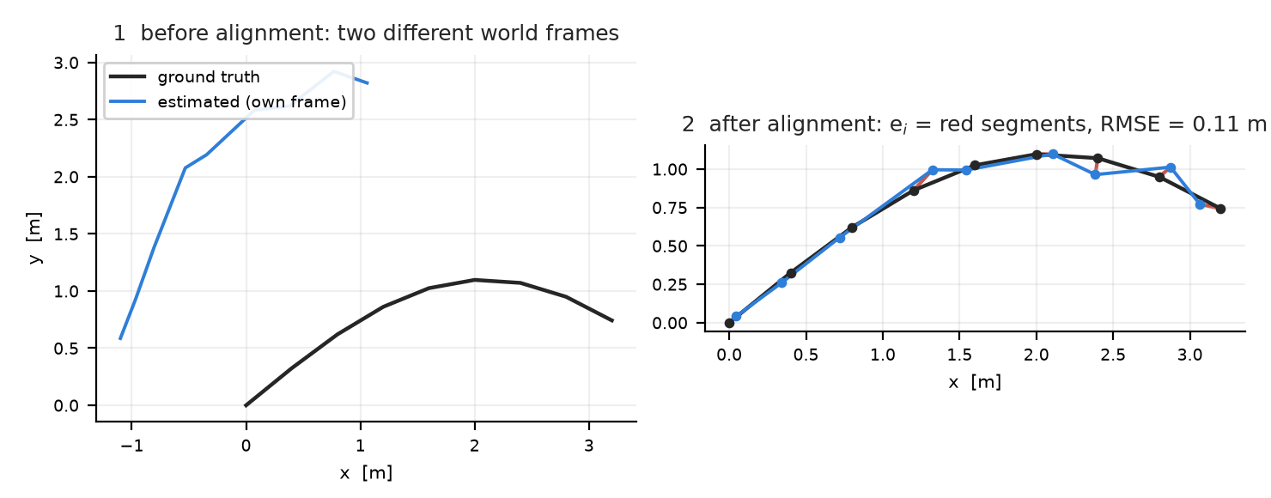
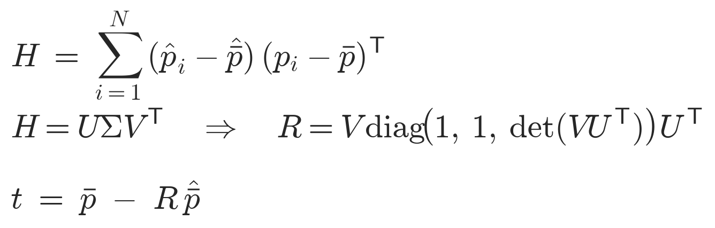
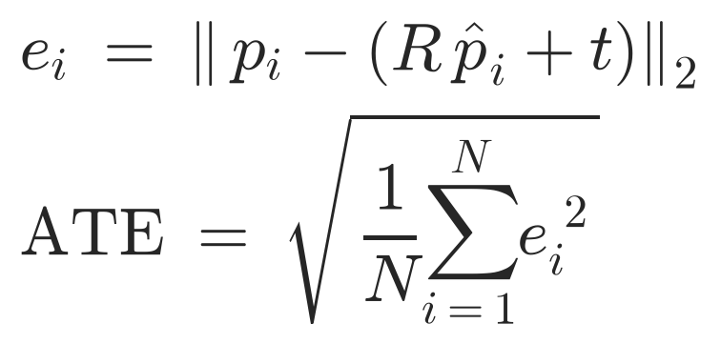
The metric: how ATE is computed
Presenter: Member 3
1 pair the poses in time
Match each estimate to the ground-truth pose carrying the same lidar stamp; keep one-to-one matches only.
2 remove the unknown frame
Solve the rigid transform (R, t) that best maps the estimate onto the truth — least squares, closed form via SVD:
Worked example (illustration)
Nine poses, estimate rotated by 32° and offset. Step 2 recovers that transform; the residual segments of step 3 give ATE = 0.11 m.
What we report
ATE RMSE and its rotation part, RPE over 1 s windows, endpoint error, poses beyond 0.5 m, and output rate — because one average can hide a trajectory that is locally fine and globally wrong.
The det term forbids a mirrored solution, and no scale is fitted: a trajectory 10 % too large must not be "aligned" into agreement.
3 one number per run
RMSE, not the mean, so one bad stretch cannot hide behind many good ones. Metres, lower is better.

Slide 21
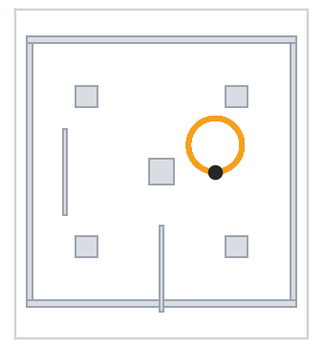
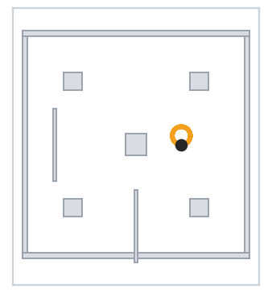
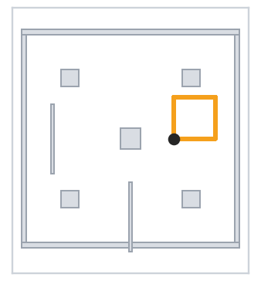

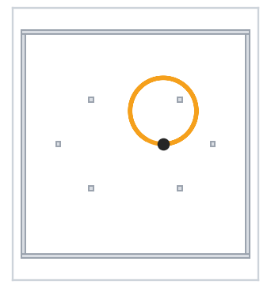
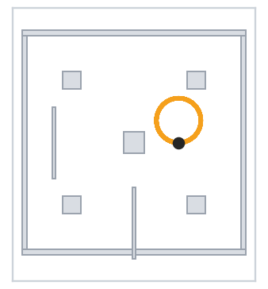
Six conditions, one variable at a time
Presenter: Member 3
Scenario | World | Path | Motion | What it isolates
S0 nominal | 12 × 12 m room | 36 m | circle, 0.40 m/s | baseline: geometry is rich
S1 fast yaw | 12 × 12 m room | 27 m | ω = 0.90 rad/s | distortion inside one sweep
S2 high speed | 12 × 12 m room | 48 m | 1.2 m/s + 90° turns | large motion between sweeps
S3 corridor | 30 × 3 m corridor | 29 m | back and forth | geometry loses 2 DoF
S4 sparse hall | 20 × 20 m, 6 pillars | 36 m | r = 3 m circle | few features per sweep
S5 long run | 12 × 12 m room | 72 m | 9 laps | accumulation over 180 s
S0
S1
S2
S3
The sketches on the right show each world’s actual geometry and commanded path, read from the scenario files. S3 is the only case whose driven direction is parallel to the only surfaces in view.
S4
S5
Grey: walls and pillars · orange: commanded path · dot: start

Slide 22
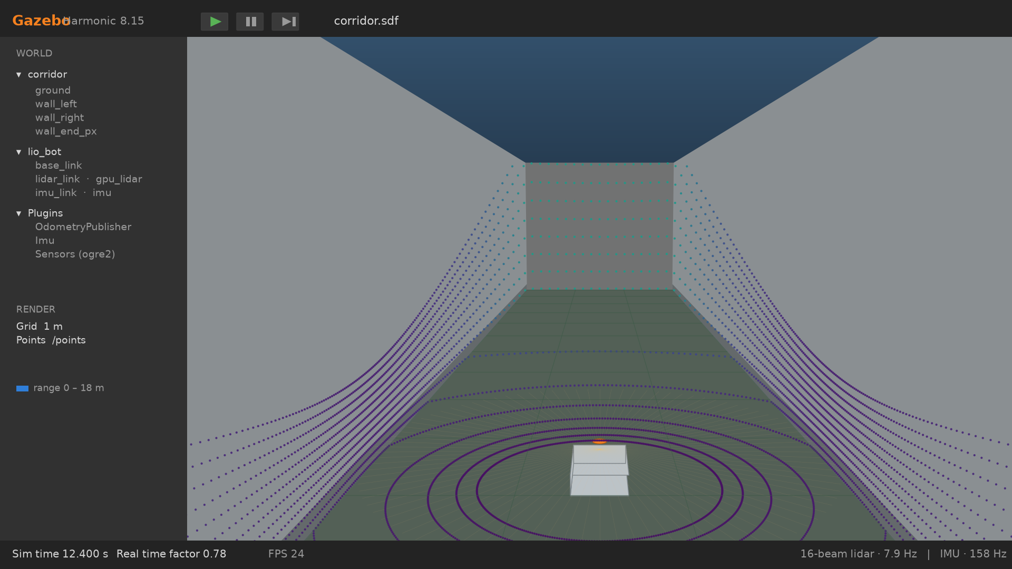
S3 in the simulator: the corridor in Gazebo
Presenter: Member 3
View rebuilt from corridor.sdf and lio_bot/model.sdf geometry; points are ray-cast at 16 × 360, coloured by range.
7.2 m along the axis, a 180° turn, and back — four legs, 28.8 m in 56 s, always on the centreline.
Every sweep returns two parallel planes of points, so sliding along x moves them along themselves: two of the six degrees of freedom are missing from the data, not from the solver.

Slide 23
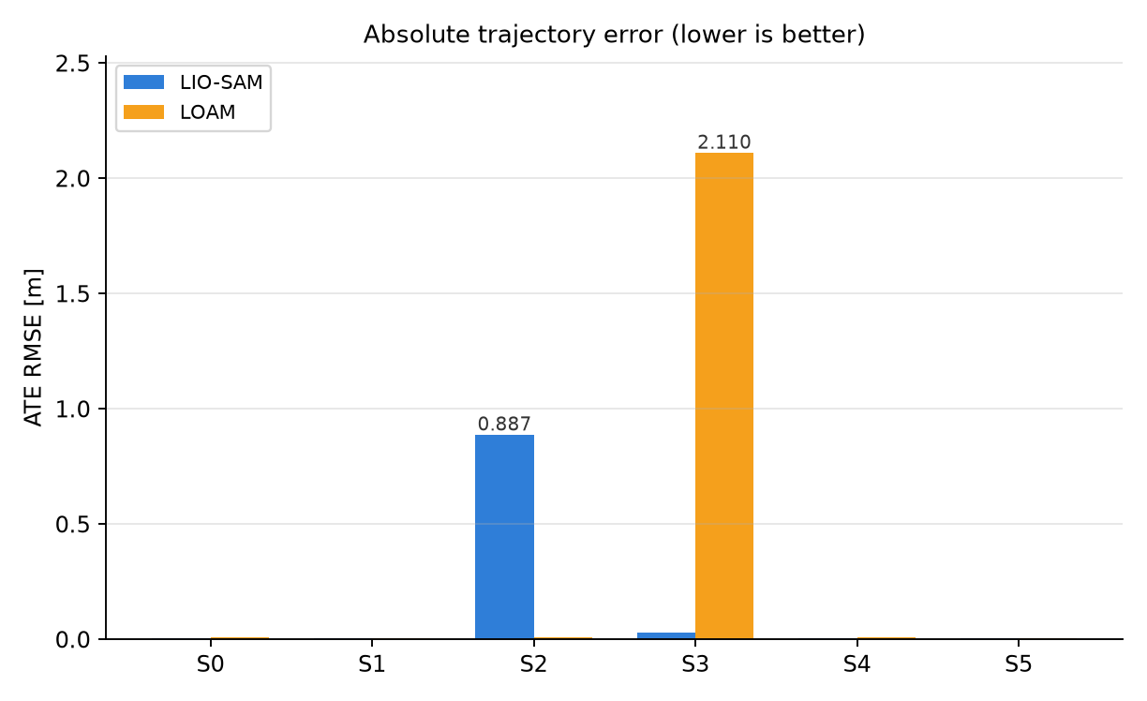
Result: the gap depends on the motion
Presenter: Member 3
Headline numbers (ATE RMSE)
S0 0.0095 → 0.0047 m +51%
S1 0.0051 → 0.0035 m +31%
S3 2.110 → 0.030 m +99%
S4 0.0105 → 0.0044 m +59%
S5 0.0042 → 0.0052 m -22% (millimetres: a tie)
S2 0.0112 → 0.887 m -7799% ← the exception
Lower is better. Improvement is measured against the LOAM baseline, computed from the CSV, not asserted.

Slide 24
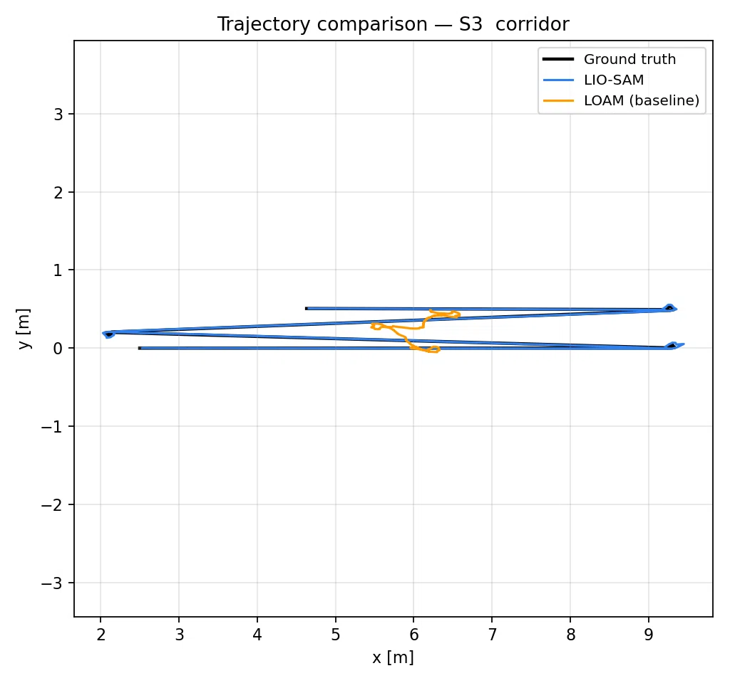
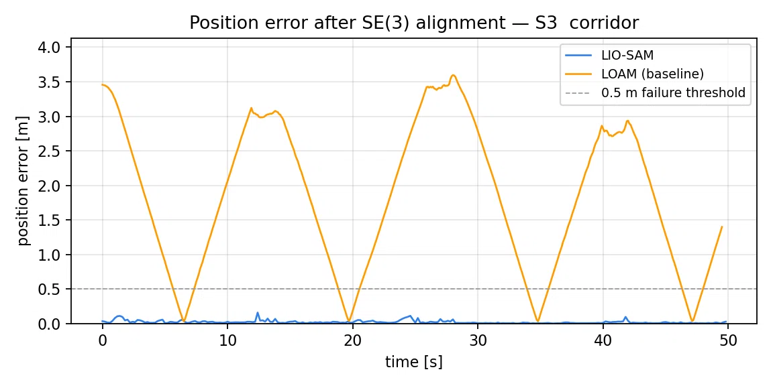
Key advantage: where geometry runs out
Presenter: Member 3
S3 | LOAM | LIO-SAM
ATE | 2.110 | 0.030
rot ° | 12.6 | 0.7
final m | 1.40 | 0.027
>0.5 m | 429 | 0
What the two plots say
Trajectory: LOAM (orange) covers a fraction of the corridor, LIO-SAM (blue) covers all of it. LOAM’s estimated path is 18 % of the true length — it barely translates, because translation along x and yaw are not observable from two parallel walls.
Error: LOAM oscillates between 0 and 3.6 m, resetting each time the robot turns round; LIO-SAM stays under 0.16 m for the whole run. 429 of LOAM’s 508 poses are beyond the 0.5 m line, none of LIO-SAM’s are.
That is the argument for the IMU: it constrains exactly the two directions the corridor removes.

Slide 25
Part 3 conclusion
Presenter: Member 3
1 Geometric degeneracy is where the IMU earns its place.
In the corridor LIO-SAM is 69× more accurate than LOAM (0.030 m vs 2.110 m), and the mechanism is visible in the data: LOAM never translates along the axis it cannot observe. Where geometry is rich (S0, S1, S4, S5) the two stay within a centimetre of each other — the fusion buys precision only under degeneracy.
2 One anomaly, reported rather than explained.
On S2 (1.2 m/s with 90° in-place turns) LIO-SAM diverged to 0.887 m while LOAM held 0.011 m, with every pose beyond 0.5 m. The same bag replayed at a different rate gave 0.040 m, so the result is not stable. Message loss or IMU preintegration gaps at this speed are plausible, but we have not isolated the cause and do not claim to.

Slide 26
Part 4 Limitations, Future Trends and Conclusion
Presenter:
Notes:
Divider for part 4. Put the presenter's real name here. Dividers are optional; delete them if you are short of time.

Slide 27
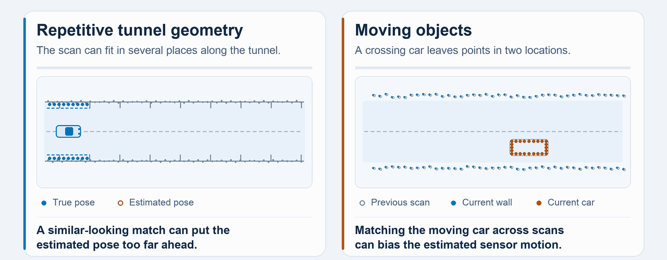
Limitations and Challenges
Presener: Xi Yilin
Weak or repetitive geometry: In long corridors, open flat ground, and symmetric scenes, there are few edge/planar features. Feature matching becomes unstable, and the pose estimate drifts.
Dynamic objects: The original system assumes a static world. Pedestrians and moving vehicles create moving points in the cloud, which corrupt frame-to-frame registration.
Notes:
Be specific. Link limitations back to the error sources discussed in the course where possible.

Slide 28
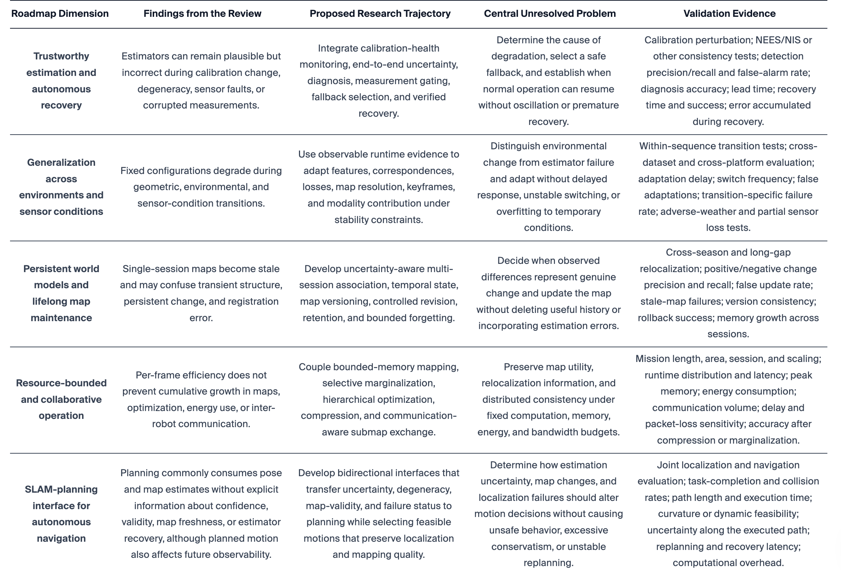
Limitations and Challenges
Presener: Xi Yilin
Single-session mapping: Single-session maps become stale, and the system cannot distinguish transient structure, persistent environmental change, and registration error.
Summary of existing limitations and open‑research directions for LiDAR‑based SLAM
（E. Muhammed and A. Shaker, “LiDAR‑Based SLAM: A Review of Algorithmic Modules and LiDAR‑Inertial Integration Architectures,” Sensors, vol. 26, no. 19, art. no. 6141, 2026, doi:10.3390/s26196141.）
Notes:
Be specific. Link limitations back to the error sources discussed in the course where possible.

Slide 29
Limitations and Challenges
Presener: Xi Yilin
Cost:
A mechanical 16-beam LiDAR plus a high-grade IMU is still expensive, which limits deployment on low-cost platforms.
Coverage:
The system relies on surrounding geometric structure; open/featureless areas and GPS-blocked urban canyons weaken positioning coverage.
Integrity:
There is no built-in reliability or uncertainty output, so failures are hard to detect in safety-critical applications.
Regulation & privacy:
Mapping public roads and indoor spaces raises data-compliance and privacy concerns.
Notes:
Be specific. Link limitations back to the error sources discussed in the course where possible.

Slide 30
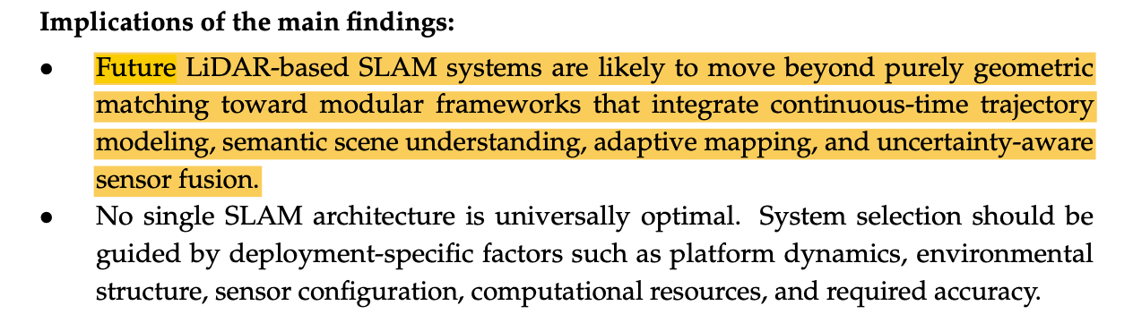
Future Trends
Presener: Xi Yilin
Research directions
Move beyond geometric matching toward modular integrated SLAM frameworks
E. Muhammed and A. Shaker, “LiDAR‑Based SLAM: A Review of Algorithmic Modules and LiDAR‑Inertial Integration Architectures,” Sensors, vol. 26, no. 19, art. no. 6141, 2026, doi:10.3390/s26196141
Notes:
Mention two or three trends with a source for each.

Slide 31
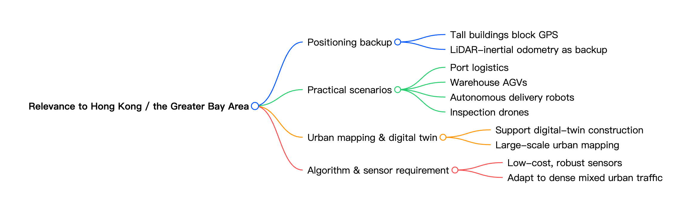
Future Trends
Presener: Xi Yilin
Leverage machine‑learning and deep‑learning techniques to boost SLAM system performance
Develop scalable SLAM algorithms that support large robot fleets for logistics and automation
Research on SLAM algorithms that can effectively scale and handle sizable fleets of robots at once will be vital for optimizing logistics and automation operations.
Source: L. Li, L. Schulze and K. Kalavadia, “Promising SLAM Methods for Automated Guided Vehicles and Autonomous Mobile Robots,” Procedia Computer Science, vol. 232, pp. 2867‑2874, 2024, Section 6 Conclusion.
Notes:
Mention two or three trends with a source for each.

Slide 32
Conclusion
Presener: Xi Yilin
Take-home message 1
Take-home message 2
Take-home message 3
Notes:
Three short sentences the audience should remember. No new material here.

Slide 33
References
[1] A. Author, B. Author, “Title of paper,” Journal Name, vol. x, no. x, pp. xx–xx, Year.
[2] Organisation, “Title of web page,” URL, accessed DD Mon 2026.
[3]Shan, T. [TixiaoShan]. (n.d.). LIO-SAM [Source code]. GitHub. https://github.com/TixiaoShan/LIO-SAM
[4]T. Shan, B. Englot, D. Meyers, W. Wang, C. Ratti, and D. Rus, “LIO-SAM: Tightly-coupled lidar inertial odometry via smoothing and mapping,” in Proc. 2020 IEEE/RSJ Int. Conf. Intell. Robots Syst. (IROS), 2020, pp. 5135–5142, doi: 10.1109/IROS45743.2020.9341176.
[5] L. Li, L. Schulze and K. Kalavadia, “Promising SLAM Methods for Automated Guided Vehicles and Autonomous Mobile Robots,” Procedia Computer Science, vol. 232, pp. 2867‑2874, 2024, doi:10.1016/j.procs.2024.02.103.
[6] E. Muhammed and A. Shaker, “LiDAR‑Based SLAM: A Review of Algorithmic Modules and LiDAR‑Inertial Integration Architectures,” Sensors, vol. 26, no. 19, art. no. 6141, 2026, doi:10.3390/s26196141.
Notes:
Use IEEE style. Every figure or number taken from elsewhere must be cited on its slide as [n].

Slide 34
Thank You — Questions?
Group Gxx · Topic No. XX — Your Topic Title
Member 1 · Member 2 · Member 3 · Member 4
AAE4203 – Guidance and Navigation · Semester 1, 2026/27
Notes:
Q&A lasts 3 minutes and is answered by the whole group. Prepare answers to two or three likely questions.

