Slide 1
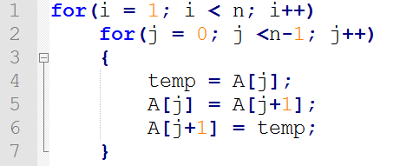

Slide 2
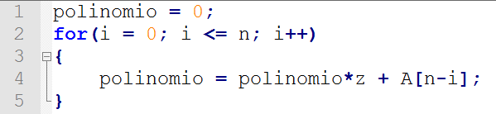

Slide 3
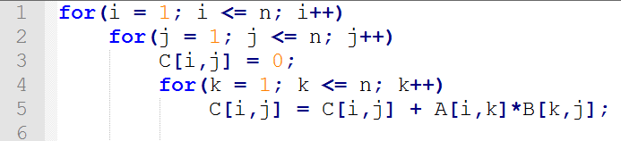

Slide 4
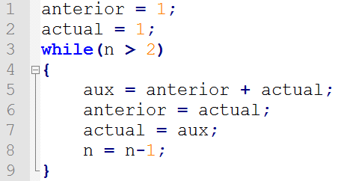

Slide 5
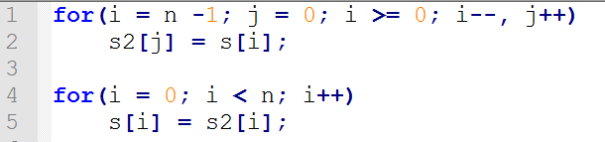

Slide 6


Slide 7
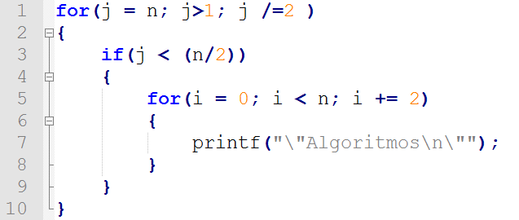

Slide 8
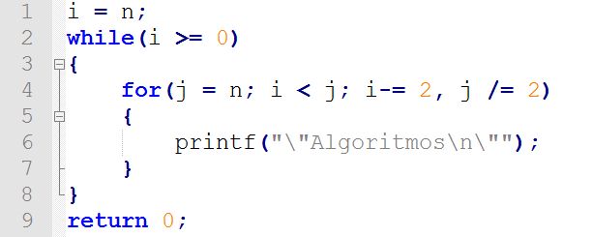

Slide 9
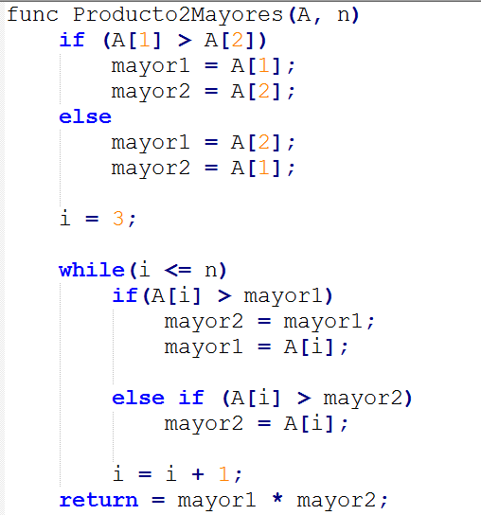
1
3
1
1
1
3 + 3(n-2)
3 + 2(n-2)
1
1
1
1
1

Slide 10
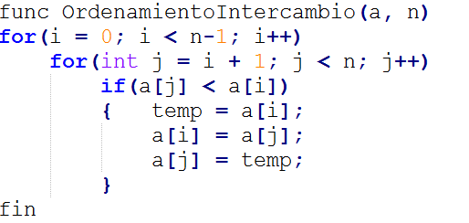
n-1
(n-1)^2
n-1
1
4(n-1)^2
1
1
1

Slide 11
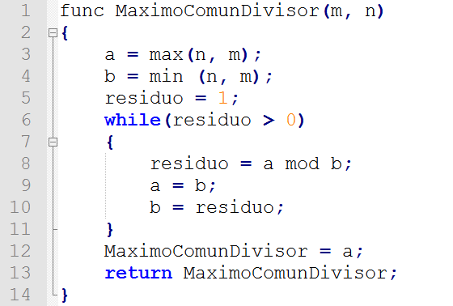

Slide 12
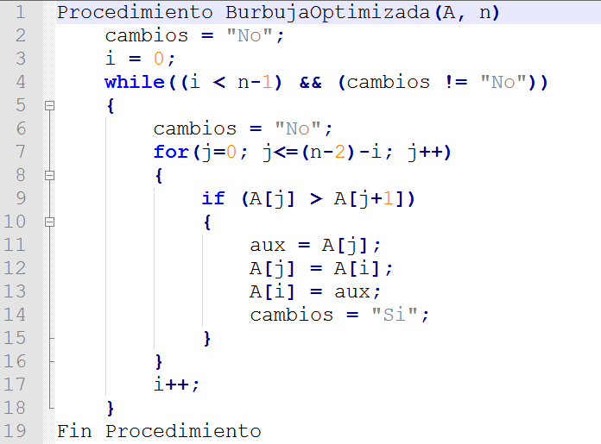
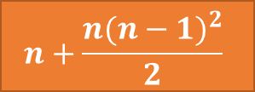

1
$$n+\frac{n{(n−1)}^{2}}{2}$$
1
1
$$n+\frac{5}{2}n(n−1)$$
1
1
1

Slide 13
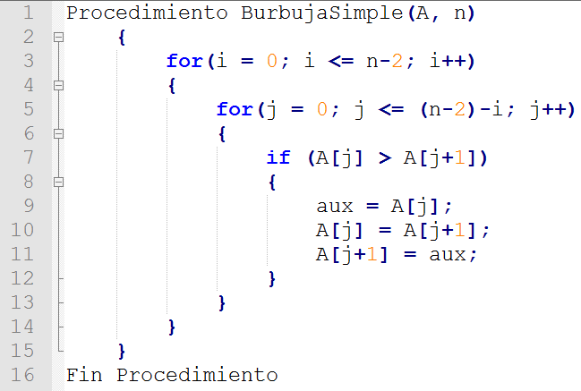

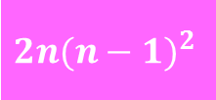
$$\frac{{n(n−1)}^{2}}{2}$$
1
$${2n(n−1)}^{2}$$
1
1
1

Slide 14
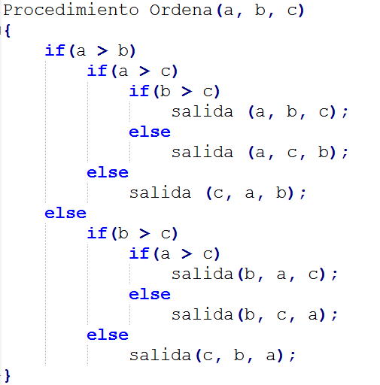
1
1
3
1
1
2
1

Slide 15
