Slide 1
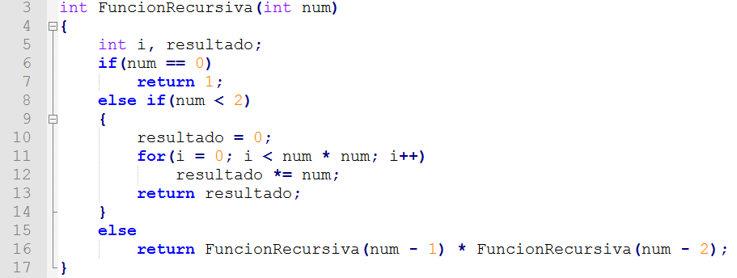
1
1
1
1
1

Slide 2

1
1
1

Slide 3

1

Slide 4
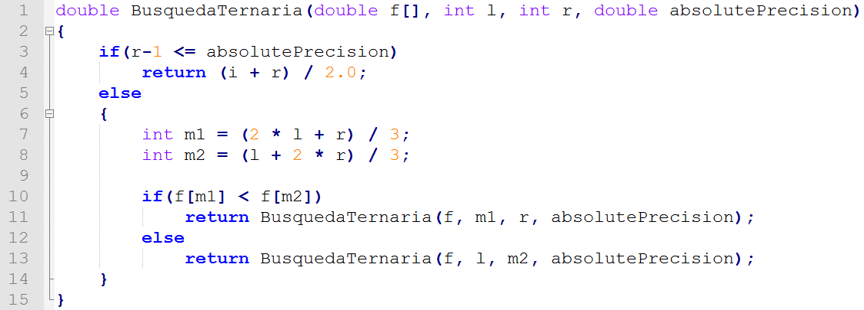

Slide 5
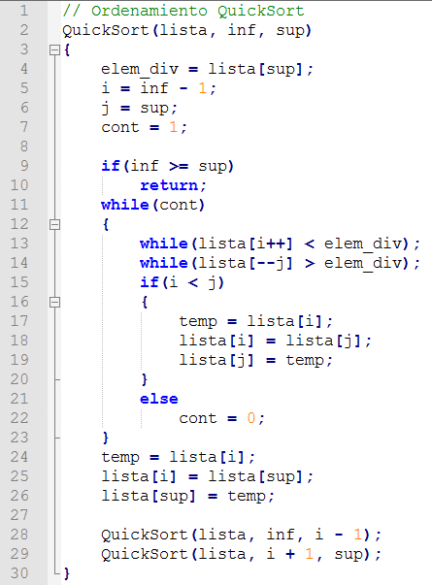
1
1
1
1
1
1
1
1
1
1

