Slide 1
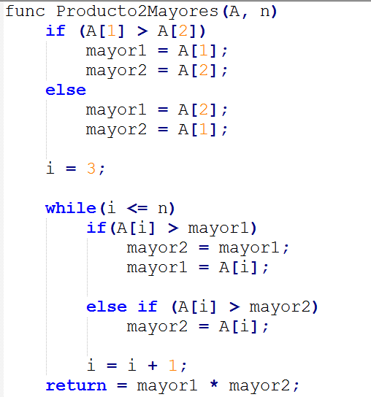
1
3
1
1
1
3 + 3(n-2)
1
1
1
1
1

