Slide 1
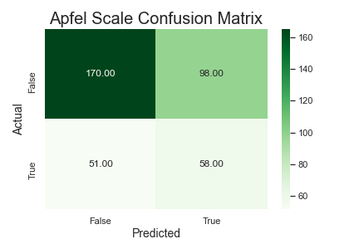
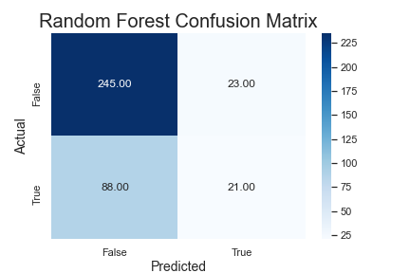
Post Operative Nausea and Vomiting (PONV)
Problem
Better equipping doctors with information to proactively treat nausea after surgeries
Manage patient’s expectations of outcome at surgery and consequently, enhancing patient satisfaction
Progress
30.5% of sample patients experienced PONV
Created baseline model to compare performance to current model used in healthcare
Apfel Metrics
Accuracy | 60.4%
Precision | 37.2%
Recall | 53.2%
RFC Metrics
Accuracy | 70.6%
Precision | 47.8%
Recall | 19.3%
Next Steps
Try other models (Logistic and Naïve Bayes)
Additional feature engineering
Improve recall score
Acquire data for average surgery times

