Slide 1
Predicting Quarterback Touchdown Passes for a season
My First Linear Regression Model
Paul Chung

Slide 2
Contents
Introduction
Results
Other Predictions
Thinking Ahead
Methodology
Notes:
Why
A few items to highlight in approach
Results
Fun

Slide 3
Leaders in the trenches
Why Touchdowns?
Points: How you win
High Value: Highest value of the ways you can score in football
Why Quarterbacks?
Leader: Decision-making on field
Passing: The more efficient way to advance the ball
Critical Factor in Outcome
Notes:
Why the quarterback?

Slide 4
Methodology
Data
Each row snapshot of player’s avg stats
13 Features, scaled to per game basis
Input
Player’s YTD career average
Target
Subsequent Year’s Touchdown
Train on YTD 2018 Averages
Training on generalized data
Notes:
I’m taking a player’s average stats
I’m comparing that player’s average stats to other player’s average stat at that same stage in player’s career
Avoiding leakage

Slide 5
Overperformers / underachievers
Model Statistics
Strongest Indicators
Completions / game
QB Tier
Passing Yards / game
Notes:
Take a look at what a 0.35 R2 gives you in the realm of football. Not as bad as I thought it’d be.
Coming within 1-3 TDs in volatile world of sports exceeded expectations
Did not take into consideration externalities (coach play calling, strength of schedule/opponents);
Eyes go to the worst performance. Andy Dalton benched. Russell Wilson had a career season? Patrick Mahomes coming down to earth (50); actually a good sign my model wasn’t still predicting something close to 50 since that is the only data I have (1 full season of stats)
)

Slide 6
Overperformers / underachievers
Model Statistics
Strongest Indicators
Completions / game
QB Tier
Passing Yards / game
Notes:
Take a look at what a 0.35 R2 gives you in the realm of football. Not as bad as I thought it’d be.
Coming within 1-3 TDs exceeded expectations. in volatile world of sports Did not take into consideration externalities (coach play calling, strength of schedule/opponents);
Eyes go to the worst performance. Andy Dalton benched. Russell Wilson had a career season? Patrick Mahomes coming down to earth (50); actually a good sign my model wasn’t still predicting something close to 50 since that is the only data I have (1 full season of stats)

Slide 7
Overperformers / underachievers
Model Statistics
Strongest Indicators
Completions / game
QB Tier
Passing Yards / game
Notes:
Take a look at what a 0.35 R2 gives you in the realm of football. Not as bad as I thought it’d be.
Coming within 1-3 TDs in volatile world of sports exceeded expectations
Did not take into consideration externalities (coach play calling, strength of schedule/opponents);
Eyes go to the worst performance. Andy Dalton benched. Russell Wilson had a career season? Patrick Mahomes coming down to earth (50); actually a good sign my model wasn’t still predicting something close to 50 since that is the only data I have (1 full season of stats)

Slide 8
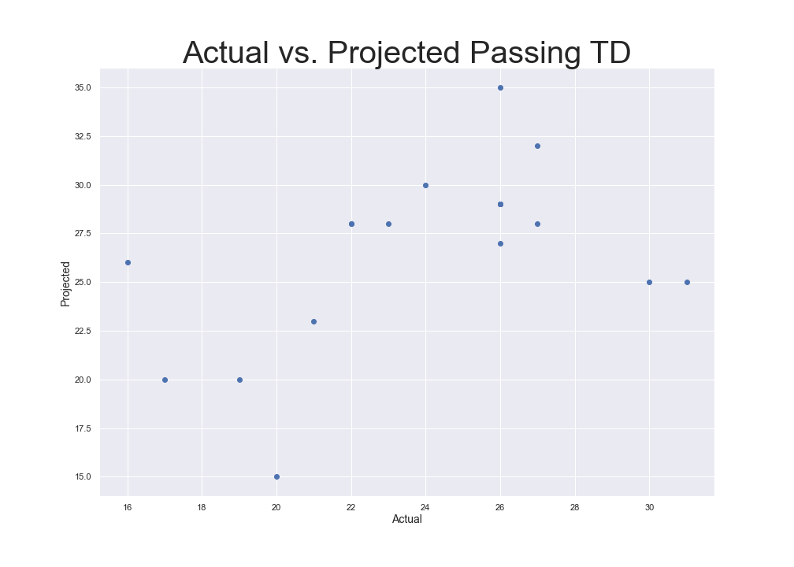
Graphical result
Notes:
Take a look at what a 0.35 R2 gives you in the realm of football. Not as bad as I thought it’d be.
Coming within 1-3 TDs in volatile world of sports exceeded expectations
Did not take into consideration externalities (coach play calling, strength of schedule/opponents);
Eyes go to the worst performance. Andy Dalton benched. Russell Wilson had a career season? Patrick Mahomes coming down to earth (50); actually a good sign my model wasn’t still predicting something close to 50 since that is the only data I have (1 full season of stats)

Slide 9
For your Enjoyment
Notes:
I maybe should have not filtered by games started
Predictions for the 2020 season.

Slide 10
Thinking Ahead
Externalities
Advanced Metrics
Coach's tendencies
Difficulty of opponent and schedule
Time in the pocket
Number of reads
Rookies
Notes:
Basic
Behavioral Psychology – how stats translate into decision making and composure under pressure

