Slide 1
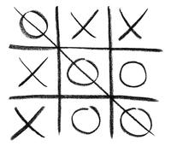
TIC TAC TOE

Slide 2
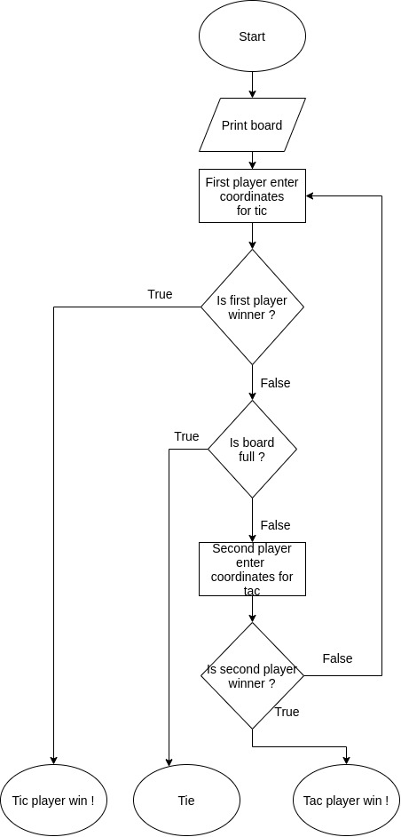
FLOWCHART

Slide 3
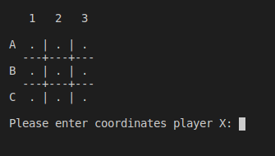
CONSOLE OUTPUT

Slide 4
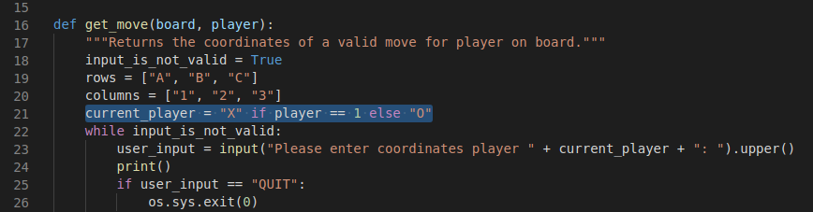
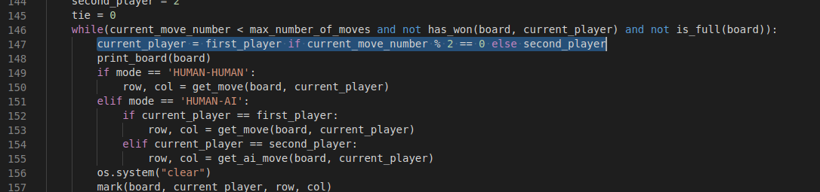
TERNARY OPERATOR

Slide 5
TO DO:
“smart” AI unbeatable AI
UX-friendly graphic output

Slide 6

THANK YOU !

