Slide 1


Am I Breaking My Client’s Code? An Analysis of Breaking Changes in the npm Ecosystem
Benjamin Rombaut
MSc Candidate
Software Analysis & Intelligence Lab
Queen’s University
Notes:
Hi everybody. I'm Ben Rombaut, and my project proposal is titled "Am I Breaking my Client's Code? An Analysis of Breaking Changes in the npm Ecosystem".

Slide 2
Software Dependency Relationships
Client A
Build Status
Passing
Provider
lodash
v4.17.11
Client B
Build Status
Passing
Notes:
Prior research shows that code reuse is related to the improvement of developer's productivity, software quality, and time-to-market of software products. Software ecosystems arose as an important mechanism to promote and support code reuse in the form of package platforms. These platforms are built on the notion of dependencies between packages, where software dependency relationships enables a client package to reuse a certain version of a provider package. Packages in a software ecosystem often release versions containing bug fixes, new functionalities, and security enhancements. Therefor, updating the provider version is an important maintenance task for client packages.

Slide 3
Software Dependency Relationships
Client A
Build Status
Passing
Provider
lodash
v4.17.12
Client B
Build Status
Failing
Notes:
However, these updates sometimes include breaking change. Semantic versioning, which takes the form of major dot minor dot patch updates, allows package providers to specify when an update contains a breaking change by incrementing specifically the major version. However, versioning decisions are still often made by humans, and humans often version irrationally. Humans are also fallible, and sometimes miscategorise a commit, or somebody else’s code may break your code, because you’re using theirs in a way they haven’t foreseen.

Slide 4
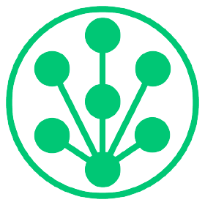
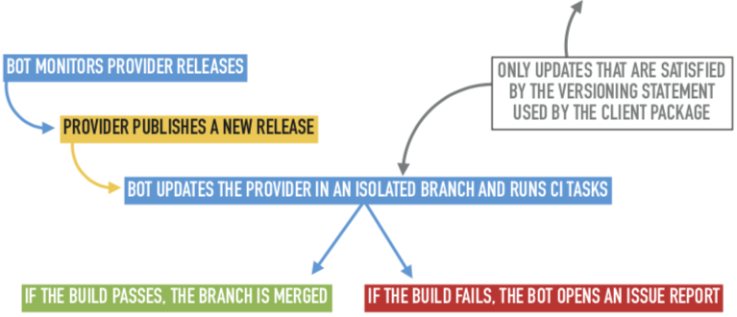
GREENKEEPER
How does Greenkeeper detect build breakages of implicit updates?
Notes:
Greenkeeper is a tool that owners of a repository can integrate with their project. It sits between npm and GitHub, observing all of the modules their repository depends on. Each time one of these dependencies is updated, Greenkeeper opens a new branch with that update. The repository’s CI tests run, and Greenkeeper watches them to see whether they pass or fail. Based on the test results and the client’s dependency version definitions, Greenkeeper will open up an issue report in the client’s repository with information stating which dependency update caused the problem.

Slide 5
Examine Changes by Package Providers that Break a Client’s Build
RQ1: How often patch, minor, and major updates of the dependency break a client’s build?
RQ2: What types of change do client packages need to perform to recover from a build breakage?
RQ3: To what extent do issue reports filed with a provider package originate from a broken build in a client?
Notes:
My project proposes to examine these issue reports created by Greenkeeper to determine characteristics of changes in provider packages that cause build failures in client packages, as well as what action is needed on the client’s part to resolve their build.
Specifically, I look to answer the following research questions
How often patch, minor, and major updates of the dependency break a client’s build?
What types of change do client packages need to perform to recover from a build breakage?
To what extent do issue reports filed with a provider package originate from a broken build in a client?

Slide 6
What Data Do We Have?
Issue Reports (110,512 )
Comments on Issue Reports (365,625)
Events associated with the issue reports (209,750)
Closed / Reopened (88,565 / 197)
Commits with reference to the issue report (1,388)
NPM package dependency information
Notes:
The data set for this project has been built using the GitHub API, and is based on GitHub projects that have integrated with Greenkeeper. It contains all commits related to issues reported by Greenkeeper, all issue reports for all projects, all comments on these issue reports, and all events on issue reports (e.g. tags, updates, etc.). There is additional data that has been been collected, like package dependency information from the npm registry, but at the moment I’m not sure if that will be useful for the analysis.

Slide 7
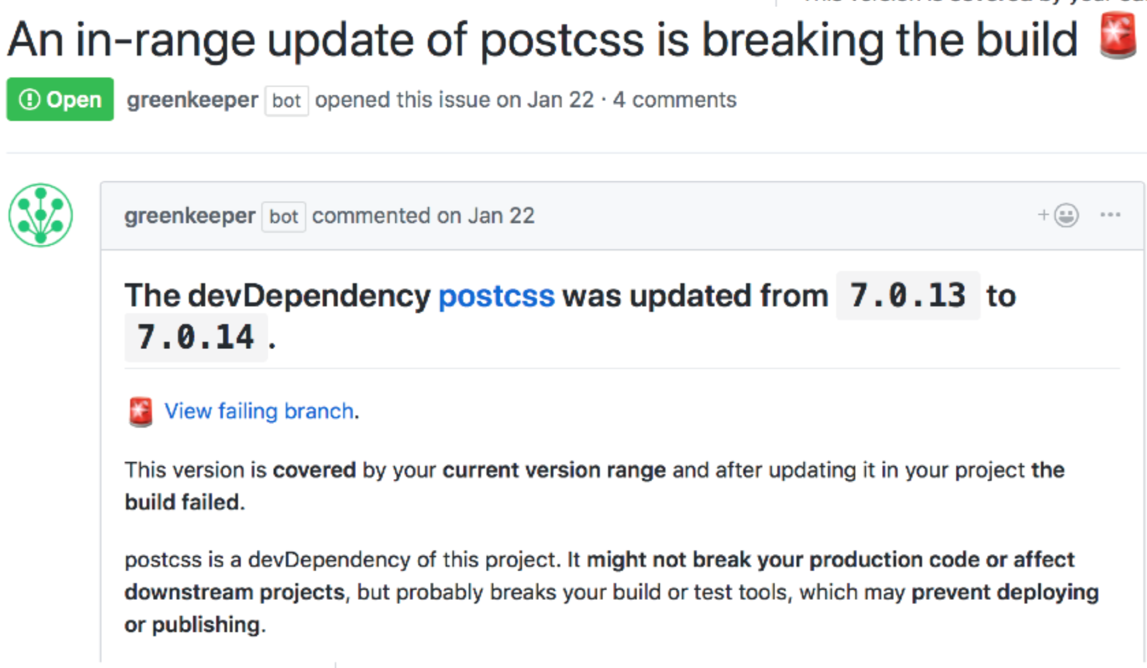
Analyzing Issue Reports & Associated Data
Versions
Dependency
More information in issue body and comments
Notes:
The package name and version of the provider that broke the clients build can be extracted from the majority of issue reports opened by Greenkeeper. This information can be used to answer the first research question of what type of provider updates break a client's build. The format of the issues opened by Greenkeeper isn’t consistent, and some of them don’t contain the prior dependency version, which may pose a challenge for ensuring we can determine the dependency version ranges that break the client’s build.
To answer the second research question, the commits for the client’s package will have to be examined in order to find the commits that fix the client’s build. Once these commits have been identified, further metrics, such as commit size and modified files, can be used to identify types of changes client’s make to recover from a build breakage. We could even do some sentimental analysis on the comments left by developers on the broken build reports to try and determine whether they find these reports helpful in resolving their build.
To answer the third research question, which looks at whether issue reports filed with a provider package originate from a broken build in a client, the comments on build failure issues in the client package will have to be analyzed for links back to the provider package. Some manual analysis is going to have to be done first to ensure these links can be found.

Slide 8
Related Papers
Historical and Impact Analysis of API Breaking Changes: A Large-Scale Study
Xavier et al. 2017
API breaking changes in Java ecosystem
An Empirical Study of Dependency Downgrades in the npm Ecosystem
Cogo et al. 2020
Breaking a client’s build can cause them to downgrade
Can Automated Pull Requests Encourage Software Developers to Upgrade Out-of-Date Dependencies?
Mirhosseini et al. 2017
PR notifications help keep dependencies up to date
Notes:
In terms of related papers, Xavier et al. conducted a large-scale study in 2017 on API breaking changes in the Java ecosystem. They used a tool named APIDIFF to compare two versions of a library and lists all syntactic changes in public elements. My study takes inspiration from their RQs to examine the npm ecosystem, but the methodology and ecosystem are different.
Cogo et al. found in their study on dependency downgrades in the npm ecosystem this year that provider packages that break the client’s build cause them to downgrade the dependency. However, they did not look into the types of changes that caused these issues or what other steps clients take to resolve the build issue, other than downgrading the dependency. My project aims to extend their analysis in this regard.
Mirhosseini et al. conducted a study on why developers neglect to update software dependencies, and how effective Greenkeeper other tools are at helping developers keep their dependencies up to date. They found these tools to be useful, and that one of the primary reasons why developers don’t update their dependencies is due to the fear of breaking changes. I want to build on this study by specifically looking into how breaking changes are resolved by developers.

Slide 9
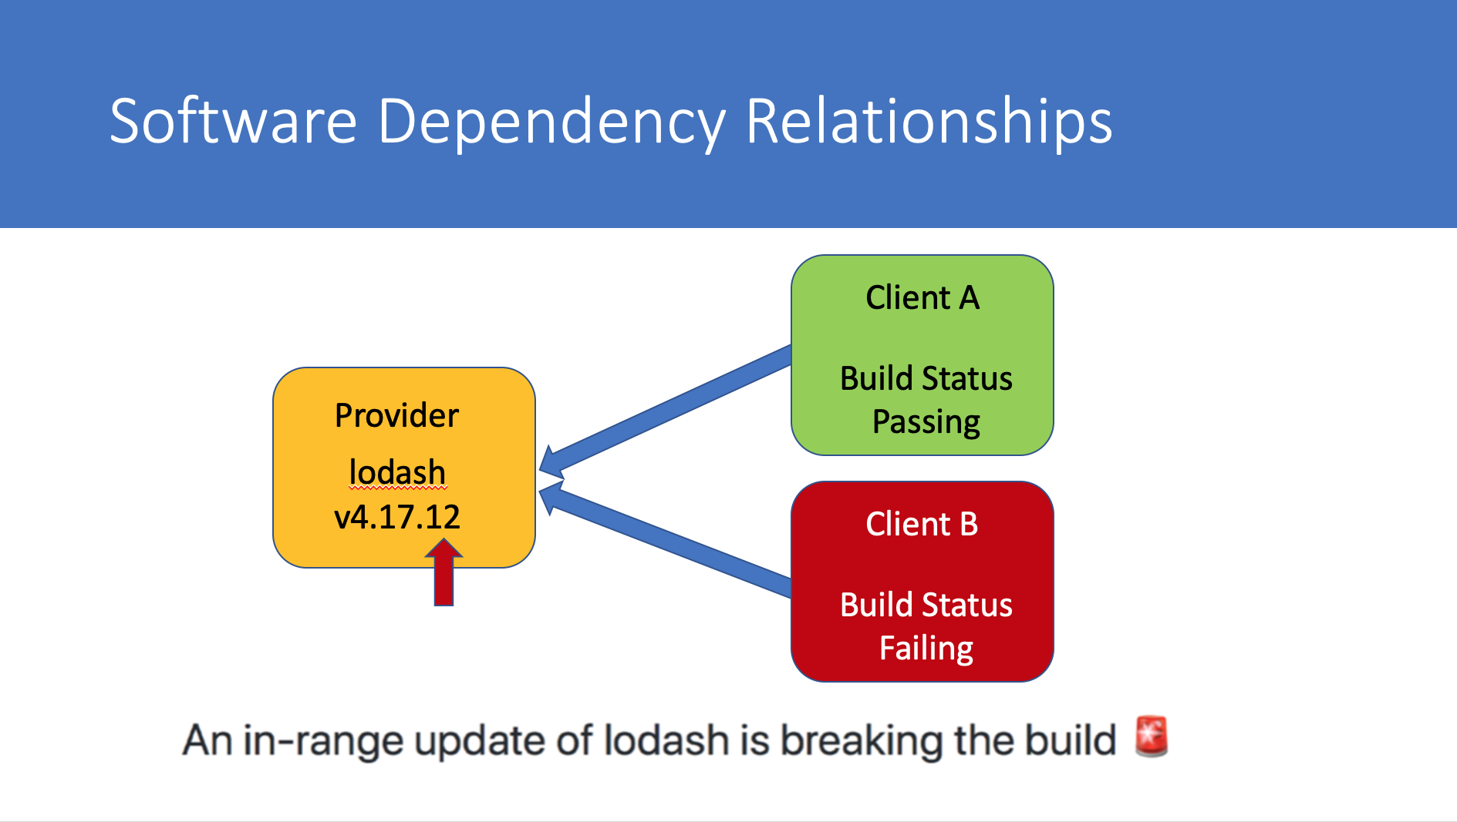
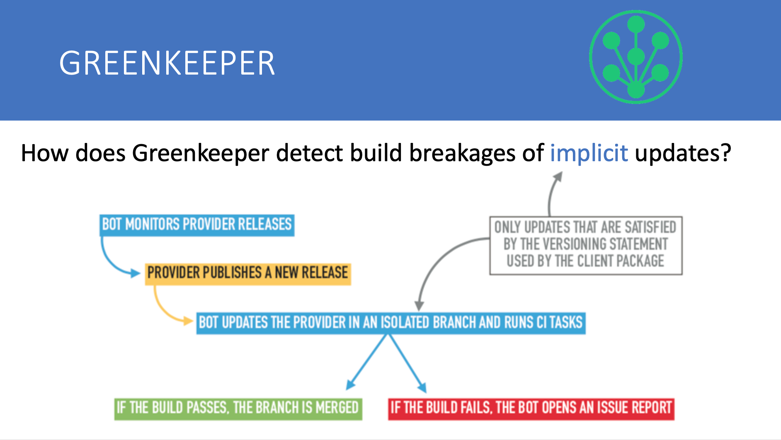
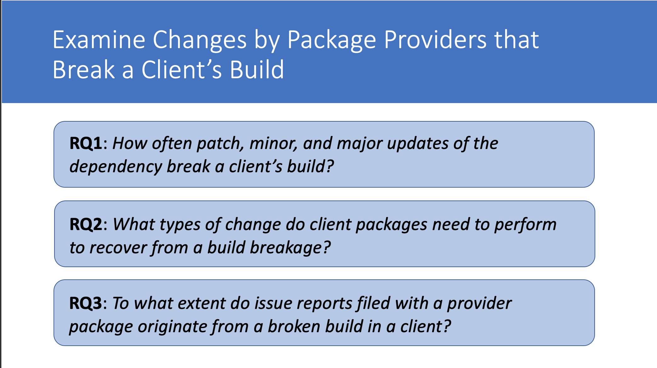
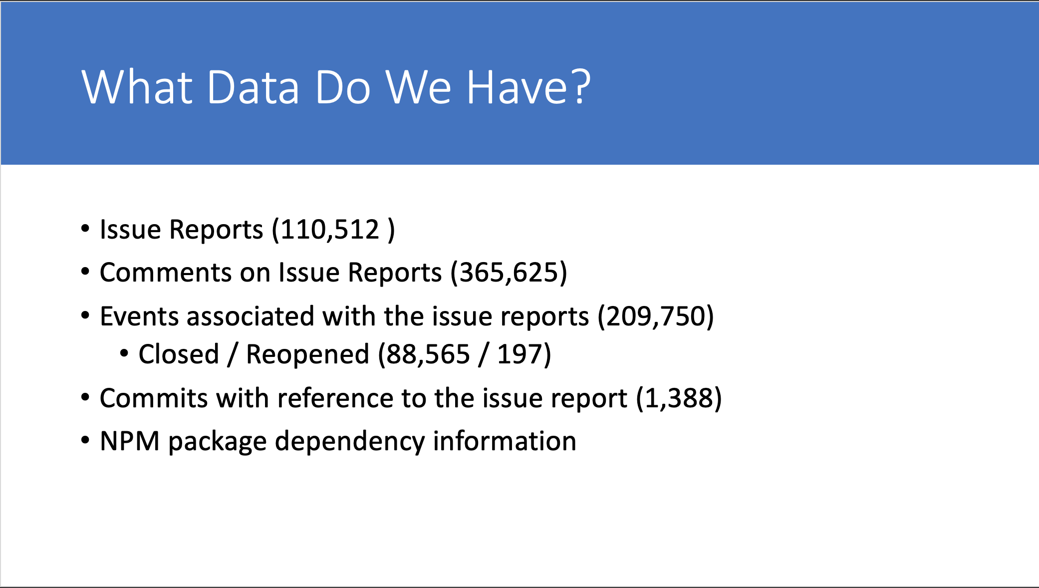
Notes:
In summary, while being able to reuse packages from other providers is incredibly beneficial, it can also lead to them breaking your build.
Greenkeeper is a tool for repository owners to monitor their dependencies, runs the CI pipeline when new updates are available, and opens an issue report if the dependency update caused a problem.
My project proposes to look at changes made by package providers that break a client’s build, as well as how client’s resolve their build breakage. A dataset of issue reports created in client repositories for dependency updates that broke their build will be used for this project.

