Slide 1
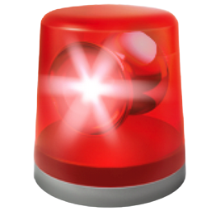


Am I Breaking My Client’s Code? A case study on Greenkeeper Breaking Changes Progress Presentation
Benjamin Rombaut
MSc Candidate
Software Analysis & Intelligence Lab
Queen’s University
Notes:
Hi everybody. I'm Ben Rombaut, and my project is titled “Am I Breaking My Client’s Code? A case study on Greenkeeper Breaking Changes".

Slide 2
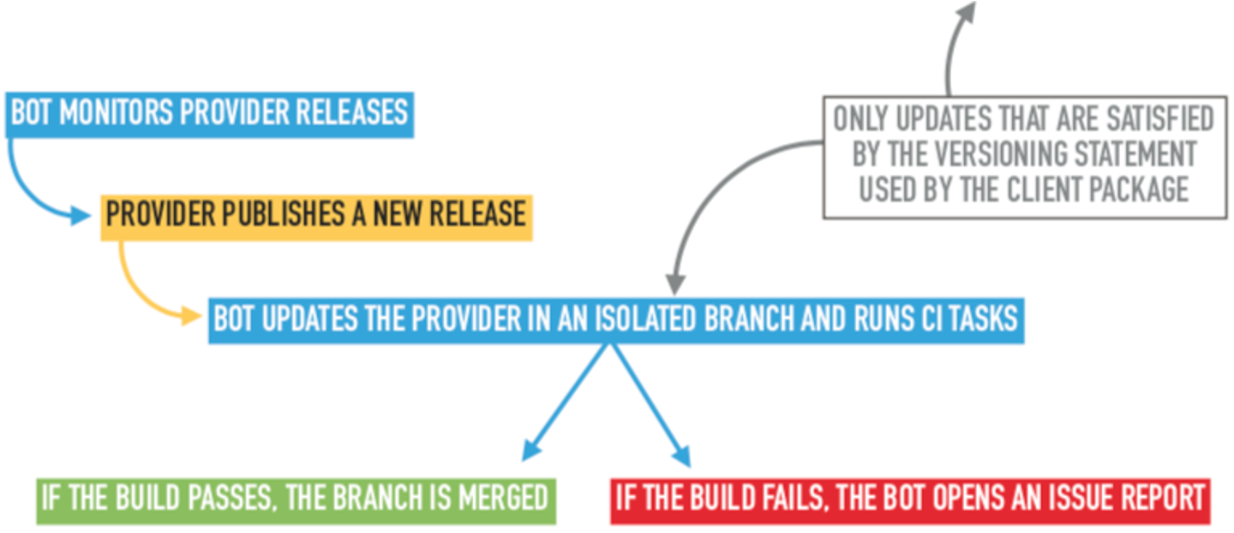
Dependencies & Breaking Changes
How does Greenkeeper detect build breakages of implicit updates?
Notes:
So just a quick recap on the focus of my project. Dependency relationships allow a client package to reuse a certain version of a provider package. These provider packages often release versions containing bug fixes, new functionalities, and security enhancements, so it is important for the clients to keep their dependencies up to date. However, these updates sometimes include breaking changes, and the provider does not always explicitly follow the semantic versioning scheme that allows clients to specify updates they would like to receive.
Greenkeeper is a tool that practitioners can integrate with their project. It sits between npm and GitHub, watching the modules their repo depends on. Each time one of these dependencies is updated, Greenkeeper opens a new branch with that update. The repository’s CI tests run, and Greenkeeper watches them to see whether they pass or fail. Based on the test results and the client’s dependency version definitions, Greenkeeper will open up an issue report in the client’s repository with information stating which dependency update caused the problem.

Slide 3

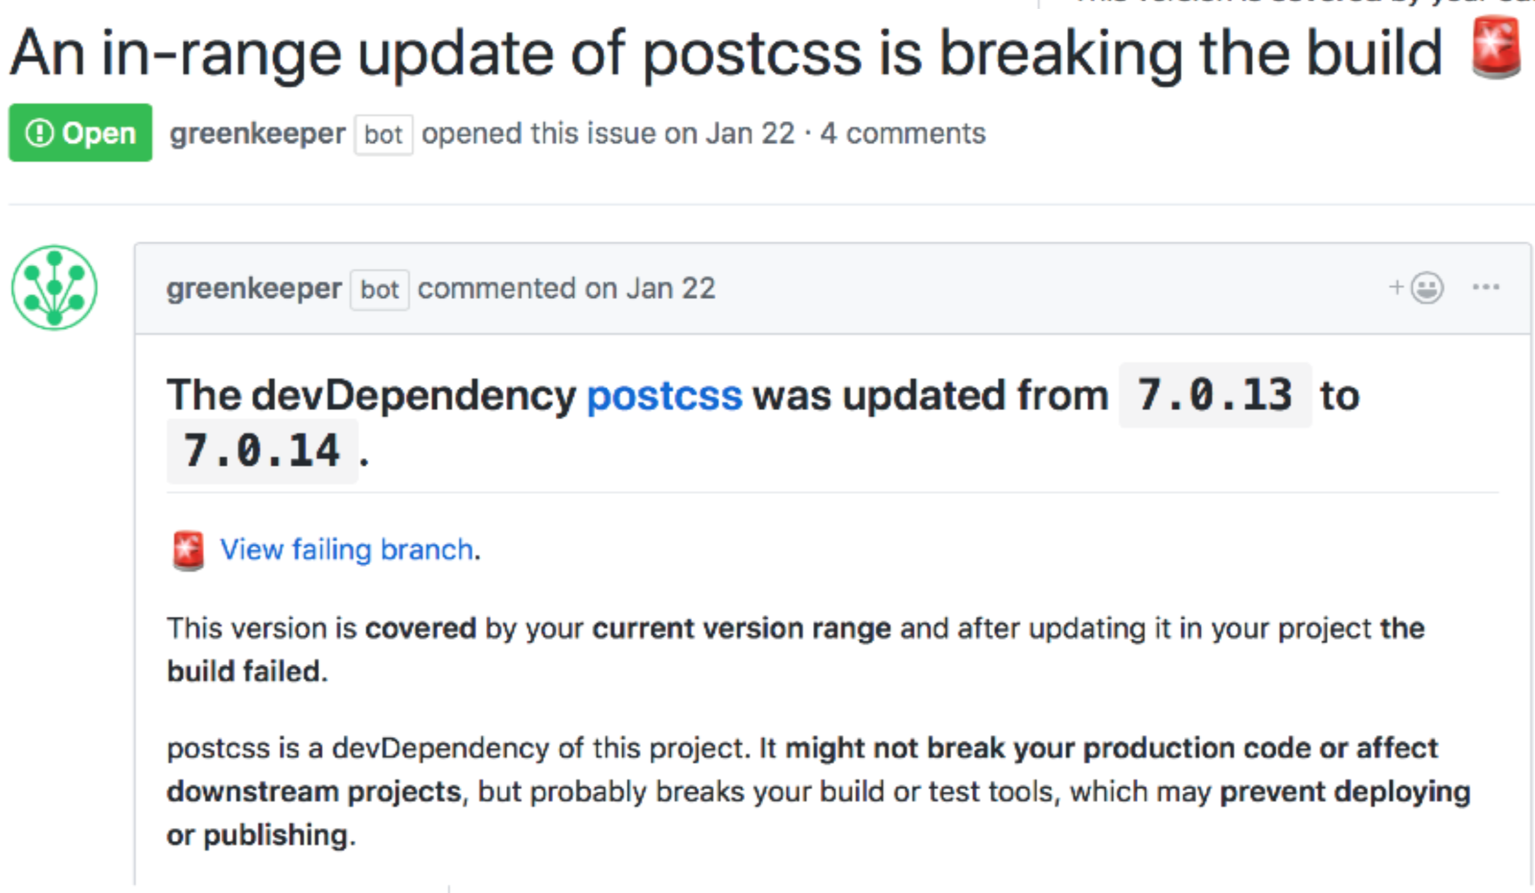
Greenkeeper
Versions
Dependency
More information in issue body and comments
Notes:
One of the key points to understand here is the “in-range update” on these issue reports. Semantic versioning works so that, as a client, you can specify a range of versions you would like to be able to use from a provider. This is done so that you can automatically receive simple bug fixes and patch updates as the provider releases them. This point is important because, if Greenkeeper is opening an issue for an in-range update that is breaking your build, it means that if someone were to download and install your package right now, or just try to update the dependencies on your project, it would fail to build. So there should be a certain level of urgency from developers when they get these sorts of issue reports.

Slide 4
Determine how providers break their clients & how clients resolve these breakages
RQ1: What types of changes break a client’s build?
RQ2 How do client packages recover from a build breakage?
RQ3: To what extent do issue reports filed with a provider package originate from a broken build in a client?
Notes:
Our project proposes to examine these issues to determine characteristics of changes in provider packages that cause build failures in client packages, as well as what action is needed on the client’s part to resolve their build. We look at the following research questions:
What types of changes break a client’s build?
How do client packages recover from a build breakage?
To what extent do issue reports filed with a provider package originate from a broken build in a client?

Slide 5


Data Set
Package Dependencies Lists (12,005)
Breaking Build Issue Reports (123,197)
Created between October 2016 – June 2020
Comments on the Issue Reports (365,625)
Events for the Issue reports (209,750)
E.g. “Referenced”, “Mentioned”, “Closed”, etc.
Commits that reference the Issue Reports (17,623)
Notes:
The data set for this project was built using Google BigQuery and the GitHub API, and is based on projects that have integrated with Greenkeeper. We collected information on each repository, including each projects dev and production dependencies. We then collected over 123 thousand breaking build issue reports that were created by Greenkeeper. For each of these issues, we then retrieved all of it’s comments and events, for a total of 365 thousand comments and nearly 210 thousand events. If there were any commits that referenced the issue report, we retrieved the information for it as well, for a total of about 17 thousand commits.

Slide 6
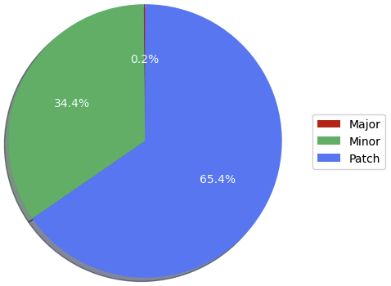
RQ1: Most Breaking Changes are Patch Updates – With Some Caveats
65% of Greenkeeper issues have had their update type extracted.
Providers usually make far more Patch and Minor updates than Major updates – will need to examine the proportion of change types on breaking builds.
Does frequency of releases influence breaking frequency?
Notes:
One of the first steps in our study was to look at the types of changes that were breaking client’s builds. A strawman technique was to compare the current dependency version and the updated version on each breaking build issue report to determine if the update was a major, minor, or patch update. Of the update types we’ve parsed, 65% of them were patches, 34% were minor updates, and only 0.2% were major updates. At first glance, it might seem like package developers aren’t following the semantic versioning scheme at all, but you have to remember that patches are released far more frequently than minor updates, which in turn are released far more frequently than major updates. A more accurate representation of breaking change types would be the proportion of release types that end up breaking the build. To do this, we need to collect all release versions of these provider packages, which is still a work in progress.
Another thing to consider is that it’s common practice for client developers to restrict their range of updates to only patch and minor updates. Therefor, if a provider package releases a major version, it would not be considered an ”in-range” update, which would contribute to driving the number of major breaking updates down.

Slide 7
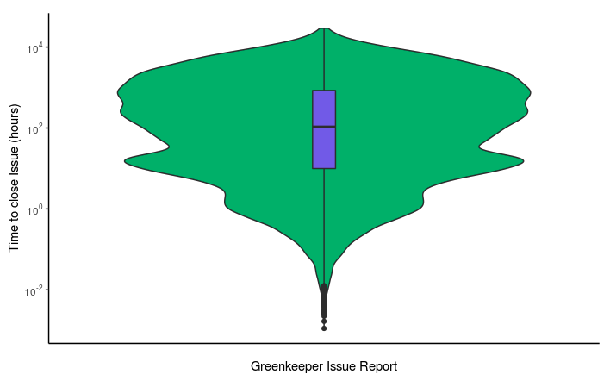
RQ2: Four Days is the Median Time for Breaking Issues to be Resolved
80% of build failure issues are eventually closed.
The median time to close the issue is 107 Hours (4 days & 11 hours)
Five Number Summary for Time-to-Close (X Days HH:MM)
Min | 25% | 50% | 75% | Max
0 Days 00:04 | 0 Days 09:58 | 4 Days 11:04 | 35 Days 07:48 | 1219 Days 02:01
Notes:
RQ2 looks at how clients recover from these build breakages. Remember I said that these “in-range breaking build” issues should be acted on with some sense of urgency from the developers, since people who install or reinstall their package from that point forward would experience the same build failure. So the first metric to look at was whether these issues were actually being resolved. We found that 80% of these issue reports are eventually closed, with a median time-to-close value of 4 days and 11 hours. Is this timeframe too long to let your build stay broken? I think it depends on a couple factors, but we’re going to see in a second here that just because the issue report says the build is broken, doesn’t mean it actually is.
DONT READ
Also, for each of the issues reports that had not been resolved, we looked at when they had last received an update, and found that for all of them the time between their creation date and the last time the issue was updated was greater than the median time-to-close value.

Slide 8
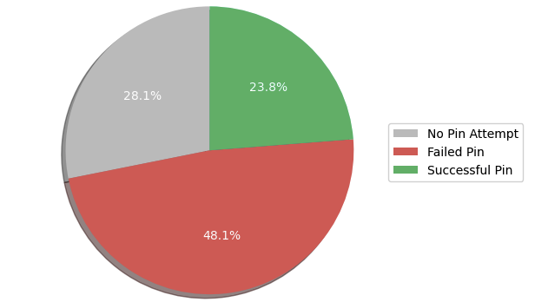
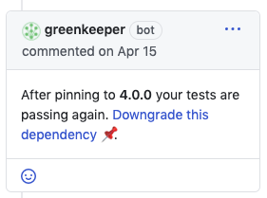
RQ2: Quick Fix – Pinning the Dependency Not As Successful As You Would Think
Notes:
One of the first things the Greenkeeper bot will do when it opens a breaking build issue report is try to pin the dependency to the previous version. Pinning a dependency is a legitimate option when developers don’t have the time or resources to fix a problem introduced by a dependency update. Greenkeeper will bundle upgrades for the packages that have to be upgraded together, and it won’t attempt to pin all of the packages in this bundle, which is why 28% of issues don’t have a pin attempt. But for the rest of issues where a pin attempt was made, only about a third of them resulted in a successful build. This actually shows that a good amount of breaking issue reports were not actually caused by the update to the dependency, and raises questions about the amount of noise a bot like this would introduce to a project.
Now, just because the bot reports that pinning the dependency resulted in resolving the build failure doesn’t necessarily mean the developer took this action. We are still in the process of figuring out how often developers actually used this method to fix their build.

Slide 9
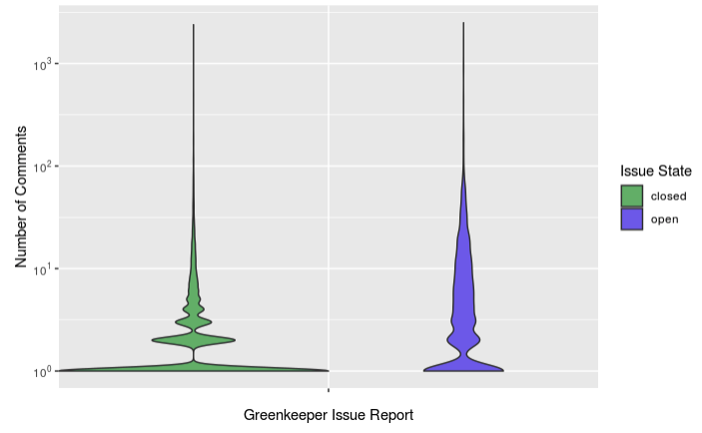
RQ2: Most Activity on Breaking Issues Comes From the Bot Itself
86% and 48% of issues have at least 1 and 2 comments, respectively.
97% of comments are from the Greenkeeper bot.
8% of breaking issue reports have at lease one comment from a user.
Five Number Summary - Number of Comments On Issues
Min | 25% | 50% | 75% | Max
0 | 1 | 1 | 3 | 2500
Notes:
We then wanted to look at the interactions that happen on these breaking build issues. We found that 86% of issues have at least 1 comment, which is not surprising since remember that most of the time Greenkeeper will add the first comment stating whether the pin strategy was successful or not. Only 48% of issues have at least 2 comments. The vast majority of these comments are being made by the Greenkeeper bot itself. Greenkeeper will keep commenting on the same issue report if the provider package mentioned in the issue continues to release new version updates. You can see that issues that remain open tend to have a higher number of comments. Only about 3% of all comments are from actual users, with only 8% of breaking issue reports having at least one comment from a user on them.

Slide 10
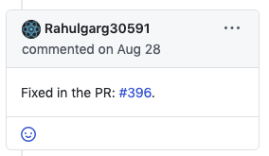
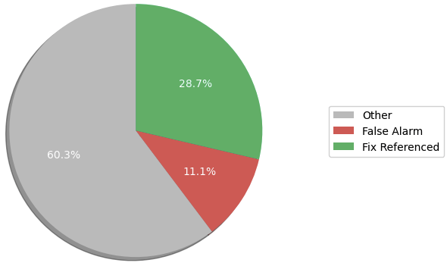
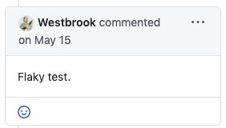

RQ2: User Comments
DeFlaker, anyone?
Notes:
Focusing in on the user comments, we wanted to see what developers were saying on these issues. Two obvious initial categories to look at are users commenting that they had fixed the issue, or commenting that the issue was a false alarm. We matched different string patterns for both scenarios, and found that 29% of the comments included a reference to a fix. Over 11% of the comments indicated that the issue was some sort of a false alarm and could be ignored. Classifying the rest of these comments is still ongoing work.

Slide 11
Left To Do
RQ1: What types of changes break a client’s build?
Frequency of provider releases.
Manual analysis on sample of provider release notes to characterize types of breaking changes.
RQ2: How do client packages recover from a build breakage?
Analyze referenced commits to see what types of changes clients are performing to recover from a breakage.
Classify remainder of user comments.
RQ3: To what extent do issue reports filed with a provider package originate from a broken build in a client?
Not started
Notes:
So there is obviously still work on the table. In terms of RQ1, answering whether the release frequency of providers has any correlation with frequency the provider breaks their clients will be an interesting result. We are also looking to manually classify the changes that are being made, such as removing or renaming an API method.
For RQ2, we still need to look more into the user comments to see how they are grouped. Since we have the reference commits data available, we are also going to examine them to see what types of changes the clients are doing to recover from the build breakage.
Finally for RQ3, haven't started, having some doubts about whether we'll find anything interesting there, but that remains to be seen.

