Slide 1
Product Failure Prediction
Bromley Thornton
1 March 2026

Slide 2
ABOUT US
The main objectives of the analysis were to create predictive models that help tell if products will fail.
Focuses were cleaning the dataset, taking care of missing values, building predictive models, and selecting best approach.
The end goal is to increase quality and reduce losses in production.

Slide 3
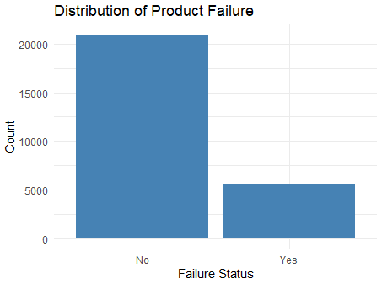
Data Prep
Before modeling began, character variable were changed to categories, missing values were imputed, the dataset was split between 70% training and 30% testing and 3 way cross-validation was applied

Slide 4
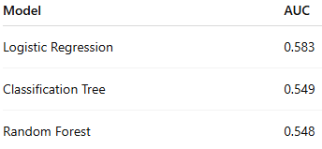
Model Comparison
Logistic Regression did the best out of the three models when compared. The AUC score of .583 was the highest and outperforms the others by a statistically significant amount. While Classification Tree and Random Forest did well, they were more limited.

Slide 5
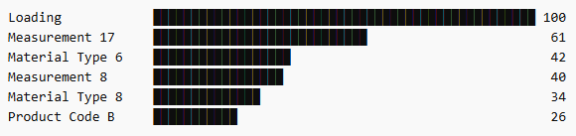
Key Predictors of Failure
-Loading is the most dominant Predictor.
- There are many other variables that have importance as well. The top ones are listed above.
-These variables show have the biggest influence on failure prediction.

Slide 6
Business Implications
The strongest predictor is loading. There are other measurements which increase defect probability. Material type and product configuration play a large role in reliability while being able to identify high-risk products can aid quality control.
By using modeling in production monitorization, manufacturing is smoother with the added ability to be able to identify potential problems before they occur.

Slide 7
Final Recommendation
Logistic Regression was the strongest AUC performer (.583).
This model gives sight into the most important driver of failure.
Loading, among other variables, should be most closely followed during the production process.
Use Logistic Regression as the main screening model for predicting failure. Model insights should be used to better guide targeted inspections and improve the production process.

