Slide 1
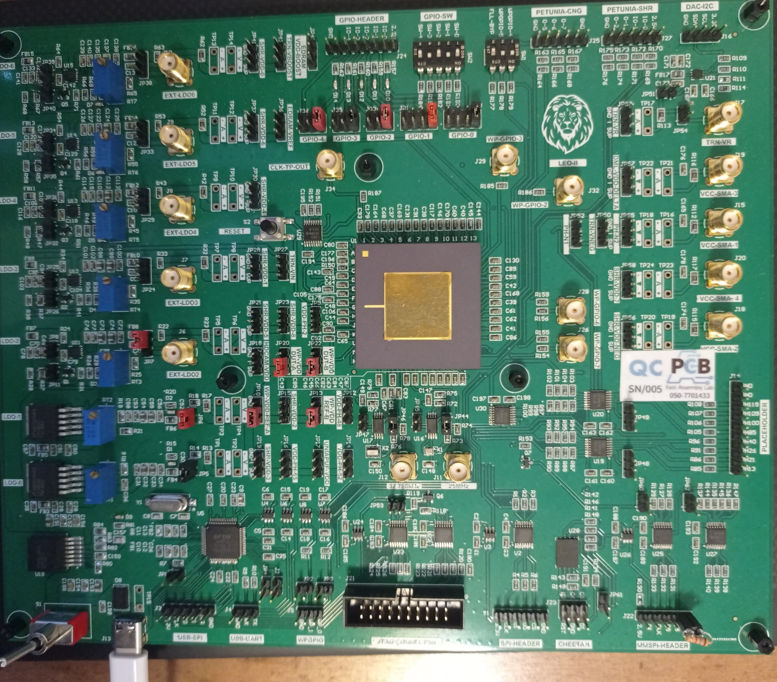
Switches configuration
(not sure which is critical, but this works)
Not sure if Mandatory
But harmless Jumpers
(most right of each group)
resistor R111
needs to be professionally removed
WavePro Related Jumpers
Needed only for WP modes testing.
Mandatory Jumpers
JP5 , JP6
Mandatory Jumpers
JP44 , JP46
Patch weak resistor between
GND and CS of MMSPI header
To be professionally added.

