Slide 1
Week 5
Relational Databases
The Relational Model, Relational Algebra, and SQL

Slide 2
Today’s Topics
Part I:
  Introduction to the relational model of database design
  Introduction to relational algebra, which forms the basis of the Structured Query Language (SQL)
  Mapping relational algebra to SQL
Part II:
  Hands-on exercise with SQL

Slide 3
Database Options
Repeated from Week 4
SQL databases (or relational databases)
  Well defined schema
    the database is modeled as a set of joinable tables with pre-defined columns
  Entities are stored in tables (called relations), managed by an RDBMS
  Tables can be joined and using a powerful and flexible querying language: SQL
  Data follows a rigid structure and is mostly non-redundant
  Changing/updating the structure of data involves change in schema and database alterations.
  There is a DBA – a database administrator -- between the application developer and the database, responsible for defining and altering the schema if needed.
    Using SQL’s DDL
Naturally ideal for vertical scaling, i.e., increasing the database’s capacity by adding more resources (CPU, memory, storage) to a single machine.
Notes:
You have the choice of using a SQL or NoSQL database

Slide 4
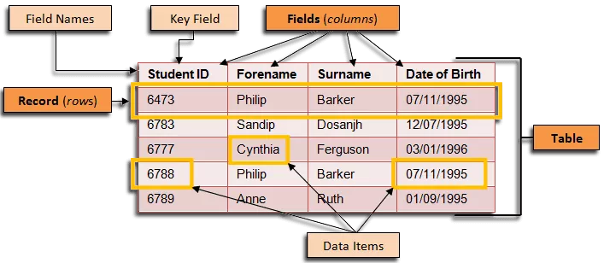
The Relational Model
A relation (table) contains records (rows) made of fields (columns).
At least one of the fields is a primary key (key field), used to uniquely identify a record.
Important rule: each data item has a type (the type of that field) and must be atomic, i.e.,
it cannot be a list or any other kind of collection.

Slide 5
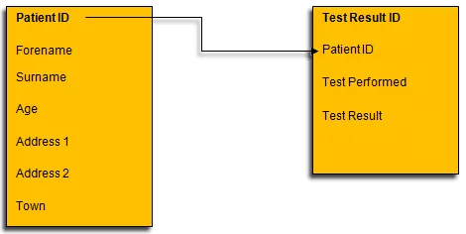
The Relational Model
Foreign Key: a field (or set of fields) in one relation that references the primary key of another relation, establishing a relationship and enforcing referential integrity between the two relations.
Foreign Key
Referential integrity is enforced, as only
those patient IDs that exist in the Patient
table could appear as foreign keys in the
Test Result table
Referential Integrity is enforced by an
RDBMS when, for example:
- A patient is removed from the Patient table.
- A test result is added to the Test Result table.
Test Result Table
Patient Table

Slide 6
Relational Schema
The name of a relation and its fields together is called the schema of that relation.
e.g. the schema for a Movies relation may be written as:
Movies (title, year, length, genre)
    The Movies table contains rows each of which have 4 columns, namely: title, year, length and genre (usually displayed in that order).
    title and year together are the primary key (composite), i.e. the (title, year) combination uniquely identifies a row of the Movies table
The collective schema of all relations of a database make up the database schema.
In practice, to create a relational database, a database administrator must specify the database scheme using SQL’s DDL (data definition language).

Slide 7
Example: A simple HR database
Employee (fname, mint, lname, empid, bdate, address, gender, salary, superid, dno)
Department (dname, dno, mgrid, mgstartdate)
Project (pname, pno, plocation, dno)
WorksOn (empid, pno, hours)
Dependent(empid, depname, gender, bdate, relationship)
Overall description:
Employees work for departments.
Departments run projects.
Employees work on projects.
Employees have dependents.
Foreign keys:
Employee.dno
Employee.superid
Department.mgrid
Project.dno
WorksOn.empid
WorksOn.pno
Dependent.empid
Notes:
Comprehensive list of attribute meanings:
Employee
fname: first name
mint: middle initial
lname: last name
empid: employee identifier
bdate: birth date
address: home address
gender: gender
salary: annual salary
superid: supervisor’s employee id
dno: department number
Department
dname: department name
dno: department number
mgrid: manager’s employee id
mgstartdate: manager start date
Project
pname: project name
pno: project number
plocation: project location
dno: controlling department number
WorksOn
empid: employee id
pno: project number
hours: hours worked
Dependent
empid: employee id (owner)
depname: dependent name
gender: dependent gender
bdate: dependent birth date
relationship: relationship to employee

Slide 8
Relational Operators
Relational operators operate on existing relations to produce new relations corresponding to user queries
Relational operators maybe divided into two main categories:
Set Operators | Database Operators
Union Intersection Difference Cartesian Product | Select Project Join Aggregate Division Rename

Slide 9
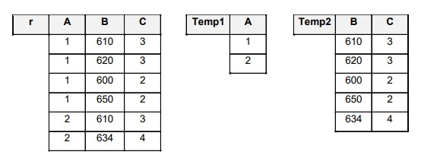
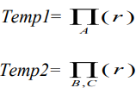
Projection
Extracts certain columns from the table:
Set Semantics
Corresponding SQL:
SELECT A FROM r;
SELECT B, C FROM s;
Bag Semantics (requires DISTINCT for set semantics)

Slide 10
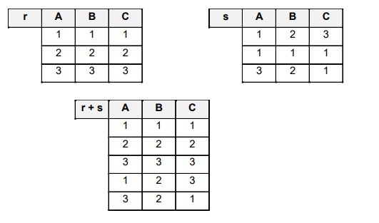
Union
Written as (r+s) or (r U s)
Relations must be union compatible
Duplicate rows are eliminated
Corresponding SQL:
SELECT * FROM r
UNION
SELECT * FROM s;

Slide 11
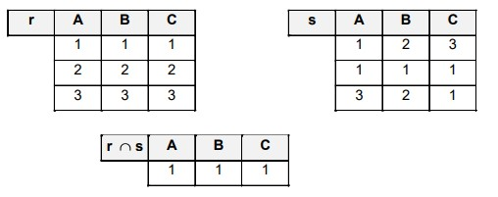
Intersection
Written as (r ∩ s)
Relations must be intersection compatible
Corresponding SQL:
SELECT * FROM r
INTERSECT
SELECT * FROM s;

Slide 12
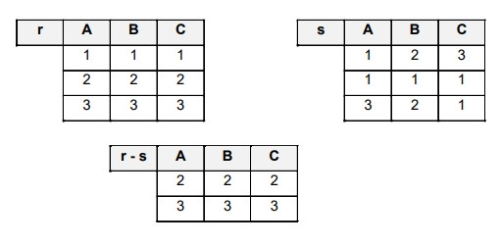
Difference
Written as (r-s)
Relations have to be difference compatible
Includes rows that are in r but not in s
Corresponding SQL:
SELECT * FROM r
EXCEPT
SELECT * FROM s;

Slide 13
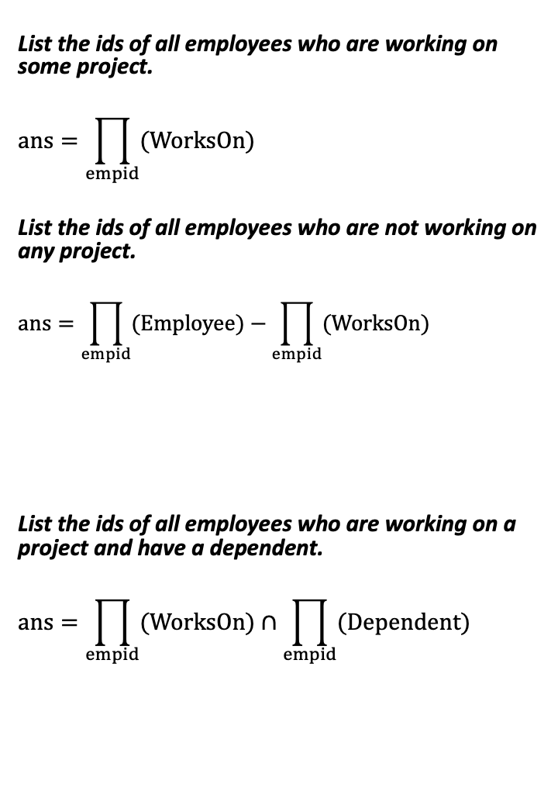
Queries Using Union, Intersection, Difference and Projection
List the ids of all employees who are working on some project.
$$ans=\prod_{empid}{(WorksOn)}$$
List the ids of all employees who are not working on any project.
$$ans=\prod_{empid}{(Employee)}−\prod_{empid}{(WorksOn)}$$
List the ids of all employees who are working on a project and have a dependent.
$$ans=\prod_{empid}{(WorksOn)}∩\prod_{empid}{(Dependent)}$$
Schema
Employee (fname, mint, lname, empid, bdate, address, gender, salary, superid, dno)
Department (dname, dno, mgrid, mgstartdate)
Project (pname, pno, plocation, dno)
WorksOn (empid, pno, hours)
Dependent(empid, depname, gender, bdate, relationship)
SELECT empid
FROM WorksOn;
SELECT empid FROM Employee
EXCEPT
SELECT empid FROM WorksOn;
SELECT empid FROM WorksOn
INTERSECT
SELECT empid FROM Dependent;

Slide 14
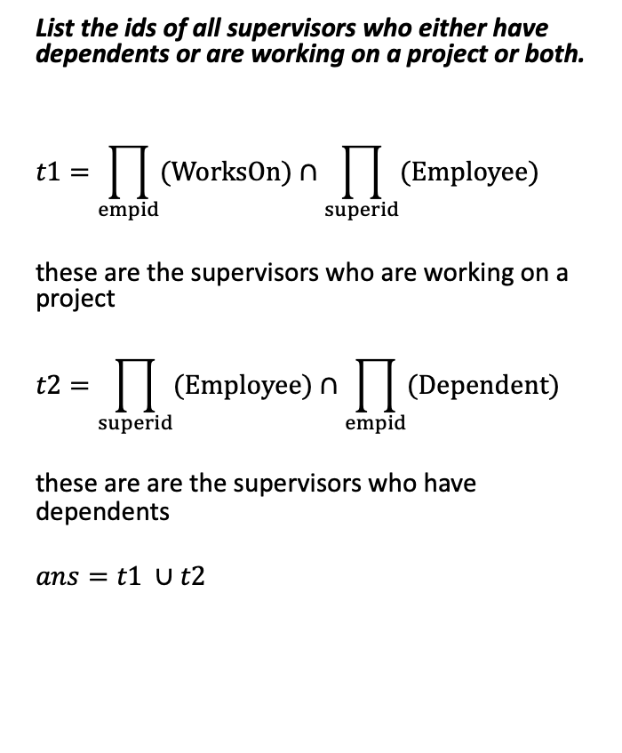
Queries Using Union, Intersection, Difference and Projection
List the ids of all supervisors who either have dependents or are working on a project or both.
$$t1=\prod_{empid}{(WorksOn)}∩\prod_{superid}{(Employee)}$$
these are the supervisors who are working on a project
$$t2=\prod_{superid}{(Employee)}∩\prod_{empid}{(Dependent)}$$
these are are the supervisors who have dependents
$$ans=t1 ∪t2$$
Schema
Employee (fname, mint, lname, empid, bdate, address, gender, salary, superid, dno)
Department (dname, dno, mgrid, mgstartdate)
Project (pname, pno, plocation, dno)
WorksOn (empid, pno, hours)
Dependent(empid, depname, gender, bdate, relationship)
SELECT empid FROM WorksOn
INTERSECT
SELECT superid FROM Employee
UNION
SELECT superid FROM Employee
INTERSECT
SELECT empid FROM Dependent;
Corresponding SQL
Notes:
In contrast to set semantics are the ‘bag semantics’ used by SQL, where non-unique tuples are allowed, and we have to write an explicit ‘DISTINCT’ statement to remove duplicates.

Slide 15
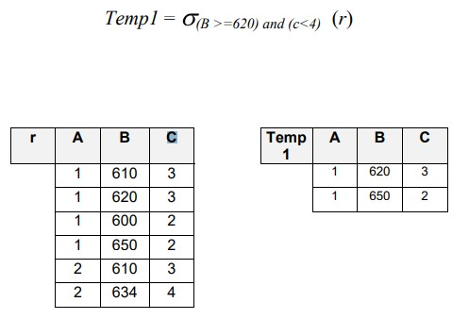
Conditional Selection
The selection operator extracts certain rows from the table and discards the others. Retrieved tuples must satisfy a given filtering condition.
SELECT *
FROM r
WHERE B >= 620 AND C < 4;
Corresponding SQL

Slide 16
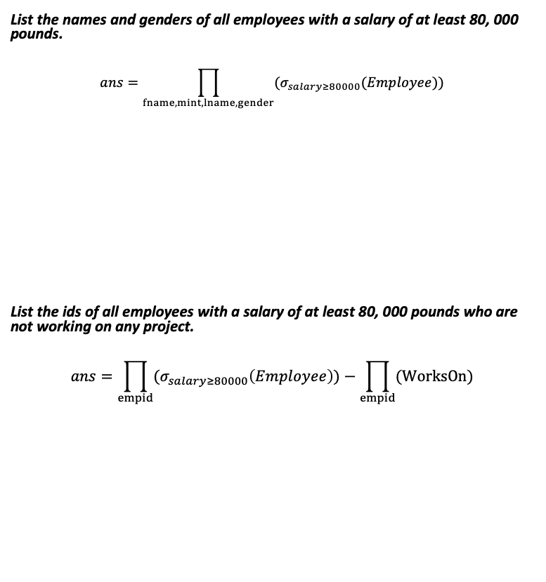
Queries Using Union, Intersection, Difference, Projection and Conditional Selection
List the names and genders of all employees with a salary of at least 80, 000 pounds.
$$ans=\prod_{fname, mint, lname, gender}{(σ_{salary≥80000}(Employee))}$$
List the ids of all employees with a salary of at least 80, 000 pounds who are not working on any project.
$$ans=\prod_{empid}{(σ_{salary≥80000}\left(Employee\right))}−\prod_{empid}{(WorksOn)}$$
Schema
Employee (fname, mint, lname, empid, bdate, address, gender, salary, superid, dno)
Department (dname, dno, mgrid, mgstartdate)
Project (pname, pno, plocation, dno)
WorksOn (empid, pno, hours)
Dependent(empid, depname, gender, bdate, relationship)
SELECT fname, mint, lname, gender
FROM Employee
WHERE salary >= 80000;
SELECT empid
FROM EMPLOYEE
WHERE salaray >= 80000
EXCEPT
SELECT empid
FROM WorksOn
Notes:
Can you answer the following query with the operators we have seen so far?
List the names and genders of all employees with a salary of at least 80, 000 pounds who are not working on any project.

Slide 17
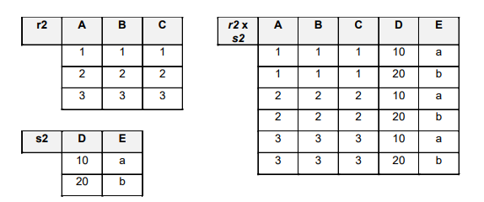
Cross Product (or Cross Join)
Written as (r X s)
Concatenates rows from two relations, making all possible combinations of rows.
SELECT *
FROM r2, s2;
Corresponding SQL

Slide 18
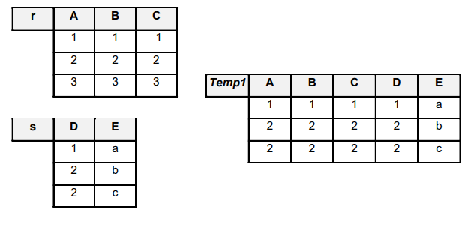
Join (or inner join)
The join operation, denoted by (r ⋈COND s ), is used to combine related tuples from two relations.
Here COND is the matching condition r ⋈COND s
The following example demonstrates the operation r ⋈C=D s
SELECT *
FROM r JOIN s
ON r.C = s.D;
Corresponding SQL
Notes:
We can think of the join operation as a cross product with a filter.

Slide 19
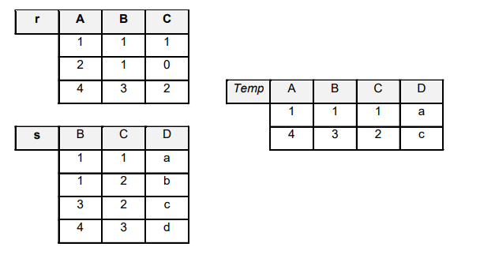
Natural Join
Denoted by (r * s)
Combines tuples of two relations using an implicit condition, i.e. the tables are related by columns that have the same names and types.
SELECT *
FROM r NATURAL JOIN s;
Corresponding SQL
Notes:
A Natural Join is an inner Join in which the columns in the condition are chosen by default to be the ones with the same names. The reason for having a separate natural join operator is simply because often the primary key of one table and the foreign key of another have the same name, hence a natural join simplifies the syntax.

Slide 20
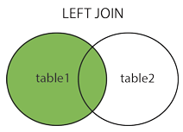
Left Outer Join
Denoted (r ⟕COND s)
Combines tuples of two relations and keeps in the result every tuple from the left table, but only those from the right table that meet the join condition.
SELECT *
FROM r LEFT JOIN s
ON r.A = s.D;
Corresponding SQL

Slide 21
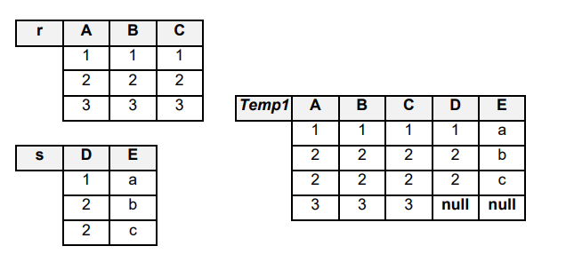
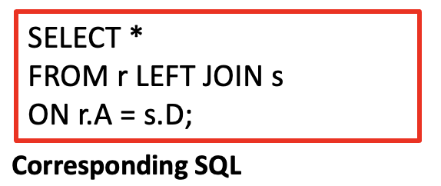
Left Outer Join Example
(r ⟕A=D s)
Notes:
Example: You might want to join employees to their departments but also wish to include employees who have not been assigned departments yet.

Slide 22
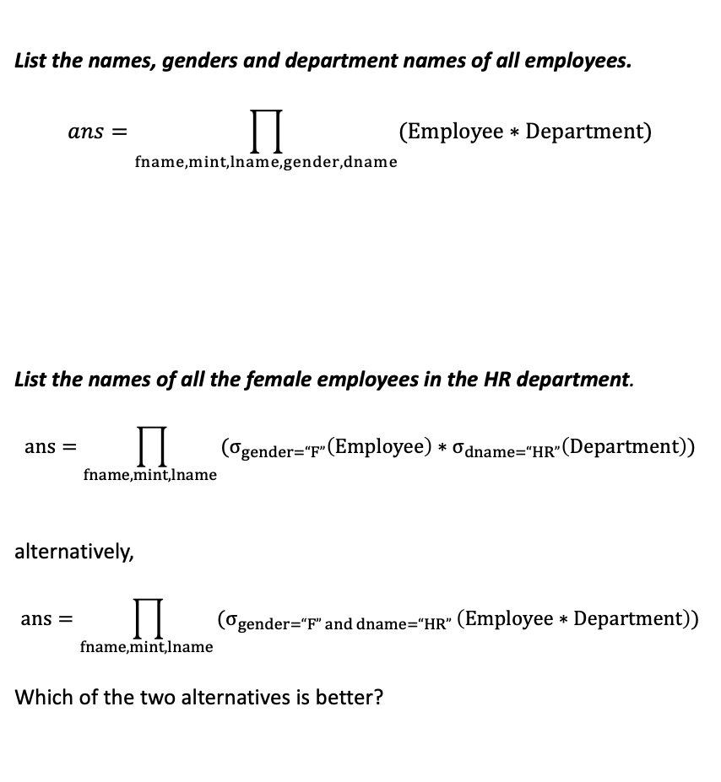
Queries Using Set Operations, Projection, Conditional Selection and Joins
Schema
Employee (fname, mint, lname, empid, bdate, address, gender, salary, superid, dno)
Department (dname, dno, mgrid, mgstartdate)
Project (pname, pno, plocation, dno)
WorksOn (empid, pno, hours)
Dependent(empid, depname, gender, bdate, relationship)
List the names, genders and department names of all employees.
$$ans=\prod_{fname, mint, lname, gender,dname}{(Employee∗Department)}$$
List the names of all the female employees in the HR department.
$$ans=\prod_{fname, mint, lname }{(σ_{gender=“F”}\left(Employee\right)∗σ_{dname=“HR”}\left(Department\right))}$$
alternatively,
$$ans=\prod_{fname, mint, lname }{(σ_{gender=“F” and dname=“HR” }\left(Employee∗Department\right))}$$
Which of the two alternatives is better?
SELECT fname, mint, lname, gender, dname
FROM Employee NATURAL JOIN Department;
SELECT fname, mint, lname
FROM Employee e JOIN Department d
ON e.dno = d.dno
WHERE e.gender = 'F'
AND d.dname = 'HR';
RDBS performs query chain optimization
to generate an optimal sequence of
relational algebra statements.
Notes:
It is generally a good idea to push the selections to the inner levels of nesting as much as possible, as this would leave less data for the external operations to work on.

Slide 23
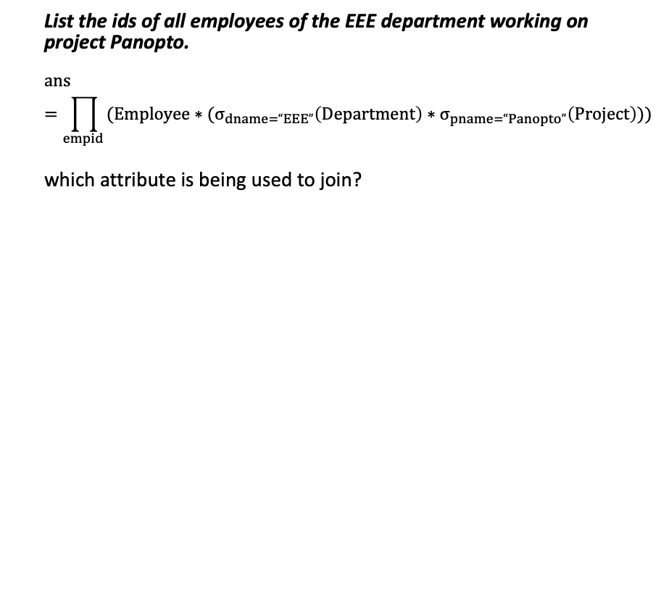
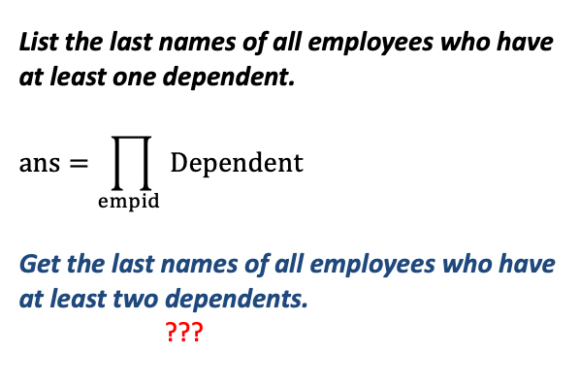
Queries Using Set Operations, Projection, Conditional Selection and Joins
Schema
Employee (fname, mint, lname, empid, bdate, address, gender, salary, superid, dno)
Department (dname, dno, mgrid, mgstartdate)
Project (pname, pno, plocation, dno)
WorksOn (empid, pno, hours)
Dependent(empid, depname, gender, bdate, relationship)
List the ids of all employees of the EEE department working on project Panopto.
$$ans=\prod_{empid }{(Employee∗(σ_{dname=“EEE”}\left(Department\right)∗σ_{pname=“Panopto”}\left(Project\right))})$$
which attribute is being used to join?
SELECT DISTINCT e.empid
FROM
Employee e JOIN Department d
ON e.dno = d.dno
JOIN WorksOn w
ON e.empid = w.empid
JOIN Project p
ON w.pno = p.pno
WHERE d.dname = 'EEE'
AND p.pname = 'Panopto';
List the last names of all employees who have at least one dependent.
$$ans=\prod_{empid }{Dependent}$$
Get the last names of all employees who have at least two dependents.
???
SELECT empid FROM Dependent;

Slide 24
Aggregation
Syntax: (<Grouping attribute> F <function list> (relation name) )
<function list> : contains simple mathematical functions.
  Common functions are: MAX, MIN, AVG, SUM and COUNT
<Grouping attribute>: contains a column name to organize the function outputs into groups.
  Without a grouping attribute a global, across-the-table result is returned

Slide 25
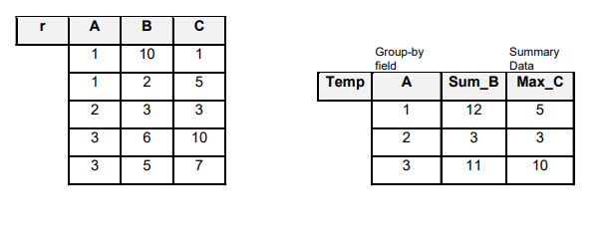
Aggregation Example
( A F SUM(B), MAX(C) (r) )
SELECT A,
SUM(B) AS Sum_B,
MAX(C) AS Max_C
FROM r
GROUP BY A;
Corresponding SQL
Renaming of column names required to
have reusable column names, e.g., to be used
in projection or conditional selection, etc.
Notes:
For each unique value in A, compute sum of the elements of B and the max of C
When a grouping attribute is not supplied, global results are computed. In this case, the result would be a 1x2 table containing: 26, 10

Slide 26
Queries Using Aggregation
Get the employee ids and number of dependents of all employees who have at least two dependents.
Schema
Employee (fname, mint, lname, empid, bdate, address, gender, salary, superid, dno)
Department (dname, dno, mgrid, mgstartdate)
Project (pname, pno, plocation, dno)
WorksOn (empid, pno, hours)
Dependent(empid, depname, gender, bdate, relationship)
SELECT e.empid,
COUNT(*) AS num_dependents
FROM
Employee e JOIN Dependent d
ON e.empid = d.empid
GROUP BY e.empid
HAVING COUNT(*) >= 2;
HAVING is used for conditional selection when
GROUP BY based aggregation is involved.
Notes:
It is generally a good idea to push the selections to the inner levels of nesting as much as possible, as this would leave less data for the external operations to work on.

Slide 27
Nested Queries (or Subqueries)
List the ids and names of employees who are working on some project.
Schema
Employee (fname, mint, lname, empid, bdate, address, gender, salary, superid, dno)
Department (dname, dno, mgrid, mgstartdate)
Project (pname, pno, plocation, dno)
WorksOn (empid, pno, hours)
Dependent(empid, depname, gender, bdate, relationship)
SELECT empid, fname, mint, lname
FROM Employee
WHERE empid IN (
SELECT empid
FROM WorksOn
);
List the ids and names of employees who have at least one dependent.
Other Subquery Operators like IN that can be used:
IN: value appears in the subquery result set
NOT IN: value does not appear in the subquery result set
EXISTS: subquery returns at least one row
NOT EXISTS: subquery returns no rows
ANY: comparison true for at least one value returned by subquery
SOME: same as ANY
ALL: comparison true for every value returned by subquery
SELECT e.empid, fname, mint, lname
FROM Employee e
WHERE EXISTS (
SELECT *
FROM Dependent d
WHERE d.empid = e.empid
);

Slide 28
Miscellaneous Queries
List the complete employee data of all employees, and if they are working on projects, display the total number of hours they spend across all their projects.
Schema
Employee (fname, mint, lname, empid, bdate, address, gender, salary, superid, dno)
Department (dname, dno, mgrid, mgstartdate)
Project (pname, pno, plocation, dno)
WorksOn (empid, pno, hours)
Dependent(empid, depname, gender, bdate, relationship)
SELECT e.*, SUM(w.hours) AS total_hours
FROM Employee e LEFT JOIN WorksOn w
ON e.empid = w.empid
GROUP BY e.empid;

Slide 29
Miscellaneous Queries
List the ids and last names of all EEE employees working on maximum number of projects.
Schema
Employee (fname, mint, lname, empid, bdate, address, gender, salary, superid, dno)
Department (dname, dno, mgrid, mgstartdate)
Project (pname, pno, plocation, dno)
WorksOn (empid, pno, hours)
Dependent(empid, depname, gender, bdate, relationship)
SELECT e.empid, e.lname
FROM Employee e
JOIN Department d ON e.dno = d.dno
JOIN WorksOn w ON e.empid = w.empid
WHERE d.dname = 'EEE'
GROUP BY e.empid, e.lname
HAVING COUNT(*) = (
SELECT MAX(ct)
FROM (
SELECT COUNT(*) AS ct
FROM
Employee e2 JOIN Department d2
ON e2.dno = d2.dno
JOIN WorksOn w2
ON e2.empid = w2.empid
WHERE d2.dname = 'EEE'
GROUP BY e2.empid
)
);
Results in a single-column table
with column name ct
Results in a single value.

Slide 30
Miscellaneous Queries
Output a table with the following columns:
Employee Id, Last Name, Dept. name, Salary, No. of Proj, No. of Dependents
Schema
Employee (fname, mint, lname, empid, bdate, address, gender, salary, superid, dno)
Department (dname, dno, mgrid, mgstartdate)
Project (pname, pno, plocation, dno)
WorksOn (empid, pno, hours)
Dependent(empid, depname, gender, bdate, relationship)
SELECT
e.empid AS "Employee Id",
e.lname AS "Last Name",
d.dname AS "Dept. name",
e.salary AS "Salary",
COUNT(DISTINCT w.pno) AS "No. of Proj",
COUNT(DISTINCT dep.depname) AS "No. of Dependents"
FROM Employee e JOIN Department d
ON e.dno = d.dno
JOIN WorksOn w
ON e.empid = w.empid
JOIN Dependent dep
ON e.empid = dep.empid
GROUP BY
e.empid, e.lname, d.dname, e.salary;

Slide 31
RDBMS
A database is a structured collection of data that is managed by a DBMS (Database management system)
Some of the most powerful and widely used database management systems are relational: RDBMS.
  They provide a high-level query language called SQL, which is based on relational algebra.
  Examples of RDBMS: Oracle, MySQL, Microsoft SQL Server, PostgreSQL, SQLite, Amazon RDS, etc.

Slide 32
RDBMs Ensure ACID Properties
Atomicity: transactions, which consist of multiple statements, are treated as atomic.
  Either the whole thing succeeds or the whole thing fails
Consistency: transactions can only bring the database from one valid state to another
  a state is valid if it follows all the specified rules including constraints
Isolation: ensures that concurrent execution of transactions leaves the database in the same state that would have been obtained if the transactions were executed sequentially.
Durability: database commits are final and durable even if system fails after a commit.

Slide 33
PART II
Practicing with SQL
Open:
https://sqliteonline.com/
Upload Schema/Data:
  Download emp_db.sql
  Import into https://sqliteonline.com/

Slide 34
Write SQL for the Following Queries
1) List the first name, last name, and salary of all employees whose salary is at least 80000.
2) List the employee id and department number of all employees whose gender is 'F' and who live at an address containing 'London’ (use LIKE '%London%’)
3) List the department name and manager start date for all departments whose department number is greater than 20.
Expected result:
4) List the employee ids and last names of all employees who work in the HR department.
Expected result:
5) List the project names and locations for all projects controlled by the Engineering department.
Expected result:
dname | mgstartdate
Finance | 2021-04-10
Sales | 2020-06-20
IT | 2024-02-01
empid | lname
1004 | Baker
1005 | Patel
pname | plocation
Product Alpha | Cambridge

Slide 35
continued…
6) List the employee ids and project numbers for all employees who work more than 15 hours on a single project.
7) For each department, list the department name and the number of employees in that department.
empid | pno
1008 | 2002
1001 | 2004
1003 | 2004
Expected result:
dname | num_employees
Engineering | 3
Finance | 1
HR | 2
IT | 1
Sales | 1
Expected result:

Slide 36
continued…
8) List the employee ids and last names of employees who work on at least two projects.
9) List the employee ids and last names of employees whose salary is higher than the average salary in their own department.
10) List the employee ids and last names of employees who work on the maximum number of projects in the entire company.
Expected result:
empid | lname
1008 | Ali
Expected result:
empid | lname
1001 | Rahman
1004 | Baker
empid | lname
1008 | Ali
Expected result:

Slide 37
More Queries to Attempt
List the first and last names of all employees along with their department names.
List the project names and the last names of employees working on each project.
List the employee ids and total number of hours each employee works across all projects.
List the department names and the total salary paid to employees in each department.
List the ids and last names of employees who have no dependents.
List the project names of projects that currently have no employees assigned.
List the ids and last names of employees who work on every project.
List the department names that have more than three employees.
List the ids and last names of employees who earn the highest salary in their department.
List the ids and last names of employees whose total project hours exceed the company-wide average total project hours per employee.

