Slide 1
Information Processing
Week 4
Cloud Services, Client-Server, NoSQL Database

Slide 2
Today’s Topics
This presentation describes the activities covered in Lab 4
  AWS Connectivity, Client-Server, NoSQL Database
The presentation has two parts:
  Part I: Describes how to make some basic use of a cloud platform to run your server-side apps
    How to remotely configure a virtual server on the cloud platform (Amazon’s AWS is taken as an example)
    How to make local apps communicate with remote apps running on the cloud
    In particular: approaches to multi-client handling
  Part II: Describes how to use a database on a reliable remote server to implement persistence features in your apps
    How to perform basic CRUD (Create, Read, Update, Delete) and other operations on the database from your server-side code

Slide 3
Intended Leaning Outcomes
After this week’s discussion, you will be able to:
Implement a realistic cloud-based server capable of handling multiple concurrent clients using different concurrency models
Select appropriate server implementation strategies based on workload and design requirements
Integrate a NoSQL database with server code, design efficient queries, and evaluate their performance trade-offs

Slide 4
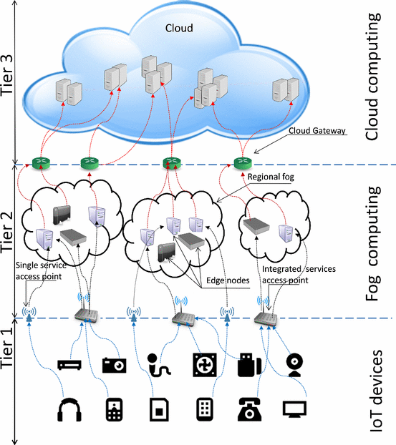
Architecture of a Typical IoT System
Roughly mapping your current system nodes to the three tiers:
Tier 1 — IoT / Edge devices
  Closest to the physical system; perform low-latency, hardware-coupled computation and control, e.g., Zynq board (PS + PL with hardware acceleration, etc.)
Tier 2 — Fog / Edge Computing
  Local intermediary layer for aggregation, preprocessing, control, and cloud communication, e.g., local laptop / local computing component (interface to Zynq PS, AWS client)
Tier 3 — Cloud computing
  Centralised, elastic compute and storage for coordination, services, and long-term data, e.g., AWS server, AWS database
The centralized Tier-3 cloud layer enables wide and remote access to the application by providing globally reachable services and shared state.
Database belongs in Tier 3 to provide global, persistent, shared state, especially when multiple fog nodes are involved.
Communication between tiers is handled over networked
interfaces, with Tier-2 acting as the gateway
between edge devices and cloud services.
Three-tier architecture of a typical IoT system
Notes:
Image Source:
Efficient and Dynamic Scaling of Fog Nodes for IoT Devices. Available from: https://www.researchgate.net/figure/Three-tier-architecture-of-a-typical-IoT-system_fig3_317380217 [accessed 12 Jan 2026]

Slide 5
Cloud Computing – What is it?
“Cloud computing is an information technology (IT) paradigm that enables ubiquitous access to shared pools of configurable system resources and higher-level services that can be rapidly provisioned with minimal management effort, often over the Internet. Cloud computing relies on sharing of resources to achieve coherence and economies of scale, similar to a public utility.”
“Simply put, cloud computing is the delivery of computing services – servers, storage, databases, networking, software, analytics and more – over the Internet (“the cloud”). Companies offering these computing services are called cloud providers and typically charge for cloud computing services based on usage, similar to how you’re billed for gas or electricity at home.”
https://azure.microsoft.com/en-gb/overview/what-is-cloud-computing/
Notes:
Source: https://en.wikipedia.org/wiki/Cloud_computing

Slide 6
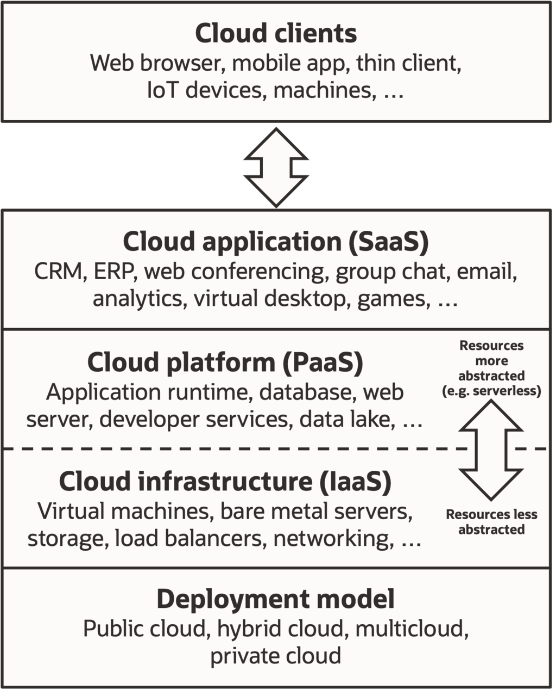
Cloud Delivery Models
Our Use Case
IaaS: Infrastructure as a Service
The consumer is able to deploy and run arbitrary software, which can include operating systems and applications.
The consumer does not manage or control the underlying
cloud infrastructure (hardware) but has control over
operating systems, storage, and deployed applications;
and possibly limited control of select networking
components (e.g., host firewalls).
Notes:
Image source:
https://en.wikipedia.org/wiki/Cloud_computing
SaaS
The capability provided to the consumer is to use the provider's applications running on a cloud infrastructure. The applications are accessible from various client devices through either a thin client interface, such as a web browser (e.g., web-based email), or a program interface. The consumer does not manage or control the underlying cloud infrastructure including network, servers, operating systems, storage, or even individual application capabilities, with the possible exception of limited user-specific application configuration settings.
PaaS
The capability provided to the consumer is to deploy onto the cloud infrastructure consumer-created or acquired applications created using programming languages, libraries, services, and tools supported by the provider. The consumer does not manage or control the underlying cloud infrastructure including network, servers, operating systems, or storage, but has control over the deployed applications and possibly configuration settings for the application-hosting environment. (API provided by provider).
IaaS
the consumer is able to deploy and run arbitrary software, which can include operating systems and applications. The consumer does not manage or control the underlying cloud infrastructure (hardware) but has control over operating systems, storage, and deployed applications; and possibly limited control of select networking components (e.g., host firewalls).
We will be using AWS in the IaaS mode.

Slide 7
Your Project Setup
AWS Cloud
Database
(DynamoDB)
private IP in the current LAN
FPGA + On-board processing
EC2
Local node
(laptop)
UDP/TCP
Configuration link
SSH/SCP
an always-available public IP as long as the instance is running

Slide 8
Amazon’s Elastic Compute Cloud (EC2)
Amazon Elastic Compute Cloud (EC2) is a part of Amazon.com's cloud-computing platform: Amazon Web Services (AWS)
  lends virtual computers on the cloud to configure and run your apps
  the virtual computer is typically running a Linux distribution (e.g., Ubuntu)
Using EC2 an example of IaaS
  We can choose an OS, storage, computing resources, networking configurations, etc.
Unlike the lower tiers (Edge and Fog), we can rely on EC2 to be elastic, i.e. to grow according to our application’s needs
Notes:
Amazon Web Services, Inc. (AWS) is a subsidiary of Amazon that provides on-demand cloud computing platforms and APIs to individuals, companies, and governments, on a metered, pay-as-you-go basis.

Slide 9
EC2 Configuration Steps (Lab 4)
Using the web-based console on your AWS account
  Choose a machine image: processor, storage, operating system, etc.
  Instance type (computational power): no of processors, amount of memory, networking capacity, etc. (Default options on the free-tier suffice)
  Configure security group
    What type of connections are permitted? TCP, UDP, SSH only?
    What port range is permissible?
    Are only specific IP addresses allowed to connect, or anyone can connect?
  EC2 is one of the AWS services
    To communicate with other services, it must do so through a predefined role (IAM role)
    an IAM role is an identity you create in your account that provides specific permissions.
      E.g. the DynamoDBAccessforEC2 role in your lab gives your EC2 instance to a DynamoDB database.
  The EC2 instance is always-running, with a public IP, unless you explicitly shut it down

Slide 10
Basic Software Installations on EC2 (Lab 4)
You can install any software tools on your EC2 instance that are required by your app to run on Linux:
Some basic tools needed for Lab 4:
  Python
  Pip
  Python packages using pip
  Boto3: AWS’s Python API to interface with services like DynamoDB, S3 etc.
  g++, etc.

Slide 11
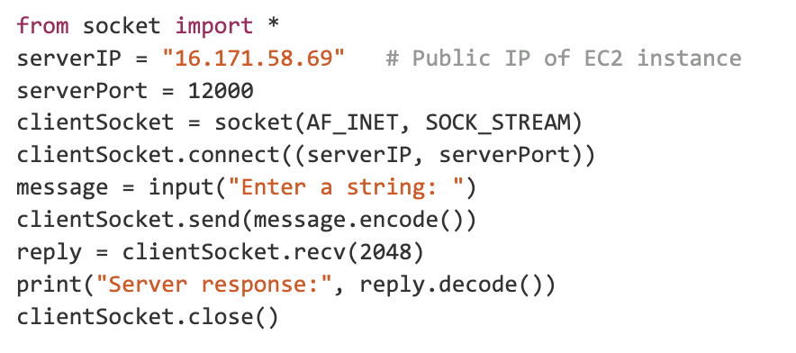
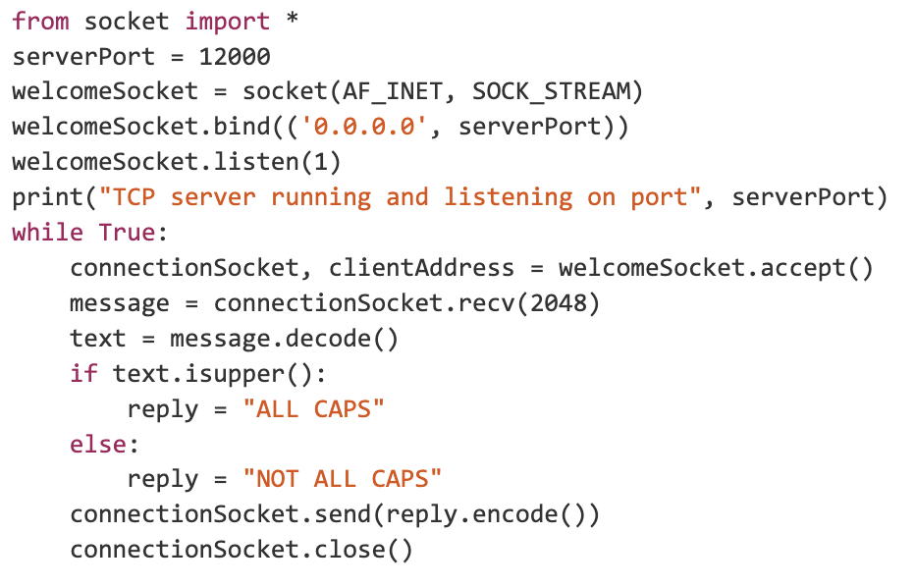
Client-Server Communication
Example: A simple TCP Client and a Server on EC2
Server’s public IP and port number
specifies its connection end-point
The welcoming socket: to receive incoming
clients / the same socket for all clients
Listen on all network
interfaces on this machine
IPv4 TCP socket
and 3-way handshake
to connect
Per-client connection
socket
TCP Client on a Local Node
Blocking calls: send and
recv, to send and receive data
Blocking calls: recv and
send to/from
this particular client
Some Issues to consider:
We’re assuming short messages of known size range
(TCP doesn't guarantee message boundaries)
The server can only handle one client at a time
Raw TCP sockets wouldn’t work from within browsers,
  or if you wished to use any web-API;
  you’d need an application layer protocol, e.g., HTTP
TCP Server on EC2
Your server may run as a daemon on your EC2 instance.

Slide 12
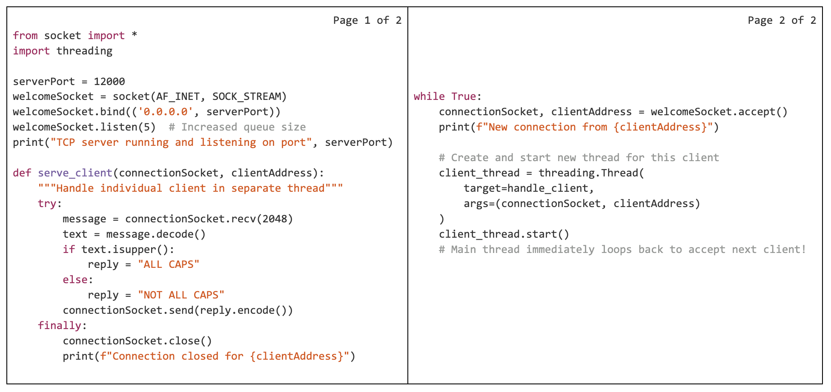
Handling Multiple Clients Concurrently
The Multithreading Approach
The modified TCP server with multi-threading
Up to 5 clients can wait in the connection queue
(could be set to a reasonable upper bound)
Serve this client in a
separate thread
The usual synchronization
tools can be used.
For example:
Mutexes:
from threading import Lock
lock = Lock()
with lock: # acquire and auto-release
# critical section - only one thread at a time
Semaphores:
from threading import Semaphore
sem = Semaphore(3) # allow 3 threads max
with sem: # one of 3 slots
# limited concurrent access
Similarly, Condition Variables, Barriers, etc.
Using pthread under-the-hood (UNIX based system)
threading.Thread → pthread_create()
threading.Lock → pthread_mutex_t
threading.Semaphore → POSIX semaphores
The client thread function: would require synchronization if
client threads are accessing/modifying shared data

Slide 13
Concurrency without Multithreading?
Multithreading Pros and Cons
Pros:
Intuitive: Each client gets mapped to one thread, familiar sequential code
True parallelism for I/O operations (threads can wait independently), multiple cores can be exploited
Preemptive scheduling: OS handles switching between threads automatically
Works well for blocking I/O (like our recv() calls)
Cons:
Resource overhead: Each thread uses memory (~8MB stack per thread on Linux)
Scalability limits: Thousands of threads → performance degradation
Context switching cost: OS must save/restore thread state
Synchronization complexity: Mishandling of locks, semaphores → potential deadlocks, race conditions
An alternative approach
Implement user-level cooperative scheduling
An event-loop (a single thread) schedules different coroutines based on events, e.g., a socket can be read from
Only the event loop potentially blocks in the kernel waiting for I/O readiness for any coroutine
Coroutines use non-blocking sockets asynchronously when scheduled by the event loop
Specifically:
  When a coroutine needs to send/recv on a socket it yields control to the event loop
  The event loop uses a system call: select/epoll to monitor multiple sockets, resumes coroutines when their I/O is ready, allowing non-blocking operations

Slide 14
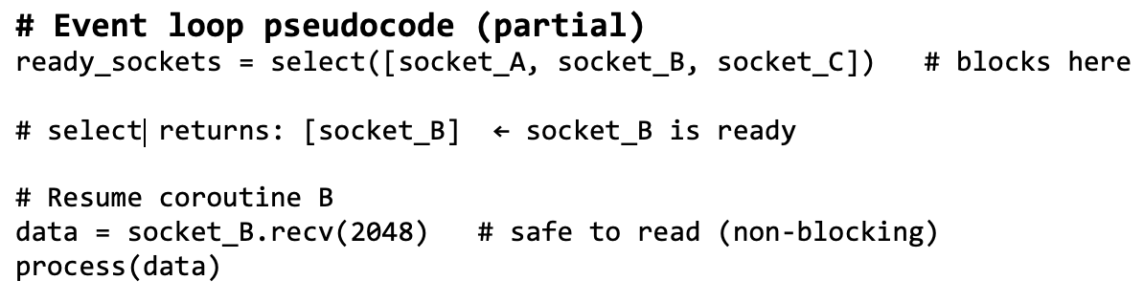
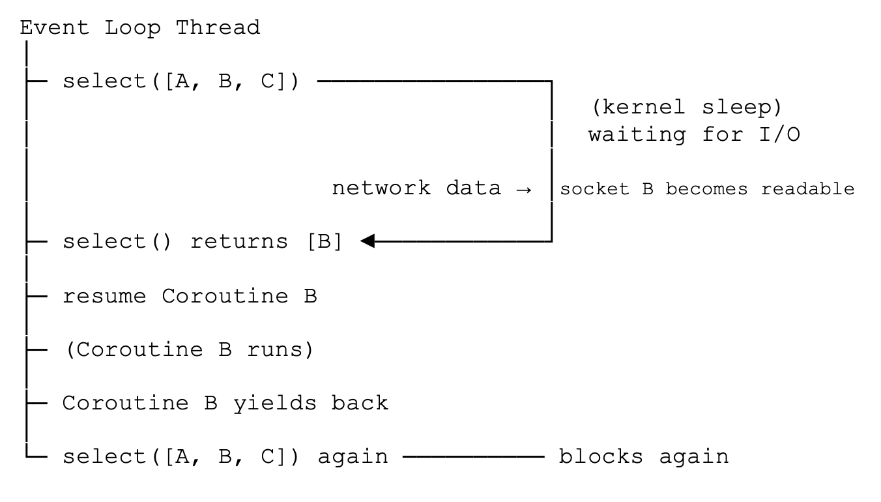
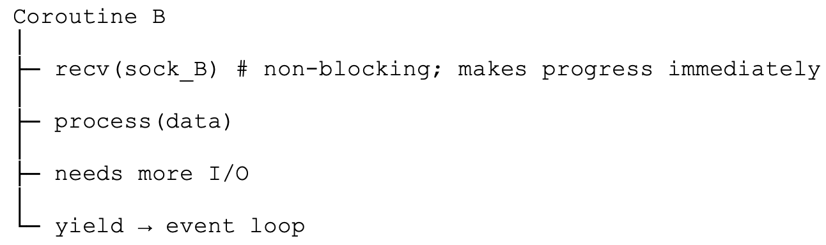
Handling Multiple Clients Concurrently
Using Event-Based Concurrency
Kernel system call via libc (under-the-hood)
works with file descriptors
($ man select)
Timeline
(on a non—blocking socket the kernel would let B know
if socket not ready)

Slide 15
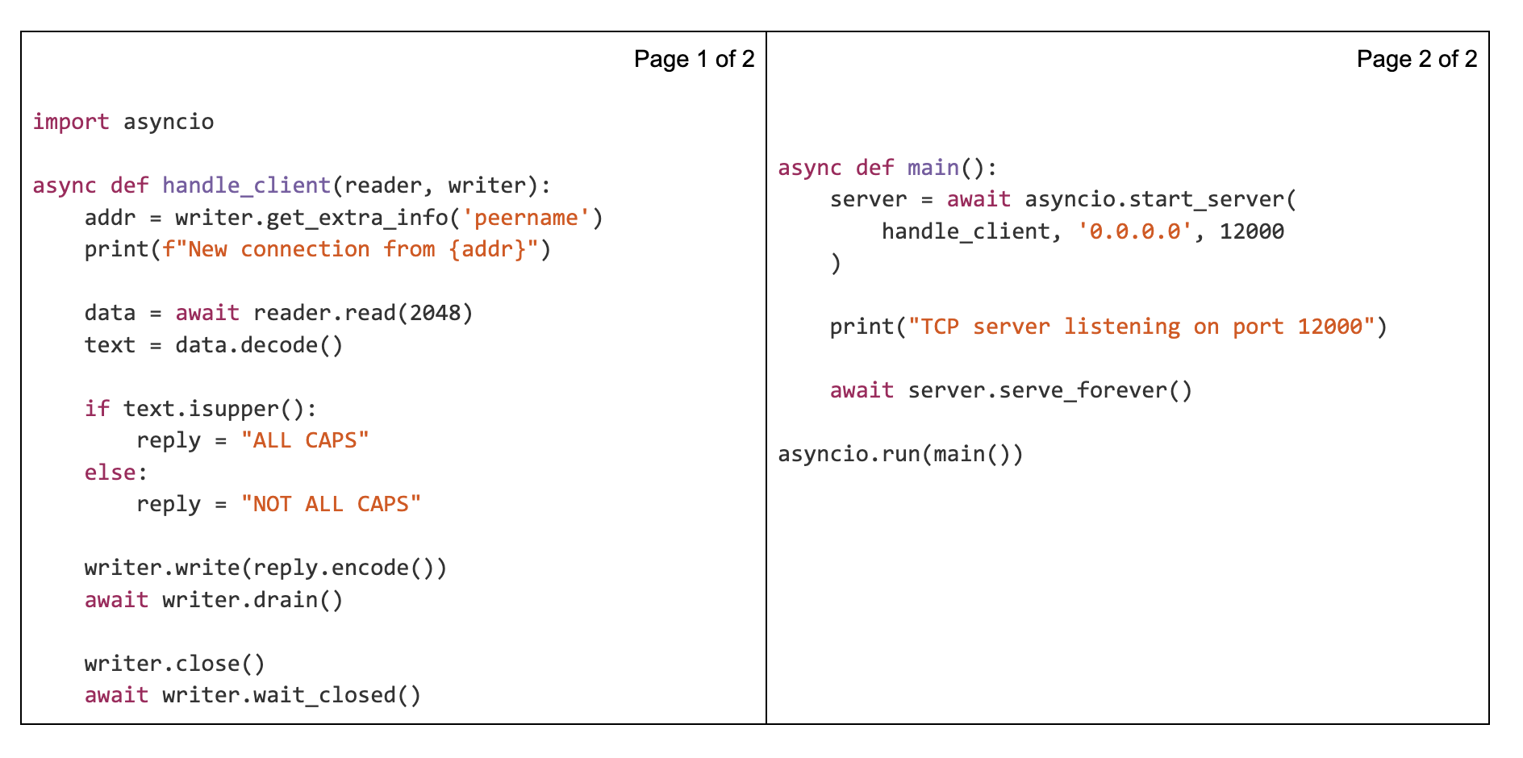
Event–Based Concurrency with asyncio
Creates a listening (welcome) socket and registers it with the event loop
Suspends while waiting for incoming connections (yields to event loop)
Suspends if no data available (yields to event loop)
The main event loop
Suspends until send buffer has space.
Notes:
Consider the case of three coroutines cr0, cr1 and cr2. A possible sequence of awaits might work as follows:
Event loop runs cr0 → cr0 awaits cr1 (control enters cr1) → cr1 awaits cr2 (control enters cr2) → cr2 awaits I/O (yields to event loop) ... → event loop resumes cr2 (I/O ready; cr2 continues, returns to cr1) → cr1 finishes, returns to cr0 → cr0 finishes, returns to the event loop.
An ‘await cr’ is effectively calling a suspend-able function. Once a function is suspended it yields control to the event loop. The event loop then reschedules the suspended coroutine when it becomes I/O ready.

Slide 16
Client-Server Communication
Event-Based Concurrency, Multithreading, Multiprocessing
A real server would use some combination of event-based concurrency, multithreading, and multiprocessing
Event-based concurrency (OS mechanisms: epoll, select, framework: asyncio)
  handles many sockets efficiently
  good for I/O bound applications, such as a server
  avoids threading overhead
  makes it easier to avoid synchronization overhead
  great for I/O-bound work
  several web frameworks use it
Multithreading
  overlaps blocking or CPU work
  good for legacy/blocking libraries
  used for background tasks
Multiprocessing
  True parallelism, isolation, security
  Scales well for CPU-bound work

Slide 17
Part II
Database
A database is an organized collection of data
  Structured so it can be efficiently searched, updated, and managed
A database is usually accessed through a Database Management System (DBMS)
  e.g., SQLite, MySQL, PostgreSQL, DynamoDB (a DBMS provides a controlled interface between programs and stored data
Why not just files?
  Raw files (e.g. text, CSV, binary) require programs to manually handle reading, writing, parsing, and consistency.
  Databases store data in structured tables or collections and provide query-based access, handling storage, consistency, and access automatically.

Slide 18
Database Options
1. SQL databases (covered next week)
  Well defined schema
    the database is modeled as a set of joinable tables with pre-defined columns
  Entities are stored in tables, managed by an RDBMS
  Tables can be joined and using a powerful and flexible querying language: SQL
  Data follows are rigid structure and is mostly non-redundant
  Changing/updating the structure of data involves change in schema and costly database alterations.
  There is a DBA – a database administrator -- between the application developer and the database, responsible for defining and altering the schema if needed.
    Using SQL’s DDL
Naturally ideal for vertical scaling, i.e., increasing the database’s capacity by adding more resources (CPU, memory, storage) to a single machine.
Notes:
You have the choice of using a SQL or NoSQL database

Slide 19
Database Options
2. NoSQL databases
  Data is not stored in relations (although the tabular form exists)
  There is no predefined schema (a flexible schema is maintained)
    Data is not highly structured: unstructured or semi-structured data may be stored.
  Flexibility of schema speeds up development, as the developer has direct control over the structure of the database: “data becomes like code”.
  NoSQL databases could be: document stores, key-value stores, column stores or graph-base.
    DynamoDB is a key-value store – meaning, they use hashing as their principal storage strategy.
  Naturally ideal for horizontal scaling, i.e., increasing the database’s capacity by adding more machines and distributing data across them.

Slide 20
Horizontal Scaling of Databases
Data needs to be divided and distributed across multiple partitions
A partition is a logical single chunk of storage managed by the cloud service provider
When queried for data, the system needs to know which partition stores what part of the data.
The system should be able to:
  map each individual record to a partition
  search for records in a data structure within that partition
This is the operation of a typical NoSQL database called a Key-Value Store

Slide 21
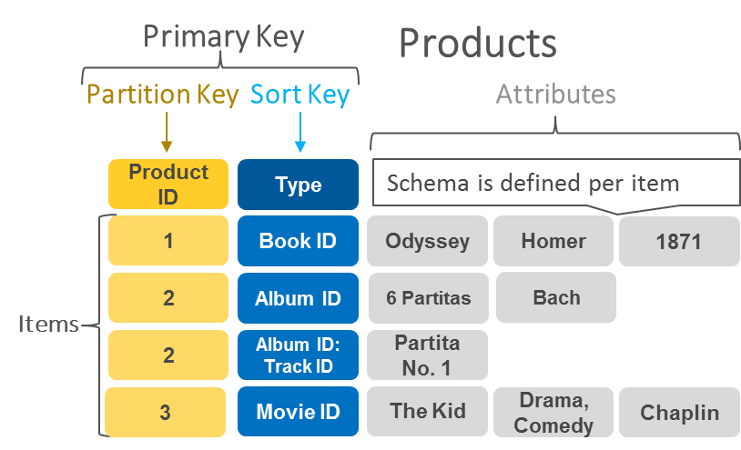
DynamoDB:
An Example of a NoSQL Key-Value Store
A simple type of NoSQL database
Stores data as a collection of key-value pairs
  key serves as a unique identifier for the record.
Highly partitionable, allows horizontal scaling
An example table in DynamoDB

Slide 22
Amazon’s DynamoDB, a key-value store
Every ‘row’ in a ‘table’ is defined by a composite primary key:
  Primary key = (Partition key, Sort Key)
A record with key (pk, sk), is assigned the partition h(pk), and sorted at s(sk), within that partition.
  h is an internally maintained hash function.
  s is an ordering function of an ordered data structure such as a height-balanced tree
A partition is an allocation of storage for a table, backed by solid state drives (SSDs) and automatically replicated
across multiple Availability Zones within an AWS Region.

Slide 23
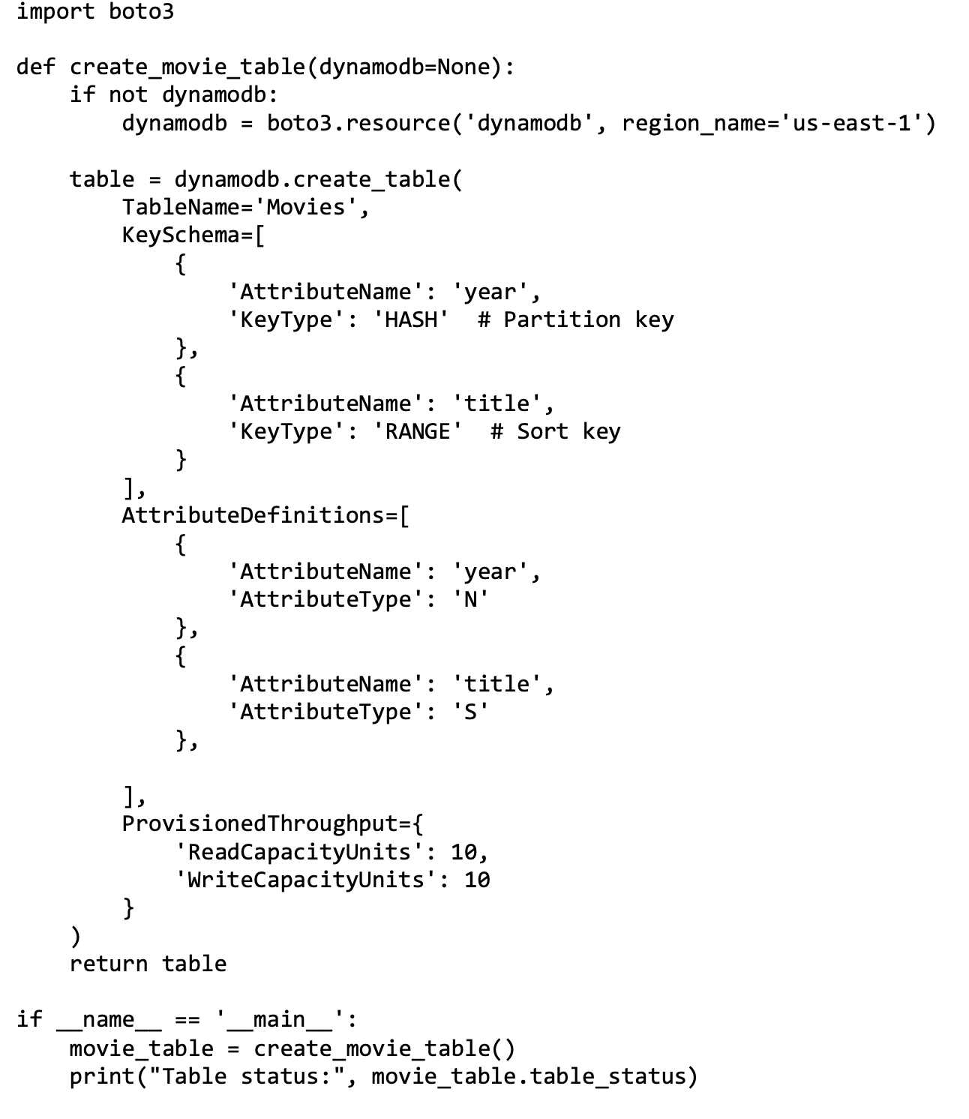
Creating a Table in DynamoDB (Boto3 Python)
Create DynamoDB service handle
(selects service + region)
Use year as the partition key
Use title as the sort key
Two columns in this table:
year: a number
title: a string
Up to 10 reads per second
Up to 10 writes per second

Slide 24
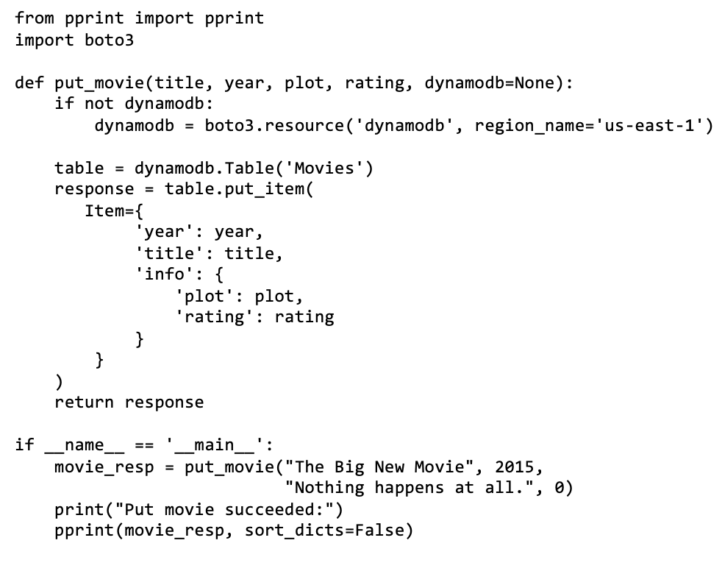
Inserting an Item into a Table
Get a handle/reference to the Movies table
Send a write request to insert an item into the table
Nested attribute for additional movie data.
These attributes are created automatically by this request.
DynamoDB has no fixed columns (except keys).
The database does not have a predefined schema (structure)
The table structure can change,
in a manner similar to objects in code.

Slide 25
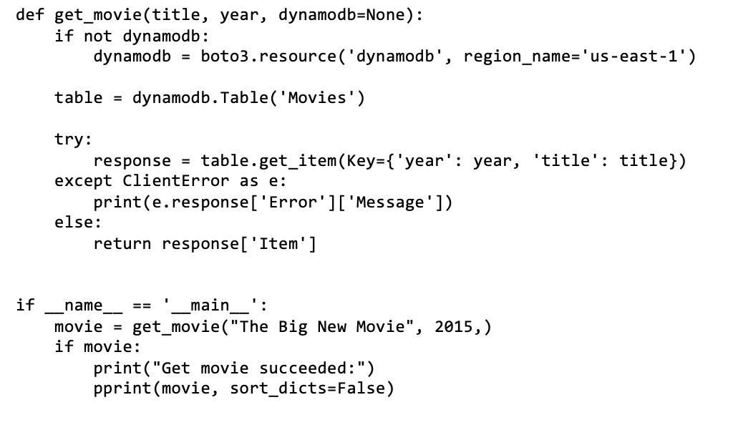
Reading an Item From a Table
Fetch item using its primary key (partition + sort key)
Only primary keys support fast reads/writes
(non-key attributes cannot be queried directly)

Slide 26
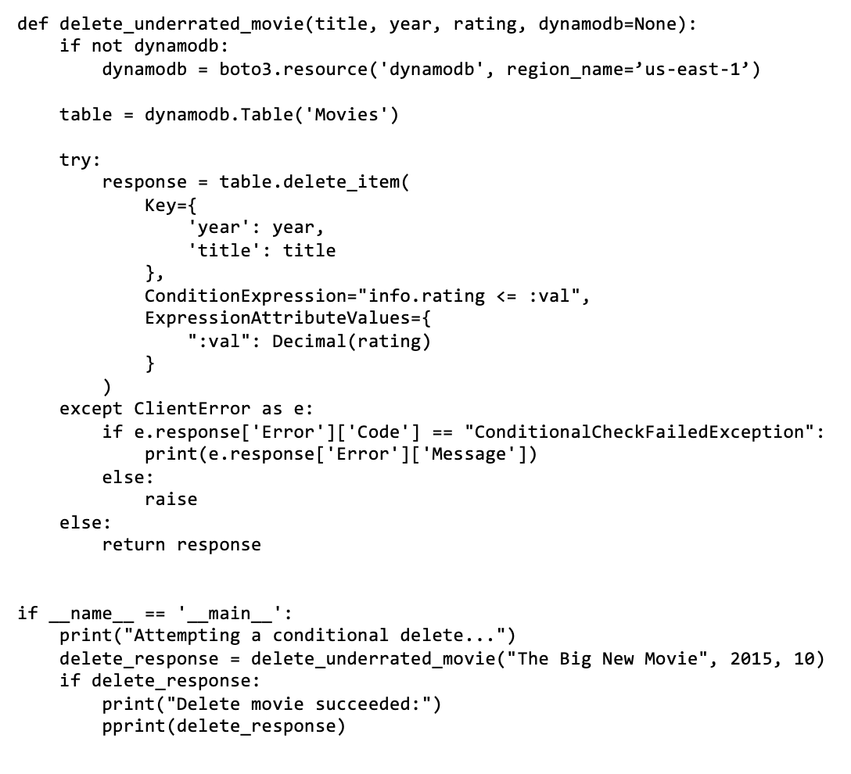
Conditionally Deleting Items
Identify the item using its primary key
Delete only if the item's rating is less than or equal
to the threshold
DynamoDB needs a description of the expression
to perform it remotely on its servers
DynamoDB performs these operations atomically:
Find item by key
Check condition on server
If true → delete
If false → abort

Slide 27
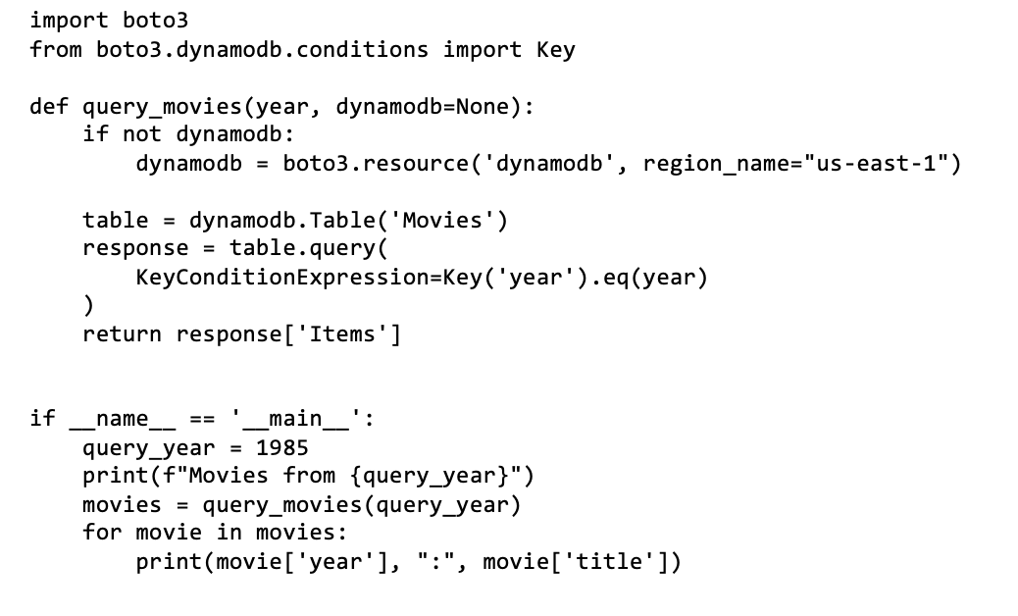
General Queries
Get all movies released in a given year
Import helper to build key-based query expressions
Use the Key convenience class to build a key condition expression
(the expression is evaluated on the DynamoDB server)
route to the correct partition and return matching items

Slide 28
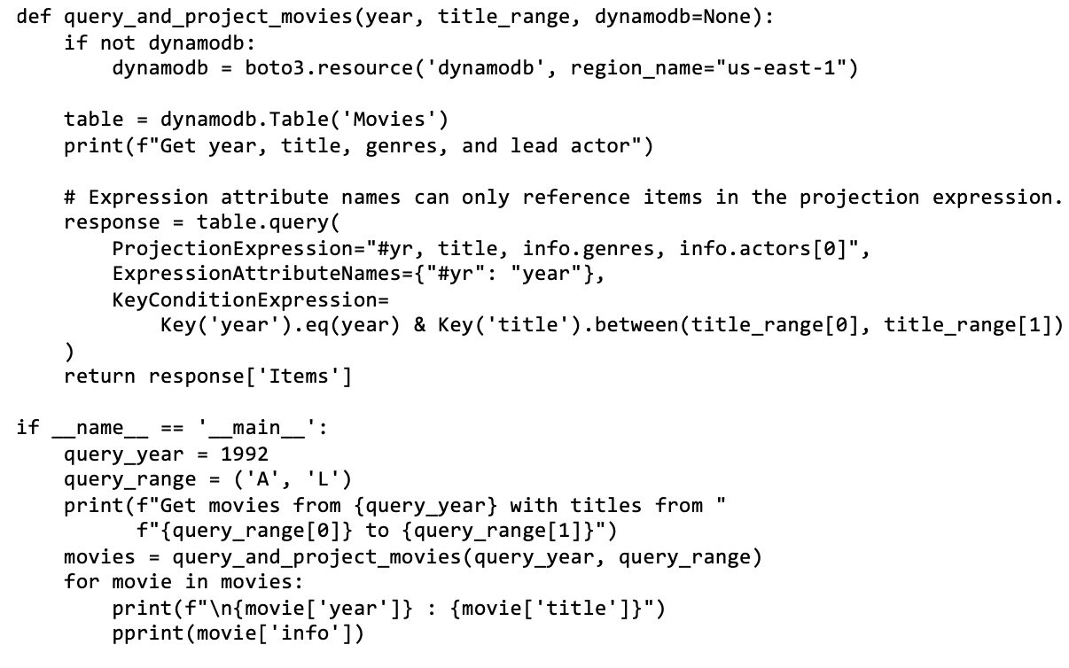
General Queries
Get all movies released in a given year, with titles within a range
Return only selected attributes
(partial item fetch, reduces
data transfer)
The alias (#yr) is not required in this specific case,
but shown as an example for alias creation for
safe parsing (to avoid potential use of reserved
keywords).

Slide 29
Querying Across Multiple Partitions
Print all movies between (and including) the years 1950 and 1959.
In a relational database this would be a straight-forward condition in a WHERE clause, as the entire table is available in one place.
In a key store, each key (i.e., the year) is mapped to a different partition, therefore all partitions in the range need to be scanned

Slide 30
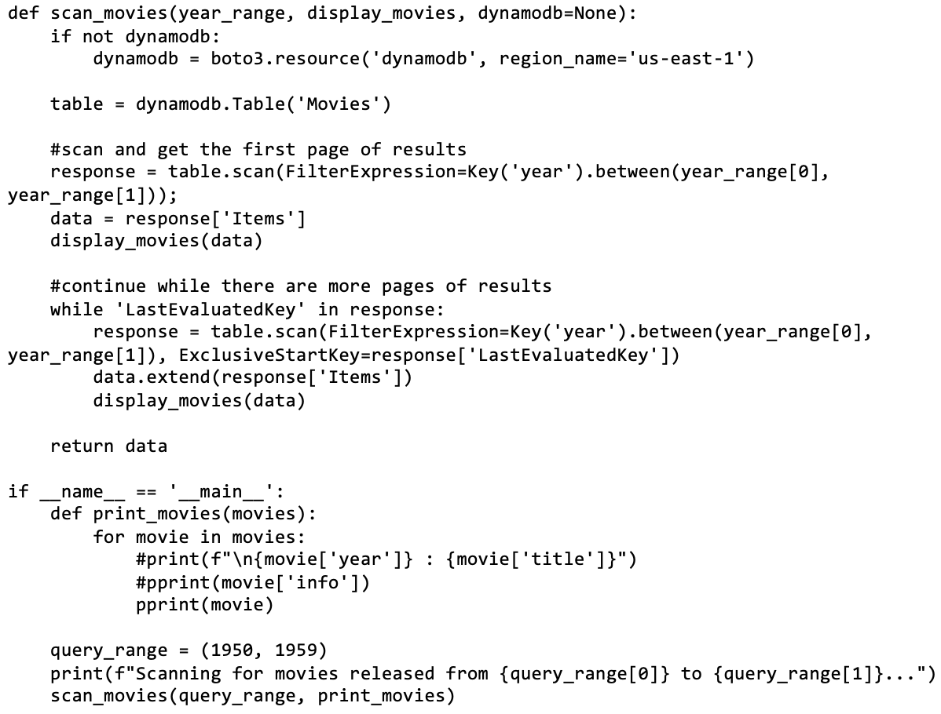
Scan Queries
Perform a Scan operation (checks every
item in the table)
Apply server-side filter after scanning items
(not key-based lookup)
Full table traversal (slow, O(N),
not partition targeted)
Retrieve first page of matching items
Continue scanning additional pages using
DynamoDB pagination until all matching items
are retrieved.
Stop when the response has no LastEvaluatedKey (pagination cursor)

Slide 31
More Complex Querying and Table Joining
Possible through scanning and additional code, but slow.
Instead of joins, design tables around your query patterns.
  Accept redundancy and controlled data duplication.
DynamoDB provides features like Global Secondary Indexes (GSIs), which maintain internally duplicated data organized by different partition keys.
In contrast, relational databases minimize redundancy and rely on joins and a powerful query language to answer complex queries.

Slide 32
Possible Database Use-cases for Your System
General application data
  Store core application data such as users, content, or domain-specific entities needed for normal operation
Data collection and history
  Store measurements, summaries, and historical records for monitoring, analysis, display through web interface etc.
System recovery and restart state
  Store checkpoints, last-known state, and progress markers so the system can resume correctly after crashes, restarts, or network failures
Configuration, preferences, and personalization
  Maintain system rules, user preferences, and adjustable parameters that shape application behaviour
Event tracking and notifications
  Record notable events (e.g. anomalies, milestones, interactions) and drive alerts or user-visible actions
Individual User activity and Data
  Track how the system is used over time to understand behaviour, performance, and trends
Shared state and coordination
  Maintain common state across components, users, or sessions to enable consistent system behaviour

