Slide 1
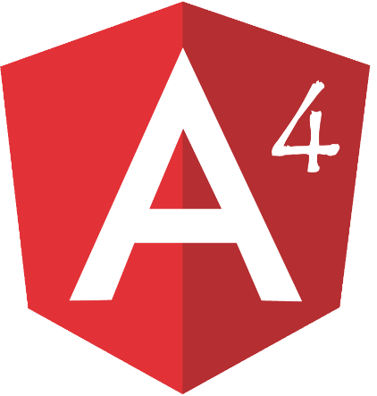


Single Page Application(SPA) using Node JS, TypeScript, Angular 4

Slide 2
Introduction to Nodejs
Node.js is an open source, cross-platform runtime environment for developing server-side and networking applications. Node.js is released under the MIT license.
Node.js is built on Google Chrome's open source JavaScript Engine (V8 Engine).
V8 is written in C++, V8 compiles JavaScript source code to native machine code instead of interpreting it in real time.
Node.js applications are written in JavaScript, and can be run within the Node.js runtime on OS X, Microsoft Windows, and Linux.
Node.js uses an event-driven, non-blocking(async) I/O model that makes it lightweight and efficient.
Corporate users of Node.js software include GoDaddy, Groupon, IBM, LinkedIn, Microsoft, Netflix, PayPal, SAP, Walmart, Yahoo! Etc.
Can be downloaded from https://nodejs.org/en/

Slide 3
Introduction to NPM
NPM (Node Package Manager) is the default package manager for the Node.js.
NPM consists of a command line client , also called npm, and an online database of public packages, called the npm registry.
NPM can install packages either local mode (node_modules of current folder) or global mode.
NPM uses package.json to store information related to project. This file is used to give information to npm that allows it to identify the project as well as handle the project's dependencies.

Slide 4
Introduction to TypeScript(.ts)
TypeScript is a free and open-source programming language developed and maintained by Microsoft.
TypeScript is a superset of JavaScript, existing JavaScript programs are also valid TypeScript programs.
TypeScript syntax is similar to Java.
TypeScript compiler transpiles code to JavaScript.
TypeScript support OOP and it has features like Data Type checking, Classes, Interfaces, Inheritance, Module(Namespace), Constructor, Function Overloading, Access Modifier, Static and Instance Members etc.
TypeScript reports compile time errors.

Slide 5
Introduction to Angular 4
Angular is written entirely in Typescript and meets the ECMAScript 6 specification.
Angular is component based framework.
Components, Directives, Services and Routers are basic building blocks.
Ahead-of-Time Compilation (AOT)
Angular-cli (command line interface) tool, Visual Studio Code

Slide 6
Angular 4 SPA Demo

