Slide 1
Hashing
Cybersecurity - CITS2006

Slide 2
What is Hashing?
Hashing is the process of mapping of arbitrary size to a fixed size to output a HASH VALUE
Where would we use hash: for storing passwords, for verification of parties sending and receiving communications (digital signatures) or in blockchain.
Hashing can be created using different algorithms

Slide 3
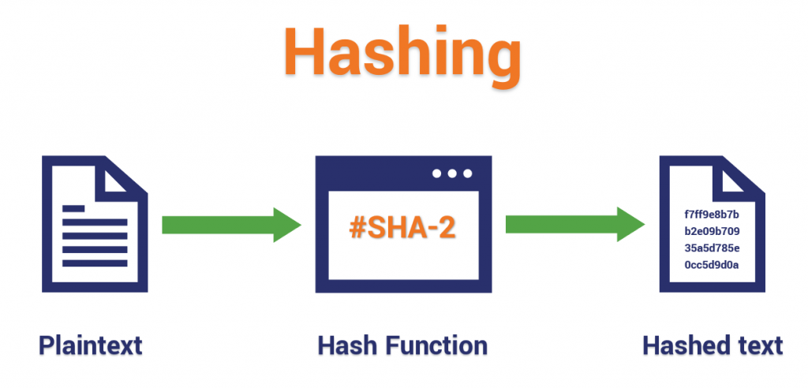

Slide 4
Fun Facts
Once you hash an input value, it is generally impossible to reverse it to find the original input (even using computers)
A change in even 1 character of the input text can completely change the output text
If using the same algorithm, an input text will always produce the same output

Slide 5

Any questions? Are you feeling Cybersecure?

