Slide 1
Messaging
Message-Oriented Middleware: Queues, Brokers & Buses Lukas Kudela 2016

Slide 2
Overview
Messaging
Patterns
Protocols
Queues
Messaging appliances
Brokers
Example – RabbitMQ
Buses
Bus vs. Broker
ESB vs. Service Bus
Example – NServiceBus

Slide 3

Message exchange patterns
Fire-and-forget | Request / response | Request / callback | Publish / subscribe
Send/receive Command | Request/reply RPC | Async R/R Async RPC | Event
One-way | Two-way | Two-way | One-way (+ subscription)
Sync & async | Sync & async | Async | Async

Slide 4
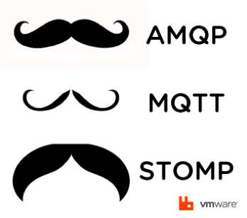
Messaging protocols
Early attempt – JMS
API, not a protocol!
Java-only
Standards used in open-source MOMs:
Advanced Message Queuing Protocol (AMQP)
Feature-rich, binary
Streaming Text Oriented Message Protocol (STOMP)
Simple, text-based
MQ Telemetry Transport (MQTT)
Extremely light-weight pub/sub messaging
M2M/IoT connectivity protocol

Slide 5

JMS – Java Message Services
Java API for messaging
Create, send, receive, read messages
Models:
Point-to-point
Publish/subscribe
JMS providers:
Apache ActiveMQ
JBoss HornetQ
IBM MQ

Slide 6
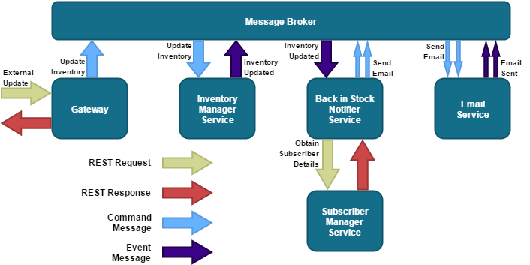
REST vs. Messaging integration

Slide 7
Queues

Slide 8

Message queues – Overview
Messaging infrastructure primitive
Point-to-point
Products
MS MQ
Store-and-forward via Outgoing queues
IBM MQ
Pub/sub via Queue managers
IBM MQ Light
Relatively new
Built on AMQP

Slide 9
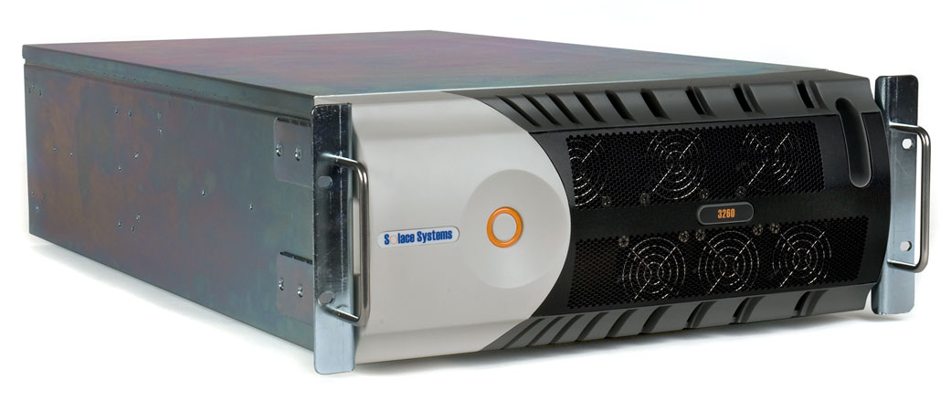
Messaging appliances
Products:
Solace
Tibco
Tervela
Needs to be justified
Large volumes of real-time messages
Strict SLAs
Involves sacrifices
Low-level APIs

Slide 10
Brokers

Slide 11

Message brokers – Overview
Centralized architecture
Bottleneck & SPOF → Clustering
Features:
Message routing
Publish/subscribe
Workload queues
Message transformation
Products:
RabbitMQ
Apache ActiveMQ
Apache Kafka
IBM Integration Bus
Formerly WebSphere Message Broker

Slide 12

RabbitMQ – Overview
Message broker
Developed by Pivotal Software
Written in Erlang
Multi-paradigm: concurrent, functional
Originated in telecommunication industry (Ericsson)
These people know a thing or two about concurrency
Designed to support distributed, fault-tolerant, soft real-time, highly available, non-stop applications
Cross-platform
Open-source
Mozilla Public License
www.rabbitmq.com

Slide 13
RabbitMQ – Features
Reliability
Trade-off for performance
Flexible routing
Exchanges & queues
Clustering/Federation
Highly-available queues
Multi-protocol
AMQP, STOMP, MQTT, (HTTP)
Many clients
Incl. C# & Python
Management UI
Tracing
Plugin system
Commercial support
Large community

Slide 14
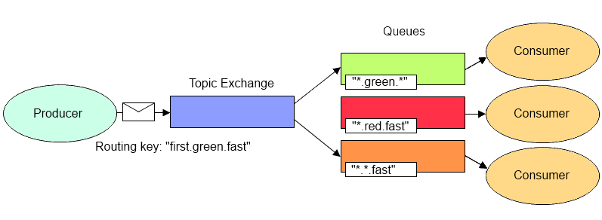
RabbitMQ – Exchanges & queues

Slide 15
RabbitMQ – Example – Publisher
var factory = new ConnectionFactory() { HostName = "localhost" };
using (var connection = factory.CreateConnection())
using (var channel = connection.CreateModel())
{
channel.ExchangeDeclare(exchange: "ex_topic", type: "topic");
string message = "Hello World!";
var body = Encoding.UTF8.GetBytes(message);
channel.BasicPublish(exchange: "ex_topic",
routingKey: "first.green.fast",
basicProperties: null,
body: body);
}

Slide 16
RabbitMQ – Example – Subscriber
var factory = new ConnectionFactory() { HostName = "localhost" };
using (var connection = factory.CreateConnection())
using (var channel = connection.CreateModel())
{
channel.ExchangeDeclare(exchange: "ex_topic", type: "topic");
var queueName = channel.QueueDeclare().QueueName;
channel.QueueBind(queue: queueName,
exchange: "ex_topic",
routingKey: ".green.*");
var consumer = new EventingBasicConsumer(channel);
consumer.Received += (model, args) =>
{
var body = args.Body;
string message = Encoding.UTF8.GetString(body);
var routingKey = args.RoutingKey;
// Process message...
};
channel.BasicConsume(queue: queueName,
noAck: true,
consumer: consumer);
}

Slide 17
Buses

Slide 18

Service buses – Overview
A.k.a. message bus
Distributed architecture
Features:
All broker features
And then some
Products:
NServiceBus
MassTransit
EasyNetQ

Slide 19
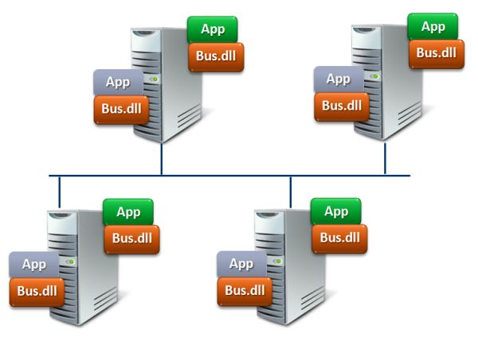
Bus vs. broker
Bus – decentralized vs. broker – centralized arch.
Bus – higher level of abstraction
Uses a broker/queue as transport
NServiceBus vs. RabbitMQ
Message (de)serialization
Neat message dispatch model
Handlers, handler pipeline, polymorphic dispatch
Unit of work
Neat saga implementation
Host process that can be
F5-debugged
Installed as a Windows service

Slide 20

Bus vs. ESB
Enterprise Service Bus
Enterprise = EAI (Enterprise Application Integration)
Service = SOA 1.0 (WS-*)
Bus = MOM
ESB is not in the vogue anymore
Brownfield system integration
Service Bus
Service = SOA 2.0 (EDA)
SB is all the rage today
Lightweight greenfield system integration
Endorsed by the microservices community

Slide 21

NServiceBus – About
Service bus
Not ESB, just SB!
Developed by Particular Software
Originally by Udi Dahan (founder)
Written in C#
Proprietary license
particular.net

Slide 22
NServiceBus – Features (1) Basic messaging
Message types
Commands vs. Events
Message conventions & unobtrusive mode
Message headers
Publish/subscribe
Native (RabbitMQ) vs. emulated (MSMQ)
Message versioning
Message handlers
Polymorphic dispatch

Slide 23
NServiceBus – Features (2) Error handling
Automatic retries
First-level retries & Second-level retries
Retries queue
Error handling
Rollbacks on transactional endpoints
Error queue
Auditing
Audit queue

Slide 24
NServiceBus – Features (3) Advanced messaging
Message handling pipeline
Custom incoming/outgoing behaviours
Long-running business processes (transactions)
Sagas – stateful
Routing slip – statless
Encryption
Whole message
Selected properties

Slide 25
NServiceBus – Features (4) Configuration
Message transport
RabbitMQ
MSMQ
…
Message serialization
XML
JSON/BSON
…
Persistence
In-memory
RavenDB
NHibernate
…
Dependency injection
Autofac
Unity
…
Logging
Built-in
Log4net
NLog
CommonLogging
…

Slide 26
NServiceBus – Features (5) Hosting
Hosting
Self-hosting
Windows service
Web application/service
ASP.NET MVC/Web API, WCF, NancyFX, ServiceStack
NServiceBus.Host
NSB endpoints can be exposed as WCF services
Interoperability from WCF + Reliability & scalability from NSB
Automatic configuration
Via assembly scanning

Slide 27
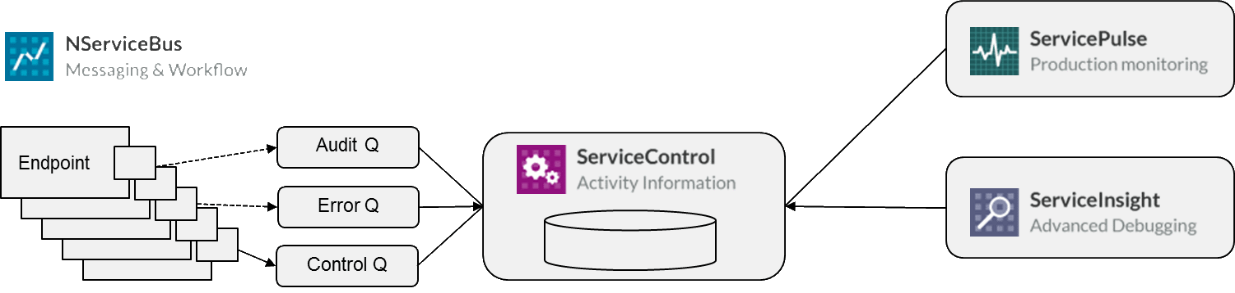
NServiceBus – Service Platform
ServiceControl – Service, information repository
ServiceInsight – Desktop app, debugging
ServicePulse – Web app, monitoring
ServiceMatrix – VS extension, tooling

