Slide 1
Microservices
Lukas Kudela
(2015-10-02)

Slide 2
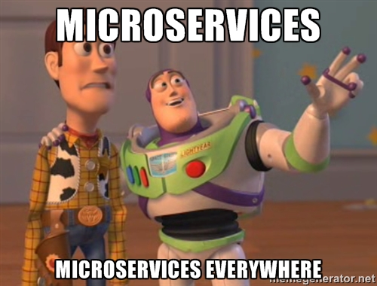

Slide 3
Overview
Principles
Microservices in general
Patterns
Useful for building microservices
Practices
Microservices at Netflix

Slide 4
Principles
Microservices in General

Slide 5
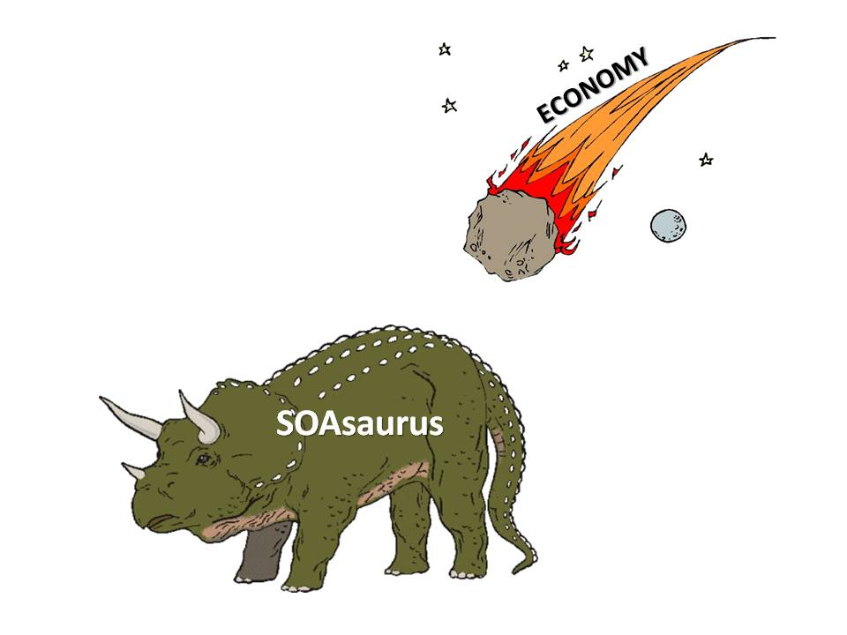
SOA Is Dead; Long Live Services
Although the word “SOA” is dead, the requirement for service-oriented architecture is stronger than ever.

Slide 6
Microservices – TL;DR
An architectural style of developing a single application as a suite of small services
Each service running in its own process
Services communicate with lightweight mechanisms, often an HTTP resource API
Services are built around business capabilities
Services are independently deployable by fully automated deployment machinery
Bare minimum of centralized management of the services
Services may be written in different programming languages and use different data storage technologies

Slide 7
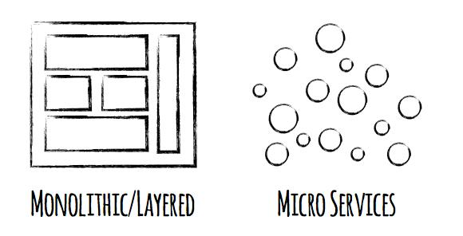
Microservices vs. Monolith

Slide 8
Componentization via Services (1)
Component
Unit of software that is independently replaceable
Library
Component linked into a program and called using in-memory function calls
Fine-grained communication
Service
Out-of-process component communicating using WS request or RPC
Coarse-grained communication

Slide 9
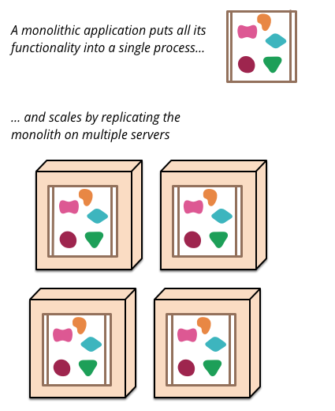
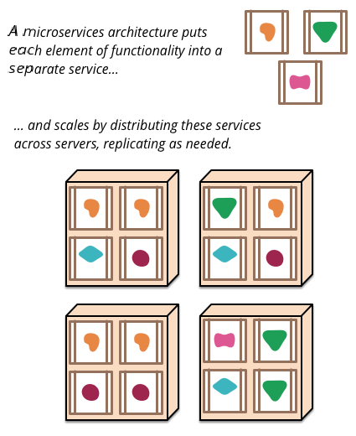
Componentization via Services (2)
Monolith
Microservices

Slide 10

Organized Around Business Capabilities (1)
Conway’s Law: “Any organization that designs a system (defined broadly) will produce a design whose structure is a copy of the organization's communication structure.”
Bounded Context
DDD pattern
Boundary where ubiquitous language is consistent
Each subdomain lives in its own BC

Slide 11
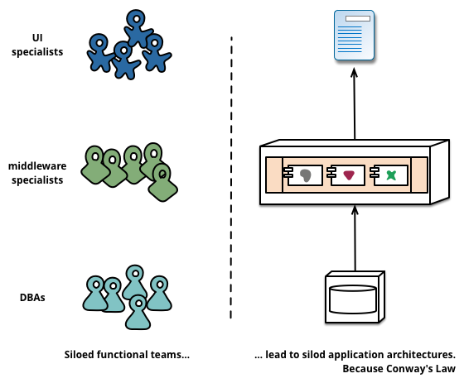
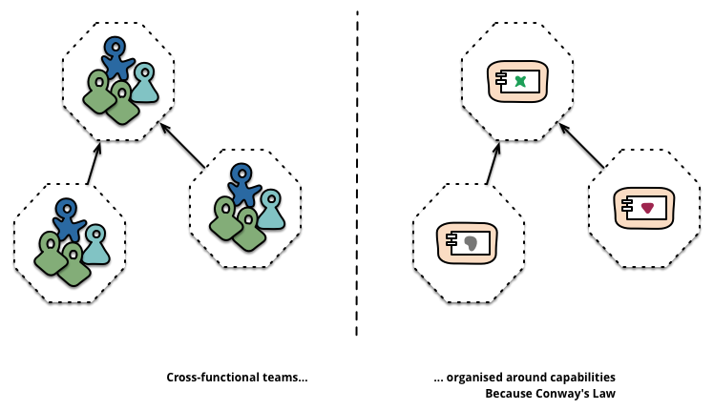
Organized Around Business Capabilities (2)
Functional/siloed teams
Cross-functional teams

Slide 12
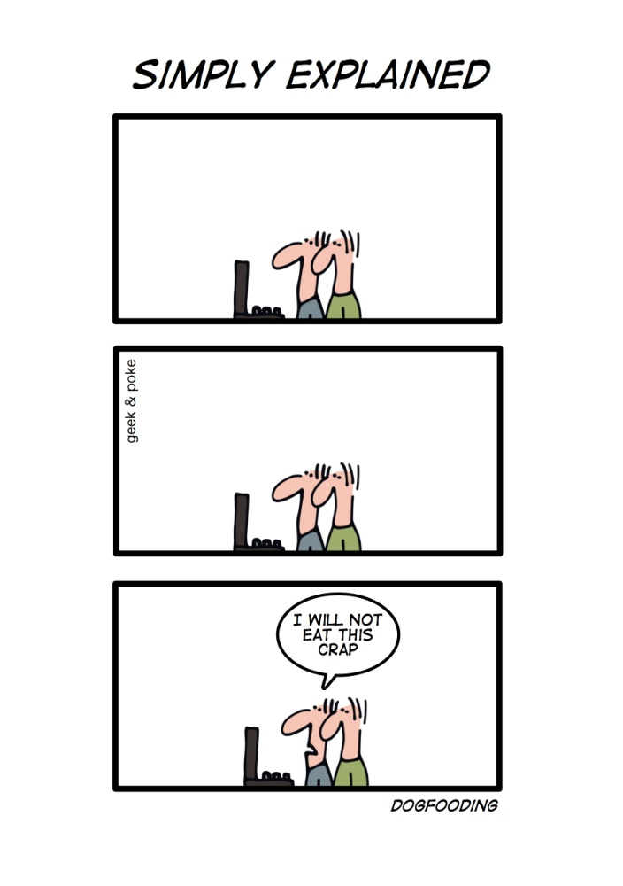
Products, Not Projects
A team should own a product over its full lifetime
Development team takes full responsibility for the software in production
“You build it, you run it!” (Amazon)
Dogfooding

Slide 13

Smart Endpoints and Dumb Pipes
Simple protocols
HTTP/REST
Lightweight messaging (RabbitMQ, ZeroMQ)
Think filters in Unix
Compare with ESB
Smart pipes
Complex protocols: WS-Choreography, BPEL

Slide 14
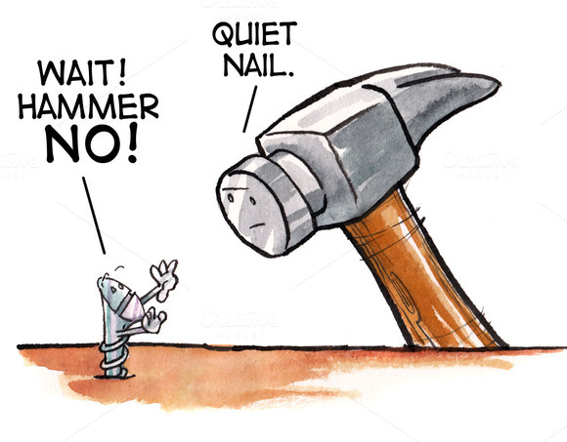
Decentralized Governance
Not every problem is a nail and not every solution a hammer
Written standards vs. Shared tools
In-house open source practices (Netflix)
Overheads are unattractive
But service contracts are valued
Tolerant Reader
Consumer-Driven Contracts

Slide 15
Decentralized Data Management (1)
Polyglot persistence
Each service manages its own database
Transactionless coordination btw. services
Ditributed transations are notoriously difficult to implement
Eventual consistency
Compensating operations
Often businesses handle a degree of inconsistency in order to respond quickly to demand
Trade-off is worth it as long as the cost of fixing mistakes is less than the cost of lost business under greater consistency

Slide 16
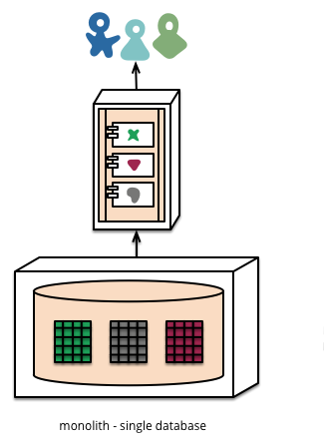
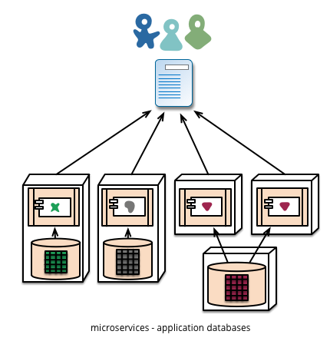
Decentralized Data Management (2)
Single database
Application databases

Slide 17
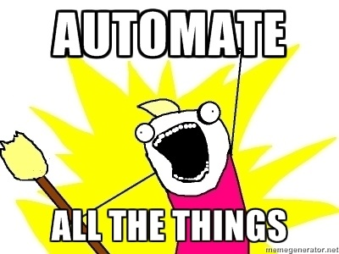
Infrastructure Automation (1)
Cont. Integration/Delivery
Automated tests
Automated deployment
Delivery pipeline
Build promotion
Docker
OS-level/container virtualization tool
Container for packaging app and its dependencies into a standardized deployment unit

Slide 18
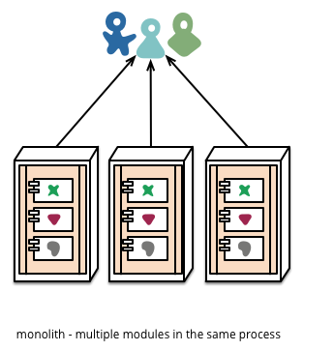
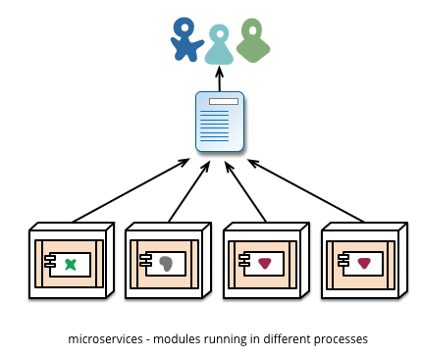
Infrastructure Automation (2)
Monolith
Microservices

Slide 19
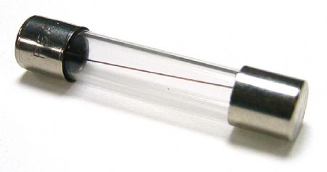
Design for Failure
Services can fail at any time
It’s important to be able to detect the failures quickly and, if possible, automatically recover
Event collaboration leads to emergent behaviour
Emphasis on real-time monitoring & logging
Business metrics: How many orders per minute?
Operational metrics: How many requests per second? (throughput, latency)
Stability patterns
Circuit Breaker
Bulkhead
Timeout

Slide 20
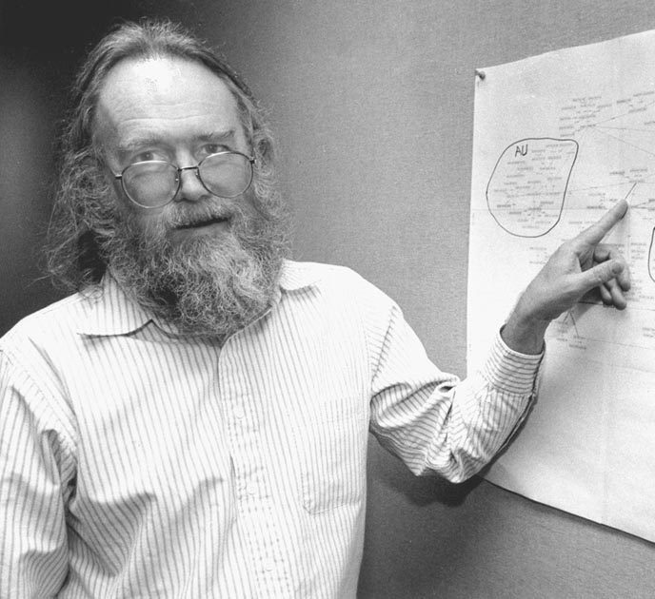
Evolutionary Design
Independent replacement is a key property of components
Postel’s Law (Robustness principle): “Be conservative in what you do, be liberal in what you accept from others.”
Drive modularity through pattern of change
Keep things that change at the same time in the same module
Use versioning only as the last resort
Design services to be as tolerant as possible to changes in their suppliers

Slide 21
PATTERNS

Slide 22
Contract Evolution Patterns
Tolerant Reader
Postel’s Law: Be conservative in what you do, be liberal in what you accept from others.
Tolerant Reader (M. Fowler)
Consumer-Driven Contracts
Consumer-Driven Contracts (I. Robinson)

Slide 23
Service Stability Patterns
Circuit Breaker
Wrap a RPC in a CB, which monitors for failures. Once the failures reach a certain threshold, the CB trips, and all further calls to the CB return with an error, without the RPC being made at all.
Circuit Breaker (M. Fowler)
Bulkhead
Divide a ship into separate watertight compartments so that a single hull breach doesn’t flood the entire ship.
Timeout

Slide 24
PracticeS
Microservices at Netflix

Slide 25
Microservices – Advice
You shouldn’t start with a microservices architecture.
Instead begin with a monolith, keep it modular, and split it into microservices once the monolith becomes a problem.
However, keep in mind that a good in-process interface is usually not a good service interface.
But... Stefan Tilkov: Don’t start with a monolith when your goal is a microservices architecture.
You’re probably not a trailblazer.
Don’t reinvent the wheel.
Stand on the shoulder of giants (Amazon, Netflix).

Slide 26
Lessons for Architectural Design
Create a separate data store for each microservice
Keep code at a similar level of maturity
Do a separate build for each microservice
Deploy in containers
Docker – de facto standard for containers
Treat servers as stateless
Netflix delivery architecture is built on nginx (“engine x”)
High-performance web server with strong focus on high concurrency
Can also act as reverse proxy, load balancer and HTTP cache
Free & open-source

Slide 27
Lessons for Team and Process Design
Optimize for speed, not efficiency
Tooling your software development process so that you can react quickly to what your customers want
Making sure your assumptions are still true
“It’s not what we don’t know what hurts us. It’s what we know that ain’t so.”
Put your infrastructure in the Cloud
Self-service Cloud makes formerly impossible things instantaneous
Create a high-freedom, high-responsibility culture with less process
Single guideline: “Act in Barclays’ best interest.”
Replace silos with microservice teams
and use the DevOps methodology
Adopt Continuous Delivery, guided by the OODA loop
Observe, Orient, Decide, Act

Slide 28
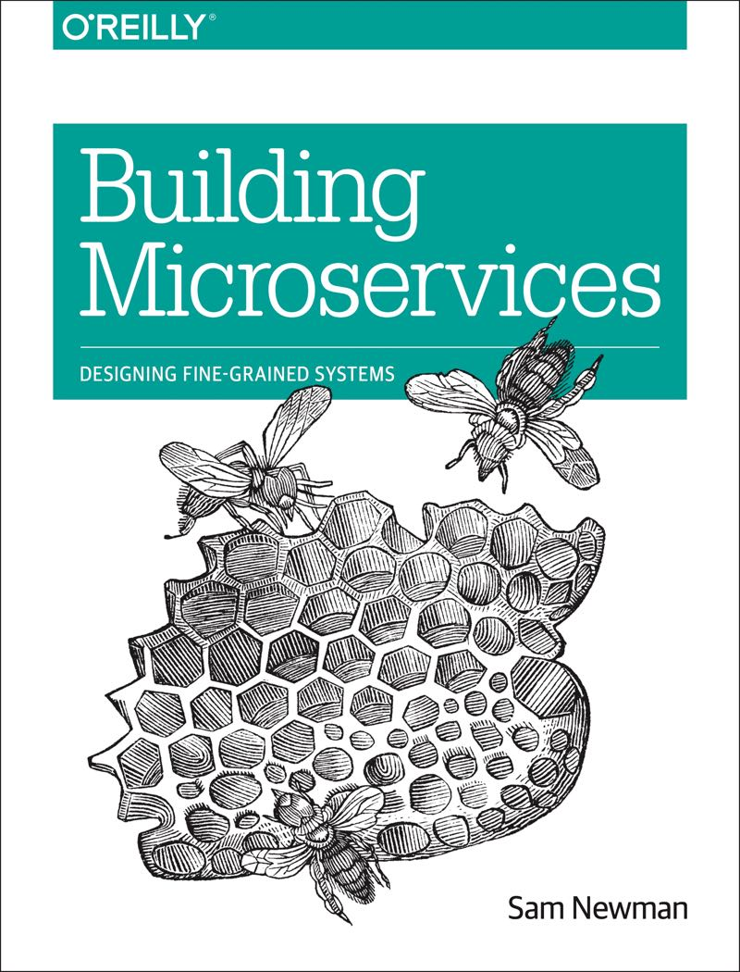
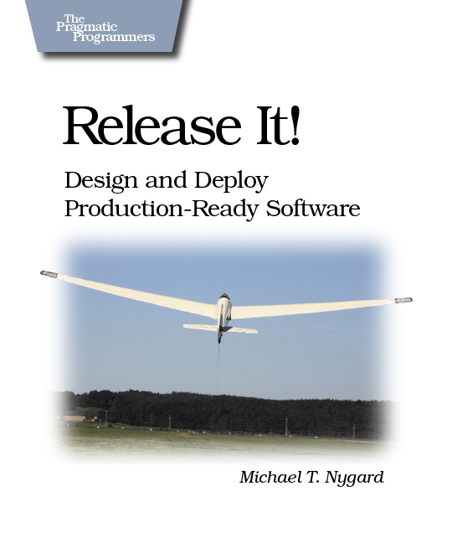
Resources
Microservices
Article
Martin Fowler, James Lewis
Building Microservices
Book
Sam Newman
Release It!
Book
Michael T. Nygard

Slide 29
Further Topics
Event-Driven Microservices
Developing event-driven microservices with event sourcing and CQRS (C. Richardson)
Event Sourcing
Event Sourcing (M. Fowler)
CQRS – Command Query Responsibility Separation
CQRS (M. Fowler)
RESTful Web API Design
Docker
De facto standard for OS-level (container) virtualization
DevOps & Continuous Delivery

Slide 30
FIN

