Slide 1
NServiceBus
Lukas Kudela
2016

Slide 2

About
Service bus
Not ESB, just SB!
Developed by Particular Software
Originally by Udi Dahan (founder)
Written in C#
Proprietary lincense
particular.net

Slide 3
Architectural Principles

Slide 4
Basic Message Exchange Patterns
Fire-and-forget
a.k.a. one-way
Request/response
a.k.a. request/reply, two-way, RPC
Request/callback
a.k.a. asynchronous request/response, asynchronous RPC
Higher level of abstraction!
Implemented using 2× fire-and-forget
Publish/subscribe
Higher level of abstraction!
Implemented using request/response & fire-and-forget

Slide 5
Store-and-forward
One-way messaging
Client process is oblivious to communication interferences
Server down
Firewall slowing down the transfer
Target process down
Critical resources (threads) are not held waiting for the call to complete
This prevents the client process from losing stability

Slide 6
(Asynchronous) Request/response
“Two-way” messaging
Well… 2× one-way messages
Used in conjunction with durable messaging
Messages are persisted to disk locally before attempting to send them
Compare with store-and-forward

Slide 7
Publish/subscribe
One-to-many messaging
Loosely coupled
Subscribers don’t necessarily have to subscribe themselves
Subscription service
Multiple physical subscribers acting as one logical subscriber
Load balancing
Published messages typically represent events
Periodic vs. continuous publishing

Slide 8
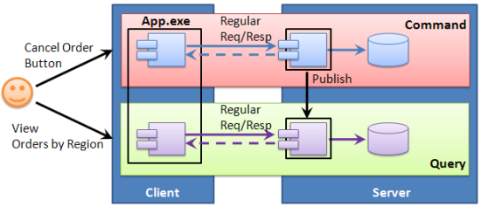
CQRS
Command-Query Responsibility Segregation
Similar idea to CQS – Command-Query Separation (B. Meyer)
Separates commands & queries at the system level
Two services:
Commands – CRUD – transactional DB
Queries – CRUD – reporting DB
Span both client & server
Communicate only via messages

Slide 9
Concepts

Slide 10
Message
Two types of messages:
Command – should be sent to a receiver
Events – should be published to subscribers
Capture intent & help enforce messaging best practices
Defined via
Marker interfaces or
Conventions
Marker interfaces
IMessage
ICommand IEvent

Slide 11
Message conventions and Unobtrusive mode
A way of defining what a certain message type is
Instead of using a marker interface or an attribute
Avoids referencing NServiceBus from the message assembly
Conventions for:
Encrypted properties
DataBus properties
Express messages
Time to be received

Slide 12
Message headers
Extra information about a message
Similar to HTTP headers
Header examples:
Serialization
Messaging interaction
Audit
Encryption
…
Custom

Slide 13
Publish/subscribe
A Subscriber lets the Publisher know they're interested in an Event
The Publisher stores the Subscriber’s address so that it knows where to send the Event
Two implementations of pub/sub mechanics:
Native
For transports with persistence
Typically brokers, e.g. RabbitMQ, Azure Service Bus
Emulated
For transports without persistence
Typically simple queues, e.g. MSMQ, SQL Server, Azure Storage Queues

Slide 14
Message handlers
public class MyHandler : IHandleMessages<MyMessage>
{
public void Handle(MyMessage message)
{
// Process message
SomeLibrary.SomeMethod(message.Data);
}
}
Receiving a message for which there are no message handlers is considered an error
Such messages are forwarded to the error queue

Slide 15
Sagas
Model long-running business processes
Processes with more than one remote calls
Require transactional consistencies
The first call may succeed, but the second might fail. What now?
Stateful
In-memory (dev)
Persisted (prod)
In essence, saga is a message-driven state machines
Alternative: Routing slip - Stateless workflow pattern

Slide 16
Sidebar: Transactions - terminology
Distributed transaction
Multiple hosts, transaction manager & transactional resources
Long-lived transaction (LLT)
No locks, no rollbacks, compensating actions, coordinator, can aggregate multiple atomic transactions
Modeled with sagas
Atomic/ACID transaction
Locks, rollbacks
Workflow
Business process, internal ("workflodize") vs. external ("orchestrated choreography", BPM)
Process Manager
Workflow pattern described in Enterprise Integration Patterns by G. Hohpe
Saga
Transactional model for long-lived activities
Set of component & compensating transactions

Slide 17
Automatic retries
First-level retries (FLR)
NSB automatically retries the message when an exception is thrown during message processing
Up to 5 times (by default)
Second-level retries (SLR)
Messages that fail all FLRs are sent to the retries queue, kept there for a while, and re-sent to the original worker queue
Up to 3 times × 10 second (by default)
Total no. of retries = (SLR + 1) × FLR

Slide 18
Error handling
NSB has its own error handling logic
Surrounds all calls to the user code
Exceptions cause rollbacks on transactional endpoints
Message is returned to the queue
Sent/published messages are undone
When a message fails, it’s automatically retried
On repeated failure, it’s forwarded to the error queue
Monitor the error queue with ServiceInsight or ServicePulse
If not available, use native management tools (scripting)

Slide 19
Message handling pipeline (Done)
Series of actions taken when
an incoming message is processed and
an outgoing message is sent
Customizing the pipeline
Custom behaviors
Message mutators
Aborting the pipeling
Features built on the pipeline
DataBus
Encryption
Second Level Retries (SLRs)

Slide 20
Message encryption
Leverages the pipeline to apply encryption to the whole message body
public class MessageEncryptor : IMutateTransportMessages
{
public void MutateIncoming(TransportMessage transportMessage)
{
// Decrypt
}
public void MutateOutgoing(LogicalMessage logicalMessage, TransportMessage transportMessage)
{
// Encrypt
}
}
Enabling message encryption
BusConfiguration busConfiguration = new BusConfiguration();
busConfiguration.RegisterComponents(c =>
c.ConfigureComponent<MessageEncryptor>(DependencyLifecycle.InstancePerCall));

Slide 21
Property encryption
Keeps the performance impact of encryption as low as possible
Rijndael (AES)
Two ways to specify which properties to encrypt
Special property type
WireEncryptedString
Convention
E.g. property names ending with “Encrypted”
Enabling property encryption
BusConfiguration busConfiguration = new BusConfiguration();
busConfiguration.RijndaelEncryptionService();

Slide 22
Transports
NServiceBus is built on top of existing queuing technologies
Available transports
RabbitMQ
MSMQ
SQL Server
Azure
Service Bus
Storage Queues
… and others (community-supported)

Slide 23
Auditing
Built-in message auditing for each endpoint
Forwards messages to a specified audit queue
Recommendation: central audit queue for all related endpoints
Required by ServiceControl
Configuration
Code
BusConfiguration busConfiguration = new BusConfiguration(); busConfiguration.AuditProcessedMessagesTo(“audit_queue");
App.config
<AuditConfig QueueName="audit_queue@admin_machine" />
IProvideConfiguration

Slide 24
Message serialization
Messages are .NET types → Need to be serialized/deserialized over a transport
Available serializers
XML (default)
JSON/BSON
Binary
… and others (community-supported)
Configuration
BusConfiguration busConfiguration = new BusConfiguration();
// XML serialization as default
busConfiguration.UseSerialization<XmlSerializer>();
// Additional JSON deserialization
busConfiguration.AddDeserializer<JsonSerializer>();

Slide 25
Message persistence
Various features of NSB require persistence (subscriptions, sagas, outbox, …)
Available persistences
In-Memory (default)
Suitable for development
RavenDB
Document (NoSQL) database
NHibernate
Any data store with ADO.NET Data Provider
MSMQ subscription storage
Azure storage
… and others (community-supported)

Slide 26
Dependency injection
NSB relies heavily on DI to manage services & state
Available containers
Autofac (default, built-in, ILMerged)
Ninject
Castle Windsor
StructureMap
Spring
Unity
… and others (via plugin)

Slide 27
Logging
Limited, opinionated logging built-in
For more advanced logging, use
log4net
NLog
CommonLogging
It is important to configure logging before any bus configuration is done
Program.Main()
Global.Application_Start()
IConfigureThisEndpoint.ctor()

Slide 28
Hosting
NSB is a library → Can be hosted in any .NET process
Hosting options
Self-hosting
Windows service
Web application/service
ASP.NET MVC/Web API, WCF, NancyFX, ServiceStack
NServiceBus.Host
Opinionated approach → New concepts: Profiles, Custom installation
Automates parts of Windows service deployment
Windows service or Console application (for development purposes)
Multi-hosting
Multiple endpoints in a single .NET process (single AppDomain)

Slide 29
Assembly scanning
By default, NServiceBus scans all assemblies in the endpoint bin folder to find types implementing its interfaces so that it can configure them automatically
Exclude assemblies from scanning
IExcludesBuilder excludesBuilder = AllAssemblies .Except("MyAssembly1.dll") .And("MyAssembly2.dll");
busConfiguration.AssembliesToScan(excludesBuilder);
Excelude specifi types
busConfiguration.ExcludeTypes(type1, type2);

Slide 30
NServiceBus and WCF
NServiceBus endpoints can be exposed as WCF services
Leverage features of WCF such as interoperability
Without giving up features of messaging such as reliability & scalability
Write an empty class that inherits from WcfService
Specify the types of Request & Response
public class MyService : NServiceBus.WcfService { }

Slide 31
Service Platform

Slide 32
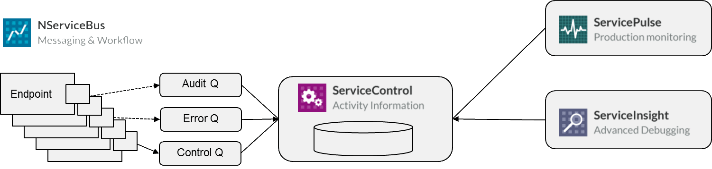
Overview

Slide 33

ServiceControl
Invisible service
Runs on a central server
Stores information about every message running through the system
Uses an embedded RavenDB database
Exposes a RESTful API, allowing rest of the Service Platform to access the data
Default URL: http://localhost:33333/api

Slide 34

ServiceInsight
Desktop application
GUI to visualize data provided by ServiceControl
Debugging
Understand what is happening
Return a failed message to its original source

Slide 35

ServicePulse
Web application
Displays the health of the system
Which endpoints are running & responsive, and which may have failed
Messages that have failed – retry or archive?
Configure custom health checks for external resources
Default URL: http://localhost:9090

Slide 36

ServiceMatrix
Visual Studio extension
Graphical tool for prototyping/building NServiceBus systems quickly
Project templates
Boilerplate generation

Slide 37
NServiceBus vs. RabbitMQ
NServiceBus advantages over RabbitMQ
Message serialization/deserialization
Neat model for message dispatching
Handlers, handler pipeline, polymorphic dispatch
Unit of work
Neat saga implementation
Host process
F5-debuggable
Deployable as Windows service
If you use NSB/MSMQ, you get all these features in a broker-less mode

