Slide 1
Service-Oriented Architecture
Lukas Kudela
2015-09-11

Slide 2
Outline
Purpose
Clear up SOA-related terminology
Map contemporary SOA landscape
Kick-start SOA implementation discussion
SOA 1.0 – Web Services
SOA 2.0 – Event-Driven SOA
Queues, Brokers & Buses
Microservices

Slide 3
SOA 1.0 Web Services
Why dinosaurs didn’t survive the asteroid impact

Slide 4
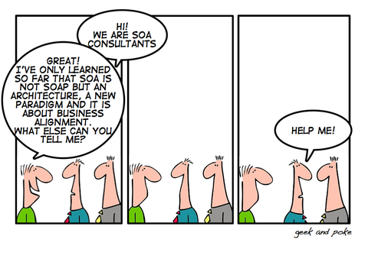

Slide 5
SOA Principles (1)
Standardized contract
Services within the same service inventory are in compliance with the same contract design standards
Loose coupling
Service contracts impose low consumer coupling requirements and are themselves decoupled from their surrounding environment
Abstraction
Service contracts only contain essential information and information about services is limited to what is published in service contracts
Reusability
Services contain and express agnostic logic and can be positioned as reusable enterprise resources

Slide 6
SOA Principles (2)
Service autonomy
Services exercise a high level of control over their underlying runtime execution environment
Statelessness
Services minimize resource consumption by deferring the management of state information when necessary
Discoverability
Services are supplemented with communicative metadata by which they can be effectively discovered and interpreted
Composability
Services are effective composition participants, regardless of the size and complexity of the composition

Slide 7
Web Services (1)
Software system designed to support interoperable machine-to-machine interaction over a network (W3C)
Interface described in machine-processable format (WSDL)
Clients interact in a manner prescribed by its description
using SOAP messages
with XML serialization
over HTTP
2 major types of Web Services
RESTful WS – uniform set of stateless operations to manipulate (representations of) Web resources
Arbitrary WS – arbitrary set of operations

Slide 8
Web Services (2)
4 key technologies
SOAP – Simple Object Access Protocol
XML-based protocol for accessing Web Services
WSDL – Web Service Description Language
XML-based language for describing Web services
UDDI – Universal Description, Discovery, and Integration
XML-based service registry (White/Yellow/Green Pages)
XML
Gazillions of WS-* specifications
“Any time you need an ontology to manage your ontologies you’re in deep trouble”

Slide 9

SOAP Simple Object Access Protocol
Lightweight protocol for exchanging structured information in decentralized, distributed environments (W3C)
Design goals
Simplicity
Extensibility
Features defined as extensions (WS-*)
Routing, Reliability, Security, Correlation
Message format: XML InfoSet
Transport: HTTP, SMTP, TCP, UDP, JMS

Slide 10
WSDL Web Service Description Language
XML-based interface definition language used for describing the functionality offered by a web service
Abstract Section
Types (Messages)
Interfaces (PortTypes)
Operations
Input types
Output types
Concrete Section
Bindings
Services
Endpoints (Ports)

Slide 11

REST & HATEOAS REpresentational State Transfer
REST – REpresentational State Transfer
Resources uniquely identified – URI
Resources decoupled from their representations
HTML, XML, JSON, ...
Resources manipulated though a fixed set of CRUD operations and their representation
HTTP’s POST, GET, PUT and DELETE
Stateless interaction – HTTP
Stateful interaction through hyperlinks (HATEOAS)
HATEOAS – Hypermedia as the Engine of Application State
Client has no prior knowledge about how to interact with the service beyond generic understanding of hypermedia (“URIs in representations”)
Decouples client and server, allows the server functionality to evolve independently
Essential part of REST according to Roy Fielding

Slide 12

JaBoWS Just a Bunch of Web Services
SOA is an architectural style, a set of principles
Business/IT alignment
Web Services is a set of specifications
Tools for building SOA
Different level of abstraction
But what happens when we focus on tooling only, ignoring processes & people?
JaBoWS = Just a Bunch of Web Services!
JaBoWS = Tools + Existing processes

Slide 13
SOA 2.0 Event-Driven SOA
How we learned to do it better

Slide 14
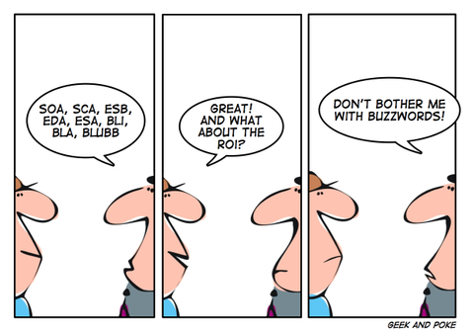

Slide 15
EDA Event-Driven Architecture
Publishing & consumption of “events”
Event itself vs. event notification
Asynchronous communication, loose coupling
Event flow layers
Event generator (publisher, source)
Event channel (queue)
Event processing engine (consumer, sink)
Downstream event-driven activity (consequences)

Slide 16
Event Processing
Tracking & analyzing streams of events
Event processing styles
Event stream processing (ESP)
High-volume streams of events
Complex event processing (CEP)
Complex events inferred from patterns of events
Examples
Algorithmic trading (ESP)
Credit card fraud detection (CEP)
Business activity monitoring

Slide 17
Event-Driven SOA a.k.a. SOA 2.0
Event-Driven SOA = EDA + SOA
Essential elements
Multiple low-level system events
No obvious relationship
Correlation detected by pattern recognition (CEP)
Data enrichment
Based on the intent of the high-level business event to eventually be triggered
High-level business event created when a trigger condition is met
Human/automated process invoked by the triggered business event
Composition
Orchestration (SOA 1.0) – relies on central coordinator
Choreography (SOA 2.0) – doesn’t rely on central coordinator

Slide 18
Queues, Brokers & Buses
Why terminology matters

Slide 19


Slide 20
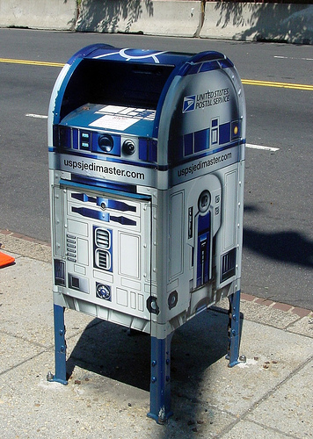
MOM Message Oriented Middleware
SW/HW infrastructure supporting sending & receiving messages between distributed systems
Possibly running on heterogeneous set of platforms
Examples
Standards
AMQP – Advanced Message Queuing Protocol
Supports both one-to-one and one-to-many comm
XMPP – eXtensible Messaging and Presence Protocol
Built for one-to-one comm; one-to-many via extension

Slide 21

AMQP Advanced Message Queuing Protocol
Open-standard application-layer protocol for MOM
“The HTTP of messaging”
Cross-platform and language agnostic
Wire-level protocol
Low-level application-layer protocol used to describe a common way to represent information at the application level (e.g. SOAP for WS)
Main characteristics:
Open
Standard
Interoperability
Reliability
Security

Slide 22
Types of MOM
Message Queues (store-and-forward)
MS Message Queuing (MSMQ)
Message Brokers
MS BizTalk – Integration server (EAI & BPM)
SQL Server Service Broker
IBM MQ
Solace (Virtual) Message Router
RabbitMQ/EasyNetQ
Service Bus
NServiceBus (by Particular)
MassTransit (by Pandora)
Enterprise Service Bus
MS Windows Azure Service Bus
IBM Integration Bus
Neuron ESB (by Neudesic)

Slide 23
ESB Enterprise Service Bus
ESB = SOA + MOM + EAI
Enterprise application integration of heterogeneous landscapes
Smart pipes, dumb endpoints (“SOA 1.0”)
Often, ESB modifies the messages it transports
Complex message routing
Content-based routing
Dynamic routing (dynamic rulebase)
Message transformation
Content filtering/enrichment
Normalization
After the perceived failure of “SOA 1.0” many products dropped the “ESB” tag

Slide 24

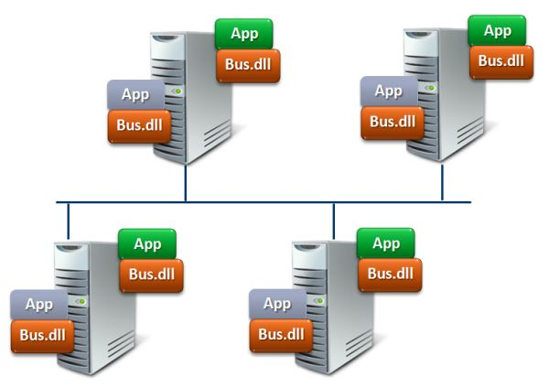
Message Broker vs. Service Bus (2)
Message broker
Centralized
Hub-and-spoke
Service bus
Decentralized
It’s everywhere and nowhere at once
Think Ethernet – Smart adapter & dumb wire

Slide 25
Message Broker vs. Service Bus (2)
Accountability rule: There can only be a single publisher for a given event type (topic)!
Message broker
Multiple endpoints publish messages under a given topic
Which is message is right?
No responsibility, no single source of truth
Service bus
Only one logical endpoint publishing a given type of event
Can be scaled out across multiple physical endpoints
Bus’ responsibility is to make this transparent for subscribers

Slide 26

RabbitMQ
Free (Mozilla PL) & open-source
Cross-platform, written in Erlang
Features
Performance vs. Reliability
Persistence
Delivery acknowledgement
Publisher confirms
Highly-available (mirrored) queues
Clustering/federation
Highly-available queues
Flexible routing
Polyglot
Multi-protocol:
Many languages
Monitoring
Management UI
Tracing
Extensibility
Plugin system
Support
Commercial support
Large community

Slide 27
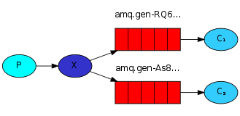
RabbitMQ – Messaging model
Producer – user application that sends messages
Consumer – user app that receives messages
Queue – buffer that stores messages
Exchange – router
Binding – rel. between exchange & queue
Core idea: Producer never sends any messages directly to a queue
Doesn’t even know if a message will be delivered to any queue at all

Slide 28
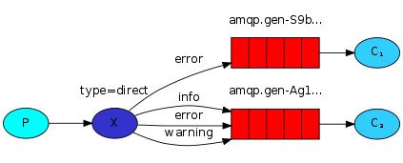
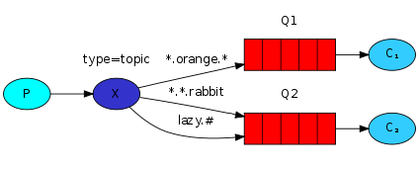

RabbitMQ – Exchanges
Exchange types:
Fanout
Direct
Topic
Headers

Slide 29
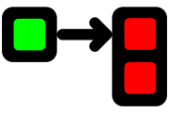
EasyNetQ
Simple to use, opinionated .NET API for RabbitMQ
Trades flexibility for simplicity by enforcing simple conventions
Messages should be represented by .NET types
Messages should be routed by their .NET type
Messages – DTO-like POCOs
Configurable via DI

Slide 30
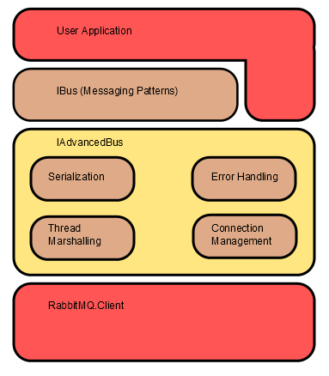
EasyNetQ – APIs
IAdvancedBus
Low-level API
AMQP-like
Components can be replaced
IBus
High-level API
Opinionated (80%)
Messaging patterns
Send/receive
Request/response
Publish/subscribe

Slide 31
EasyNetQ – Why do I need it?
RabbitMQ already has a .NET client!
EasyNetQ sits on top of RabbitMQ .NET client and provides:
Messaging patterns
Routing strategy
Exchange-queue bindings
Message (de)serialization
Consumer thread for subscriptions
Dedicated thread with a loop waiting for subscribed messages
Subscriber reconnection
Detection & subscription rebuilding
Error-handling strategy
Publisher confirms
Callback when a message has been successfully received by the broker

Slide 32

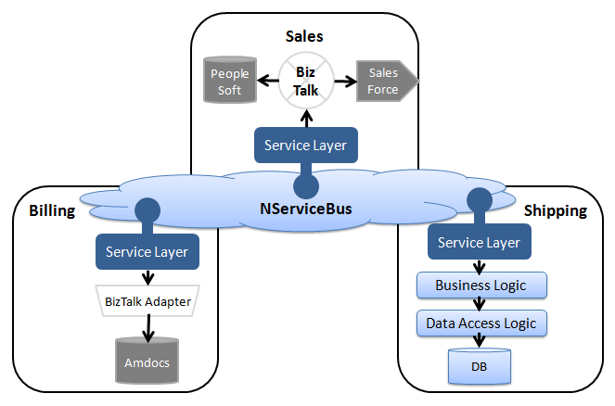
NServiceBus
Commercial & open-source
Message types
Command – multiple senders/single receiver
Event – single sender/multiple receivers
Configurable
Message transport (MSMQ, RabbitMQ, SQL Server)
Persistence (In-memory, Polyglot persistence)
Message serialization (XML, JSON, BSON, Binary)
DI container (Autofac, Unity)
Send/receive behaviour pipeline (CoR pattern)
Service Platform
Production monitoring (ServicePulse)
Advanced debugging (ServiceInsight)
Modeling & design (ServiceMatrix)

Slide 33
NServiceBus – Features
Message versioning using interfaces
Polymorphic dispatch
Multiple inheritance → Multiple base subscribers
Support for managing UoWs
Property encryption
Transporting large payloads
DataBus
Exposing web services
Sagas – Long-running business processes
Vs. scheduled batch jobs

Slide 34
Thoughts on Messaging Façades
Popular advice says to always wrap third-party dependencies
You never know when you might need to swap them
But there are downsides
Narrow façade
Forsaking special features of individual messaging technologies
Wide façade
Pledging to simulate features if they’re not available natively
For example, NServiceBus is already a messaging facade itself
Hiding complexities of MSMQ and RabbitMQ

Slide 35
FIN

