Slide 1
Global Commercial
Talent Management System
Training and online help file
To return to the contents page
To move to the next page
To return to the previous page
To view a sample screen

Slide 2
Table of Contents
THE BASICS
  Logging on & Data Protection
  Moving around the system
WORKING WITH PEOPLE INFORMATION
  Finding People
  Editing People
  Adding People
  Deleting People
  Finding, Adding and Editing People Documents
  Changing a person’s role
WORKING WITH POSITION INFORMATION
  Finding Positions / Roles
  Editing Positions
  Adding Positions
  Changing Reporting Lines
  Deleting Positions
  Finding and Editing Succession Plans
USING THE SYSTEM INFORMATION IN YOUR TALENT REVIEW PRESENTATION
  Reports – Overview
  AOP Algorithms
  Talent Matrix – Inserting to PowerPoint
  Talent Matrix – A Guide to Symbols and Colours
  Succession Planning – Inserting to PowerPoint
  Succession Planning – Good Practice Guide
FURTHER INFORMATION AND CONTACTS
  Glossary
  Contacts

Slide 3
The basics

Slide 4
Logging on & Data Protection
Every time you log on to www.gctms.com you are agreeing to the Data Protection Statement that appears on the logon screen. Please read this statement carefully.
Your logon address is the first part of your e-mail address before @astrazeneca.com and is always in lowercase. For example:
  john.smith
  john.r.smith
  john.smith2
If you have forgotten your password, click on the “Forgotten password” link, follow the onscreen instructions and you will receive your password directly your e-mail account.
If you do not have a logon account, please contact your system administrator.

Slide 5
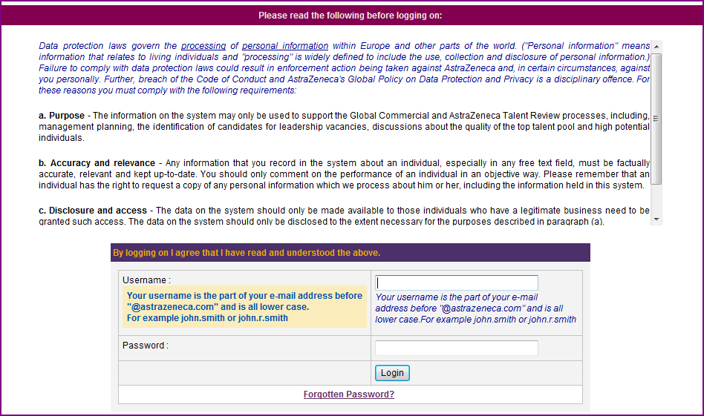
Logging on & Data Protection

Slide 6
Moving around the system
Please use the Tabs, Menu items and “Back” links to navigate around the system
Using the back and forward buttons on Internet Explorer may cause the system to close without saving any changes you have made

Slide 7
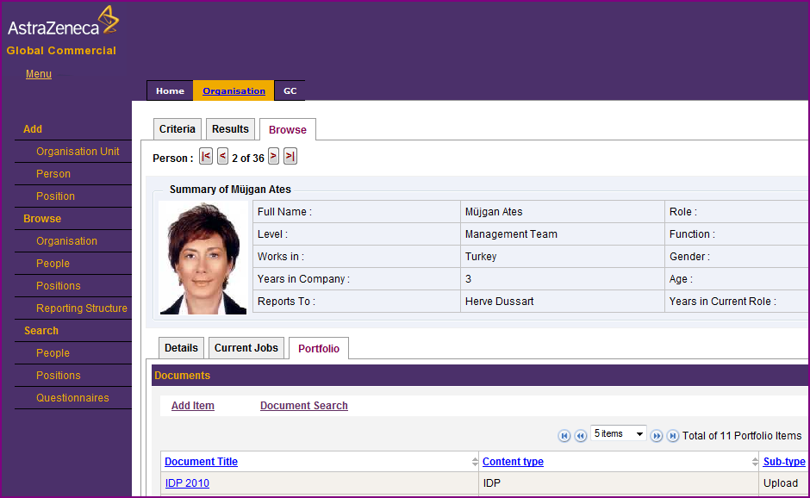
Moving around the system

Slide 8
Working with people information

Slide 9
Finding People
From the “Home” tab you can select “All People” from the navigation menu on the left side of the screen
  This will show you all records that you have authorisation to read and edit
To find just one person or a group of people, you can select the “Organisation” tab, then select Search > People:
  One person: enter all or part of the name in the First Name and Last Name boxes*
  A group of people, eg All Management Team: select the appropriate group of people from the list in the “Population” box
  Then click “Search”
The system requires an exact match for characters. So if you wish to find José, and you type Jose, it will not find the correct record. If you are unsure, you can type Jos, or Jo and it will find all names that contain those letters.

Slide 10
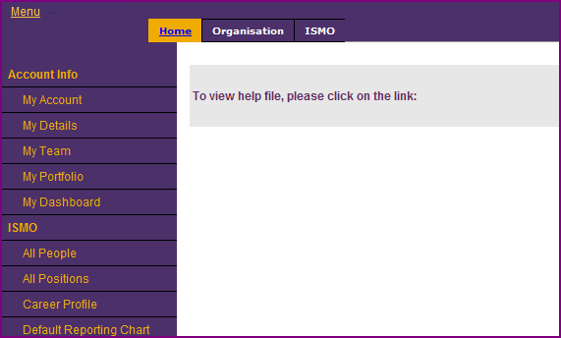
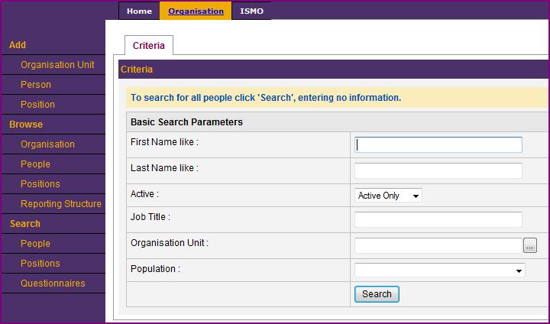
Finding People
GC
GC

Slide 11
Editing People
Find the person whose details you wish to update
  How do I find a Person?
Click on the “Details” tab for that person, then select “Edit”
  Now you can change the person’s name, nationality, start date with the company, current role start date, etc
  When you have finished, click “Save”

Slide 12
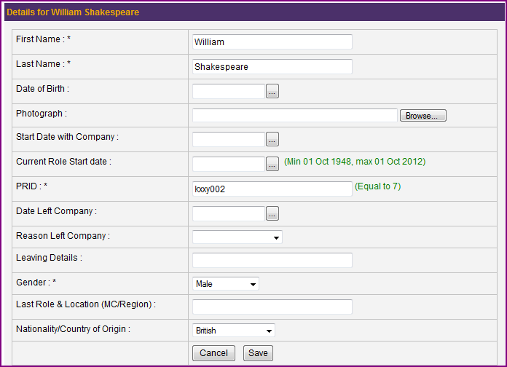
Editing People

Slide 13
Adding People (1 of 2)
From the “Organisation” tab, click “Add Person”.
  Please note: if you also need to add a new role for this person, you will need to add that role first. Click here for instructions. If the role already exists in your location, you should not add that role again.
Complete the details on the next screen
  All fields marked with a * are mandatory. You cannot proceed without completing this information.
  To find a person’s PRID (unique employee number) click here to search the People Directory.
  If you see the message This field must be unique it means the record already exists. Do not try to create another record. Contact your System Administrator who can give you access to the existing record.
  We do not record full details for people who are held in the system only for the purposes of appearing on a succession plan, or who are system administrators. Please tick the box if this new person is “Succession or Admin only”.
  Click “Next > >”

Slide 14
Adding People (2 of 2)
Now you need to indicate which role the person holds by clicking on “Add”
  Select the type of placement. Is it Permanent, an International Assignment, a Secondment or are they the interim or Acting role holder?
  Then from the next field, choose which role the person holds by choosing an option in the tree.
  Click “Save”

Slide 15
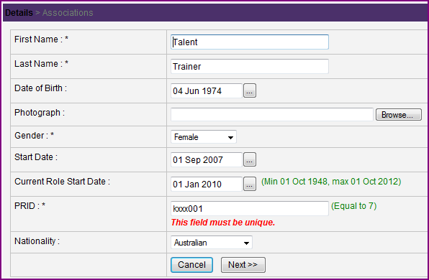
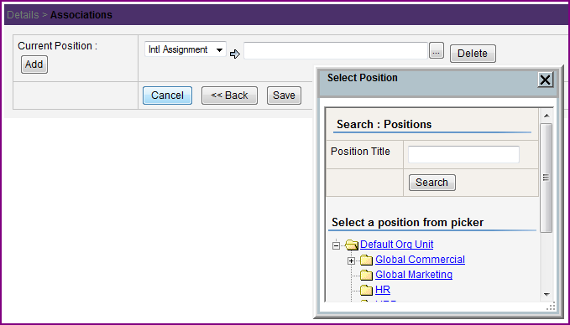
Adding People

Slide 16
Deleting People
If a person has left the organisation
  Go to the Details tab and update the information regarding leaving date, reason for leaving and last role and location
  Then contact your System Administrator to have this record de-activated
  If a record is deactivated in error, it can be retrieved later
  If a person has moved to another part of the organisation
  Go to the details tab and update the information regarding current role start date and last role and location (prior to move)
  Contact your System Administrator to have this linked to their correct new role

Slide 17
Finding, Adding and Editing People Documents – AOP (1 of 2)
When you search for a Person it will automatically take you to the Portfolio tab. The Portfolio contains all the documents relevant to one person.
To view or edit an AOP, scroll down the page to find the group of documents for the appropriate year
  For previous years you can only select “View” as historic documents cannot be edited
  Select View or Edit for the current year AOP
All changes to an AOP are automatically saved
  As you make changes to the AOP, it will automatically save those changes and update any calculations (such as High, Medium or Low for Leadership Capabilities based on the number of Above Target, At Target and Below Target ratings selected).

Slide 18
Finding, Adding and Editing People Documents – AOP (2 of 2)
You must confirm any calculated ratings by selecting the options that start with the text “Manager’s View”
  The Manager’s View ratings are used to calculate nominations to the Talent Pool, confirmation of the Talent Pool and to produce the Talent Matrix
When you have completed all the changes to the AOP, scroll to the bottom of the page and click “Close”
  All changes to the AOP are saved automatically so there is no additional “Save” button

Slide 19
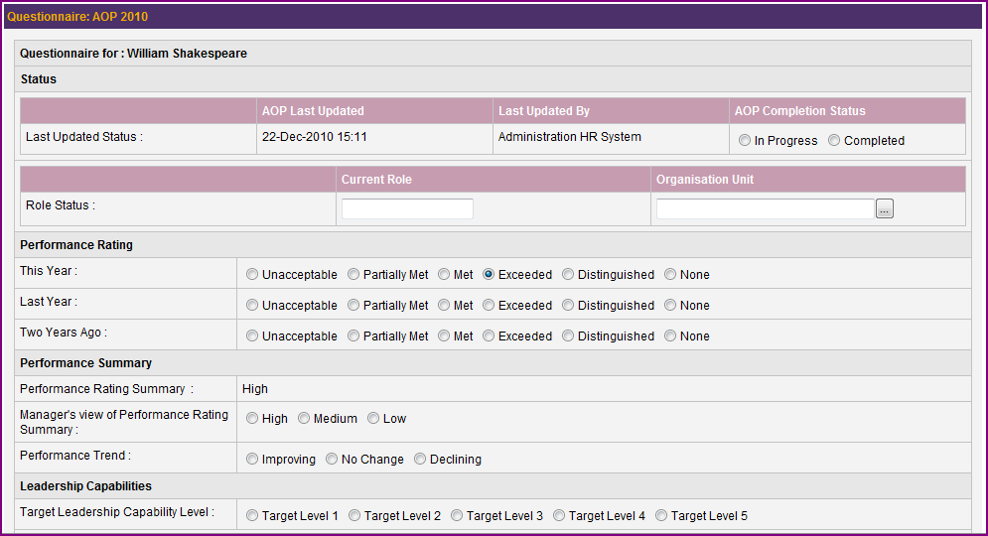
Finding, Adding and Editing People Documents – AOP (1 of 2)

Slide 20
Finding, Adding and Editing People Documents – IDPs, Objectives, CVs (1 of 2)
When you search for a Person it will automatically take you to the Portfolio tab. The Portfolio contains all the documents relevant to one person.
IDPs and Objectives may be completed in two ways. Either:
  Scroll down the page to the grouping of current year’s documents (where the AOP is held) and select “Edit”; or
  Upload a Word, PowerPoint, PDF or other document.
  You do not need to do both.
  Please note: you must complete an AOP using the online form - do not upload a separate document

Slide 21
Finding, Adding and Editing People Documents – IDPs, Objectives, CVs (2 of 2)
To upload a document,
  Click “Add Item”
  Choose the appropriate “Content type” from the drop down list
  The sub-type is already set to “Upload” – you do not need to change this
  Give the document a title. This creates a link on the Portfolio page so should be easily identifiable and should include the person’s name, which document it is, ie IDP, Objectives or CV, and the year.
  Browse your files to find the document on your computer
  Select the Access Permissions. This is currently set to Manager so that those with access to that person’s record can see the document. If you remove this selection, only you can view the item.
  Click “Save”

Slide 22
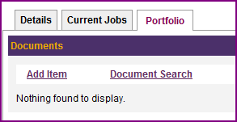
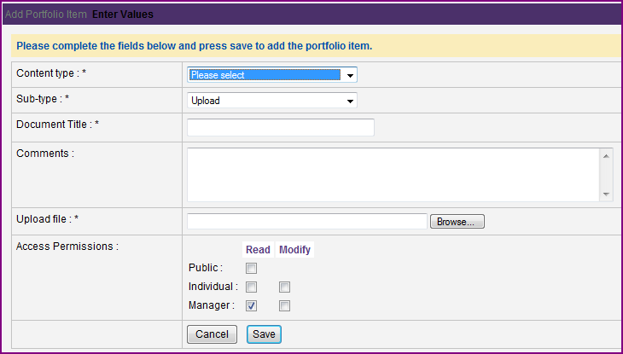
Finding, Adding and Editing People Documents – IDPs, Objectives, CVs (1 of 2)

Slide 23
Changing a person’s role
You can only change the role of someone who is working in your location
  Find a person
  Select the Current Roles tab, then select “Edit”
  Select the type of placement. Is it Permanent, an International Assignment, a Secondment or are they the interim or Acting role holder?
  Then from the next field, choose which role the person holds by choosing an option in the tree.
  Click “Save”
  If the person is moving to or from your location, please contact your System Administrator.

Slide 24
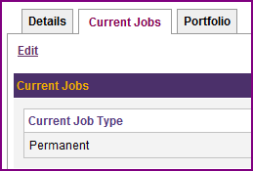
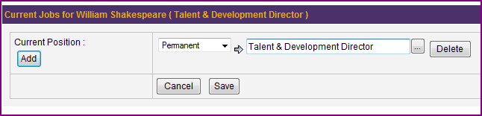
Changing a person’s role

Slide 25
Working with position information

Slide 26
Finding Positions / Roles
From the “Home” tab you can select “All Positions” from the navigation menu on the left side of the screen
  This will show you all records that you have authorisation to read and edit
To find just one position or a group of positions, you can select the “Organisation” tab, the choose Search > Positions:
  A position: enter all or part of the position title in the Title box*
  A group of positions, eg All Management Team: select the appropriate group of positions from the list in the “Population” box
  Then click “Search”
The system does not force a standard format for job titles so please search for full job titles, eg Business Unit Director, and abbreviations, eg BUD, if you cannot find the role you are looking for

Slide 27
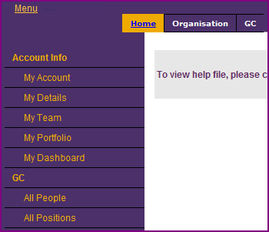
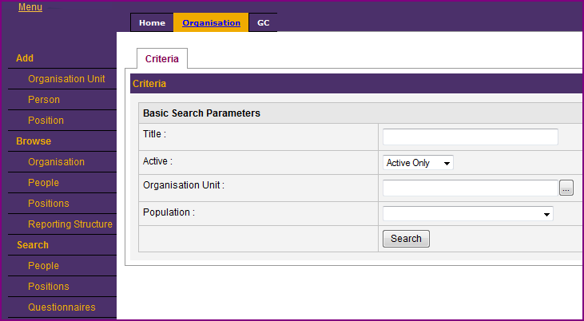
Finding Positions / Roles

Slide 28
Editing Positions
Find the position whose details you wish to update
  How do I find a Position?
Click on the “Details” tab for that position, then select “Edit”
  Now you can change the level of the role, the date the role becomes free, business function etc.
  When you have finished, click “Save”

Slide 29
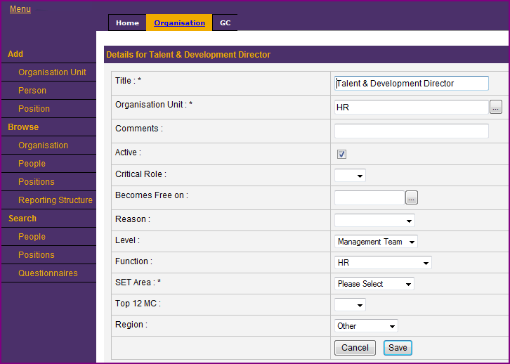
Editing Positions

Slide 30
Adding Positions
From the “Organisation” tab, click “Add Position”.
  Please note: You cannot add a role that reports to someone higher in the organisation than you. For example, if you are an HR Director, you cannot add a new position that reports to your MCP. Your System Administrator can complete this for you. Once the role is in place, you can then add a person to report to that role.
Complete the details on the next screen
  All fields marked with a * are mandatory. You cannot proceed without completing this information.
  Click here for more information on role Levels
  Click “Next > >”
  Select “Direct Report”, then choose the role this role reports to by choosing an option in the tree (for example, a Sales Manager reports to the Sales Director)
  Ignore Succession Position
  Click “Save”

Slide 31
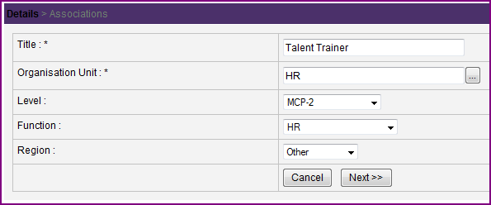
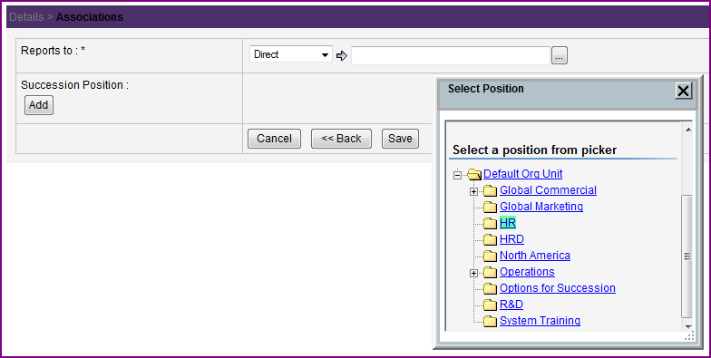
Adding Positions

Slide 32
Changing Reporting Lines
If a role now reports to a different role, eg a Sales Manager previously reported to a Sales Director, but now it reports to a Sales VP
  Click on the “Direct Reporting” tab
  Click “Edit” and select the new “Reports to” role from the tree
  You cannot link a role to someone higher in the organisation than you. Contact your System Administrator for assistance.
  Then click “Save”
  Please note, if a Person has changed roles and now reports to a different person, update the Current Role information for the person

Slide 33
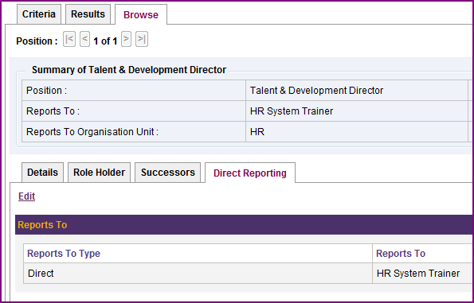
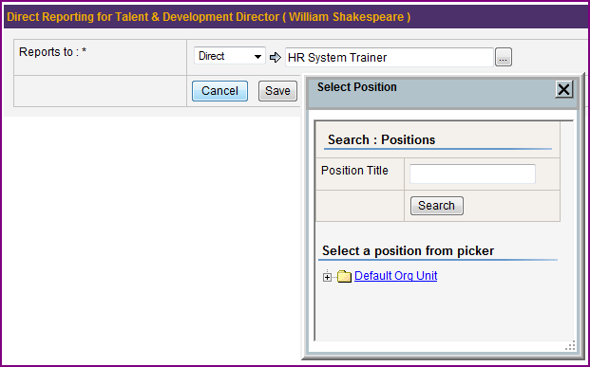
Changing Reporting Lines

Slide 34
Deleting Positions
If a position no longer exists in your organisation
  Ensure any roles that still exist have been updated so that the reporting line is correct
  Contact your System Administrator to have the old role removed

Slide 35
Finding and Editing Succession Plans
When you search for a Position it will automatically take you to the Succession tab.
Click on the “Edit” link for that position
  You can remove a successor by clicking “delete” next to their name
  You can change a successor or details against any successor by typing into a free text field, or changing the options for the Readiness or Successor field
  To add a new successor, click “Add” and complete the fields as displayed
  You can add successors who are not in your location by selecting their name from the tree, however you will not have full visibility of their AOP, IDP etc
  If you wish to add a comment about the succession for that role, or you would like to show that succession is an external appointment, or you are developing internal talent, you can find these in the people tree under Default Org Unit > Options for Succession
  When you have finished, click “Save”

Slide 36
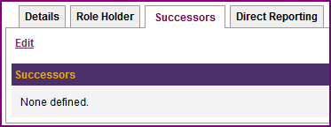
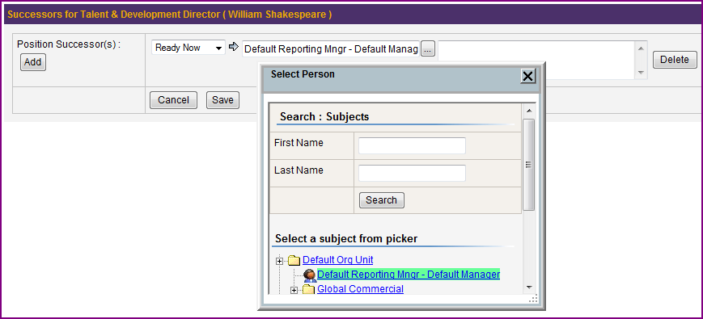
Finding and Editing Succession Plans

Slide 37
Using the system information in your talent review presentation

Slide 38
Reports – Overview
Reports can be found on the Home tab in the left hand navigation bar
All reports will automatically run according to the most common group you wish to see
  Talent Matrix - automatically shows the Management Team
  All People - automatically shows all people
  If you wish to change the group of people or positions appearing on a report
  Select the tab “Run Options”
  To refine your group you can select more than one option. For example, if you want a report that looks at only the confirmed 2010 Talent Pool in Sales and Marketing, Select “2. Sales and Marketing” and hold the CTRL key while also selecting “Talent Pool 2010”
  To receive the details on screen, click “Run”.
  To receive the details in a spreadsheet, click “CSV Export”
  To receive the details as a PDF file, click “PDF Export”

Slide 39
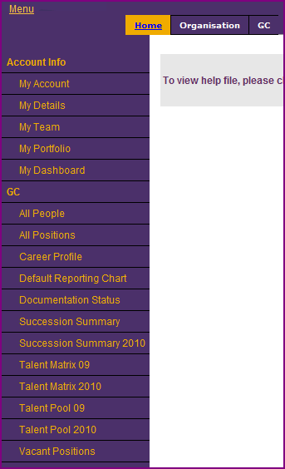
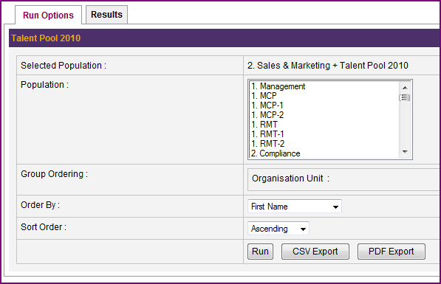
Reports – Overview

Slide 40
AOP Logarithms (1 of 2)
Summary of leadership capability
  Leadership Capability is ‘low’ regardless of rating if individual does not demonstrate the AZ values. Leadership Capability is shown by a coloured box on the Matrix (shown below).
  High  A minimum of 3 above target and all others at target
  A minimum of 6 at target
  Medium  1 below target
  Low  2 below target
  3 or more below target
Summary of Potential (YSC) Rating
  High Has two or more items in each category (Drive, Judgement & Influence)
  Medium Has one or more items in each category (Drive, Judgement & Influence)
  Low Has no items in one of the three categories (Drive, Judgement & Influence)

Slide 41
AOP Logarithms (2 of 2)
The following combinations will calculate a “Yes” for Functional Talent Pool
Performance | Leadership | Potential | Reason for adding to the talent pool
High | High | High | High performer with high potential for continued success in increasingly more senior roles
High | Medium | High | High performance with high potential for success in the future – focus is on leadership development
High | High | Medium | Review to confirm: High leadership and track record, coupled with medium potential suggests possibly promotable to the next level.
Medium | High or Medium | High | Review to confirm: high on potential suggest individual could be ‘untapped’ potential

Slide 42
Talent Matrix – Inserting to PowerPoint
  Generate the Talent Matrix report in the Talent Management System
  Take a screen shot of the Matrix
  Click on the Start button in the left bottom corner of your computer and search “Snipping Tool”
  When you select this tool it will dim the rest of your screen
  Click and drag your cursor over the area you wish to copy (eg, the Talent Matrix)
  You can then paste this picture directly into your presentation

Slide 43
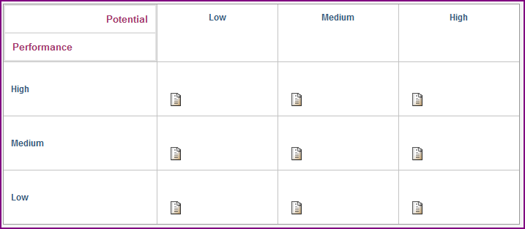
Talent Matrix – A Guide Symbols and Colours
Declan   BUD SC
Talitha  CFO
Caleb  BUD PC
Bryn “Q”  HR Director
Imogen “Q”  LCO
Include the names and job titles of anyone who is not showing on the matrix here, eg new starters
Key:
■ High Leadership Capabilities
■ Medium Leadership Capabilities
■ Low Leadership Capabilities
* Functional Talent Pool
“Q” Less than 1 year in role

Slide 44
Succession Planning – Inserting to PowerPoint
  Generate the Succession Summary report in the Talent Management System
  Click “CSV Export”. When prompted choose “Open”.
  Copy only the cells you want to appear in your succession summary slide (this should be all cells)
  Count the number of rows you have selected
  Go to PowerPoint and make sure there are enough rows in the table for the selection you have copied.
  Put the cursor in the first cell of the first blank row in your PowerPoint Table and Paste the information from Excel
  Reduce the font size to fit better on the page. If you have too many rows, to fit on a page insert a duplicate side and delete from the first slide the lower rows, and delete from the second slide the upper rows. (This means you do not have to re-copy and re-paste the information from Excel.)
  If there are returns (¶) in the “Status/action Required” column it will not paste correctly. You will have to go back to Excel and remove any returns and replace with / .

Slide 45
Succession Planning – Good Practice Guide
Current Job Holder | Role | Becomes Free On | Reason | Ready Now Candidates | Ready Later Candidates | Status/Action Required
Juan Mendoza | MCP | Q4, 2008 | Career Move | Luc Janssens (Norway), Francis Grigas (Australia) | Kevin Kang ,(Sweden) (2-3 yrs)Philip Sanchez (LatAm HIPO) (3+ yrs) | KK needs to get development outside Sweden to strengthen candidacy.ActioRVP Q4 ’06). Continue development of PS in current role, confirm progress Q1 ’07) Action RVP. / Consider recruiting 2/3 HIPO’s with MCP potential. RVP Q1 ’07
Margarita Olsen | Business Development Director | Q2, 2006 | Promotion | Mary Sherry (Switzerland) ? | Dirk Peeters (Norway) (2 years), Bert Oswald (Denmark) (3-4 years+), Karin Anders (Sweden) (3-4 years+) | Candidature of MS to be confirmed Q4 ’06. Action RVP/RHRD. / Subsequently confirm need to start external search for HIPO with longer term MCP potential. / Development of DP and BO to continue incurrent role. Action MCP/HRD. International opportunity to be identified in larger market for KA in Q2 07. Action MCP/RHRD
Roger Brown | PR & Communications | Q3, 2007 | Retirement | Caleb O’Donovan (Ireland) | Declan Ng (New Zealand) (3+ years) | RL succession being discussed with PR & Comms VP. / Candidates from talent pool to be identified by Q4, 06
Example only

Slide 46
Further information and contacts

Slide 47
Glossary: General
Term | Meaning
Person | A record for an individual. This holds their personal details, plus information relating to their performance and talent management documents
Position | A record for a role. This holds detail on succession plans, and hierarchy information (which role it reports to, which roles report to it, the level in the organisation and function).
Organisation unit | This refers to the location (eg, Regional or Marketing Company) or function (eg GMSO) of teams in the system.
Level | This refers to the level of a role in the Global Commercial talent system hierarchy. 

Slide 48
Glossary: Levels
Term | Meaning
Management | Marketing Company Management Team Position
MCP | MCP or Country Manager Position
MCP-1 | Direct Report to an MCP, but not a Management Team Position
MCP-2 | Reports to a Management Team Position
MCP-3+ | Reports to an MCP-2 or lower
RMT | This is a Position that is a Direct Report to an RVP or Functional VP, but not an MCP
RMT-1 | Direct Report to a Regional Management Team member (eg RVP-2) but not working in a Marketing Company
RMT-2 | Regional staff at RVP-3 level but not working in a Marketing Company

Slide 49
Contacts
For assistance with the system, please contact your System Administrator
  Talent Coordinator - Jennifer Lannan

