Slide 1
Northwind DATAset: Module 2/3 Final Project
By Bronwen Cohn-Cort
March 2nd, 2020

Slide 2
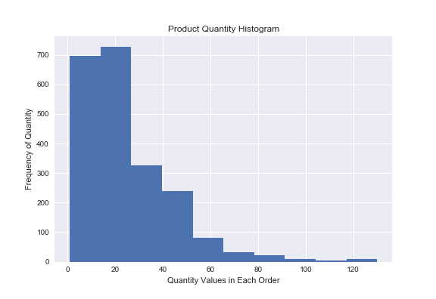
Hypothesis #1: Comparing Discounts
If a customer received a discount, they ordered more of that product.
A larger, 25%, discount does not mean more product was sold compared to a smaller (e.g., 5%) discount.

Slide 3
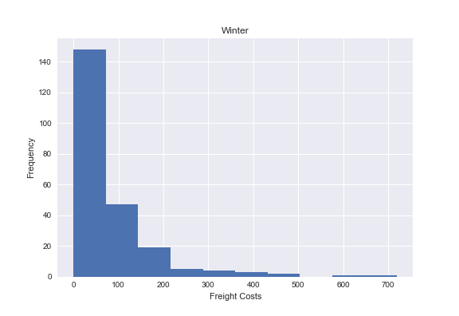
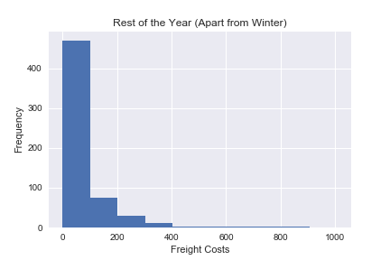
Hypothesis #2: Seasonal Freight Charges
Freight Charges when Shipping to Customers in Winter
Freight Charges when Shipping During the Rest of the Year

Slide 4
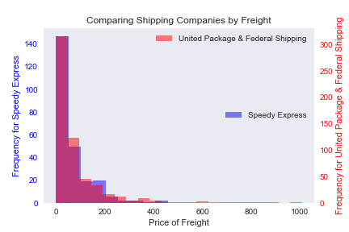
Hypothesis #3: Shipping Charges
The three shipping companies’ freight costs are comparable.
United Package (in the database as #2) and Federal Shipping (as #3) are especially similar.
The highest shipping costs are found with United Package and Federal Shipping, so look into Speedy Express (#1)’s rates at the upper end.

Slide 5
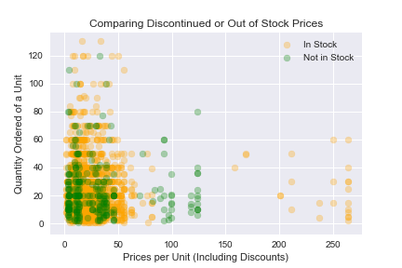
Hypothesis #4: Out-of-Stock Items
The total price of orders that contain items that are out of stock or have been discontinued.
Ultimately, the total amount paid for an order is barely affected by whether an item is out of stock or discontinued.

Slide 6
Conclusions
If an item is discounted, Northwind sells more of it
No significant difference in freight charges during winter; no extra charge for cold weather
Speedy Express does not currently ship products at the upper end of freight charges, so should look into whether their rates may be cheaper than United Package or Federal Shipping for that range
Further research into whether we sell discontinued or out-of-stock products at a discount may show that we don’t need to discount them that much

Slide 7
THANK YOU
Questions?
Also, credit to Github user arseniyturin.
Special thanks to Lead Instructors Eli & Jeff.

