Slide 1
Northwind DATAset: Module 2/3 Final Project
By Bronwen Cohn-Cort
October/December 2019

Slide 2
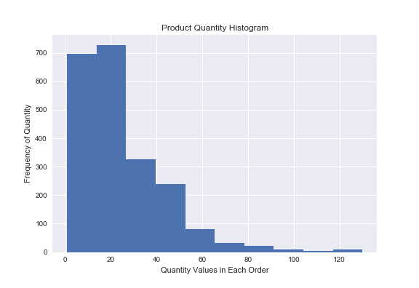
Hypothesis #1: Comparing Discounts
If a customer received a discount, they ordered more of that product.
A larger, 25%, discount does not mean more product was sold compared to a smaller (e.g., 5%) discount.

Slide 3
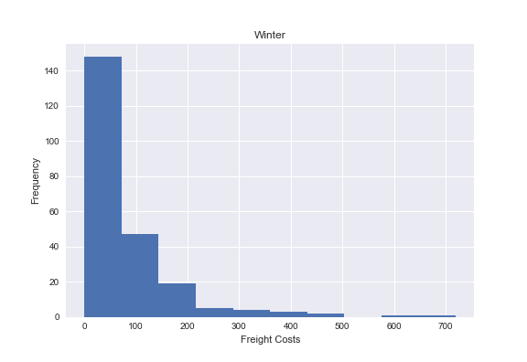
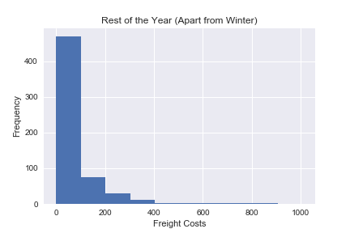
Hypothesis #2: Seasonal Freight Charges
Freight Charges when Shipping to Customers in Winter
Freight Charges when Shipping During the Rest of the Year

Slide 4
Hypothesis #3: Shipping Charges
The three shipping companies’ freight costs are comparable.
United Package (in the database as #2) and Federal Shipping (as #3) are especially similar.
The highest shipping costs are found with United Package and Federal Shipping, so look into Speedy Express (#1)’s rates at the upper end.

Slide 5
Hypothesis #4: Out-of-Stock Items
The total price of orders that contain items that are out of stock or have been discontinued.
Ultimately, the total amount paid for an order is barely affected by whether an item is out of stock or discontinued.
Combined with the earlier information on discount offers, this may mean that there is no reason to sell out-of-stock or discontinued products at any significant discount.

Slide 6
THANK YOU
Questions?
Also, credit to Github user arseniyturin.
Special thanks to Lead Instructor Eli.

