Slide 1
Five Zip Codes In Which to Invest in the Real Estate Market
Module 4 Final Project
By Bronwen Cohn-Cort
March 4, 2020

Slide 2
Methodology: Prioritizing the Safe Bet Over the ROI
Finding the best model to describe the data
Choosing a selection of records to look at more closely
Further refining the selection down to 20 that fit best
A final prediction to determine the top five based on losing the least of the investment
Zillow
Mid. 9th
Best 20
Top Five

Slide 3
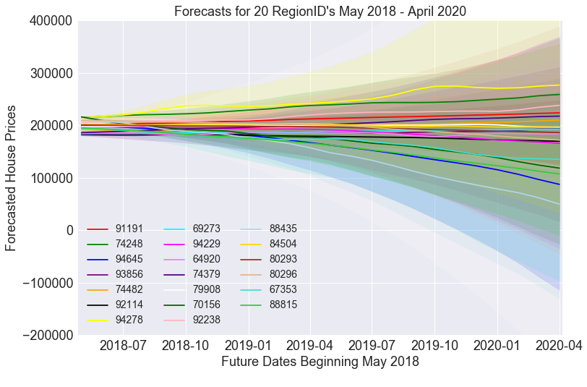
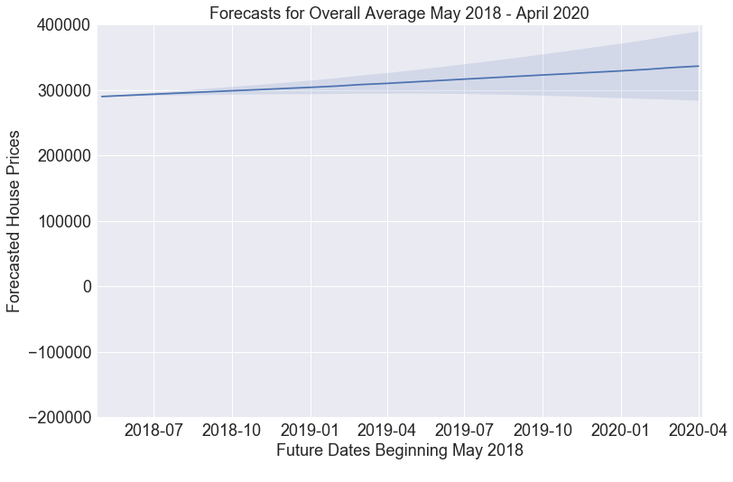
House prices in the select 20 regions from 2018 to 2020
Select 20 Predictions
Overall Average’s Prediction

Slide 4
Where Are The Top Five Regions?
The cities chosen are:
Arlington, TX
High Point, NC
Nashville, TN
Brenham, TX
Chattanooga, TN
Forecasted % Change:
+12.1%
+4.9%
+21.4%
-7.6%
+17.6%

Slide 5
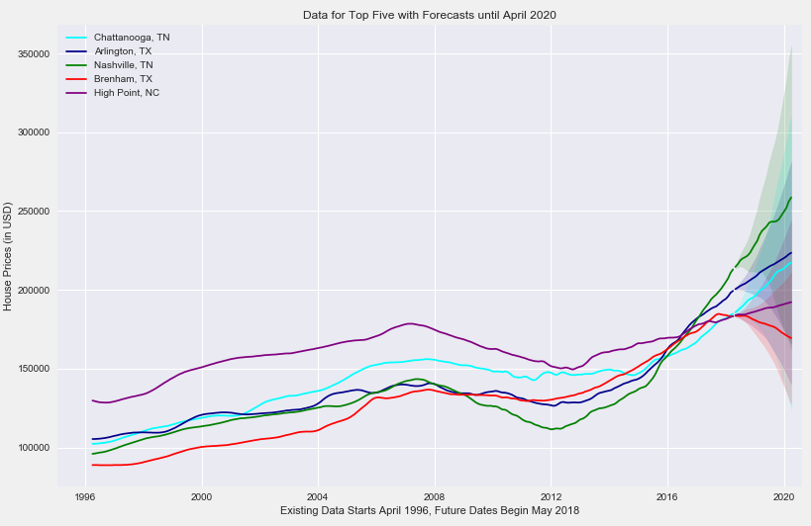

Slide 6
Lessons Learned
Future Work
Other factors that can affect an investment were not taken into account: i.e. risks of natural disasters, changes in building codes, and county infrastructure improvements
A model using proximity to other regions, perhaps predicting gentrification trends and urbanization, where rental properties become available for purchase or vice versa
More processing power is needed to determine errors and run a more precise model
Alternatively, it may be worthwhile to use different selection criteria before doing any modeling or predicting

Slide 7
Thank You
Questions or comments accepted by email or through Github repo: bronwencc/Module-4-Project

