Slide 1
Game Set Map
Andrea Luca Antonini, 1707560
Università ‘La Sapienza’ di Roma
antonini.1707560@studenti.uniroma1.it
Notes:
11

Slide 2
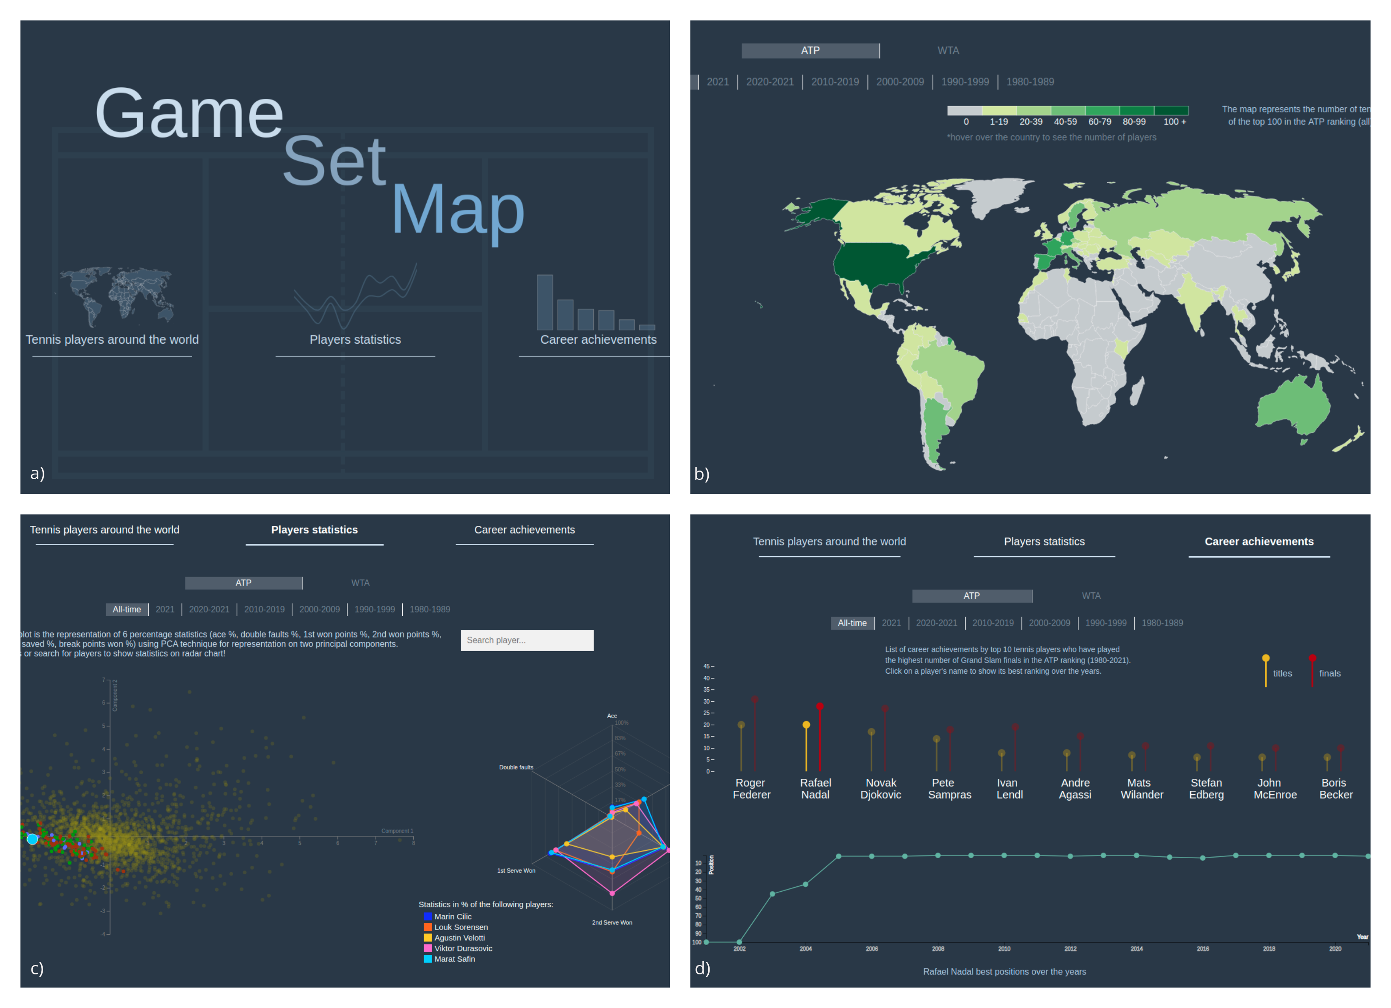
Introduction
The idea behind this project is to provide a useful and entertaining tool for visualizing tennis statistics of the last 40 years (1980 – 2021).
Through simple and effective representations, user can discover and analyse different aspects of the world of tennis.
<numero>
Game, Set, Map
10/06/21
Notes:
11

Slide 3
Overview
01. Initial view
02. Tennis players around the world
A home view with a button for each sub-view.
A world map representing nationalities distribution of top 100 players.
03. Players statistics
04. Career achievements
A scatter plot and a radar chart representing detailed players statistics.
A bargram and a connected scatter plot regarding the most winning champions.
<numero>
Game, Set, Map
10/06/21
Notes:
11

Slide 4
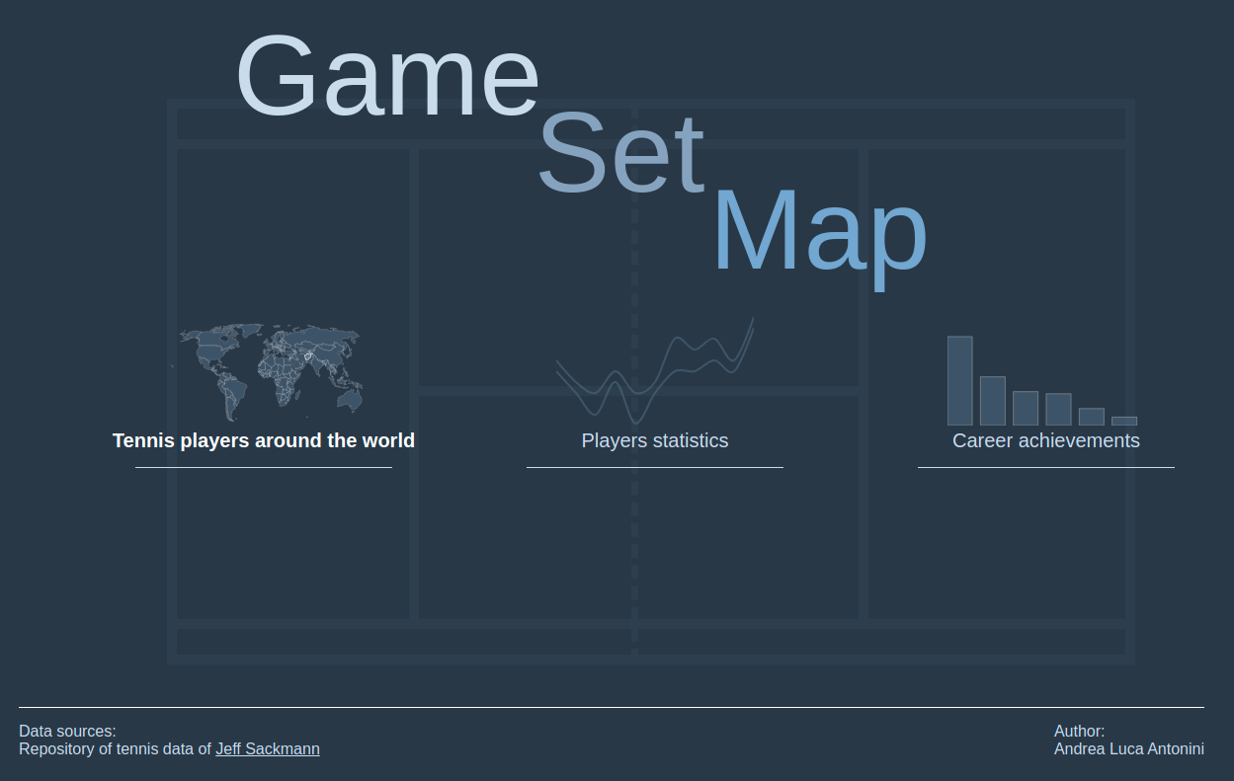
01. Initial view
Project overview, with three interactive buttons, one for each sub-view. Footer contains the link for data repositories.
4
Game, Set, Map
10/06/21
Notes:
11

Slide 5
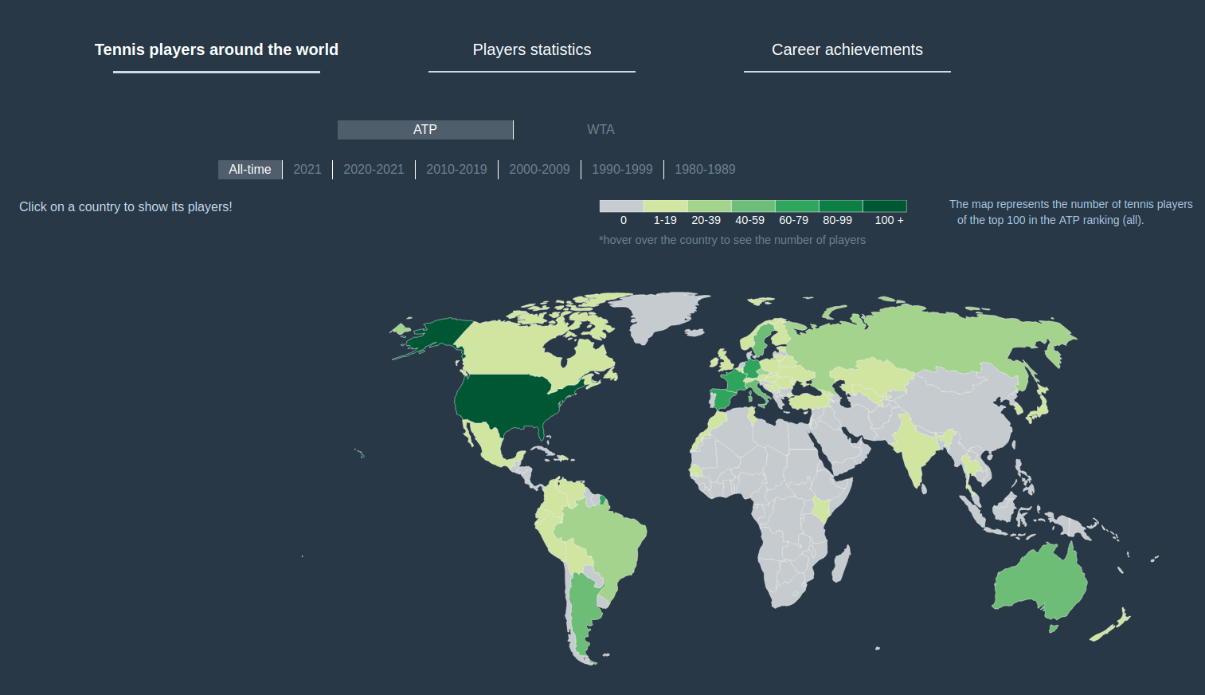
02. Tennis players around the world
Interactive world map in which each country has a colour relative to the number of players in the ATP/WTA top 100.
Colours legend is located above the map.
Selecting a different period of time, user can see changes in the colour distribution, relative to the higher or slower number of top 100 players.
Moreover, selecting a country, user can see the list of top 100 players coming from that country in a specific period of time.
5
Game, Set, Map
10/06/21
Notes:
11

Slide 6
World map
Why world map?
Legend
Intuitive and easily comprehensible representation
Through selection of time period, user can analyse the development of tennis movement in a determined country
User can see how many and which players belong to a country tennis movement all over the years
Country colour is determined by number of top 100 players
In 2021 and 2020 period, ranges goes from
1-4 to 11+
In all-time period, ranges goes from 1-19 to 100+
In the rest of the periods, ranges goes from
1-4 to 25+
5
Game, Set, Map
10/06/21
Notes:
11

Slide 7
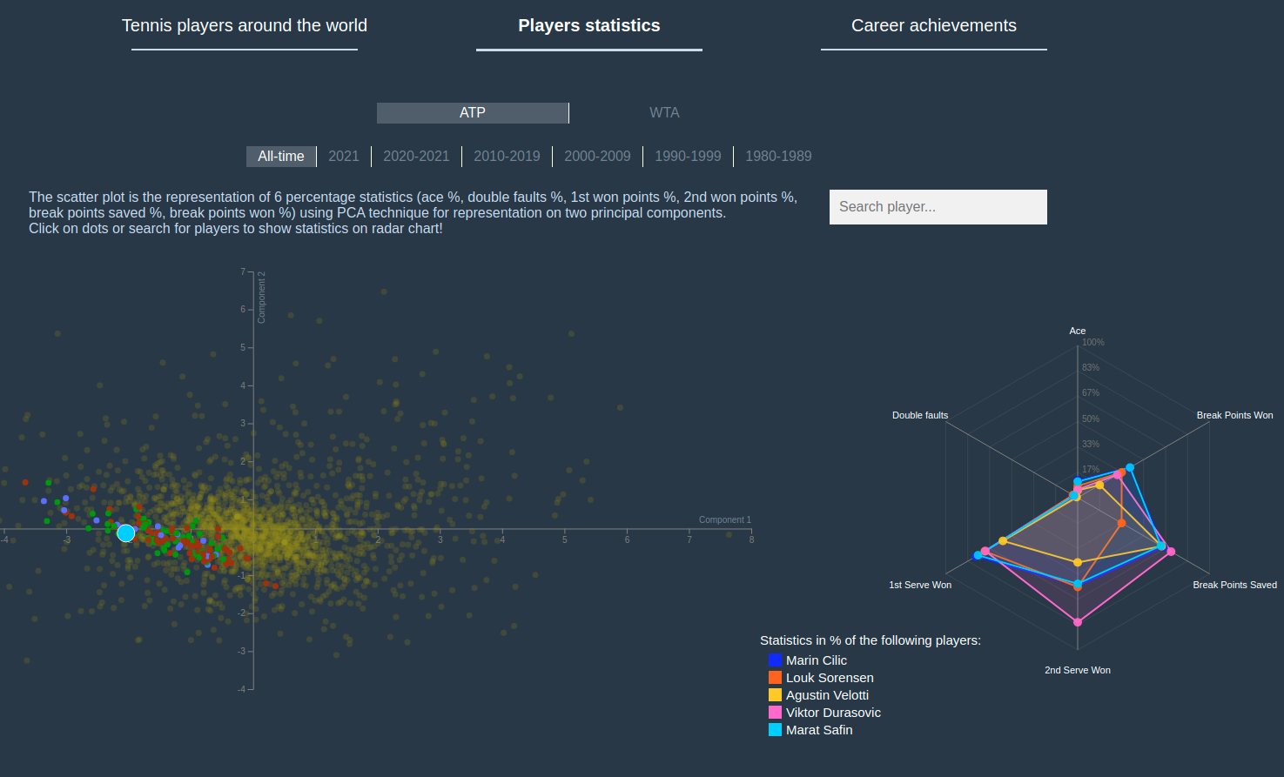
03. Players Statistics
Scatter plot
Represents top 100 players in the selected period of time, from 1980 on.
Dot coordinates are the projection on two components of six percentage statistics: ace %, double faults %, first serve won %, second serve won %, break points saved %, break points won %.
Radar chart
Display the above percentage statistics of selected player.
Each player has a different colour.
5
Game, Set, Map
10/06/21
Notes:
11

Slide 8
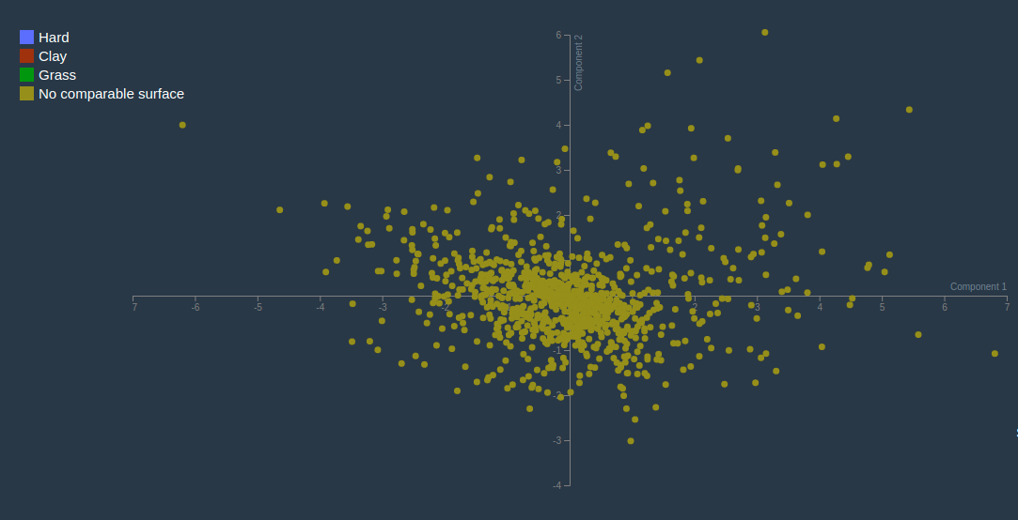
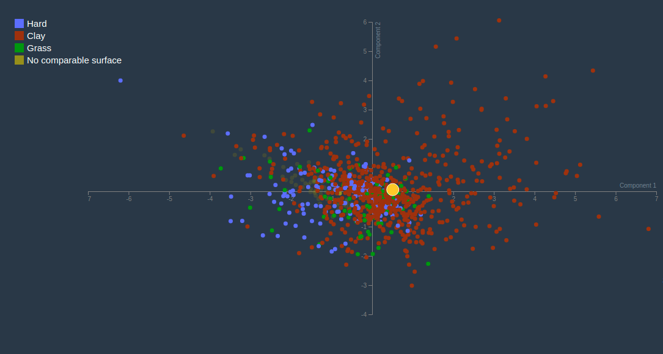
Scatter plot
Selection
Brush
User can select a player clicking on the relative dot
Or searching the player through the search bar
Dragging the mouse, user can zoom a region
Consequently, axes will change values
In this way, user can explore which players have similar statistics
8
Game, Set, Map
10/06/21
Notes:
11

Slide 9
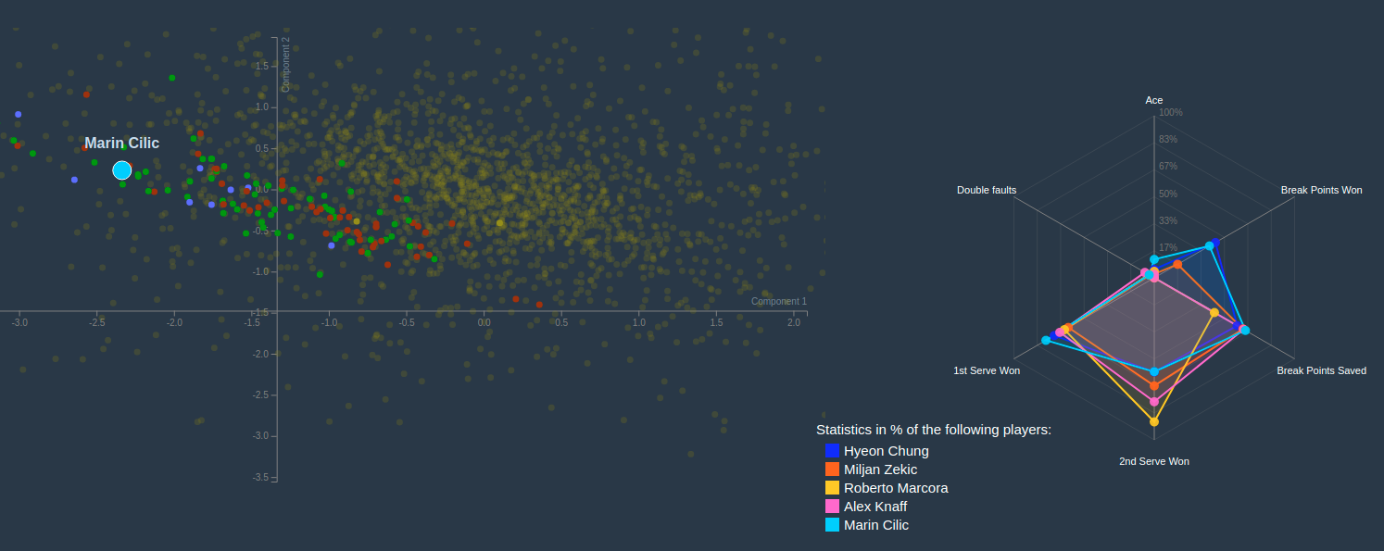

Slide 10
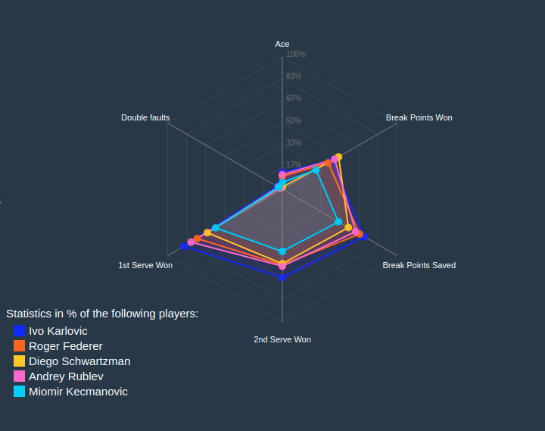
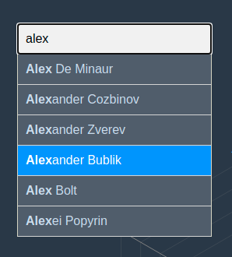
Radar chart
Highlight
Search bar
User can highlight a player geometry by passing over it
Or by clicking on his/her name in the legend
User can go up and down through the hints
Clicking on a name, that player will be displayed both on scatter plot and in radar chart
8
Game, Set, Map
10/06/21
Notes:
11

Slide 11
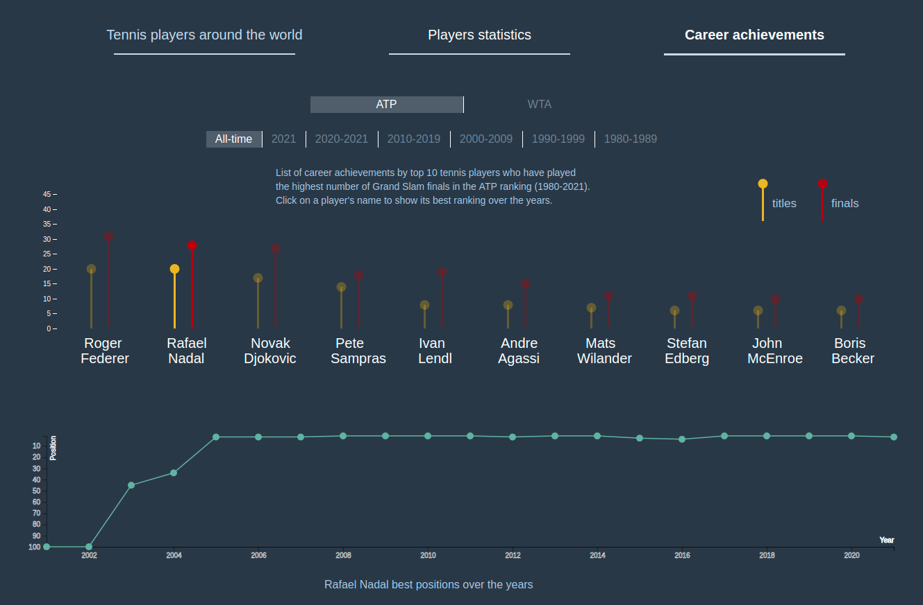
04. Career Achievements
Bargram
Represents 10 most winning champions in the selected period, i.e. those who won more Grand Slams.
Red bars indicate Grand Slam finals, while yellow bars indicate Grand Slam successes.
Connected scatter plot
Display the evolution of ranking positions of the selected player over the years.
Selecting a player from the bargram will cause an update in the connected scatter plot line.
11
Game, Set, Map
10/06/21
Notes:
<numero>

Slide 12
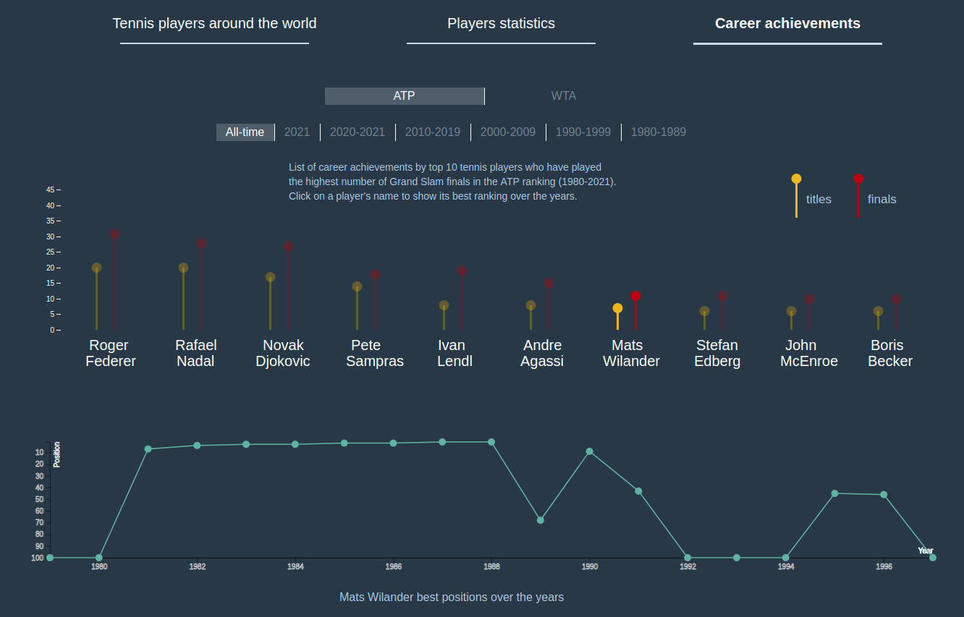
Example of selection from the bargram that causes the update of connected scatter plot.
After selecting a player, the other players bars become more opaque.
Trend in connected scatter plot gives an idea of the evolution of a player career.
11
Game, Set, Map
10/06/21
Notes:
<numero>

Slide 13
Bargram and connected scatter plot
Why bargram?
Why connected scatter plot?
Very useful to compare quantities referring to different players
In this case, two bars for each player give an idea of the proportion between Grand Slam finals played and Grand Slam finals won
Well represents the evolution over the years of selected player ranks
Dots represent ranking position
Lines connect dots, giving the idea of passing of time
11
Game, Set, Map
10/06/21
Notes:
<numero>

Slide 14

Thanks
This project has been a nice journey into d3, Javascript, CSS and Python3 worlds.
I hope that you will appreciate it.
Andrea Luca Antonini, 1707560
antonini.1707560@studenti.uniroma1.it
Notes:
<numero>

