Slide 1
HOMEWORK

Slide 2
START
INPUT A, B, C
D = √(B^2-(4*A*C))
X1= (-B + D)/2*A
X2= (-B - D)/2*A
PRINT X1, X2
QUADRATIC EQUATION FLOWCHART
STOP

Slide 3
Start.
Input a, b, c.
D ← sqrt (b × b – 4 × a × c).
X1 ← (-b + d) / (2 × a).
X2 ← (-b - d) / (2 × a).
Print x1, x2.
Stop.

Slide 4
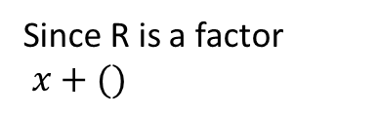
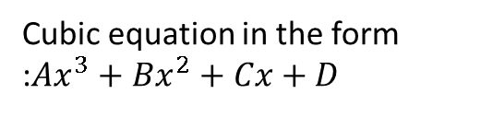

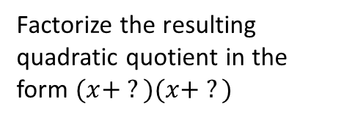
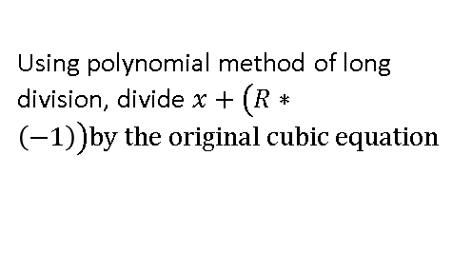
Cubic equation in the form :$Ax^{3}+Bx^{2}+Cx+D$
START
Using polynomial method of long division, divide $x+\left(R∗\left(−1\right)\right)by the original cubic equation$
CUBIC EQUATION
FLOWCHART
INPUT A
INPUT B
Factorize the resulting quadratic quotient in the form $(x+ ?)(x+ ?)$
INPUT C
INPUT D
PRINT $x+(R∗(−1)$
$$(x+ ?)(x+?)$$
Find the factors of D
Substite each factor into the equation, to find which would result to zero (0)
STOP
Resulting value is represented as R
Since R is a factor
$x+()$

Slide 5
FLOWCHART TO FIND THE LARGEST OF THREE NUMBERS.
START
INPUT A, B, C
READ A, B, C
NO
YES
IS A>B
YES
IS B >C
NO
NO
IS A > C
YES
PRINT
“B IS THE LARGEST NUMBER”
PRINT
“B IS THE LARGEST NUMBER”
PRINT
“B IS THE LARGEST NUMBER”
STOP

Slide 6
Start.
Input a, b, c.
Read a,b,c
X2 ← (-b - d) / (2 × a).
Print x1, x2.
Stop.

Slide 7
START
4I
INSERT A
INSERT B
Divide each value by the lowest number “C” that can divide either A or B to give you X and Y respectively
STORE C
Are X and Y both 1?
YES
NO
NO
Return thre original value that was to be divided as B and repeat the process with the next
Return thre original value that was to be divided as A and repeat the process with the next
NO
Is Y a whole number?
NO
Is X a whole number?
YES
Are X and Y both 1?
YES
Multiply all values of C
NO
Return the new values whether A or B and repeat the process
PRINT RESULT
STOP

Slide 8
START
4II
INSERT A
INSERT B
YES
Can any value go into both values without any remainder
NO
Divide A and B by their lowest common factor “C” to give D and E
Multiply all values of Z
STORE C
YES
Are D and E = 1?
Print result
NO
Return D and E as A and B repeat the process
STOP

Slide 9

START
INPUT A, B, C
$$F=x ∗(x−1)$$
X1= (-B + D)/2*A
STORE F
Storing each consecutive value of F as F1, F2, F3 …..
Was X – 1 = 1
PRINT
STOP

