Slide 1

BITS CloudReady™
Simulated Business Network on AWS
Professional Demo Presentation

Slide 2
AWS Console & VPC

Slide 3
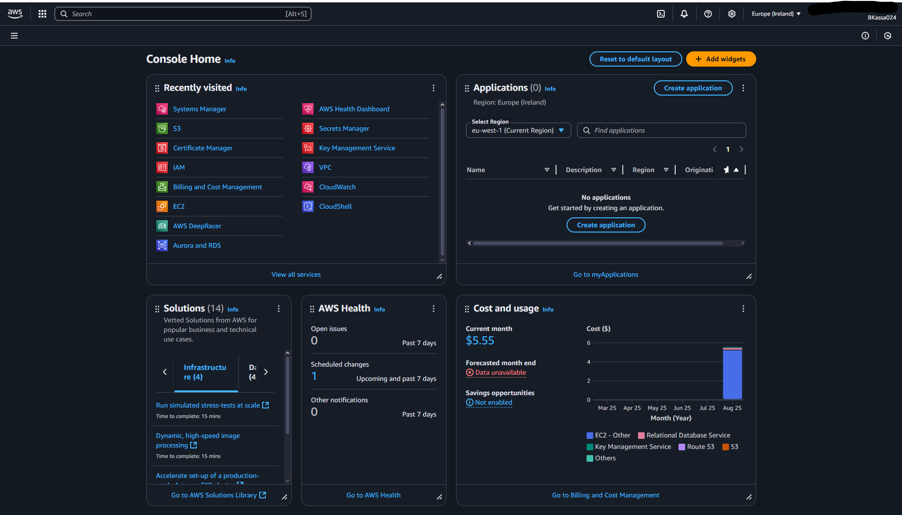
Console Home

Slide 4
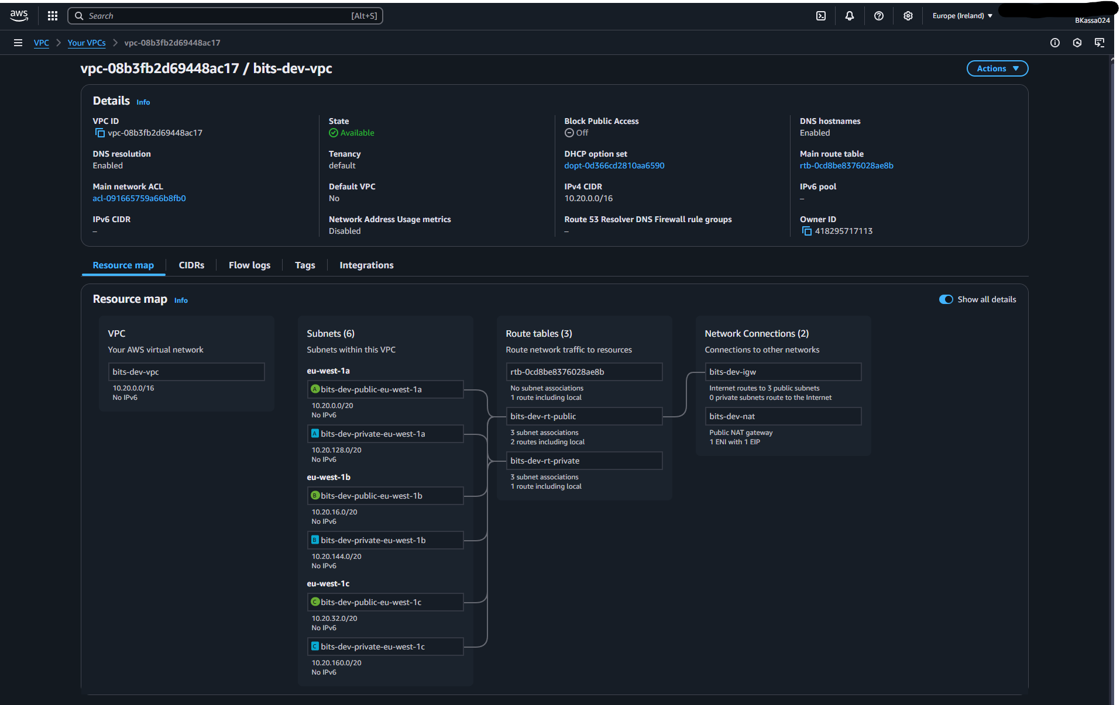
VPC Resource Map

Slide 5
Routing

Slide 6
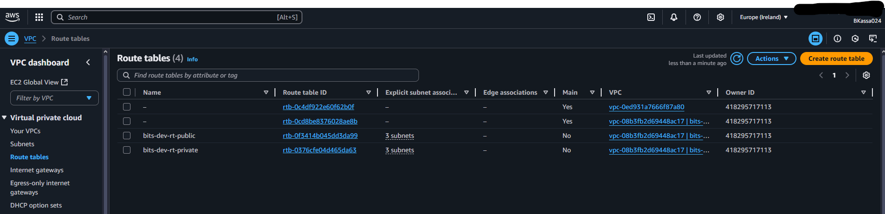
Route Tables

Slide 7
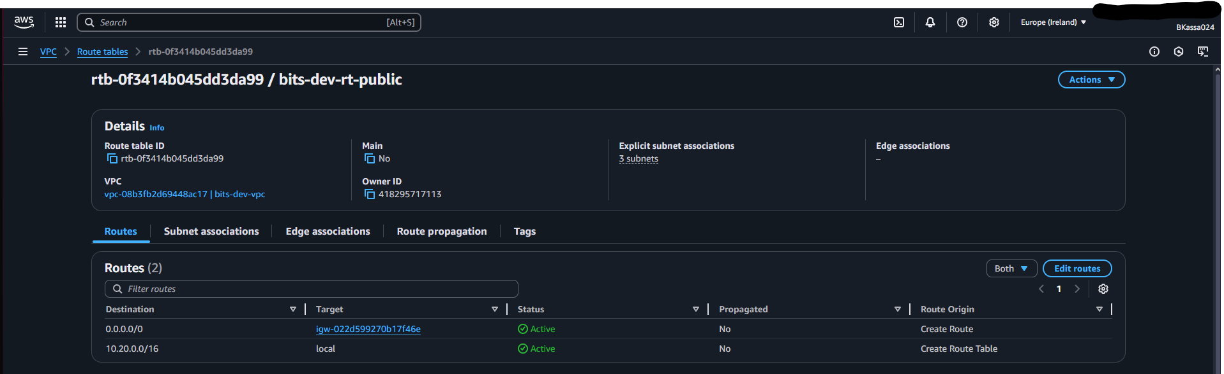
Public Route Table

Slide 8
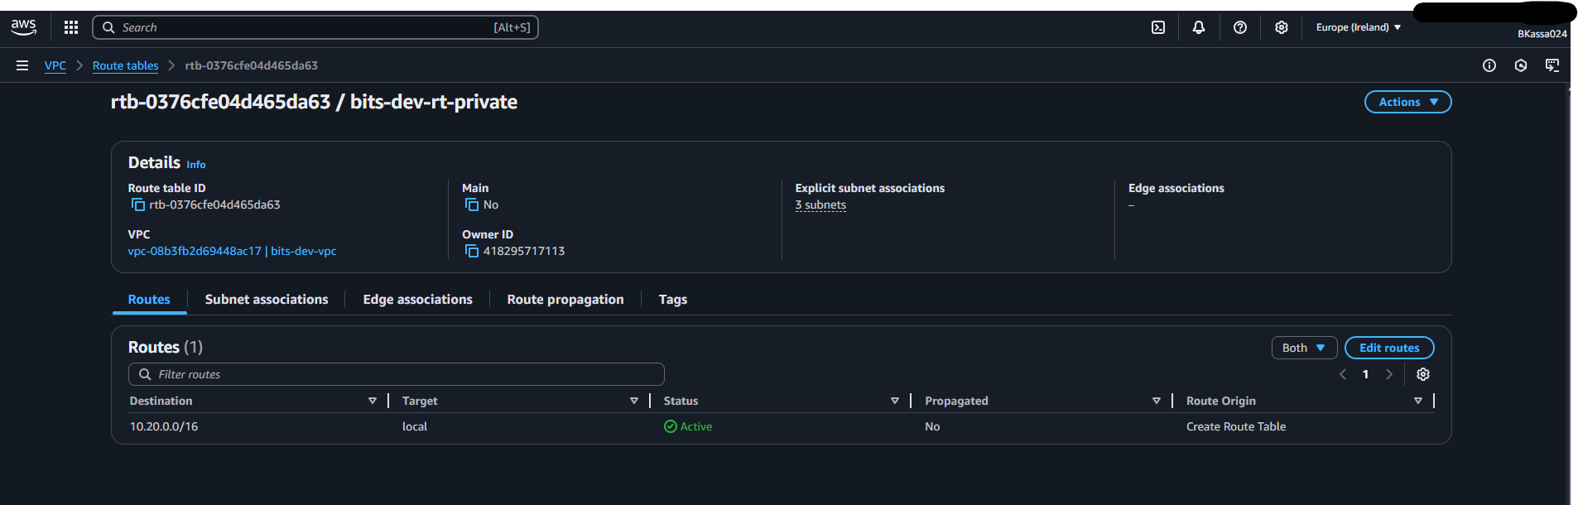
Private Route Table

Slide 9
Security Groups

Slide 10
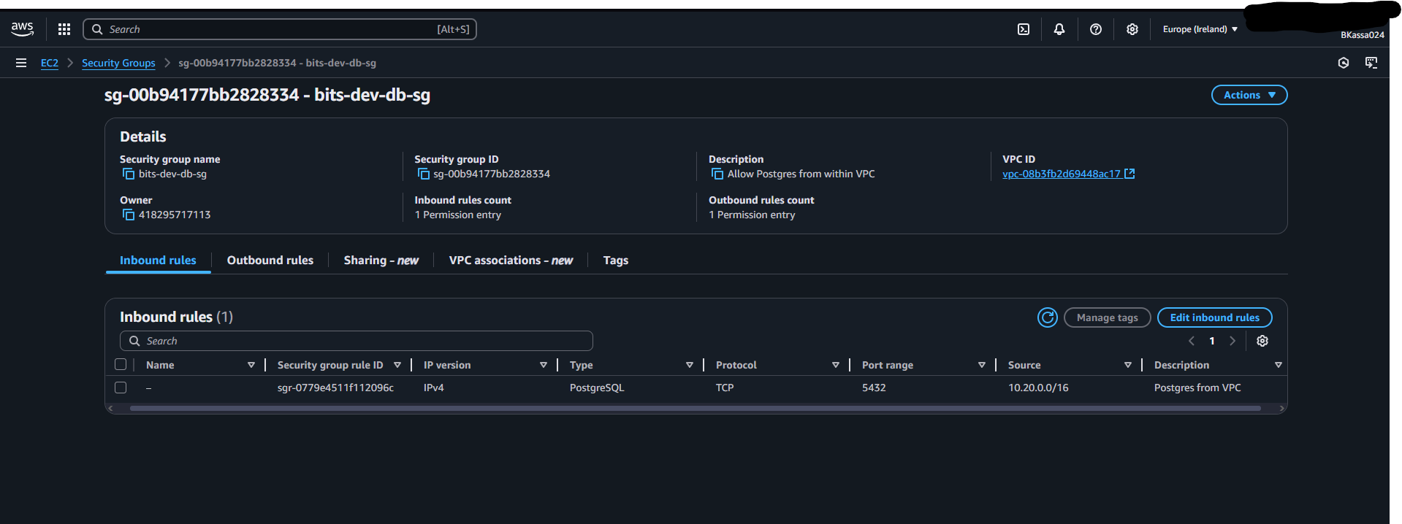
DB SG Inbound

Slide 11
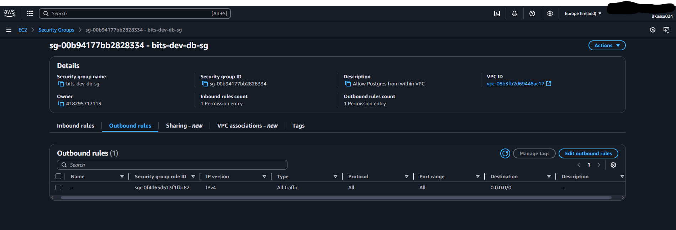
DB SG Outbound

Slide 12
Compute & Data

Slide 13
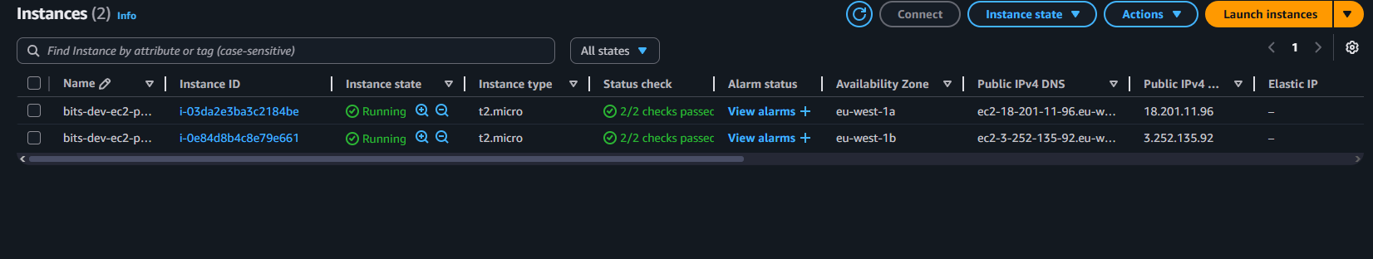
EC2 Instances

Slide 14
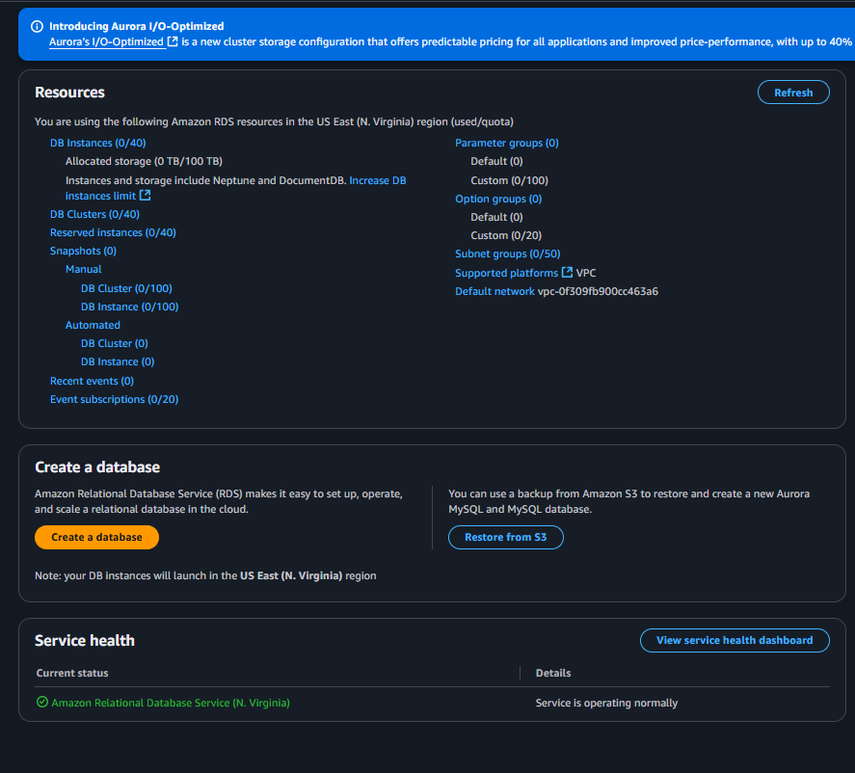
RDS Dashboard

Slide 15
Storage (S3)

Slide 16
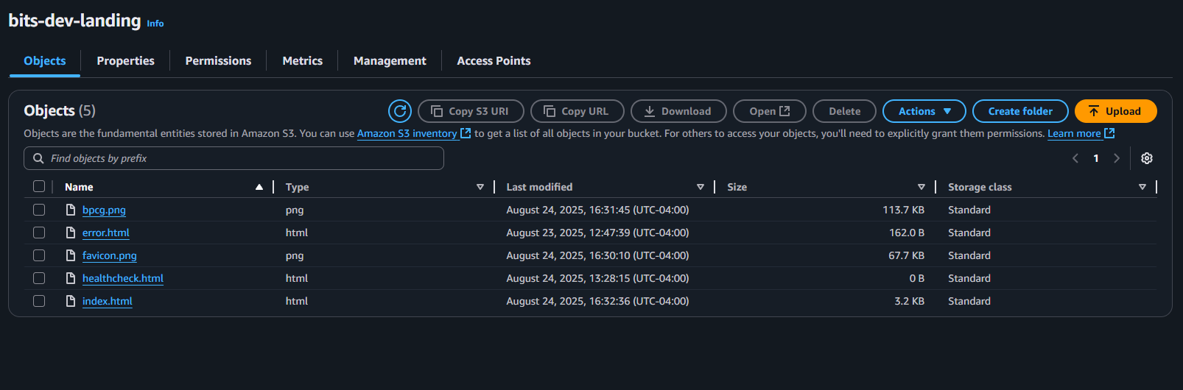
Landing Objects

Slide 17
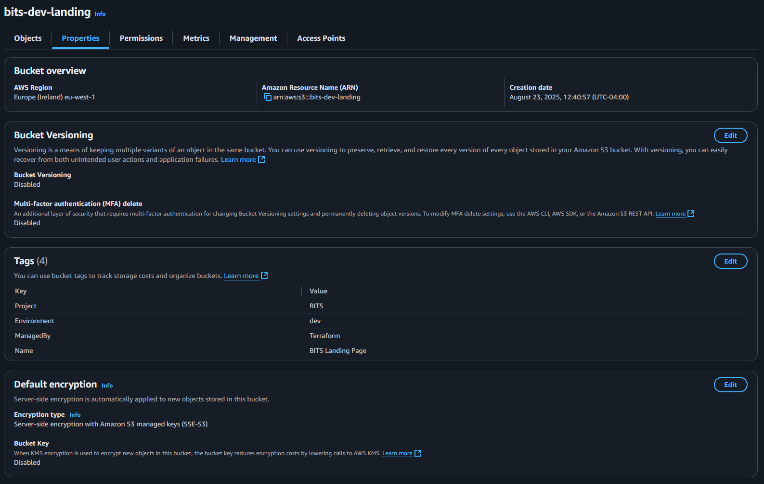
Landing Properties

Slide 18
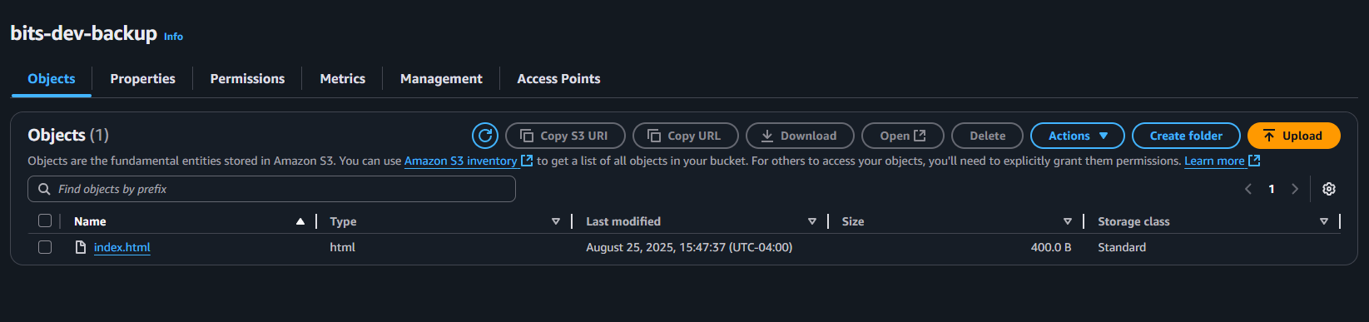
Backup Objects

Slide 19
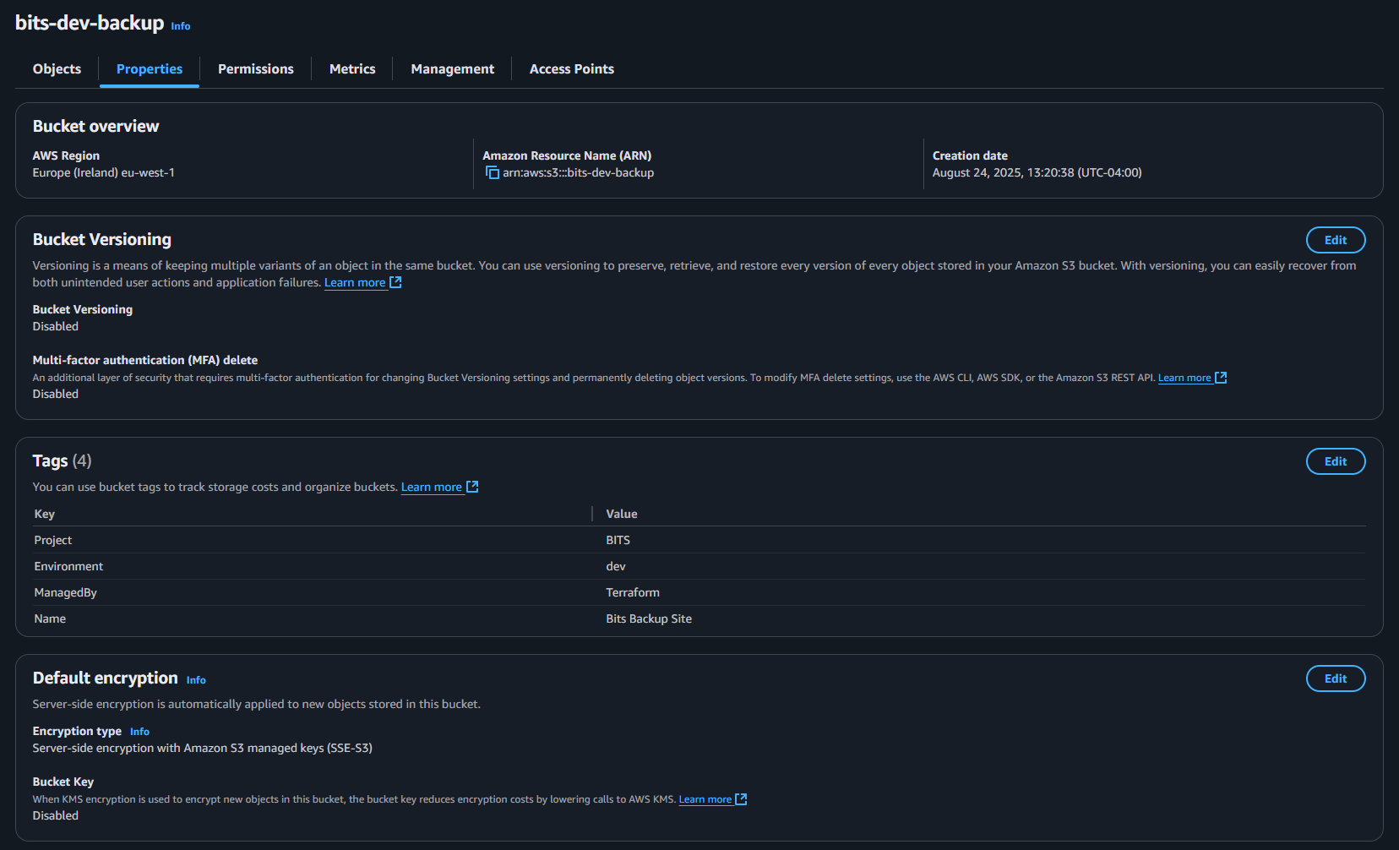
Backup Properties

Slide 20
Encryption (KMS)

Slide 21
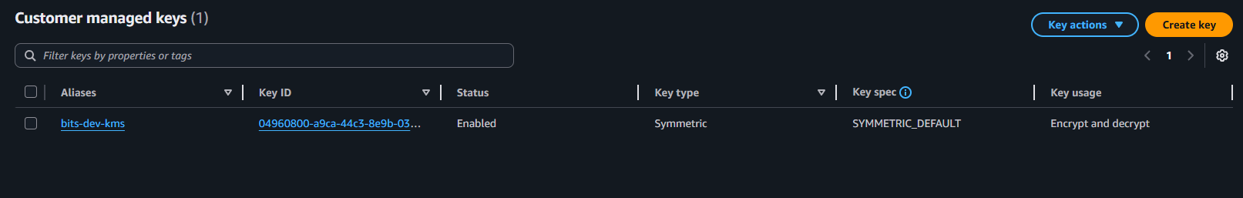
KMS Keys

Slide 22
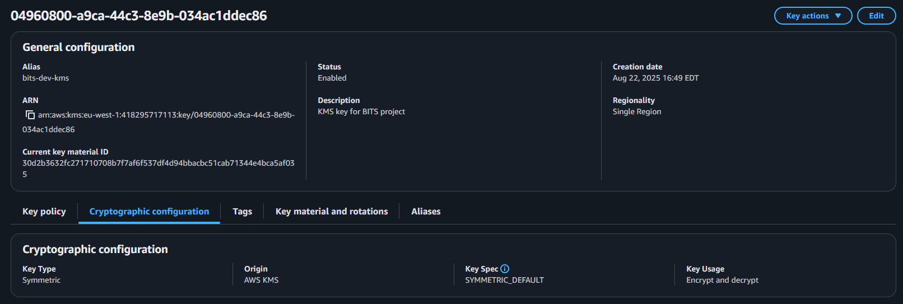
KMS Key Details

Slide 23
Observability & Cost

Slide 24
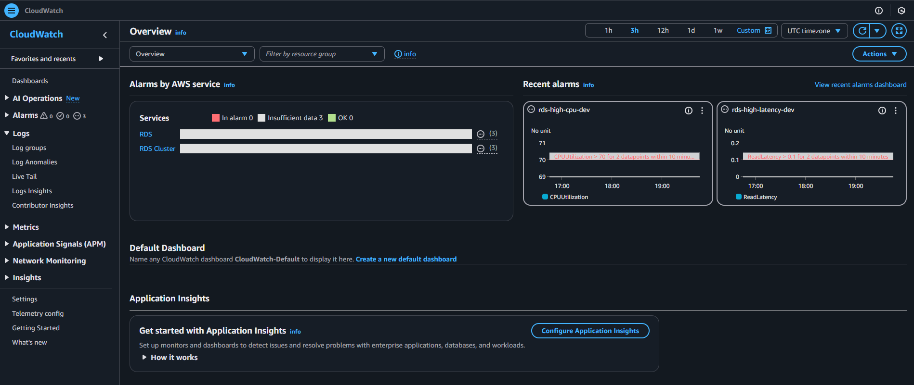
CloudWatch Overview

Slide 25
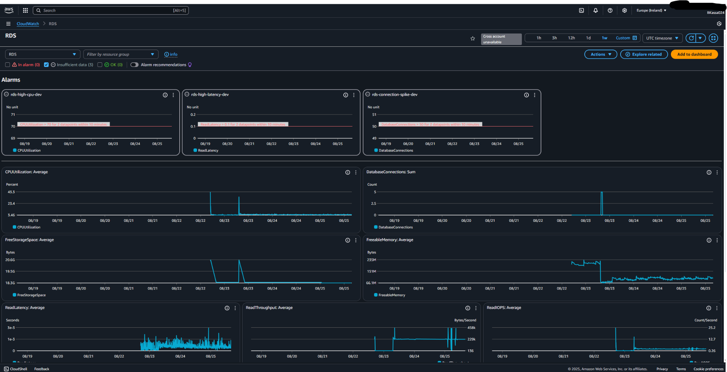
CloudWatch RDS Metrics

Slide 26
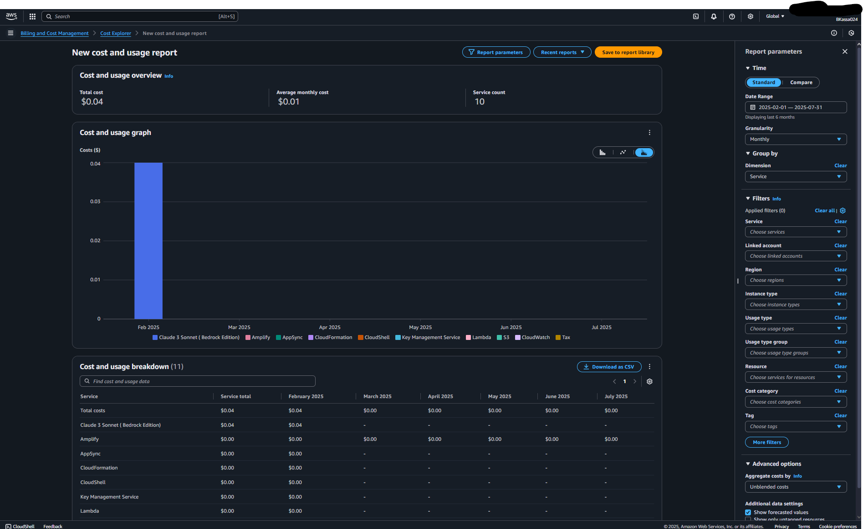
Cost Explorer

Slide 27
Infrastructure as Code

Slide 28
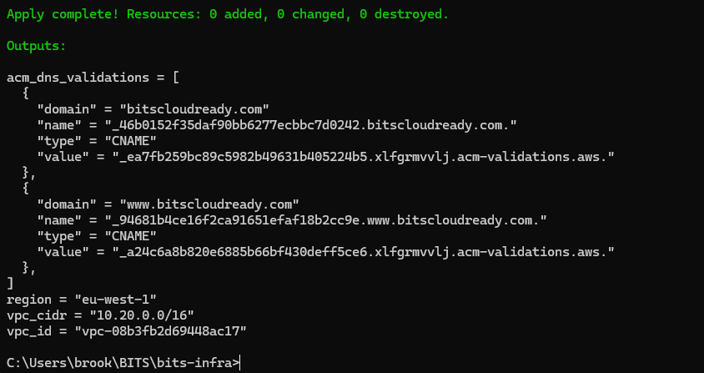
Terraform Outputs

