Slide 1
Alcohol, Tobacco and Firearms - Quality Control (aka Case Study 1)
Brook Andreas, Nicol Henderson Kuns, Dilruksha Jayaweera and Selwyn Samuel
June 27 2018

Slide 2
Focus of Study
Quarterly ATF review includes the following:
Number of breweries per state
Statistics on alcohol by volume (ABV) and international bitterness unit (IBU) per state
State with highest alcohol content and IBU
Correlation between the two attributes to ensure production quality

Slide 3
Data Description
Latest data includes 2410 US craft beers and 558 US breweries
Variable | Description
Name | Name of beer
Beer ID | Beer name as identified by a number
ABV | Alcohol by volume: the number of ml of ethyl alcohol present in each 100 ml of an alcoholic beverage when measured at 20°C (ref: dictionary.com)
IBU | International Bitterness Unit: parts per million of isohumulone found in a beer. Isohumulone is the acidity found in hops that gives beer its bitterness (ref beerconnoisseur.com)
Brewery ID | Brewery identifier by a number
Style | Type of beer as named by its character and sometimes, origin. Characterizations can include: hoppiness, additional ingredients, thickness. (ref: beeradvocate.com)
Ounces | Volume of beer
The variables and descriptions are below (breweries) and to the left (beer)
Variable | Description
Brew ID | Brewery as identified by a number
Name | Name of brewery
City | City in which the brewery is located
State | State in which the brewery is located

Slide 4
Breweries by State
State | Number of Breweries
Alabama | 3
Alaska | 7
Arizona | 11
Arkansas | 2
California | 39
Colorado | 47
Connecticut | 8
Delaware | 2
Florida | 15
Georgia | 7
Hawaii | 4
Idaho | 5
Illinois | 18
Indiana | 22
Iowa | 5
Kansas | 3
North Dakota | 1
Ohio | 15
Oklahoma | 6
Oregon | 29
Pennsylvania | 25
Rhode Island | 5
South Carolina | 4
South Dakota | 1
Tennessee | 3
Texas | 28
Utah | 4
Vermont | 10
Virginia | 16
Washington | 23
Washington DC | 1
West Virginia | 1
Wisconsin | 20
Wyoming | 4
Kentucky | 4
Louisiana | 5
Maine | 9
Maryland | 7
Massachusetts | 23
Michigan | 32
Minnesota | 12
Mississippi | 2
Missouri | 9
Montana | 9
Nebraska | 5
Nevada | 2
New Hampshire | 3
New Jersey | 3
New Mexico | 4
New York | 16
North Carolina | 19
Compared to Q1, there is an increase in these state breweries that are not in the database

Slide 5
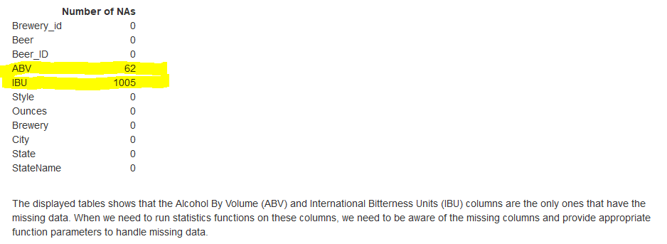
Data Not Reported
Numerous breweries are not reporting ABV or IBU

Slide 6
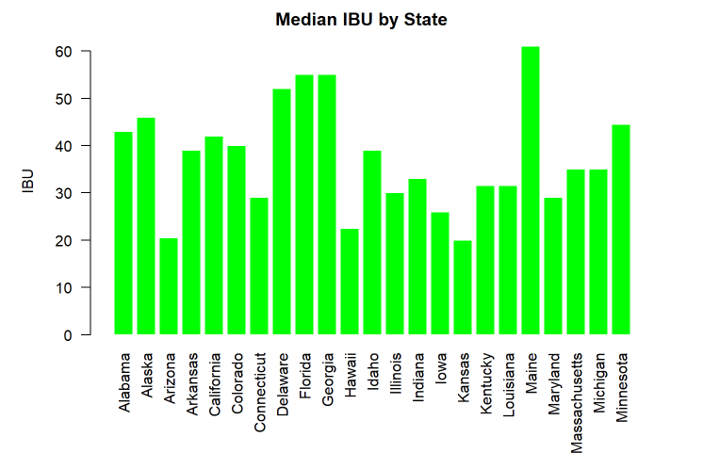
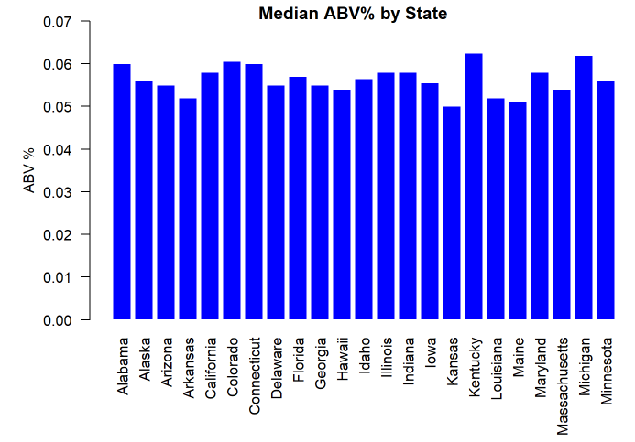
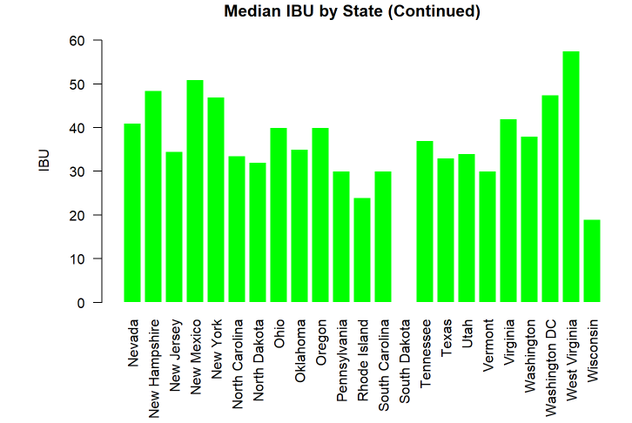
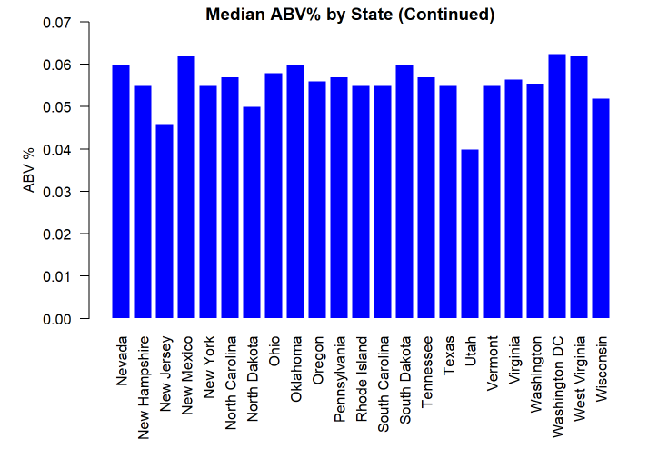
Median alcohol content and international bitterness unit for each state
IBU has larger variation by state than ABV
Expected due to all the variations of beer produced

Slide 7
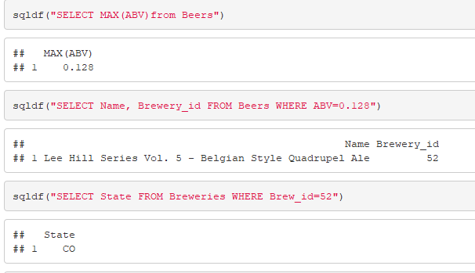
State with Max ABV
CO is the state with max ABV
ABV of the specific beer is .128
Change from Q1 - this beer was measured to have

Slide 8
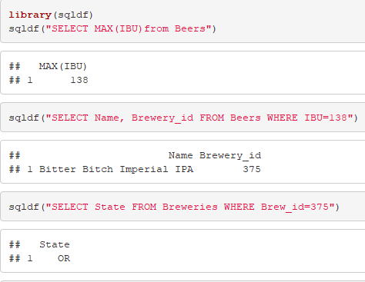
State with Max IBU
Oregon is the state with max IBU
IBU is 138
No change from Q1 - this beer was also listed as the max IBU

Slide 9
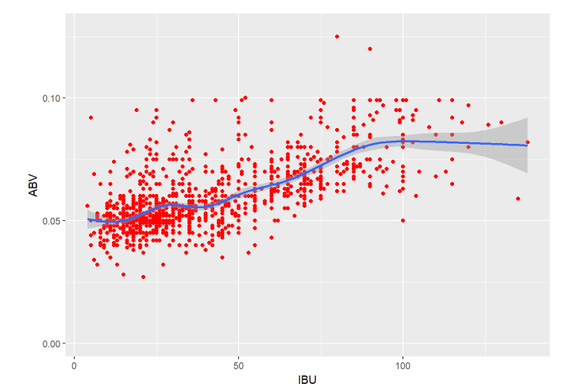
Correlation Check
Similar to last quarter’s analysis, the beer alcohol content and bitterness level show a low positive correlation between ABV and IBU.
No linear
Due to the large number of missing IBU data, correlation is deemed incomplete until feedback with breweries are complete

Slide 10
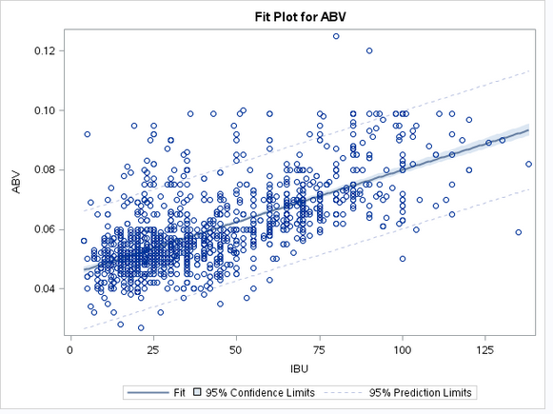


Correlation Check – Deep Dive Statistics
ABV and IBU are linearly correlated by the following model:
ABV = .045 + .0004IBU
R^2 = .45
This substantiates the very low correlation seen on the prior scatterplot

Slide 11
Summary and Actions
Further investigation is required on breweries with changed statistics from Q1 that did not register these changes with their local ATF division
AI: Need to follow up with breweries that are not reporting ABV or IBU
AI: Perform quality check and brewery reporting next quarter to show improvement

Slide 12
Team Primary Responsibilities
Coding – Brook and DJ
Code Commenting - All
Codebook - Selwyn
Presentation - Nicol

Slide 13
BACKUP

Slide 14
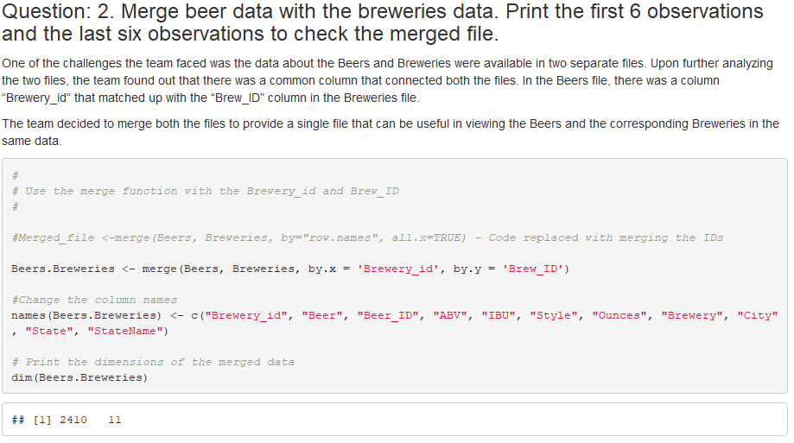
Merging Beer and Brewery Data
Merged the two data sets using the Brew ID as the key

Slide 15
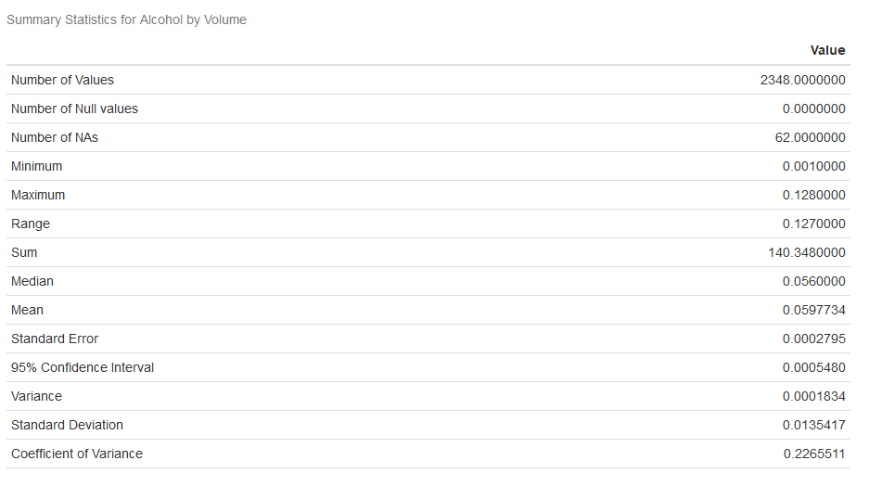
ABV Statistics

