Slide 1
Alcohol, Tobacco and Firearms - Quality Control (aka Case Study 1)
Brook Andreas, Nicol Henderson Kuns, Dilruksha Jayaweera and Selwyn Samuel
June 27 2018

Slide 2
Focus of Study
Quarterly ATF review includes the following:
Number of breweries per state
Statistics on alcohol by volume (ABV) and international bitterness unit (IBU) per state
State with highest alcohol content and IBU
Correlation between the two attributes to ensure production quality

Slide 3
Data Description
Latest data includes 2410 US craft beers and 558 US breweries
Variable | Description
Name | Name of beer
Beer ID | Beer name as identified by a number
ABV | Alcohol by volume: the number of ml of ethyl alcohol present in each 100 ml of an alcoholic beverage when measured at 20°C (ref: dictionary.com)
IBU | International Bitterness Unit: parts per million of isohumulone found in a beer. Isohumulone is the acidity found in hops that gives beer its bitterness (ref beerconnoisseur.com)
Brewery ID | Brewery identifier by a number
Style | Type of beer as named by its character and sometimes, origin. Characterizations can include: hoppiness, additional ingredients, thickness. (ref: beeradvocate.com)
Ounces | Volume of beer
The variables and descriptions are below (breweries) and to the left (beer)
Variable | Description
Brew ID | Brewery as identified by a number
Name | Name of brewery
City | City in which the brewery is located
State | State in which the brewery is located

Slide 4
Breweries by State
State | Number of Breweries
Alabama | 3
Alaska | 7
Arizona | 11
Arkansas | 2
California | 39
Colorado | 47
Connecticut | 8
Delaware | 2
Florida | 15
Georgia | 7
Hawaii | 4
Idaho | 5
Illinois | 18
Indiana | 22
Iowa | 5
Kansas | 3
North Dakota | 1
Ohio | 15
Oklahoma | 6
Oregon | 29
Pennsylvania | 25
Rhode Island | 5
South Carolina | 4
South Dakota | 1
Tennessee | 3
Texas | 28
Utah | 4
Vermont | 10
Virginia | 16
Washington | 23
Washington DC | 1
West Virginia | 1
Wisconsin | 20
Wyoming | 4
Kentucky | 4
Louisiana | 5
Maine | 9
Maryland | 7
Massachusetts | 23
Michigan | 32
Minnesota | 12
Mississippi | 2
Missouri | 9
Montana | 9
Nebraska | 5
Nevada | 2
New Hampshire | 3
New Jersey | 3
New Mexico | 4
New York | 16
North Carolina | 19
Compared to Q1, there is an increase in these state breweries that are not in the database

Slide 5
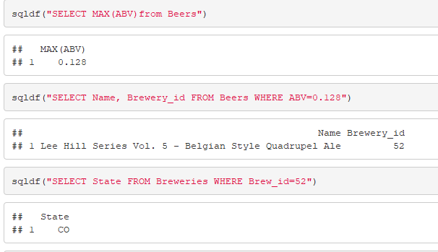
State with Max ABV
CO is the state with max ABV
ABV of the specific beer is .128
Change from Q1 - this beer was measured to have

Slide 6
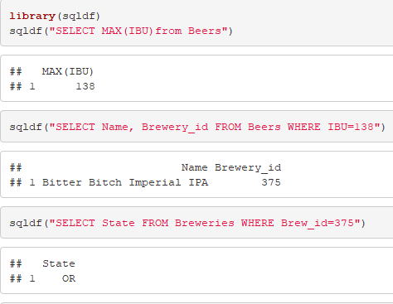
State with Max IBU
Oregon is the state with max IBU
IBU is 138
No change from Q1 - this beer was also listed as the max IBU

Slide 7
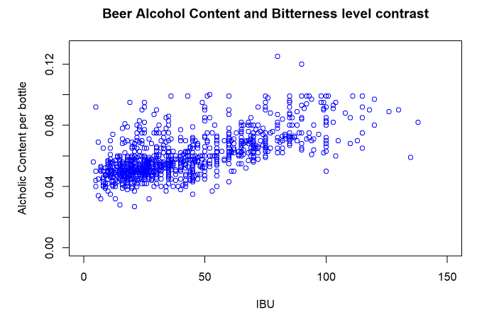
Analysis (2)
Similar to last quarter’s analysis, the beer alcohol content and bitterness level show no direct correlation to each other

Slide 8
Summary
Further investigation is required on breweries with changed statistics from Q1 that did not register these changes with their local ATF division

Slide 9
Team Primary Responsibilities
Coding – Brook and DJ
Code Commenting - All
Codebook - Selwyn
Presentation - Nicol

