Slide 1
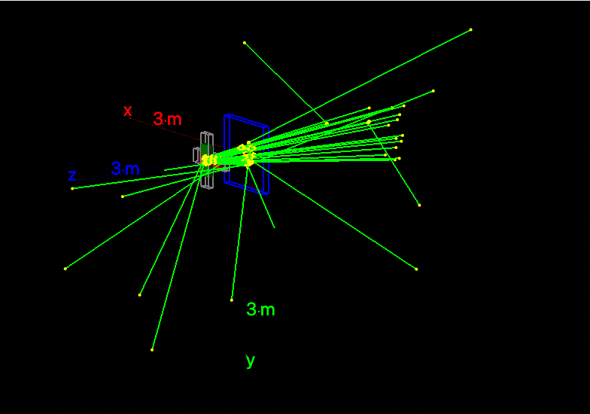
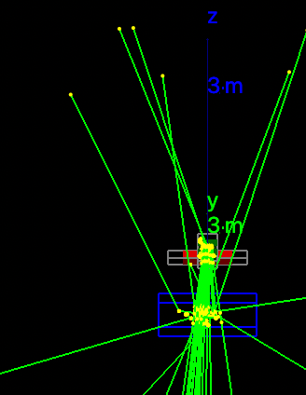
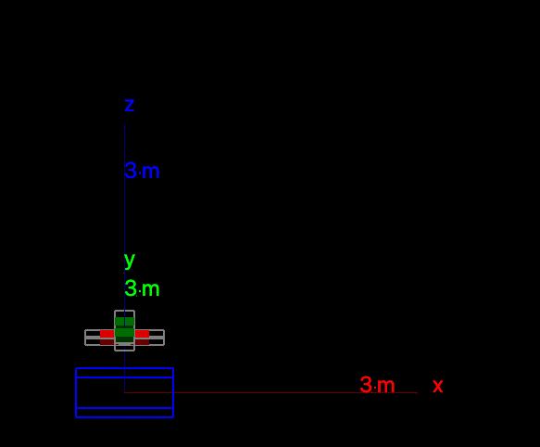
Topas Simulation for Optically-related Cherenkov-to-Dose linearity correction
Simulation Parameters:
6xFFF photon source
28x28cm field at 100cm SSD.
1mx1mx5cm:Water phantom
Mus’: 10-50
Mua: 0.1-0.6
Added MLC geometry
Scoring: At surface, we collect the Cherenkov, DoseToMedium.
Scoring: Dose/Incident fluence needs to be added.

Slide 2
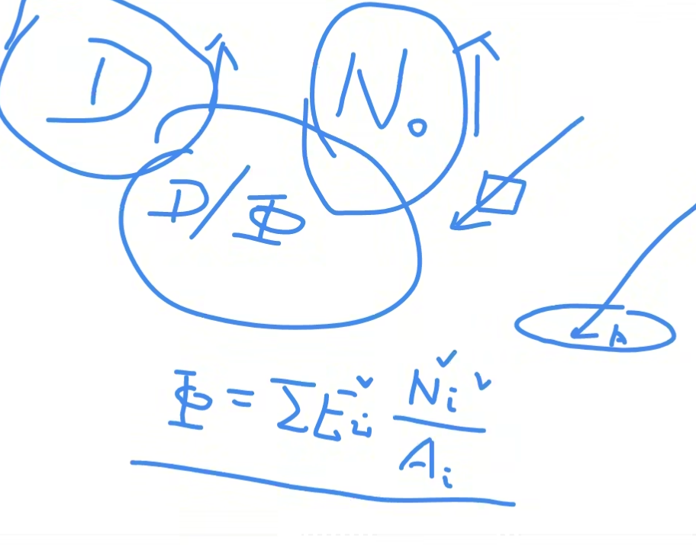
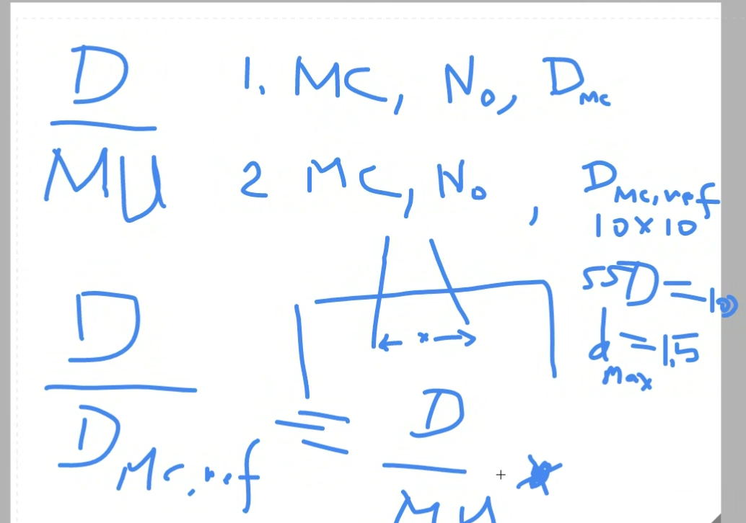
1/24/24 Meeting notes:
Dose per fluence
Dose per Mu = D_{test}/D_{mc ref}
D_{mc ref} = Shoot in 10x10cm without MLC to record the dose at dmax
Keep voxel sizes the same.

Slide 3
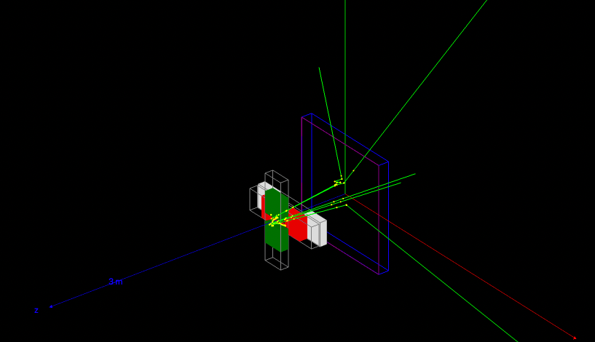
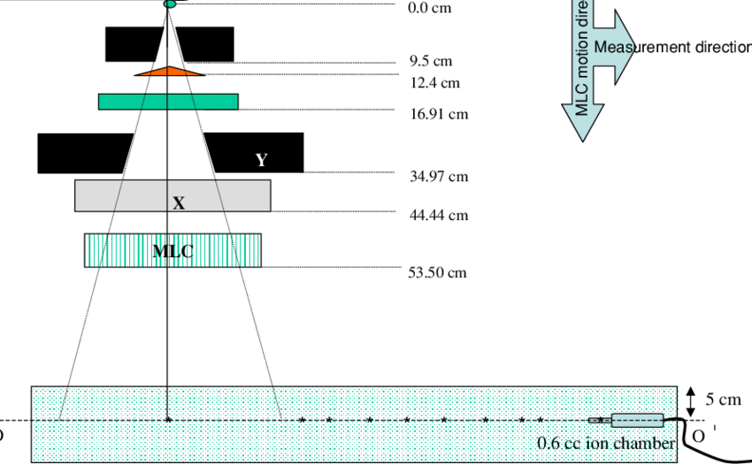
Topas Simulation for Optically-related Cherenkov-to-Dose linearity correction
Simulation Parameters:
6xFFF photon source
28x28cm field at 100cm SSD.
1mx1mx10cm:Water phantom
Mus’: 6.9, 10.9, 20.3 cm^-1
Mua: 0.11, 0.40, 0.61 cm^-1
Added MLC geometry
Scoring: At phantom surface, we collect the PhaseSpace, DoseToMedium, & Fluence scores.

Slide 4
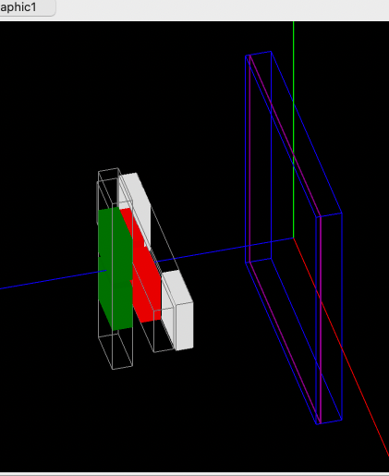
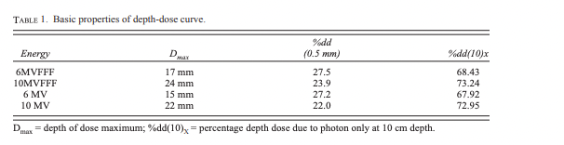
Reference conditions simulation: D_{mc ref}
Simulation Parameters:
10x10cm field defined by Jaws
Scoring plane placed at dmax (1.7cm)
No other geometry changes
Same number of particles as test conditions to find D/Mu = D_{test}/D_{mc ref}
Dmax: 1.7cm

Slide 5
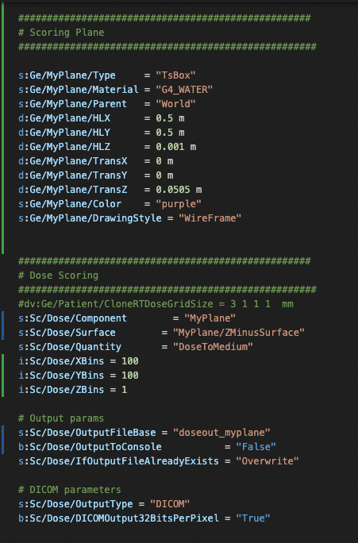
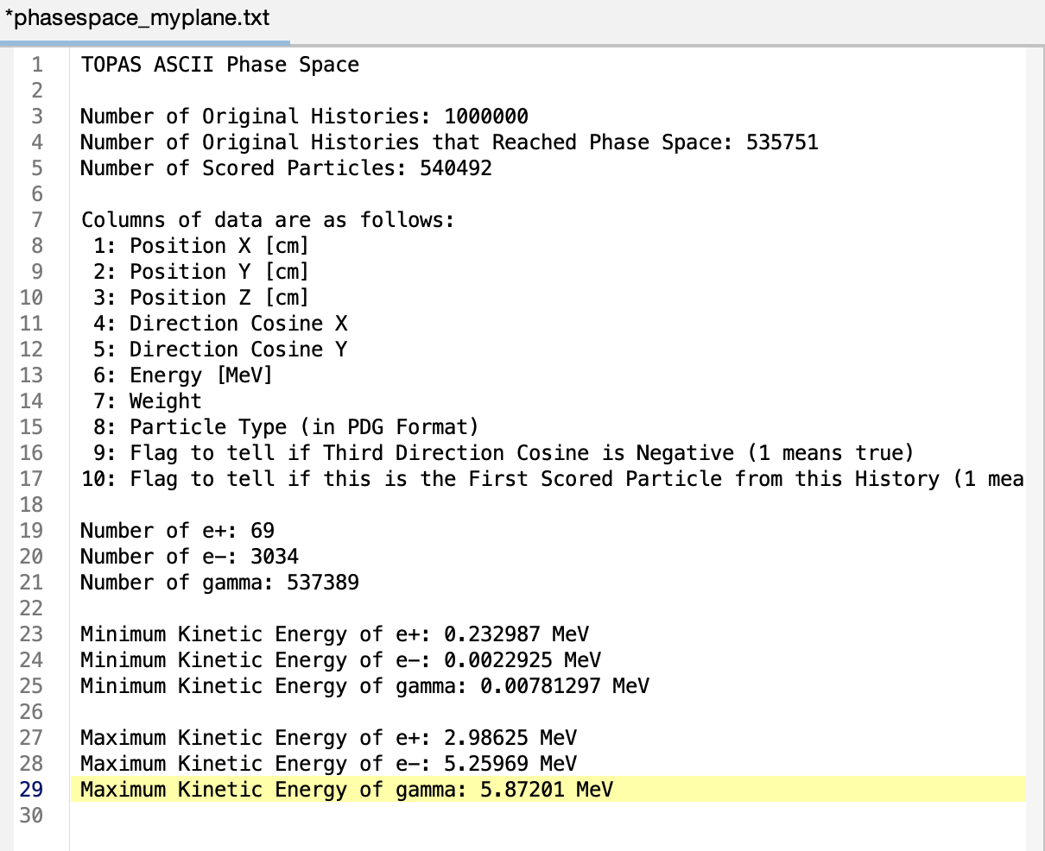
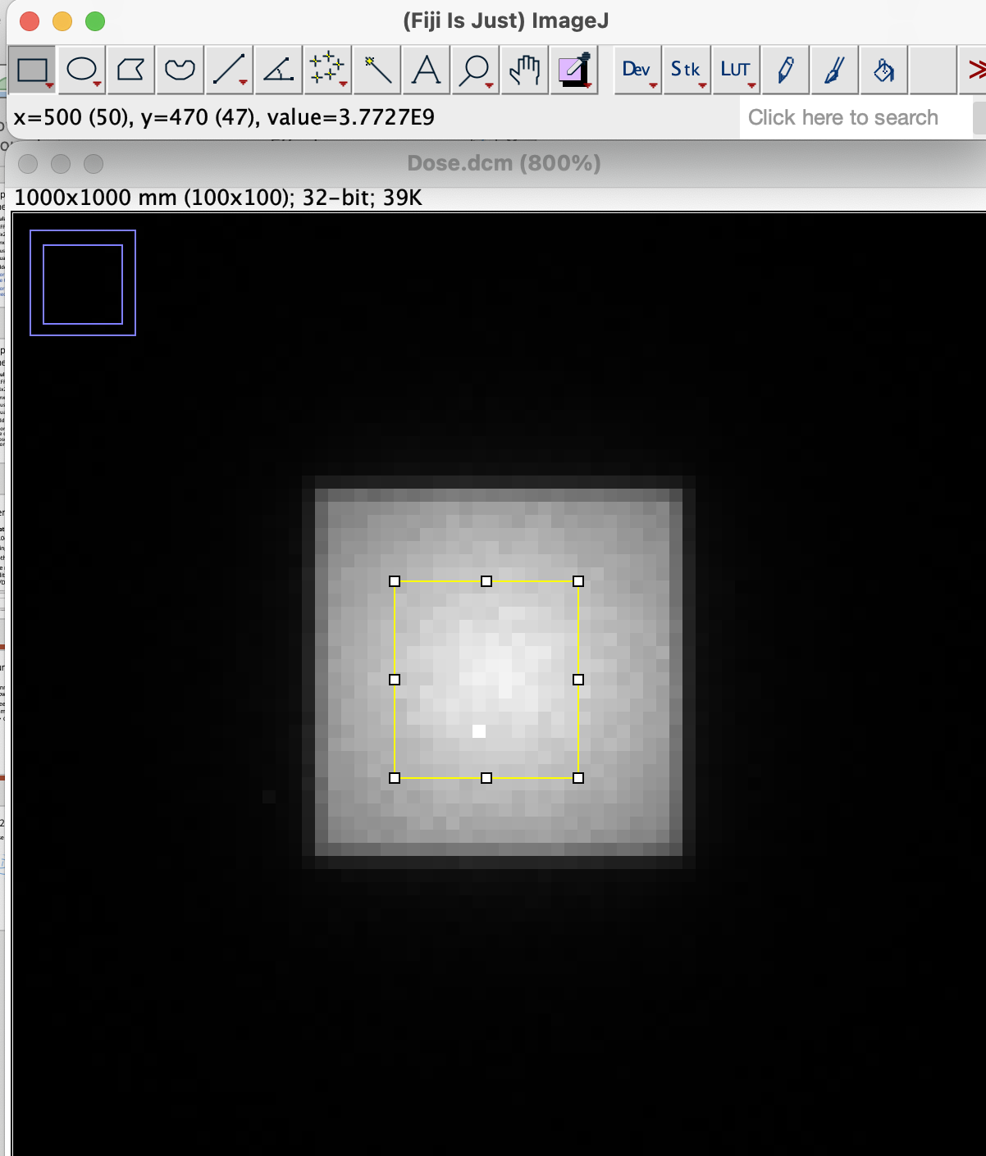
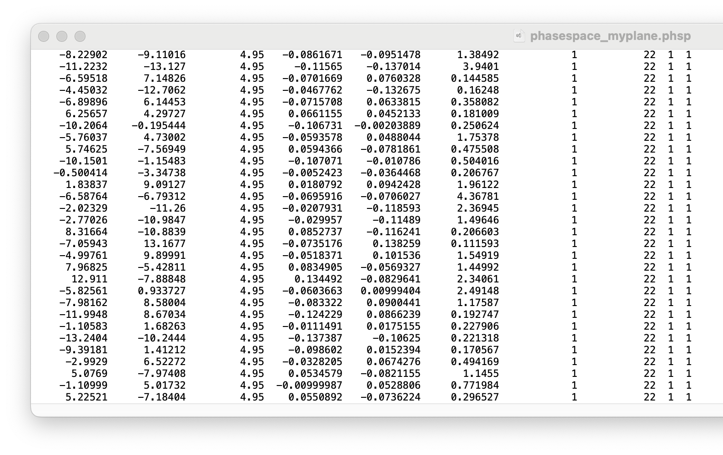
Current simulation challenges
Binned DoseToMedium (scored on surface plane) to 1cmx1cmx1mm voxels to generate a DICOM file, however dose appears unrealistic.
Set-up geometry for D_{mc ref} for comparison & to calculate D/MU
Need to convert PhaseSpace photons scored at same plane into the same voxel-space as the binned DoseToMedium.
Currently reading out phase space and header files
Dose plane is a voxelized 1cmx1cmx1mm surface plane.

Slide 6
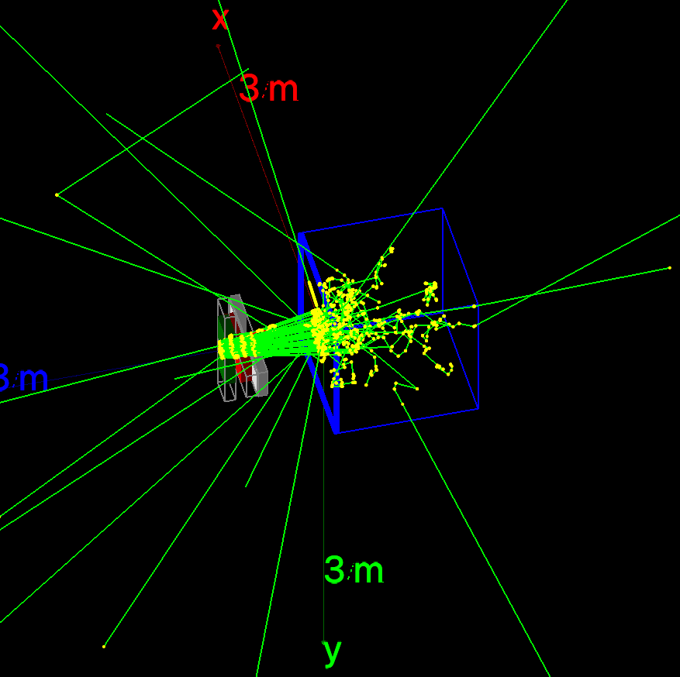
TOPAS Electron scoring

Slide 7
OpticalPhantom TOPAS software Hierarchy
bash.sh Program
Calls on 9 Batch(n).topas programs.
Batch(n).topas
Switches optical properties and then calls on OpticalPhantomTOPAS.topas
generate_ScoringGeometry.py
Generates topas geometry file with scoring boxes at selected increments.
Batch(n).topas
Switches optical properties and then calls on OpticalPhantomTOPAS.topas
Batch(n).topas
Switches optical properties and then calls on OpticalPhantomTOPAS.topas
Geometry.topas
Sets up LINAC, Collimator, MLC, and Couch geometry
ElectronScoring.topas
Sets up boxes & scoring planes for electrons.
OpticalScoring.topas
Sets up boxes & scoring planes for Cherenkov scoring.
Materials.topas
Establishes phantom material & optical properties.
Visuailzation.topas
Runs TOPAS gui to allow scene visulation. Comment out to run faster.
ElectronPhantomTopas.topas
Main loop integrates LINAC, scoring, and visualization.
Sets up # of Events
OpticalPhantomTopas.topas
Main loop integrates LINAC, scoring, and visualization.
Sets up # of Events
HUtoMaterialSchneider.topas
Converts CT HU to materials using Schneider paper. Will be used on DICOM patient scans.
CherenkovGeneration_py.py
Uses electron phsp file to generate photons with known location, angle, and inverse squared wavelengths.
CherenkovCam.py
Uses Cherenkov phsp file to generate 2D histogram. Programmed in gen3 quantum efficiency, working on simulating camera.

Slide 8
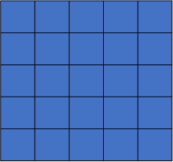
Electron Scoring Geometry
Boxes of water stacked on top of each other with following scorers:
Electron Phase Space: top surface of slices scored for electrons .
Electron Origin: 2D histogram, 100x100 scored volumetrically in each slice.
Dose: 2D histogram, 100x100 scored volumetrically in each slice.

Slide 9
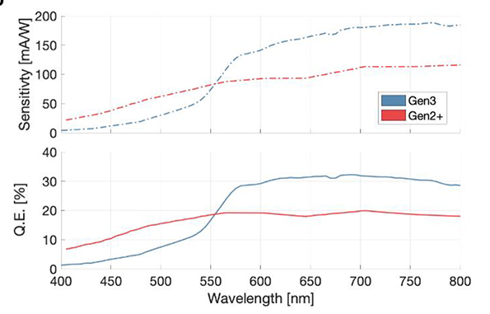
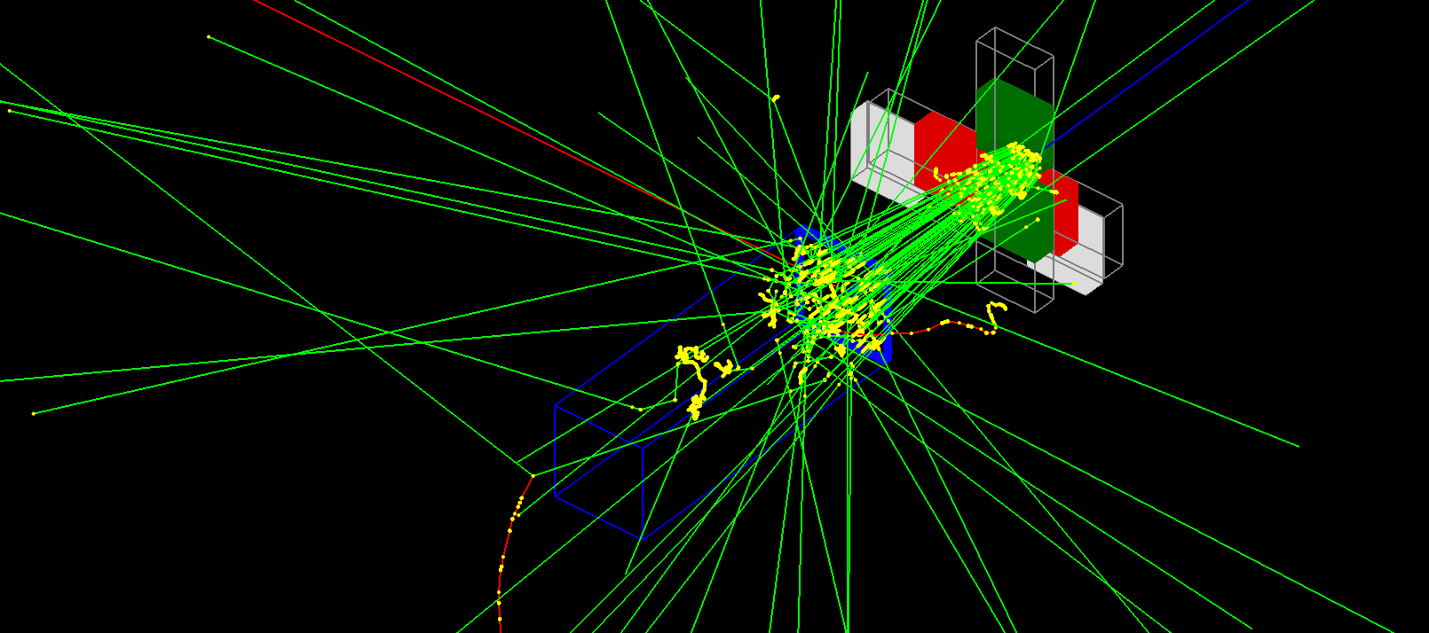
Cherenkov Scoring Geometry
Boxes of water stacked on top of each other with following scorers:
Cherenkov Phase Space: top surface of water box scored for outgoing Cherenkov photons between 400-900 nm.
Energies converted to Wavelength, and QE applied.
Virtual camera in development to simulate C-dose cam.

Slide 10
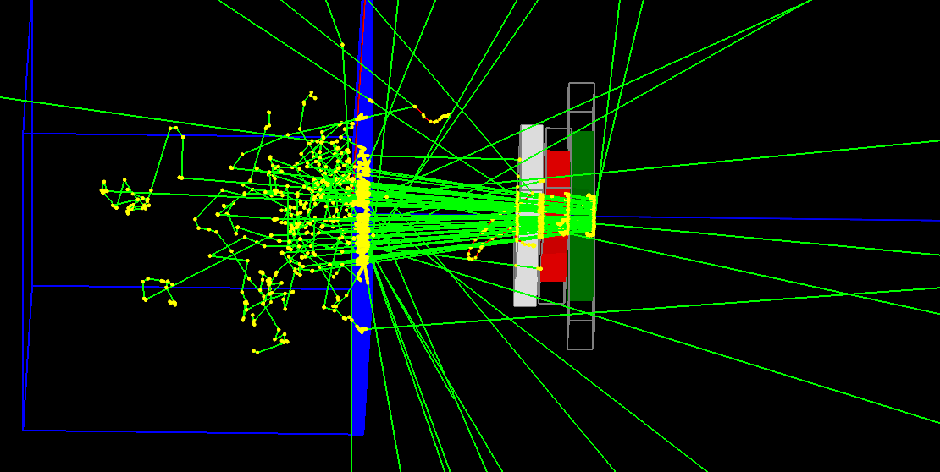
Electron Scorer Geometry
Mus’ = 20, Mua = 10

Slide 11
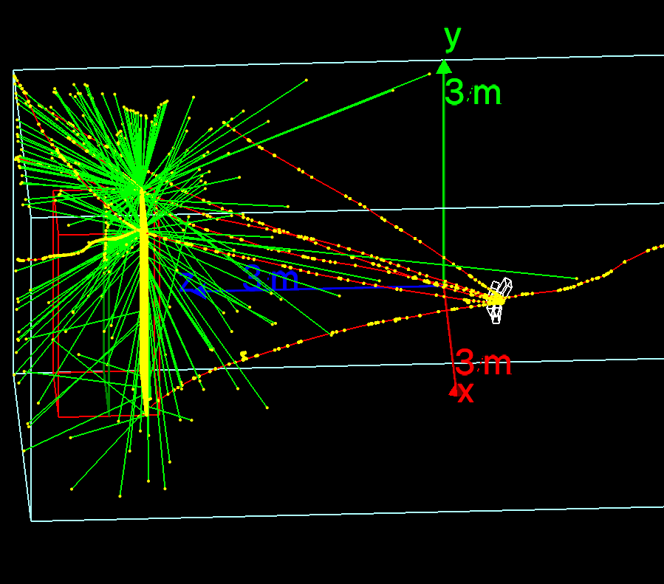
Weili Example
APGantryN – Run this program
TSEScore
TSEPhysics
TSESource – Sets # events
TSEGeometry

Slide 12
Weili Example
APGantryN – Run this program
TSEScore
TSEPhysics
TSESource – Sets # events
TSEGeometry

