Slide 1
Fake News Classification
Brooke Coneeny and Sydney Levy
Security & Privacy
Back
Next

Slide 2
Table of contents
01
02
03
What is Fake News?
Security
Goals
Exploratory Analysis
04
05
Logistic Model
Word Frequency Analysis
Security & Privacy
Back
Next

Slide 3
What is Fake News?
The term ‘Fake News’ is used to refer to news which is false or presents misleading information.
It’s purpose is often to discredit public / political figures or make money through ad revenue.
Security & Privacy
Back
Next

Slide 4
Security Goals & Fake News
Availability
Integrity
Accountability
Fake news is widely available online and through social media
Quotes and facts changed without permission
Authors of fake news are often not held accountable for presenting false info
Security & Privacy
Back
Next

Slide 5
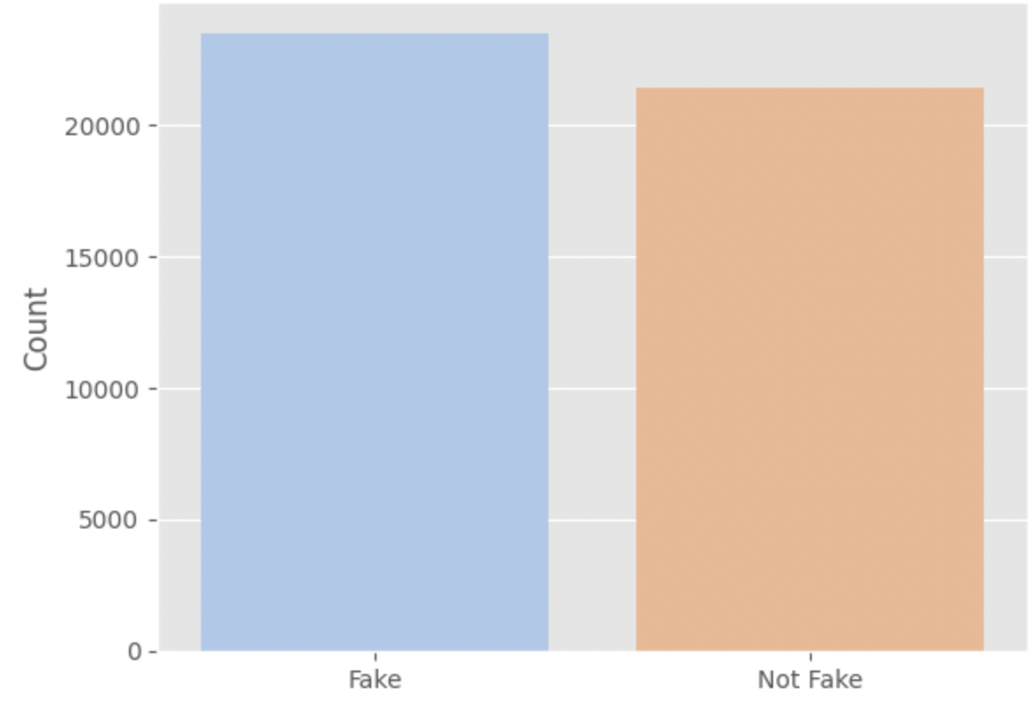
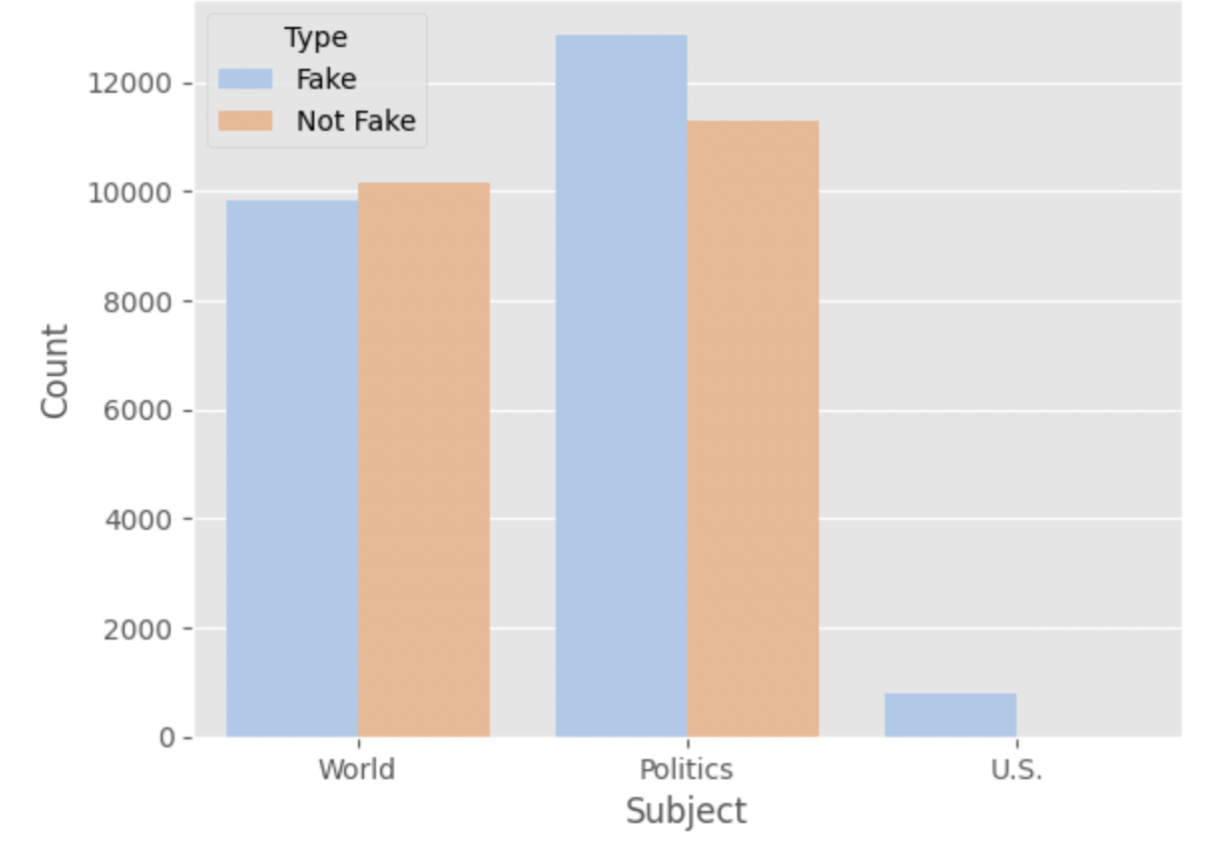
Exploratory Analysis
Percent of Fake News in Dataset
News by Subject
Security & Privacy
Back
Next

Slide 6
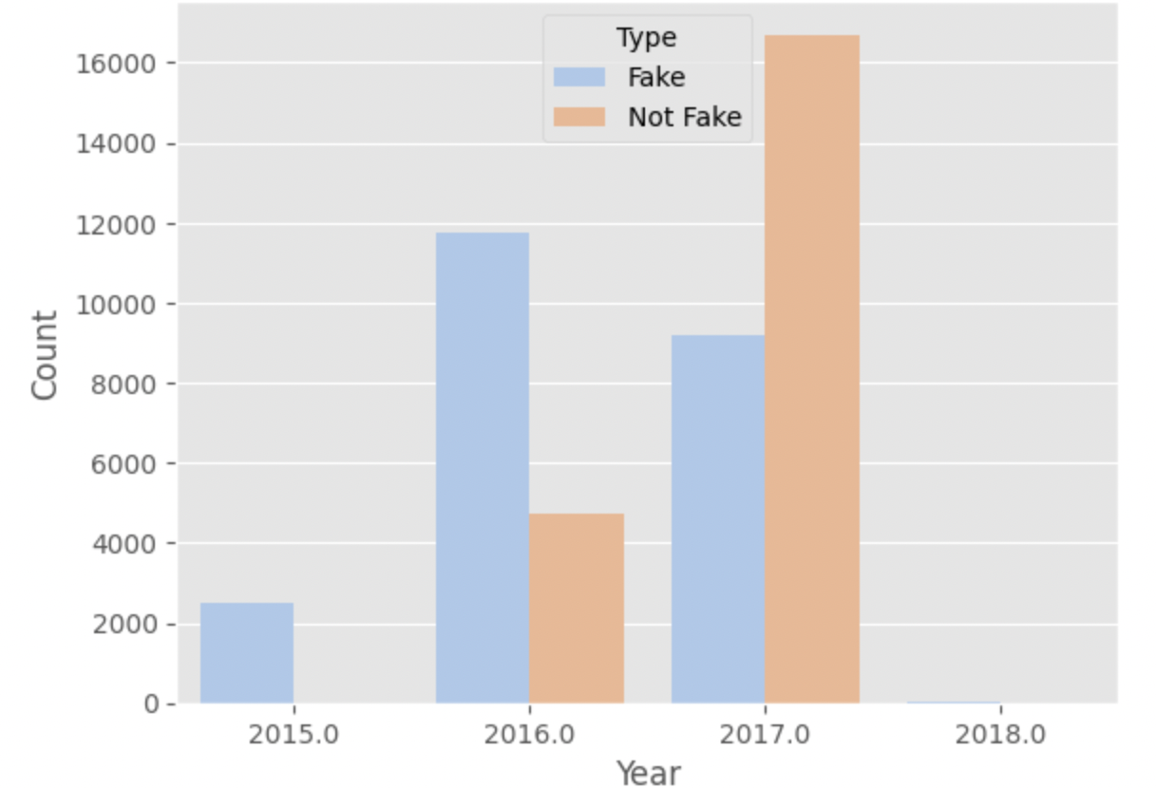
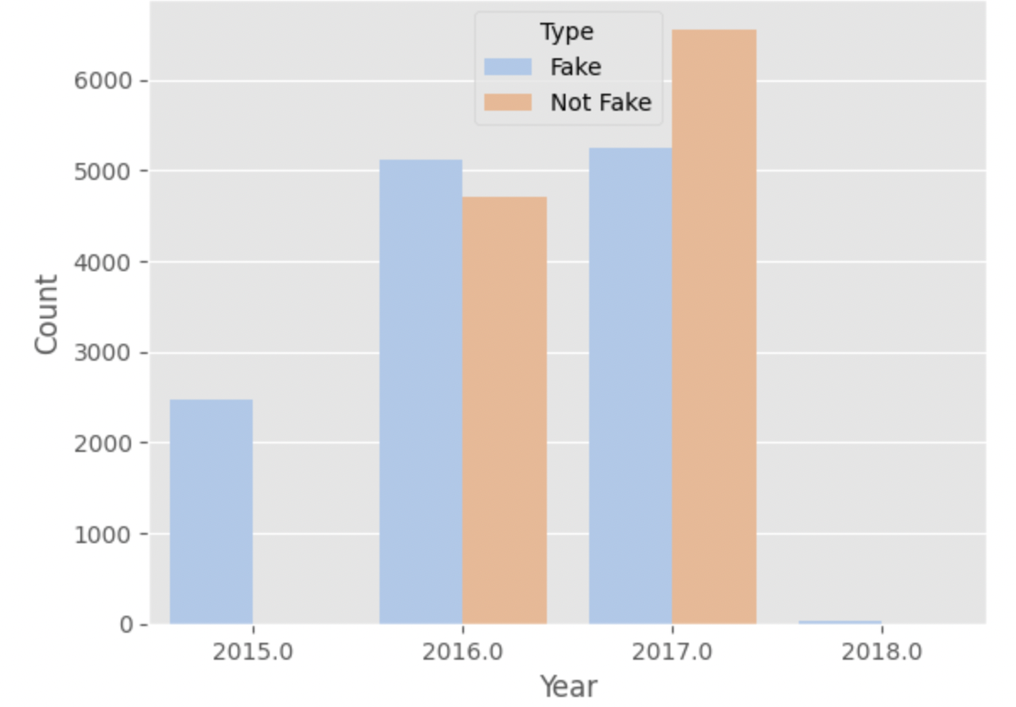
Exploratory Analysis Cont.
Percent of Fake News in Dataset
Percent of Fake News in Dataset
Security & Privacy
Back
Next

Slide 7
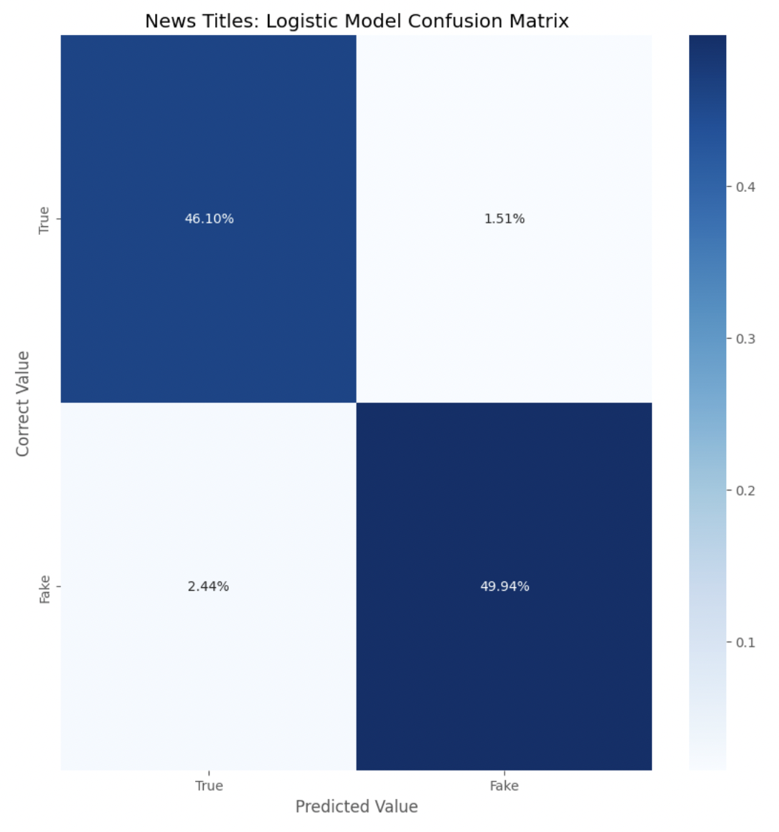
Logistic Model 1
Article Titles
Accuracy: 96%
Security & Privacy
Back
Next

Slide 8

Logistic Model 2
Article Content
Accuracy: 99%
Security & Privacy
Back
Next

Slide 9
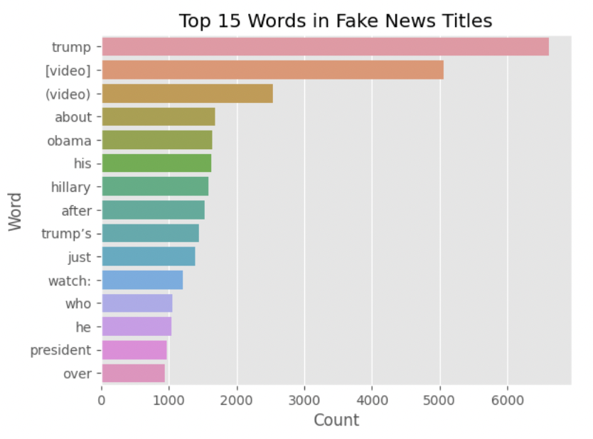
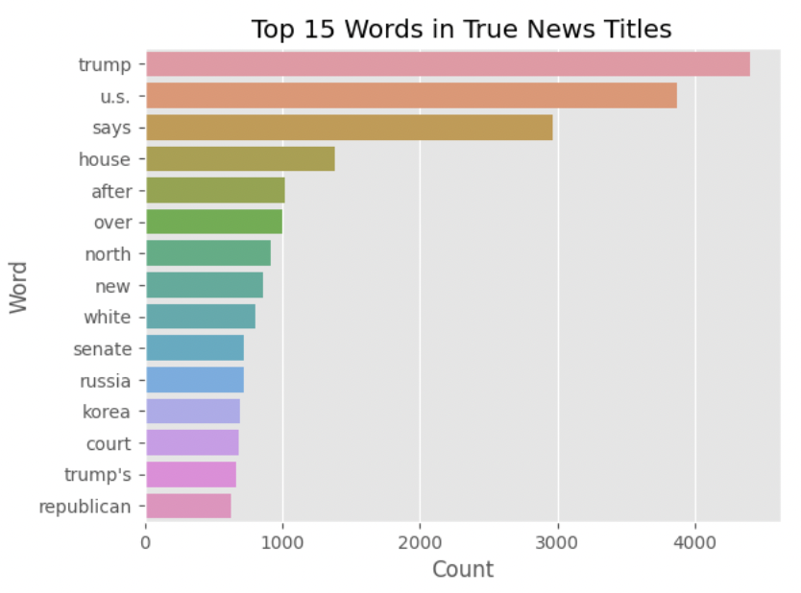
Word Frequency Analysis
Security & Privacy
Back
Next

Slide 10



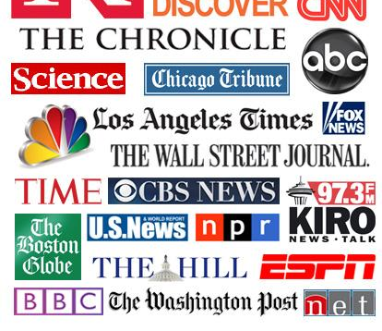
Use Cases for Security & Privacy Today
Security & Privacy
Back
Next

Slide 11
Resources
Link to Dataset: https://www.kaggle.com/code/maxcohen31/nlp-fake-news-detection-for-beginners/data
Link to Code Referenced for Logistic Model: https://www.kaggle.com/code/paramarthasengupta/fake-news-detector-eda-prediction-99
Link to Code Referenced for Analysis of Word Frequencies: https://www.kaggle.com/code/sreshta140/is-it-authentic-or-not
Security & Privacy
Back
Next

Slide 12
Questions?
Security & Privacy
Back
Next

