Slide 1
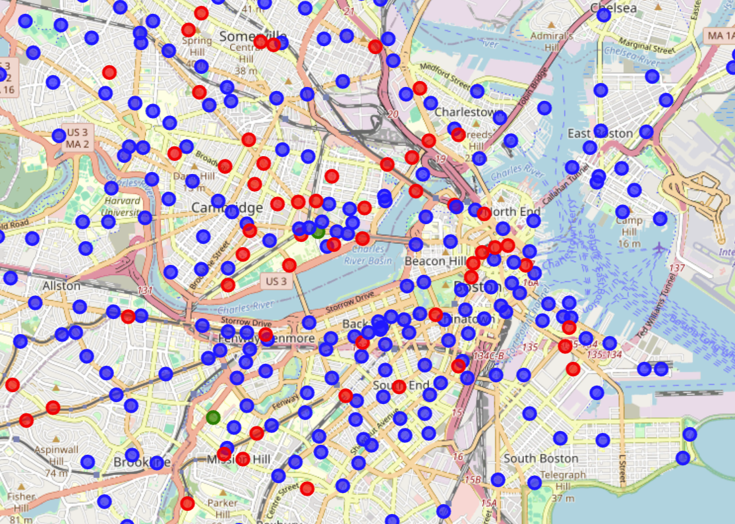
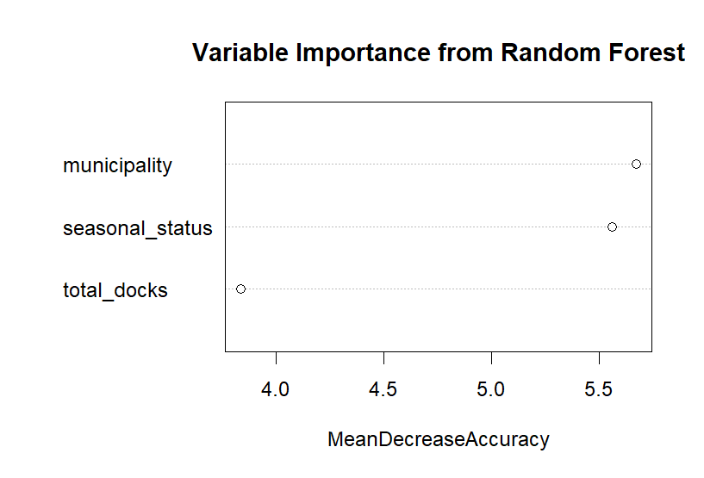
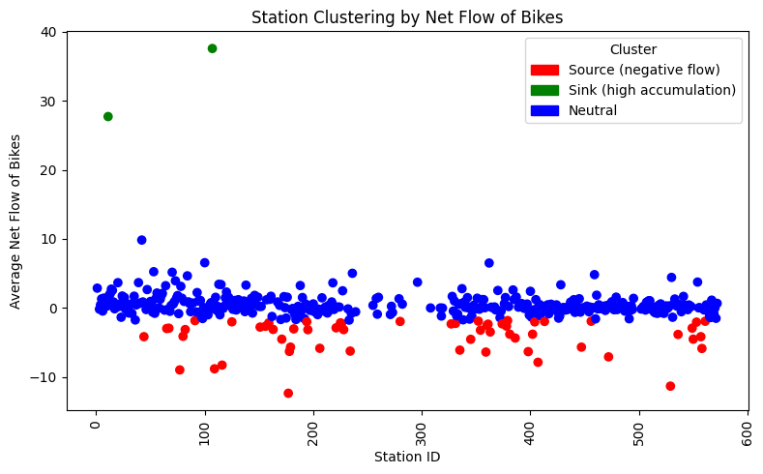
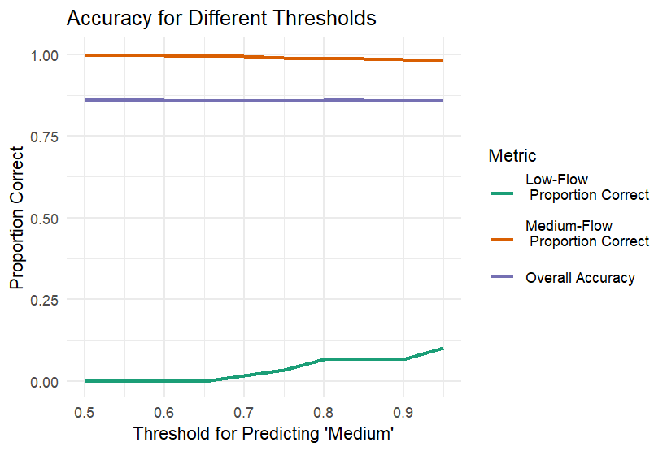
Where did the Bluebikes go? (in June – August of 2022)
Brooke Bao
Wellesley College, Data Science Capstone
Background and Research Question
Visualization
Results
Bluebikes is a bike-sharing program with 500+ stations across the Boston area,
Riders pick up a bike at one station and return it to another
Some stations may see bikes accumulate if drop-offs outpace pickups—creating imbalances, need for redistribution of bikes
This research explores the following questions:
RQ1: Do Bluebikes tend to accumulate at certain stations and remain there for extended periods?
RQ2: What attributes of stations may indicate a tendency for Bluebikes to accumulate?
Data and Methods
Data Sources
1) Bluebikes trips (start/end stations)
2) Bluebikes stations (ID, docks, municipality, seasonal status)
Data Cleaning
Extracted day for each ride start and counted the number of pickups and drop-offs per station per day
Calculated net flow per day for a station as the difference between drop-offs and pickups
Averaged “flow” across days to estimate each station’s long-term flow pattern
Methods
Used K-means clustering to group stations into clusters based on flow, clusters defined with elbow method
Used random forest to predict whether station attributes (docks, location, seasonal) can predict whether it was clustered as low or high flow
Discussion and Conclusion
There are bike stations where people are more likely to bring bikes away from and stations where people are more likely to bring bikes to
Municipality, seasonal status, and total docks are not good predictors of high or low flow of bikes
Limitation: Clustering by net flow may oversimplify rider behavior and overlooks features like time-of-day or location
Future work: clustering with features like proximity, investigate station-station unique trips

