Slide 1
Spatial Inequality in Access to
Special Education Services in Illinois
GGIS 403 Final Project
County level analysis
Xiaoxi Chen
Prof. Yue Lin
May 5, 2026
Notes:
My original goal was to find where special education services may be lacking through distance differences. For this presentation, I will focus on a county level analysis.

Slide 2
Research question and project focus
Main research question
Current preliminary unit
Do special education services show spatial inequality in Illinois, and where may access be lacking?
County level
because the ISBE file includes county, but not school latitude or longitude or ZIP code.
Why this still fits the topic
The project still studies spatial inequality in special education needs and service reporting.
County aggregation gives a first statewide pattern before the final report.
The final version can add school coordinates or geocoding for a true distance analysis.
Notes:
This question connects to my interest in education and equity. In the proposal, I planned to measure distance from students or communities to schools with special education services. After checking the actual data, I found that the dataset has county names but not latitude, longitude, or ZIP code. Because of that, I changed the analysis to the county level. This still fits my topic because it shows statewide spatial patterns in IEP enrollment and service reporting, which is the individualized education program.

Slide 3

Data and variables used
ISBE Report Card Public Data Set
Selected variable
School-level records.
General sheet selected.
% Student Enrollment - IEP.
Spatial boundary
Output table
TIGER/Line county polygons for Illinois.
school_count, schools_with_iep, mean_iep_percent, median_iep_percent.
Important data change from proposal
The original plan was school points → nearest service distance.
The actual ISBE workbook did not provide coordinates or ZIP code.
So our analysis uses county names for a reproducible spatial join.
Notes:
For the data, I use the 2025 ISBE Report Card Public Data Set, which is from illinois state board of education. I selected the General sheet because it includes school level records and the variable percent student enrollment with IEP. I use this variable as my main special education indicator. I also use TIGER Line county polygons for Illinois so I can map the results. The output table includes school count, schools with reported IEP students, mean IEP percent, and median IEP percent for each county.

Slide 4
Workflow
1
Load data
Read ISBE Excel workbook and check sheet or column names
2
Clean table
Keep school name, county, and IEP percentage
3
Aggregate
Summarize school data by county
4
Spatial join
Merge county summary with Illinois county polygons
5
Map + chart
Create choropleth maps and a county ranking chart
Notes:
So my workflow includes the following steps. First, I load the ISBE Excel workbook and inspect the sheet names and column names. Second, I clean the table by keeping school name, county, and IEP percentage. Third, I aggregate school level data to the county level. Fourth, I join the county summary table to Illinois county polygons. Last, I create maps and a county ranking chart. This uses methods such as pandas data cleaning, GeoPandas spatial data processing, joining tabular data with spatial boundaries, and mapping.

Slide 5
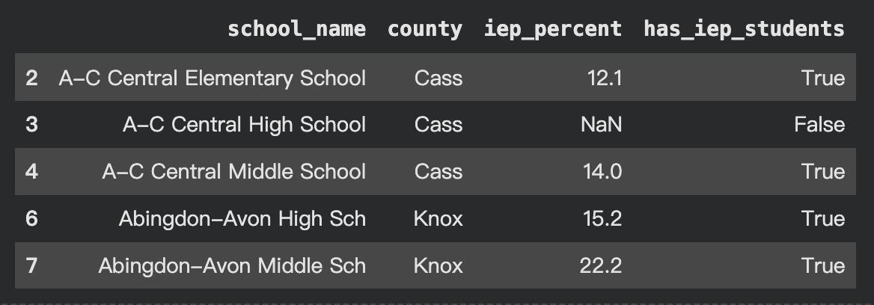
Cleaning result
Sample rows from the cleaned table
What the cleaning step created
county: spatial join key
iep_percent: selected special education need indicator
has_iep_students: True when IEP percentage is reported and above zero
county_summary: one row per county for mapping
Note: a missing IEP value is automatically treat “no service.”
Notes:
For the cleaning result step, I cleaned the school level table from the ISBE Report Card dataset. The cleaned table keeps the school name, county, IEP percentage, and a new variable called has_iep_students. This variable is true when the IEP percentage is reported and above zero. This cleaning step also created county_summary, which gives one row for each county. That summary table is what I later join with the Illinois county boundary map. One thing I need to be careful about is missing IEP values. I interpreted missing value automatically as no service.

Slide 6
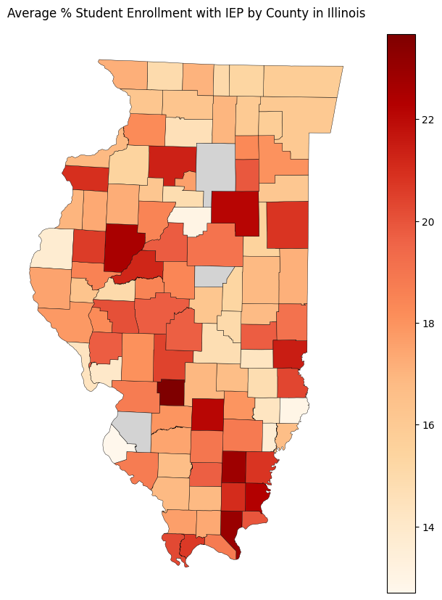
Map1: IEP percentage by county
Main Finding
IEP enrollment percentage is not evenly distributed across Illinois counties. Several counties in central and southern Illinois appear darker, meaning they have a higher average percentage of students with IEP. Most counties fall around the mid to high teens, while the highest counties are above 22%.
Interpretation: This map is more about special education need or service reporting, not direct service access. A darker county may mean a higher share of students have IEP, but it does not automatically mean services are better or worse there. It shows where special education needs may be more concentrated and where the final analysis should look more carefully.

Slide 7
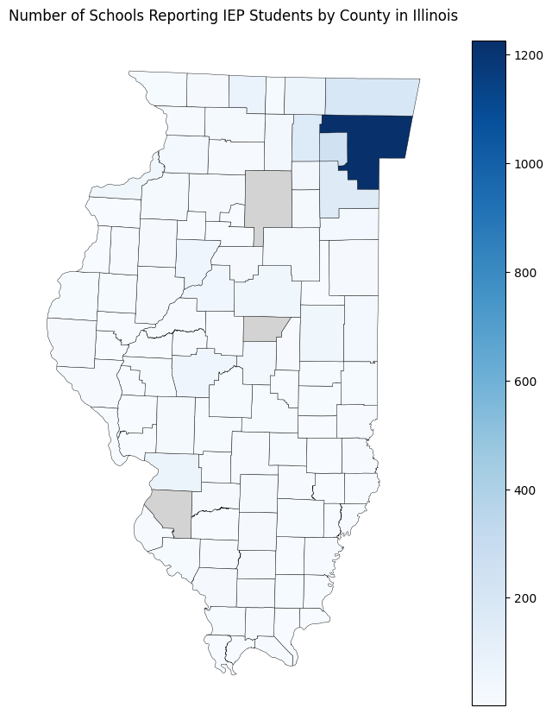
Map 2: schools reporting IEP students
Main finding
The number of schools reporting IEP students is highly concentrated in a few counties. Cook County stands out strongly because it has many more schools than most other counties.
Interpretation: This map shows volume, not equal access. A county with more reporting schools may simply have a larger population and more schools overall. It does not necessarily mean students have better access to special education services. For the final report, this count should be normalized by total schools, enrollment, or student population.

Slide 8
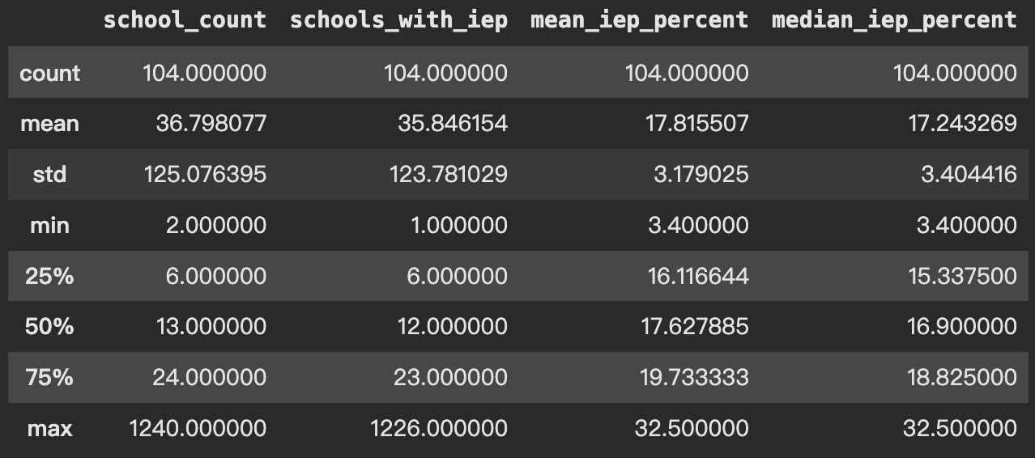
County summary
The summary table shows that the dataset contains 104 county level records. On average, each county has about 37 schools, and about 36 schools report students with IEP. However, the standard deviation is very large because some counties have only a few schools, while Cook County has many more schools. The average county level IEP percentage is about 17.82%, with most counties falling between about 16.12% and 19.73%.
Notes:
This summary helps me understand the overall distribution before focusing on individual counties. It also reminds me that school count matters. A county with fewer schools may have a less stable average, so I should not overinterpret one number.

Slide 9
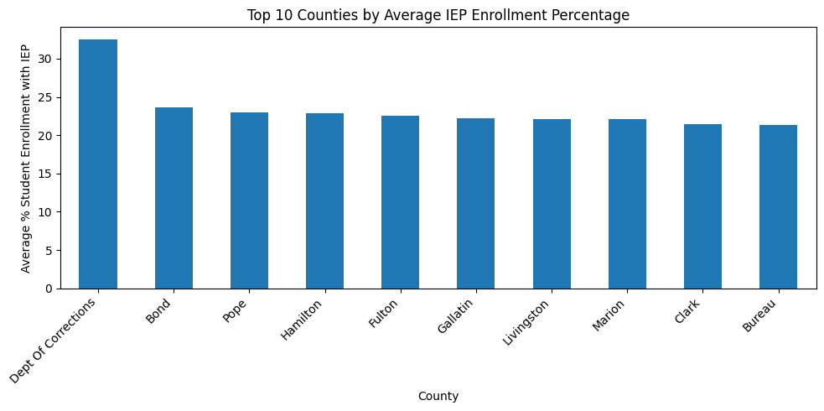
Top 10 Counties
The bar chart shows the counties with the highest average IEP enrollment percentage. Most top counties are around 21% to 24%, while Dept of Corrections is much higher at about 32.5%. Because this is not a regular county, I should treat it as a special record and check whether it should be excluded in the final analysis.
Notes:
The main point from this chart is that special education need appears uneven across space. But I also need to compare the IEP percentage with school count. Some counties may have a high average because they have fewer schools, so their average may be less stable.

Slide 10
What is valid, and what is limited?
Valid so far
Main limitation
The notebook successfully loads ISBE data, creates a county summary, joins it to county polygons, and maps two preliminary indicators.
This is not yet a distance based accessibility analysis because school coordinates are missing from the current ISBE file.
MAUP issue
Data meaning
County level analysis can hide local differences inside large counties and can make results look different from ZIP or tract analysis.
Persentage Student Enrollment - IEP indicates students with IEP, so it is a need or service reporting indicator, not a direct measure of service quality.
Conclusion: This result suggests that special education needs are not evenly distributed across Illinois counties. However, counties with smaller school counts may have less stable averages, so I need to compare IEP percentage with school count before making strong claims.
Notes:
So the workflow is reproducible and uses some analysis methods.
so I cannot calculate distance to the nearest special education service school yet.
There is also a Modifiable Areal Unit Problem issue. If I used ZIP codes or census tracts, the pattern might look different.

Slide 11
Next steps and feedback request
Next steps
Check missing county joins and missing IEP values.
Normalize school counts by student population or total enrollment.
Add ACS income or poverty data at county level for a clearer equity comparison.
Try to find a school directory with coordinates or geocode schools for distance analysis.
Thank you!

