Slide 1
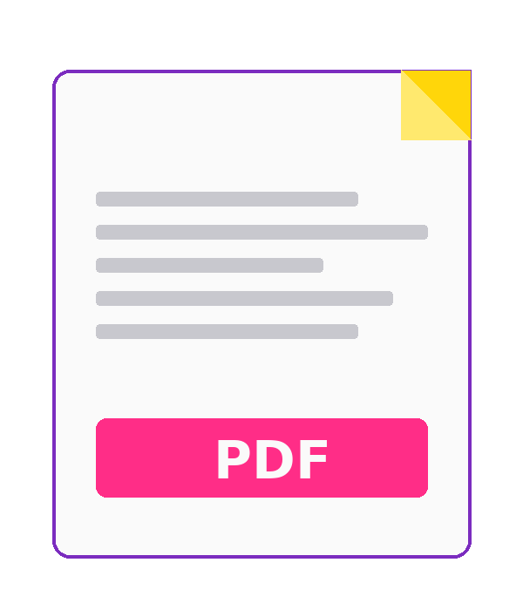
TRAINING PRESENTATION
Save Images as a PDF
— Using Print.
A simple skill that works on almost any device, with no extra software to install.
By Brooke Chauntel · BaBBled.

Slide 2
WHY THIS MATTERS
Ever needed to email a photo as a PDF?
• Job applications and résumé portfolios often require PDF.
• Schools and instructors often only accept PDF submissions.
• PDFs keep multiple images together in one tidy file.
• PDFs print and view the same on every device.
No Adobe. No paid app. Just the Print dialog you already have.

Slide 3
TODAY YOU WILL LEARN
By the end of this training, you'll be able to…
• Open one or more images on your computer or phone.
• Use the Print command to reach a hidden PDF option.
• Choose "Save as PDF" as the destination.
• Adjust orientation, size, and margins for a clean result.
• Save the finished PDF where you can find it later.

Slide 4
BEFORE WE START
What you need
A device
Your image(s)
Windows PC, Mac, Chromebook, iPhone, or Android — all work.
JPG, PNG, HEIC, or screenshots already saved on the device.
A folder in mind
A file name
Decide where you want the finished PDF to land (Desktop, Downloads, etc.).
Something clear like 'brooke-portfolio.pdf', not 'untitled1.pdf'.

Slide 5
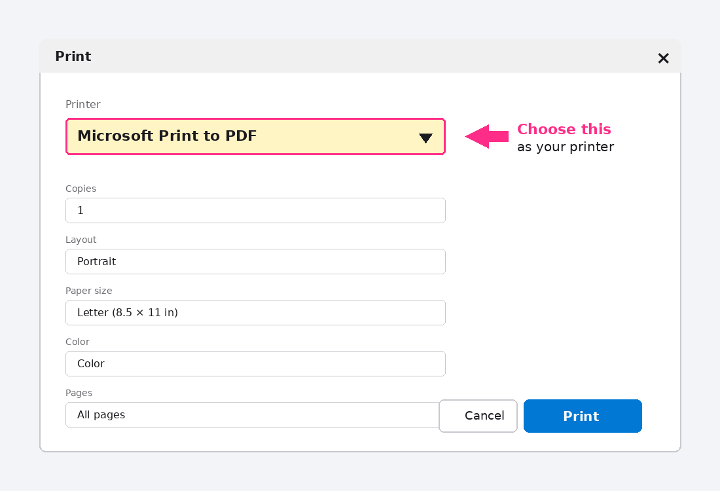
METHOD 1 · WINDOWS
Save an image as PDF on Windows
1. Open the image — double-click it so it opens in Photos.
2. Press Ctrl + P to open the Print dialog.
3. Under Printer, choose "Microsoft Print to PDF."
4. Pick paper size and orientation, then click Print.
5. Name the file and choose where to save it. Done.

Slide 6
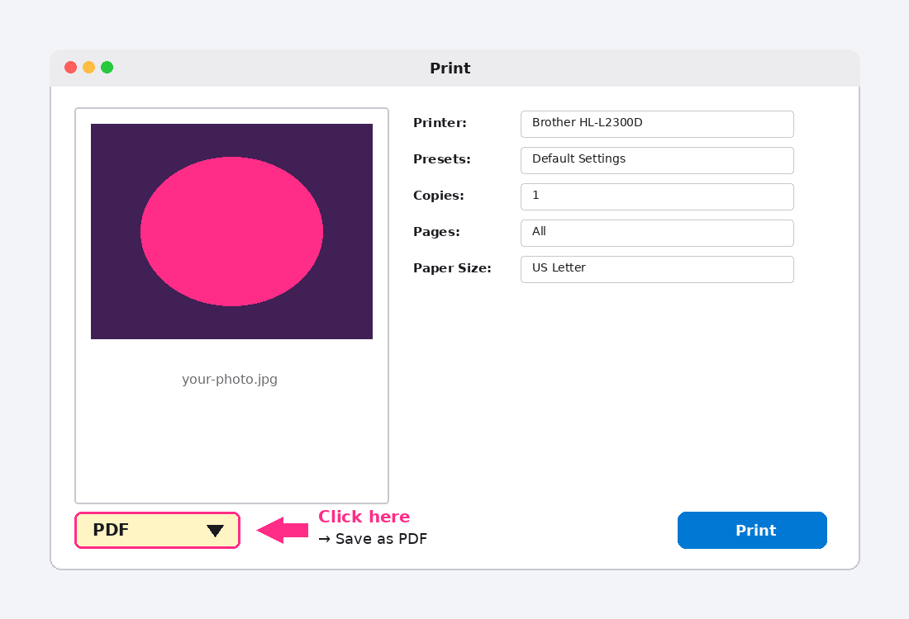
METHOD 2 · MAC
Save an image as PDF on a Mac
1. Open the image in Preview (double-click it).
2. Press ⌘ + P to open Print.
3. In the bottom-left, click the PDF dropdown.
4. Choose "Save as PDF."
5. Name it, pick a folder, click Save.
Bonus: in Finder, select images → right-click → Quick Actions → Create PDF.

Slide 7
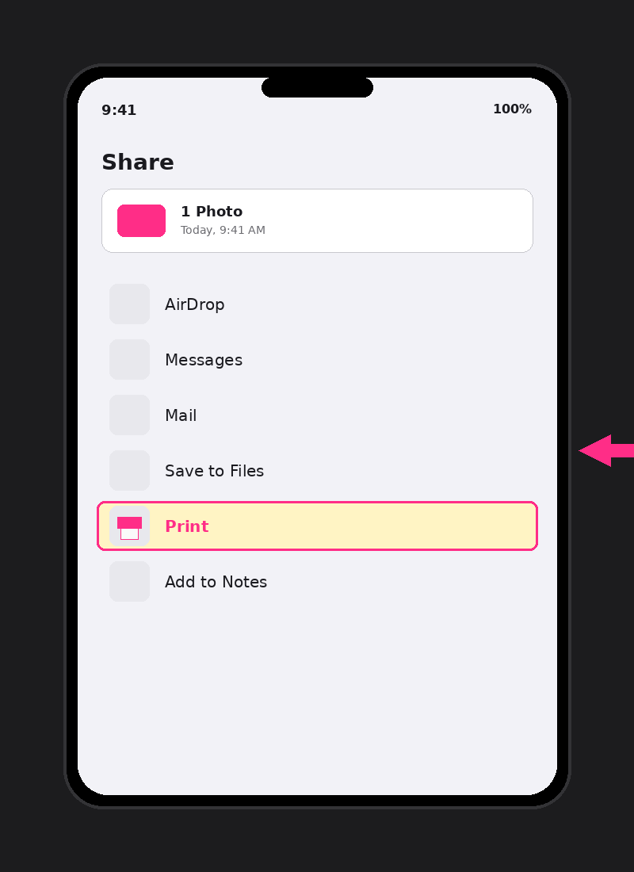
METHOD 3 · PHONE
Save an image as PDF on your phone
1. Open the image in your Photos or Gallery app.
2. Tap the Share button (the box with the arrow).
3. Scroll down and tap Print.
4. Pinch out with two fingers on the preview (iPhone) or tap the PDF icon (Android).
5. Tap Share / Save → Save to Files.

Slide 8

PRO MOVE
Putting multiple images in one PDF
• Windows: File Explorer → select images → right-click → Print → "Microsoft Print to PDF."
• Mac: Finder → select images → right-click → Quick Actions → Create PDF.
• Phone: Photos → Select → Share → Print → pinch out.
One PDF beats five attachments — every time.

Slide 9
SHORTCUT
Skip the Print dialog with Export → PDF
Some apps offer a one-step PDF export. Always check the File menu first.
Word · PowerPoint
Pages · Numbers · Keynote
File → Export → Create PDF/XPS Document
File → Export To → PDF…
Photos (Mac)
Google Docs · Slides · Sheets
File → Export → Save PDF to…
File → Download → PDF Document (.pdf)
If "Export" isn't there, fall back to the Print method we just learned.

Slide 10

NOW YOU TRY · INTERACTIVE SANDBOX
Practice on a real page, live in your browser.
Scan the QR code or open the link below. Drop in any photos, then tap "Save as PDF."
EASY
Drop in 1 photo. Save it as 'first.pdf'.
MEDIUM
Drop in 3 photos. Save them as one combined PDF.
BONUS
Change the title field, then save. Open the PDF — does the title match?
Scan to open
babbled-wear/sandbox
Stuck? Raise your hand — I'll come help.

Slide 11
WATCH OUT FOR
Three things that trip people up
1. Wrong destination
2. Cropped image
If your real printer is selected, it'll print on paper. Always switch the destination to Save as PDF.
If the photo is cut off, change orientation to Landscape or shrink margins to None.
3. Lost file
Bonus: huge file size
Note the folder before you click Save. Default is usually Documents or Downloads.
If the PDF is too big to email, lower print quality to Standard or use a smaller paper size.

Slide 12
QUICK RECAP
The whole skill in five words:
Open. Print. Save as PDF.
• Works on Windows, Mac, Chromebook, iPhone, and Android.
• No software to download, no account to make.
• Combine multiple images by selecting them all first.
• Name your file something you can find later.

Slide 13
FINAL TIPS
Two habits that will save you time
• Make a folder called PDFs so you stop hunting for them.
• Double-click the saved PDF to verify it looks right before you send it.
Thank you for your attention — and for practicing along.
Questions? Ask away.

