Slide 1


What factors influence inclusion in Spotify’s top- curated playlists?
AN ANALYSIS By Brooke Jackson
June 2020

Slide 2
Why this matters
HIGH IMPACT:
Spotify is the #1 Music Streaming Platform in the world with nearly 150 million paid subscribers worldwide.
Spotify Playlists are the best place to build a fanbase for music right now. An artist can put the least amount of effort for the biggest reward.
FIERCE COMPETITION:
Around 40,000 tracks are released on Spotify every day.
ENGAGEMENT:
Spotify users follow curated playlists to discover new music. It guarantees streams for a track.
OBSCURE METHODS:
Spotify staff curates these playlists from songs that are submitted through an online portal. Talent management companies often pay $100K+ salaries to staff to call/network/influence inclusion in the playlists, with mixed results, and “Playlisting” company scams are rampant and ineffective.

Slide 3
How to get your song on a Spotify playlist:
Submit your song to Spotify via a webform.
Select the playlists you want to be considered for with a description of reasons why it should be selected.
But there are thousands of curated playlists, and 65 curated by Spotify in the US alone.
And many artists vie for inclusion on “New Music Friday,” which is seen as a big break.
And what really is the difference between playlists called “Get Turnt” and “Workout Twerkout”?
Cross your fingers! and…maybe you know someone who can call in a favor?
Source: https://artists.spotify.com/blog/share-new-music-for-playlist-consideration

Slide 4
Data Science Research Questions:
Which playlist should you focus on to have the most impact from the inclusion?
Could you change your description - or even the song itself - to have a better chance of inclusion? Are there other factors?
What if you knew EXACTLY where your track should be placed according to regression, classification, and Machine Learning models?

Slide 5
Data to analyze:
Top 25
Most-Followed, Spotify-Curated US Frontline Playlists
(+ 3 of the least-followed)
RapCaviar
Peaceful Piano
Get Turnt
Hot Country
Chill Hits
Mint
Happy Hits!
Mood Booster
Are & Be
Motivation Mix
Rock This
Teen Party
Sleep
Workout
New Music Friday
Power Workout
Pop Remix
Cardio
K-Pop Daebak
Most Necessary
Intense Studying
Ultimate Indie
Hot Rhythmic
Chilled R&B
Dance Rising
…
62. Silk Sheets
63. PopCo
64. Next From Nashville

Slide 6
Data + Sources
Data:
All songs ever included on the playlists:
Song Name, Artist, Release Date, Playlist Add Date, Record Label, Genre.
Quantifiable audio features about these songs (tracks):
Tempo, Key, Mode, Danceability, Energy, Valence, Liveness, Speechiness, Instrumentalness, Acousticness, Duration
Sources:
Chartmetric:
Third-party Data Analytics site for the Music Industry, pulling charts, playlist information from various DSPs (Digital Streaming Platforms), including Spotify, YouTube, AppleMusic, & Shazam.
(Note this is a paid service: $140/mo + $1000+ for custom/large downloads)
https://www.chartmetric.com/
Spotify Developer API:
Granted developer access credentials to pull audio features directly from Spotify.
Utilized Spotify’s Python API integration package, Spotipy
https://developer.spotify.com/

Slide 7
Data Gathering, Cleaning + Management
Utilized Python, R and Tableau
Could only pull one playlist + playlists’ features at a time (creating functions and loops helped!)
TONS of data cleaning, shaping, merging, handling missing values, creating dummy variables for analysis. (Spent a lot of time on StackOverflow!)
Over 100,000 observations
8000+ variables after splitting genre types and record labels.
Calculations and linear regressions features provided interesting insights.
There is so much more to analyze!

Slide 8
Definitions:
Frontline: A playlist’s historical focus. Frontline playlists include tracks less than 18 months old.
Followers: # of Spotify users “following” the playlist
Tempo: Overall estimated tempo of a track in beats per minute (BPM).
Key: Integers map to 12 pitches. 0 = C, 1 = C♯/D♭, 2 = D, and so on.
Mode: Major (1) or Minor (0)
Time Signature: Estimated overall time signature of a track. Notational convention to specify how many beats are in each bar (or measure).
Duration: The duration of the song in milliseconds.
Danceability: Describes how suitable a track is for dancing, based on tempo, rhythm stability, beat strength, and overall regularity.
0 is least danceable, 1 is most danceable.
Valence: A measure from 0.0 to 1.0 describing the musical positiveness conveyed by a track. High valence sound more positive (happy, cheerful, euphoric), while tracks with low valence sound more negative (sad, depressed, angry).
Loudness: Loudness of a track in decibels (dB). Loudness values are averaged across the entire track and are useful for comparing relative loudness of tracks.

Slide 9
Definitions:
Liveness: Detects the presence of an audience in the recording. Higher liveness values represent an increased probability that the track was performed live. Value above .8 provides strong likelihood that the track is live.
Acousticness: A confidence measure from 0.0 to 1.0 of whether the track is acoustic. 1.0 represents high confidence the track is acoustic.
Energy: 0 to 1 representing a perceptual measure of intensity and activity. Energetic tracks feel fast, loud, and noisy. (Death metal has high energy, while a Bach prelude scores low on the scale.) Dynamic range, perceived loudness, timbre, onset rate.
Instrumentalness: Predicts whether a track contains no vocals. “Ooh” & “aah” sounds are treated as instrumental. The closer the instrumentalness value is to 1.0, the greater likelihood the track contains no vocal content
Speechiness: Presence of spoken words in a track. The more speech-like the recording (e.g. audio book, poetry), the closer to 1.0.
Values above 0.66 are probably entirely spoken words. Values between 0.33 and 0.66 describe tracks that may contain both music and speech, in sections or layered, such as rap music. Values below 0.33 represent music & other non-speech-like tracks.

Slide 10

Visualizing the playlists
EDA:

Slide 11
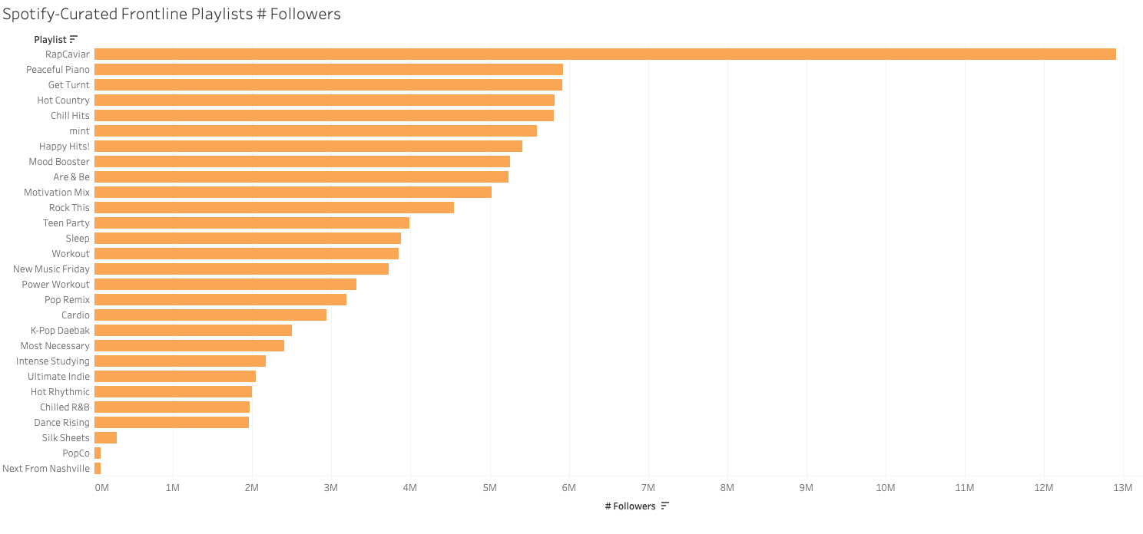
Playlist Follower Numbers
RapCaviar most followed by far!
Many artists try for New Music Friday
Least-popular playlists may give us some insights

Slide 12
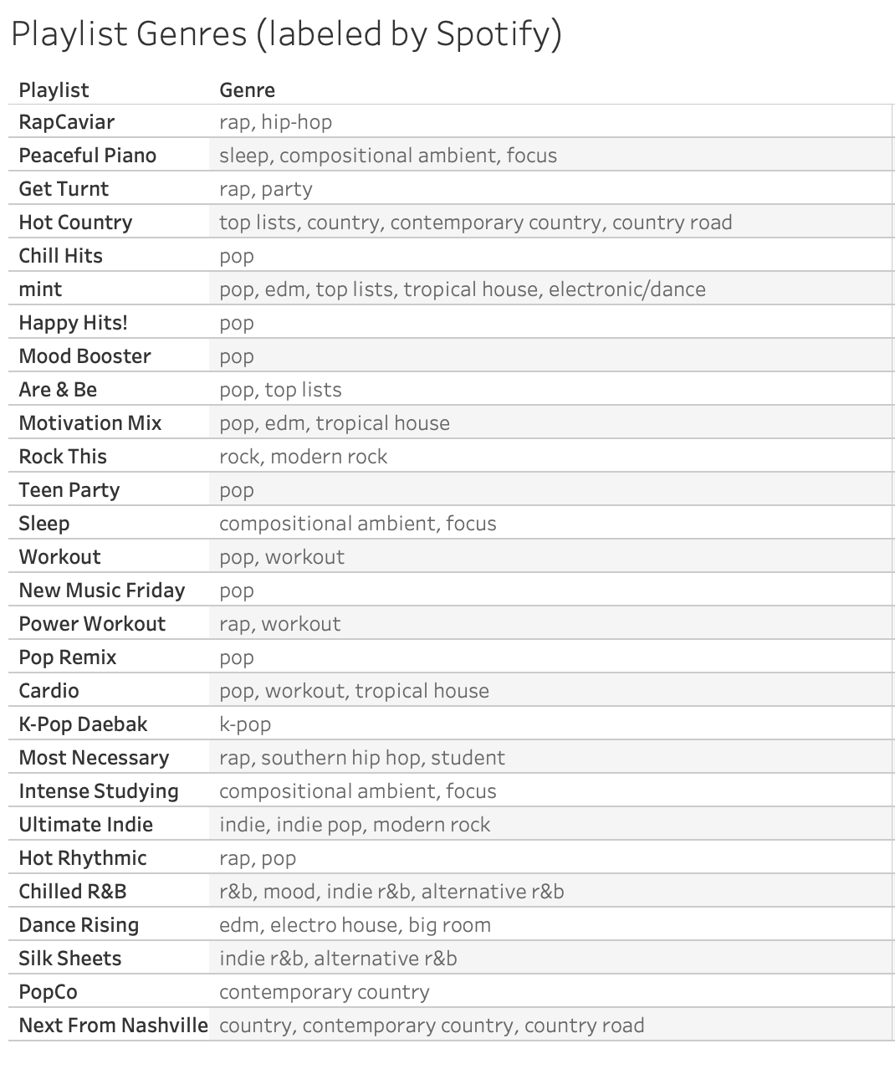
Playlist Genres

Slide 13
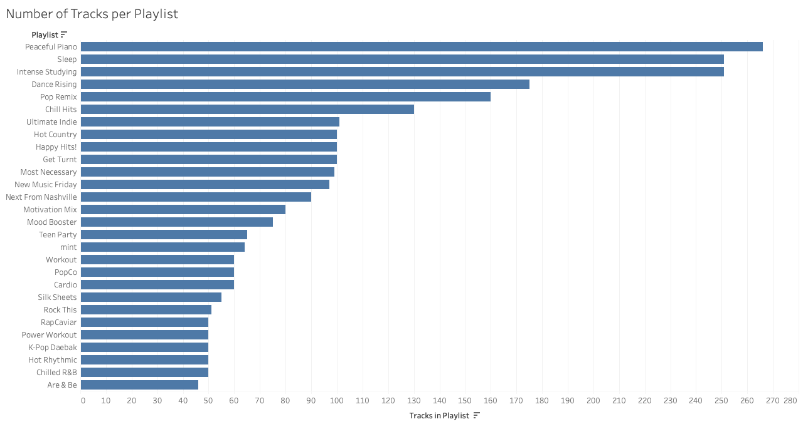

Slide 14
Understanding each playlist by audio features
Method: Calculate the mean and mode features across playlists

Slide 15

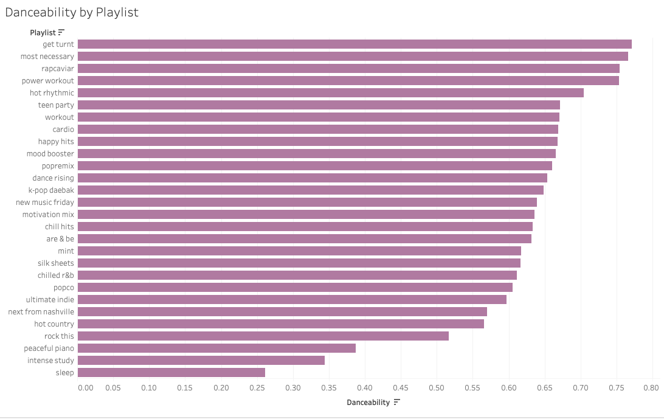
Playlist Features | Danceability

Slide 16

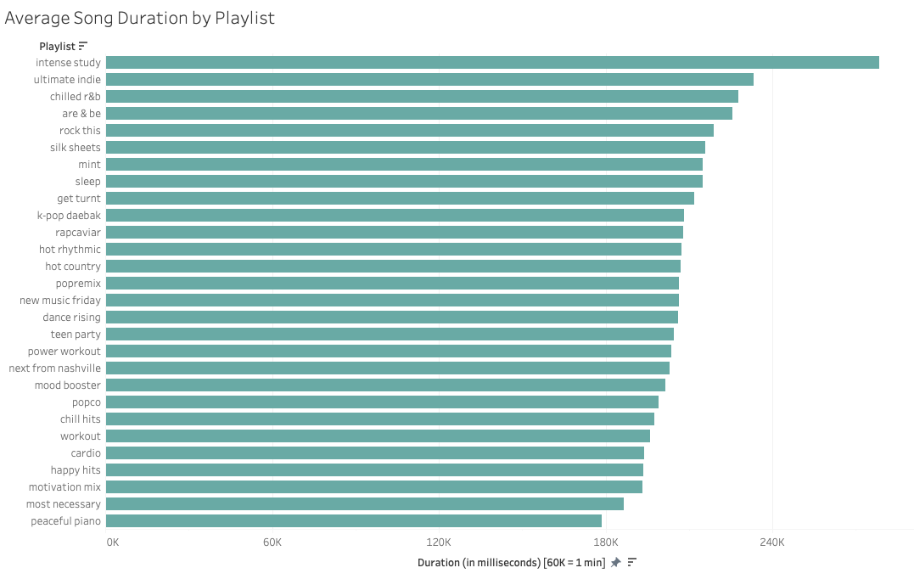
Playlist Features | Duration

Slide 17

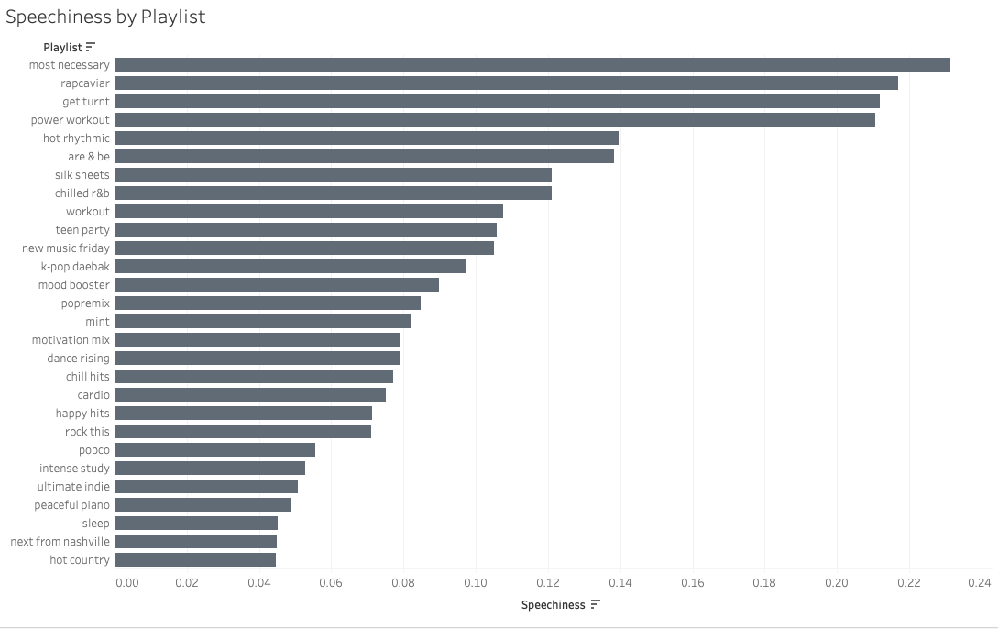
Playlist Features | Speechiness

Slide 18

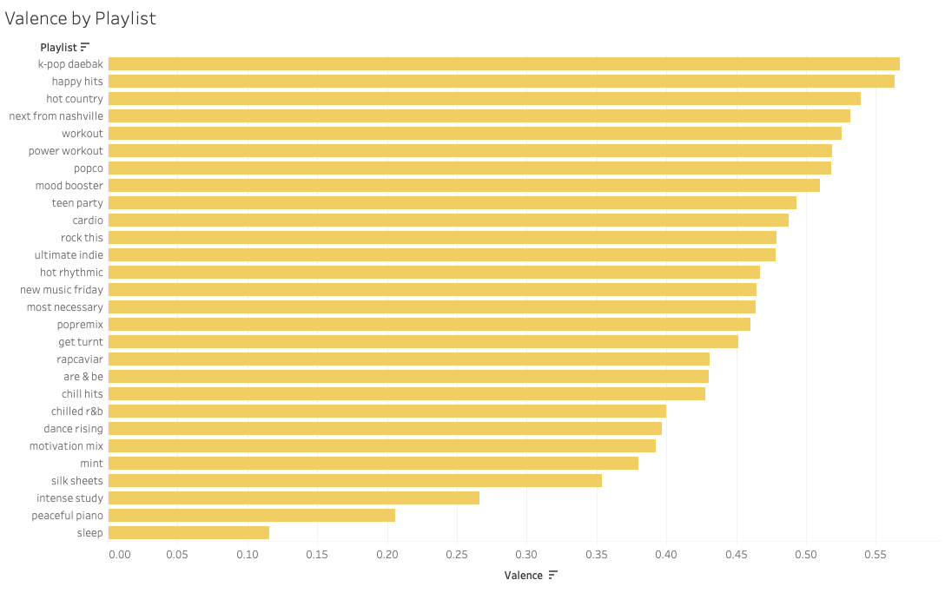
Playlist Features | Valence

Slide 19

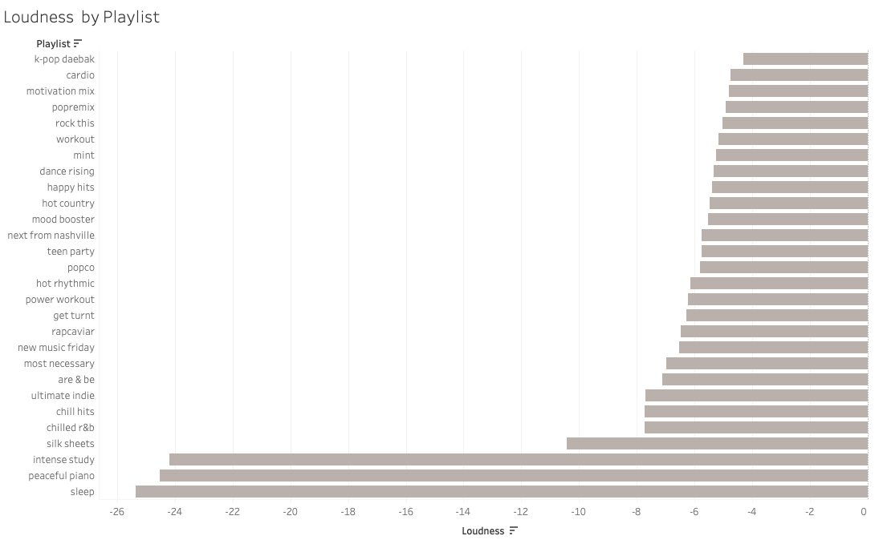
Playlist Features | Loudness
Softer
Louder

Slide 20

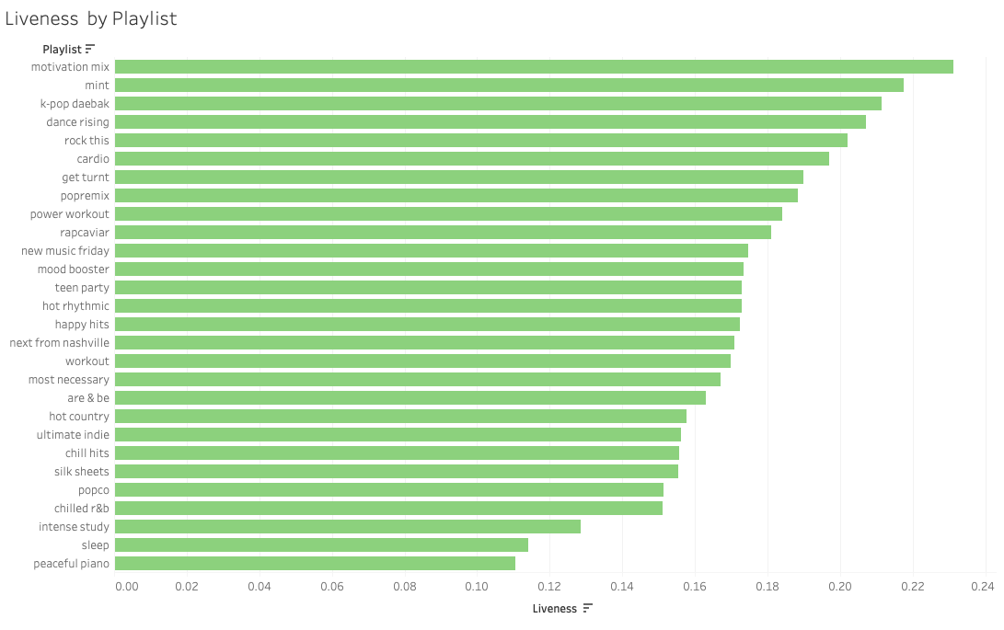
Playlist Features | Liveness

Slide 21

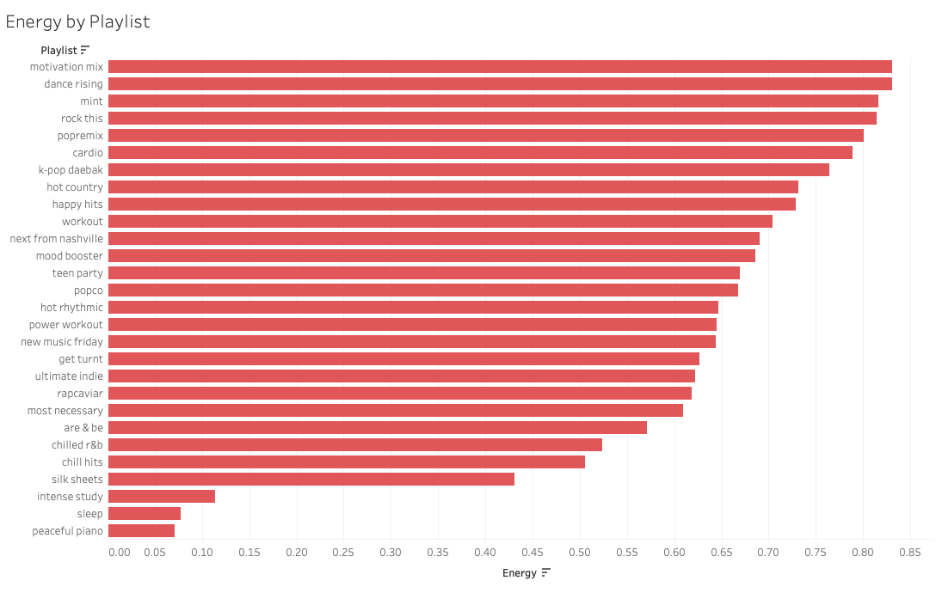
Playlist Features | Energy

Slide 22

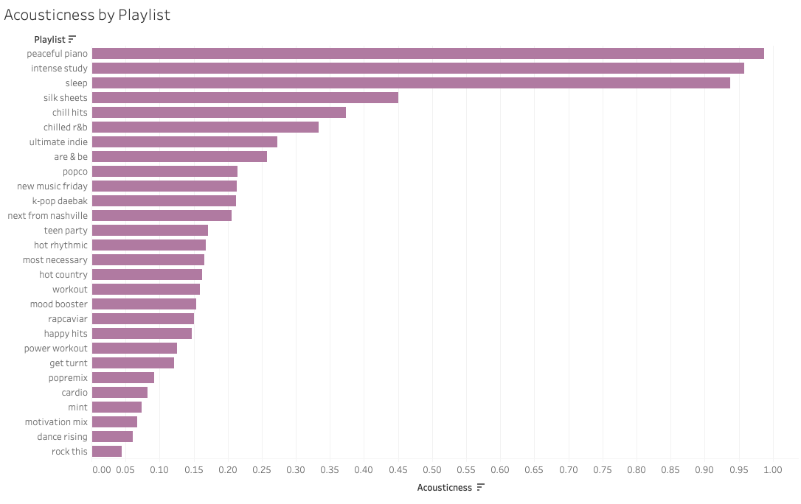
Playlist Features | Acousticness

Slide 23

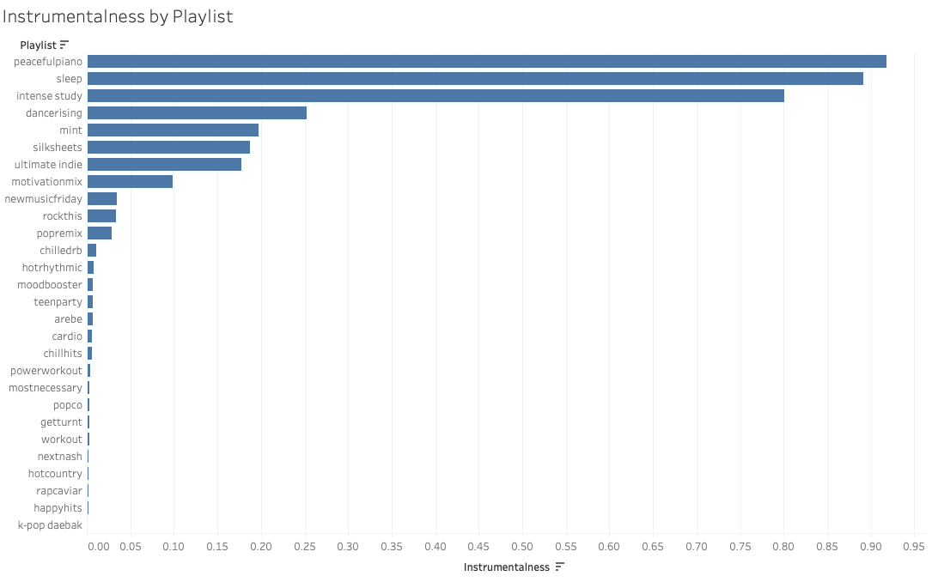
Playlist Features | Instrumentalness

Slide 24

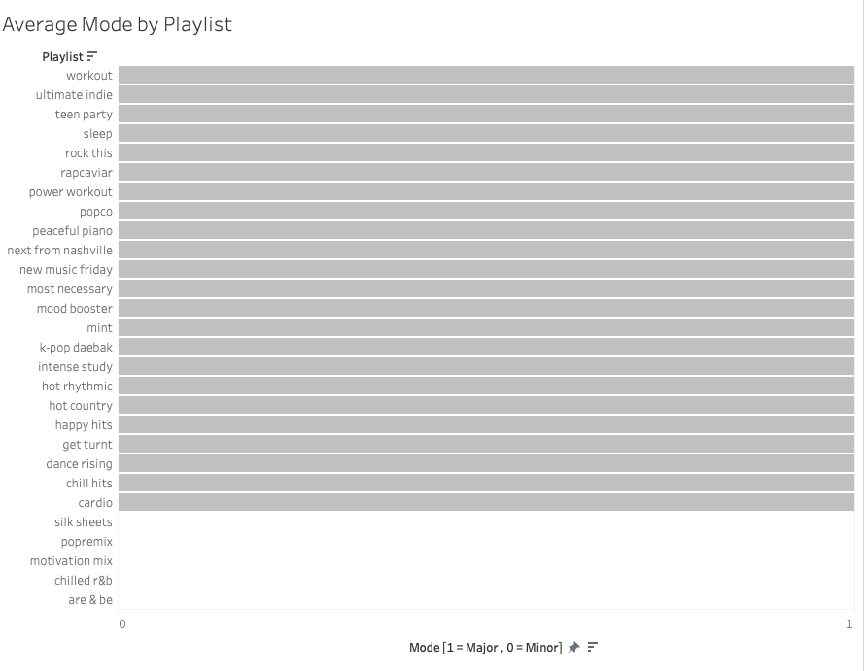
Playlist Features | Mode
Major key
minor key

Slide 25

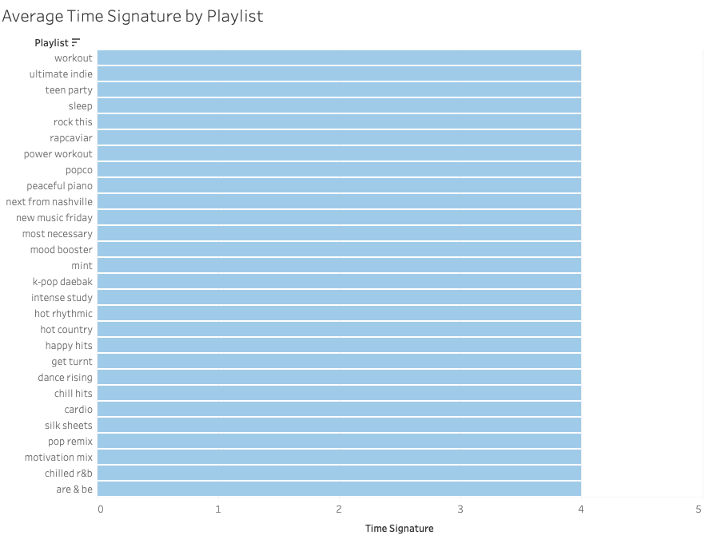
Playlist Features | Time Signature
4/4
4/4 time
down the line!

Slide 26
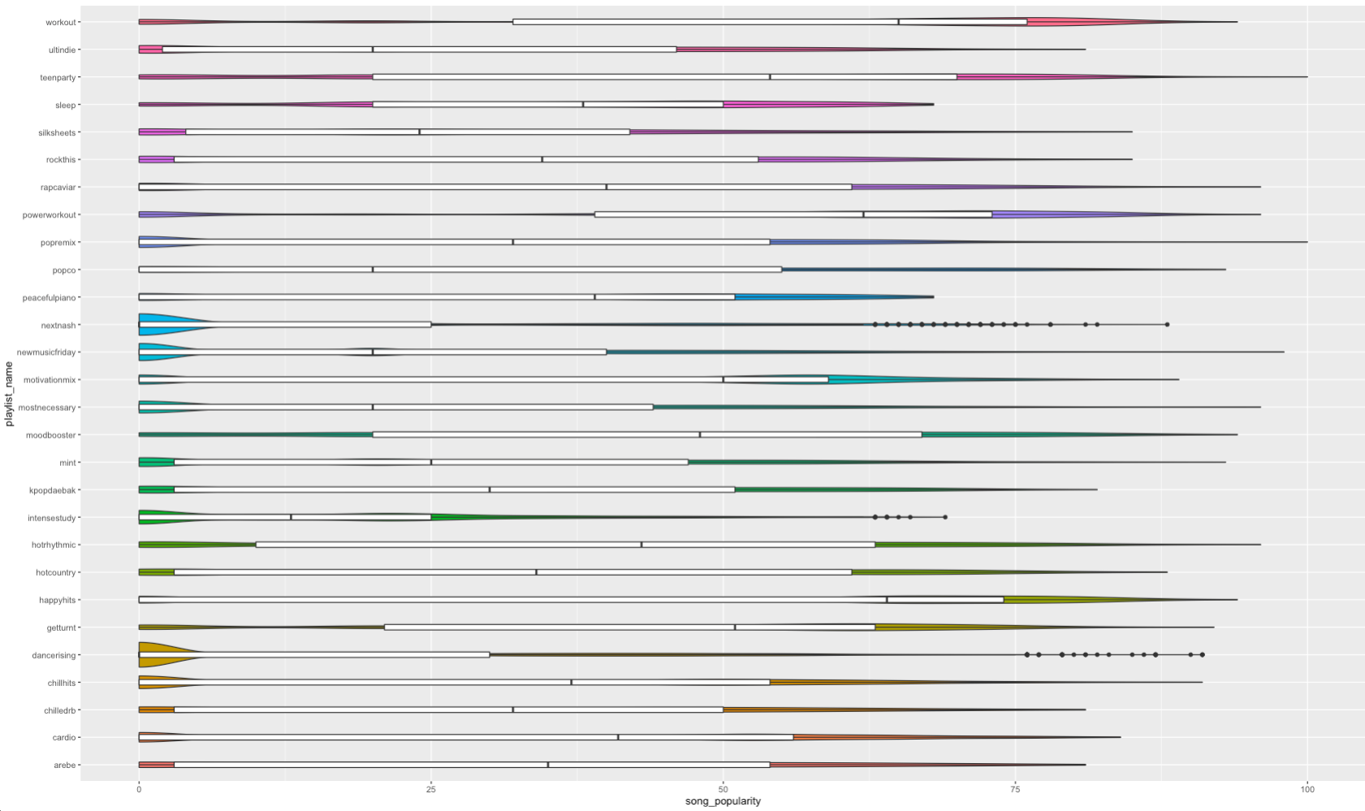

Playlists
by Song
Popularity

Slide 27
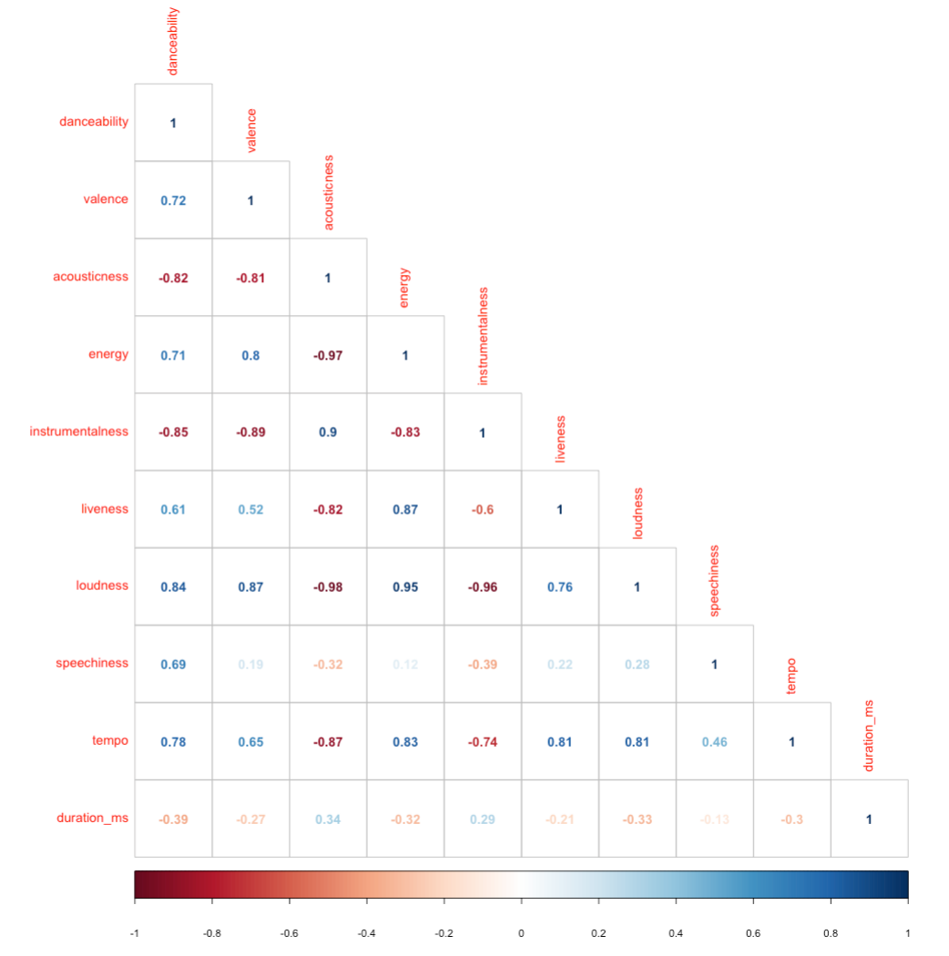
Correlation of audio features

Slide 28
Spotify Playlist Analysis:
Linear Regression

Slide 29
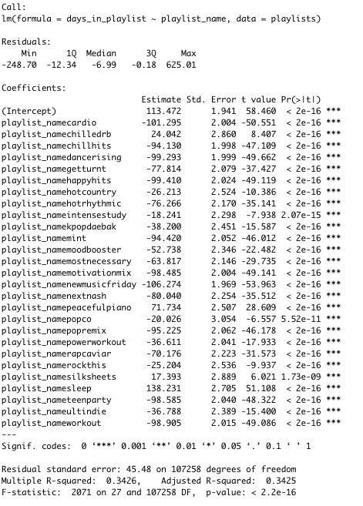
Days in playlists as explained by Playlist
Significant. Adj R-Squared = .34
Some playlists leave the songs in the playlist longer than others.
Being included on a playlist like Are & Be, Chilled R&B, Sleep, Silk Sheets, and Peaceful Piano may give you more “bang for your buck” in terms of days included on the playlist.*
Whereas New Music Friday, while cool, gets you much less playtime and likely not as much impact.*
*we will look at impact in a moment

Slide 30
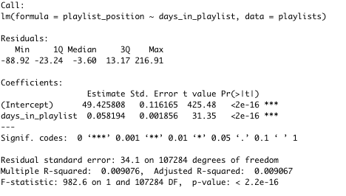
Playlist Position as explained by Days in Playlist
Significant, but low Adj R-Squared = .009
But on the other hand, the longer a song is included on a playlist, the slightly higher (worse) the position number is on that playlist, so it's possible fewer people will get to your song.

Slide 31
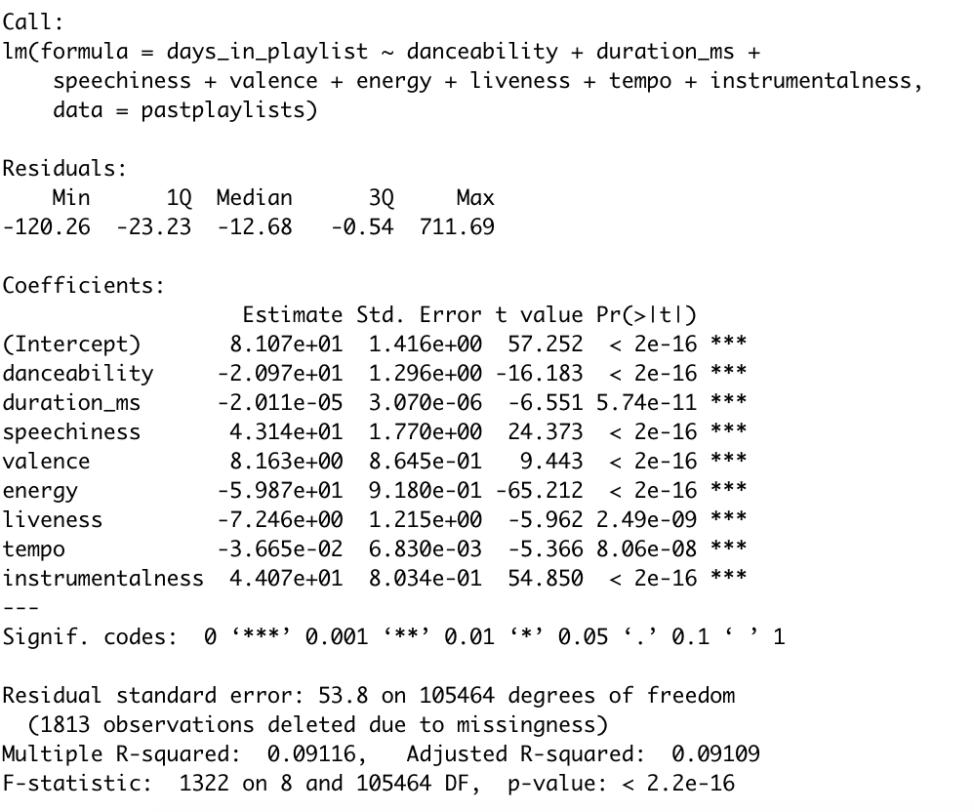
Days in playlists as explained by Audio Features
Significant. Adj R-Squared = .09
(Note: multi-colinear features were excluded)
Songs with higher qualities of instrumentalness, speechiness, and valence seem to get more days of inclusion.

Slide 32
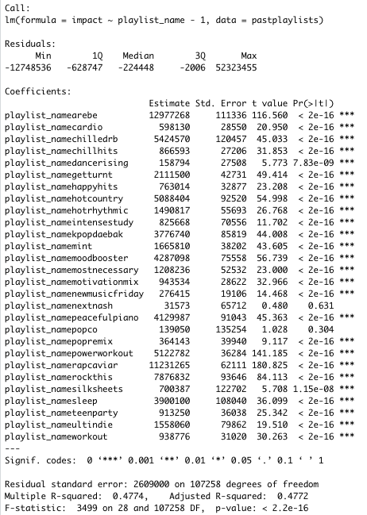
Overall Impact as explained by Playlist
Significant. Adj R-Squared = .48
Calculation:
Impact = ((Days in Playlist * # Playlist Followers)/Number of Tracks in Playlist))
RapCaviar has the most followers, so this isn’t surprising to see here as significant. But Are&Be is extremely impactful, as is Chilled R&B, Rock This, and Hot Country!*
PopCo and Next From Nashville, two of our lowest-followed playlists in this analysis, are not significant when it comes to predicting impact.

Slide 33
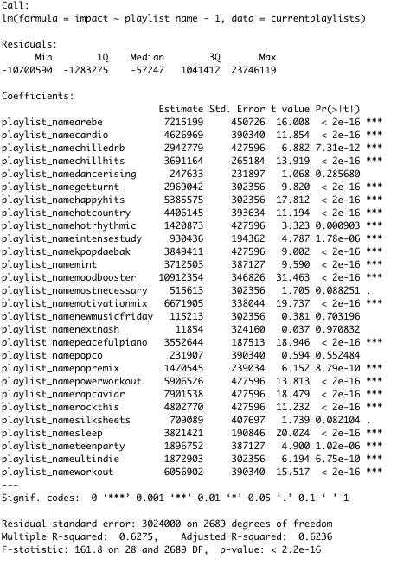
Overall Impact as explained by Playlist (This Week)
Significant. Adj R-Squared = .62
This week, RapCaviar, Are&Be and MoodBooster have the biggest impact, but several playlists still are highly significant.
Notable that we have no notable impact from
New Music Friday, which is often cited as being a big win for artists, especially those who are wanting to be discovered.
It might be a feather in the cap, but other playlists may be more worth focused pursuit (even less followed playlists).

Slide 34
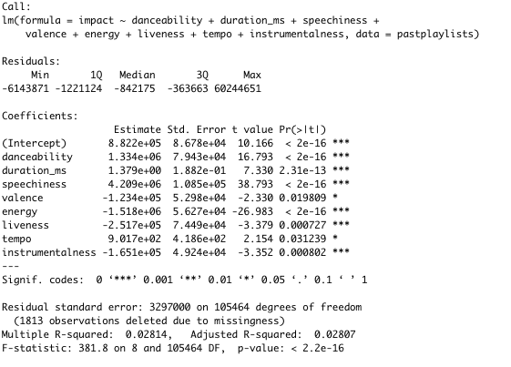
Overall Impact as explained by Audio Features
Significant. Adj R-Squared = .028
More speechy, danceable, up-tempo, slightly longer tracks may give you more bang for your buck.

Slide 35
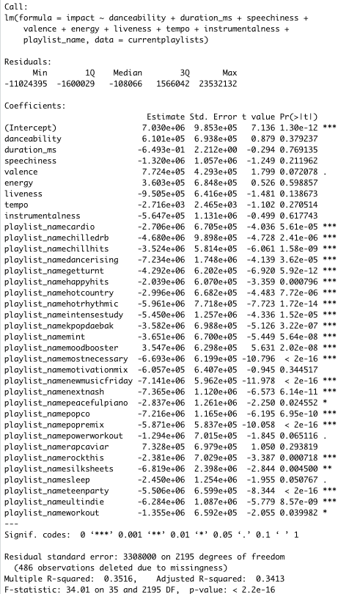
Overall Impact as explained by Audio Features + Playlists
Significant. Adj R-Squared = .34
Adjusting for the playlist itself, Valence, Energy, and Danceability gives you the most impact.
Mood Booster and RapCaviar playlists are also highly significant here.

Slide 36
Audio Features: Recommended Playlist Focus
Most Danceable:
Get Turnt
Most Necessary
RapCaviar
Power Workout
Hot Rhythmic
Longer Songs:
Intense Study
Ultimate Indie
More Speaking:
Most Necessary
RapCaviar
Get Turnt
Power Workout
Acousticness:
Peaceful Piano
Intense Study
Sleep
Valence (Positivity):
High end:
K-Pop Daebak
Happy Hits!
Loudness:
High end:
K-Pop Daebak
Cardio
Liveness:
Motivation Mix
Mint
K-Pop
Dance Rising
High Energy:
Motivation Mix
Dance Rising
More Instrumentals:
Peaceful Piano
Sleep
Intense Study
(NOT K-Pop Daebak!)
Minor key:
Silk sheets
Pop Remix
Motivation Mix
Chilled R&B
Are & Be
Popular songs go to:
Workout
PowerWorkout
Happy Hits!
Everything is in 4/4 time
Low end:
Sleep
Peaceful Piano
Intense Study
Low end:
Sleep
Peaceful Piano
Intense Study
4/4

Slide 37
Further Analysis:
Classification & Machine learning

Slide 38
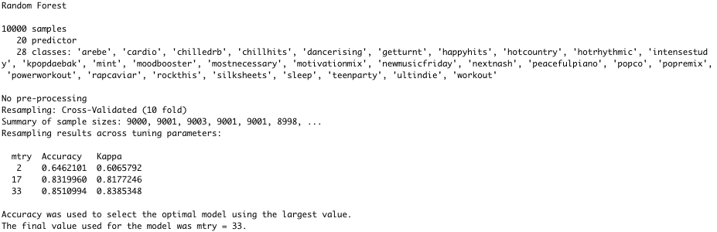
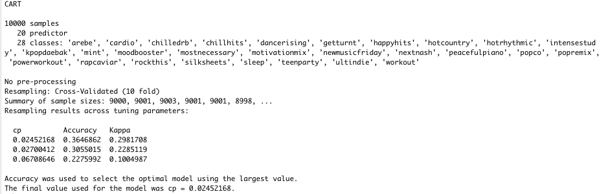
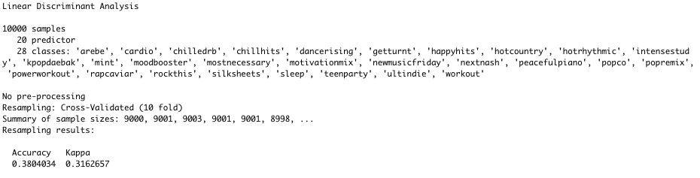
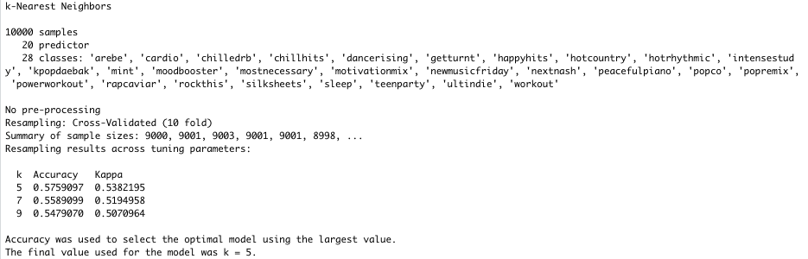
Finding the best model:
* Note: Running the entire 110K-observation dataset was too big for running the ML models in R on my PC, so I created a smaller train set (~10% of all observations) to train the model to make predictions.

Slide 39
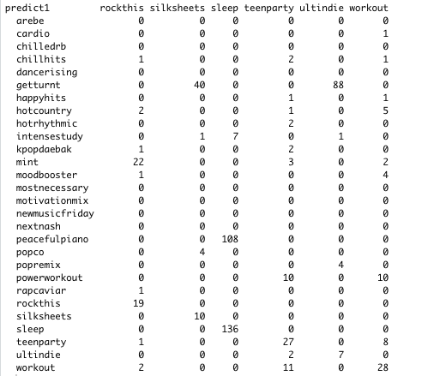
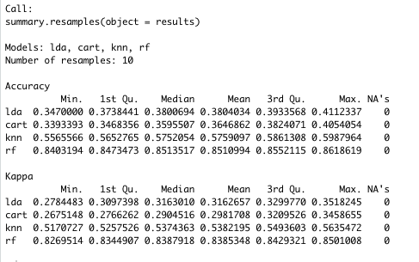
Making predictions using Random Forest
Random Forest model: highest Kappa & Accuracy
Predict from the test set

Slide 40
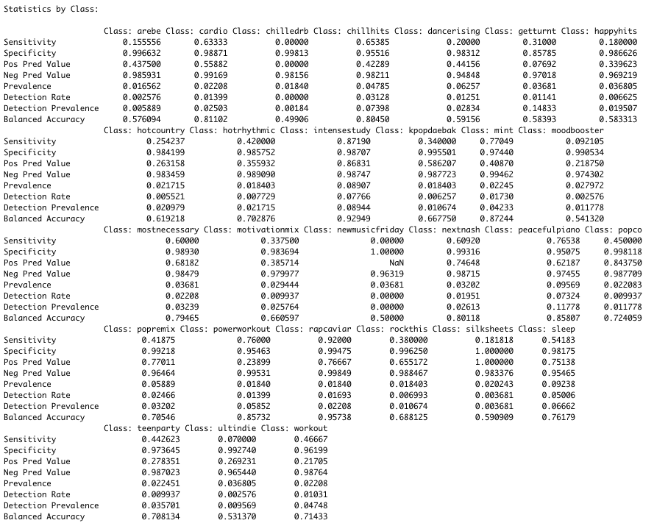
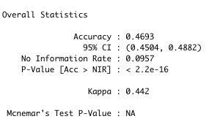
Making predictions using Random Forest
Statistics by Playlist:
Overall statistics from predictions:

Slide 41
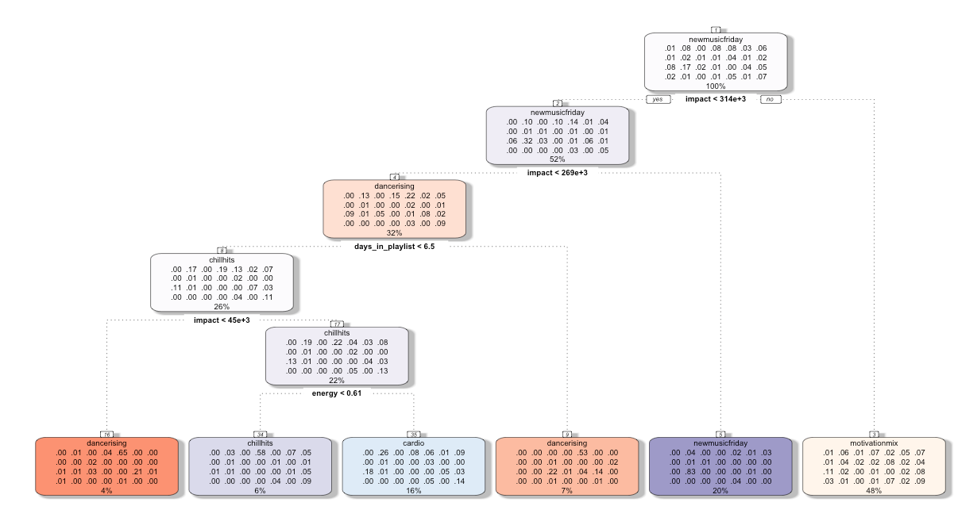
Tree Model plot

Slide 42
Data limitations
Skip rates: Spotify keeps the ”skip rates” data close to the vest, so impact is hard measure on a large scale (if users skip through your track).
30 seconds of listening counts as a play
Spotify staff tells us that more skips happen earlier in the playlist
Song genres: Self-reported by the artist and are quite subjective. Many “genres” have just one song attributable out of >100K observations.

Slide 43
Recommendations : Takeaways from this analysis
Artists should get a song feature analysis via Spotify Developer portal: https://developer.spotify.com/
Some less popular (less “followed”) playlists may have more impact in the long-run.
Artists can focus the submission specifically to the playlist.
There are clear themes from each playlist based on audio feature that may not be clear from the playlist genre descriptions. Plus, artists tend to self-label their music in more niche genres.
There are tens of thousands of playlists that we can focus on and run a similar analysis, so it’s not necessary to change the art in order to be noticed. Smaller, niche playlists may be the best bet.

Slide 44
Thank you!

