Slide 1
Introduction & LTL Model Checking
Avinash Malik
2022

Slide 2
Introduction
Who am I?
Senior Lecturer at the University of Auckland, ECE
Office: 405.775
Prefer email contact over visits to office.
Email: avinash.malik@auckland.ac.nz

Slide 3
Important information for 2022
Week-9 is systems week, so no lectures.
Test (50%)
Date: October 19/2022
Venue: Online via Canvas
Time: 16:10 – 18:10

Slide 4
Introduction – second part of 705
Learn two important things:
Linear temporal model-checking – i.e., an automated technique to check if software implementation is correct.
Constraint programming and proving – an efficient technique to check if software is correct.

Slide 5
Need for reliable software and hardware
Suppose you work (or run) a software/hardware company
Suppose you have sunk 30+ years into a product
BMAX 737 – failure
Araine 5 – rocket failure
Intel floating point bug failure
It is essential to get software/hardware implementation correct for safety critical systems.

Slide 6
Learning outcomes – Part 1
Understand what is model-checking
Understand what is Linear Temporal Logic (LTL)
Understand the semantics of linear temporal logic
Understand the Promela programming language for describing concurrent processes.
Understand SPIN – the LTL model-checker.

Slide 7
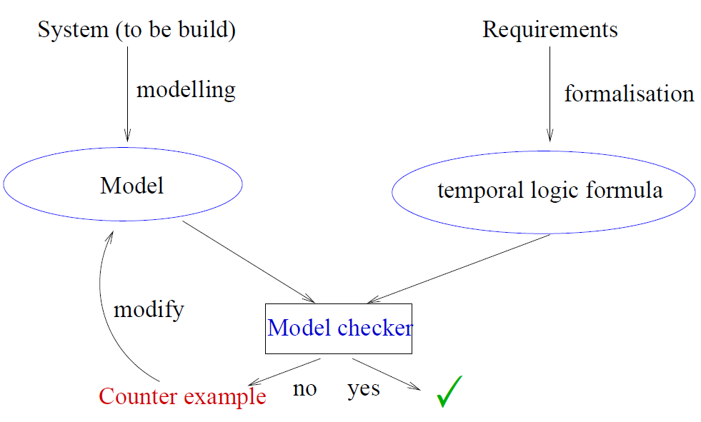
The big picture

Slide 8
LTL Model Checking
LTL
Subset of CTL* of the form:
A f
where f is a path formula
LTL model checking
Model checking of a property expressed as an LTL formula:
Given a model M and an initial state s₀:
M,s₀╞ A f

Slide 9
LTL Formulas
Subset of CTL*
Distinct from CTL
AFG p ∈ LTL
Contains a single universal quantifier
The path formula f holds for every path
Commonly:
A is omitted
G is replaced by (box or always)
F is replaced by ◊ (diamond or eventually)

Slide 10
Examples of LTL formulas
Always eventually p:
◊ p
AGF p or AG AF p
Always after p eventually q
( p → ◊ q)
AG (p -> F q) or AG (p -> AF q)
Fairness
( ◊ p ) → ϕ
A ((GF p) → ϕ)
Not a CTL formula

Slide 11
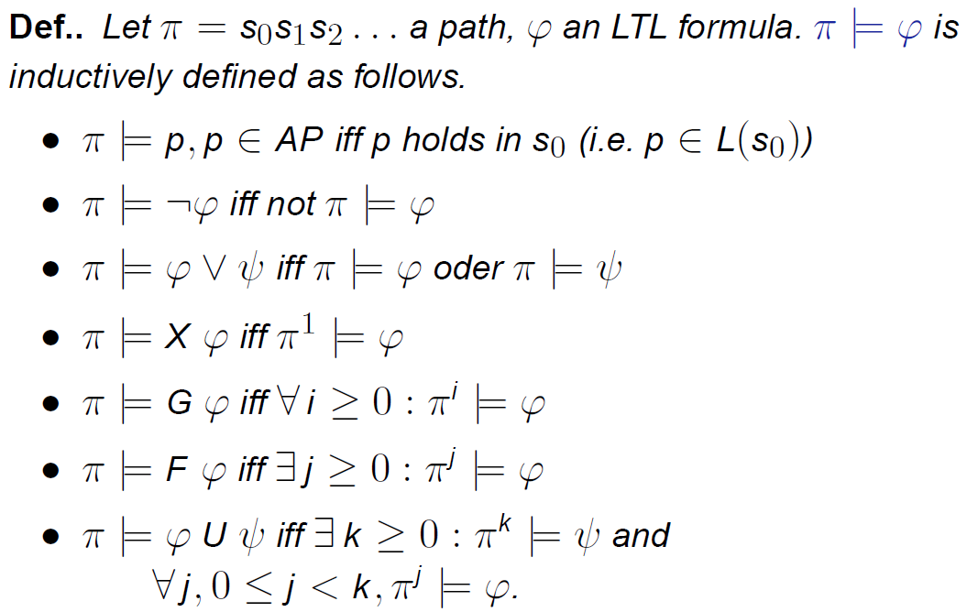
LTL Semantics

Slide 12
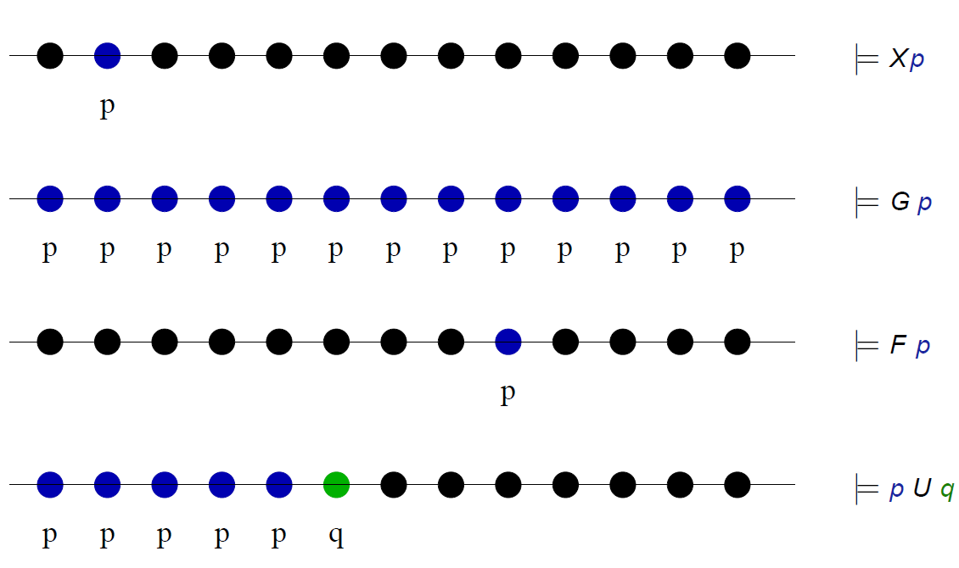
LTL semantics

Slide 13
LTL Model Checking
Given a model M and an LTL formula ϕ
All traces of M must satisfy ϕ
Σ_{M} is the set of traces of M
Σ_{ϕ} is the set of traces that satisfy ϕ
Σ_{M} ⊆ Σ_{ϕ}
If a trace of M does not satisfy ϕ
Counterexample
Equivalently Σ_{M} ∩ Σ_{¬ϕ}= ∅

Slide 14
An Example
S0,S1,S2,....
S0
x==0
int x = 0;
x++;
x++;
Trace
M |= (x==0)?
x++
S1
x==1
M |= (x==1)?
x++
M |= ◊(x==2)?
S2
x==2
C-code
M |= ☐(x==2)?
Model 'M'
M |= ◊☐(x==2)?

Slide 15
Another Example
S0
x==1
x--
M |= F(x==2)?
x++
S1
S2
x++
X--
S3

Slide 16
Property specification
AP = {coffee_chosen, tea_chosen, money_inserted, coffee_delivered, tea_delivered}
Once in a while someone chooses tea or coffee?
GF(tea_chosen \/ coffee_chosen)
If coffee is chosen and next money is inserted coffee will be delivered
G((coffee_chosen /\ X money_inserted) => F coffee_delivered)
When coffee has been chosen tea will not be delivered until tea is chosen
G(coffee_chosen => (¬tea_delivered U tea_chosen))

Slide 17
Is LTL = CTL?
S0
x==1
M |= F(x==2)?
NO
LTL
x++
x--
S1
S2
M |= EF(x==2)?
YES
CTL
x++
X--
S3

Slide 18
Application of model-checking to software programs
What kind of software programs need model-checking?
Concurrent programs
Concurrent programs with shared variables.
When two (or more) processes write/read from a shared variable it needs synchronization, e.g., mutexes, spin locks, etc.
We will use model-checkers to make sure that mutual exclusion is working.

Slide 19
Types of errors we can avoid using model-checking
Deadlocks
Livelocks
Underspecification
Over specification
Buffer over-runs
Array bound violations
..... many others
WE WILL USE THE SPIN MODEL-CHECKER

Slide 20
What is SPIN?
SPIN = Simple Promela Interpreter
(see: spinroot.com)
SPIN model-checks LTL properties on a model of the concurrent software program(s).
The model of the concurrent software program is specified in a language called Promela, and hence the name SPIN!

Slide 21
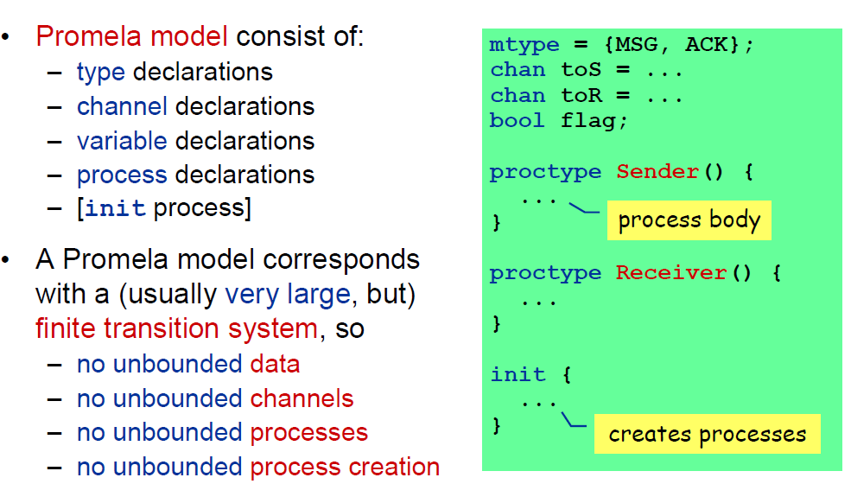
Promela parts

Slide 22
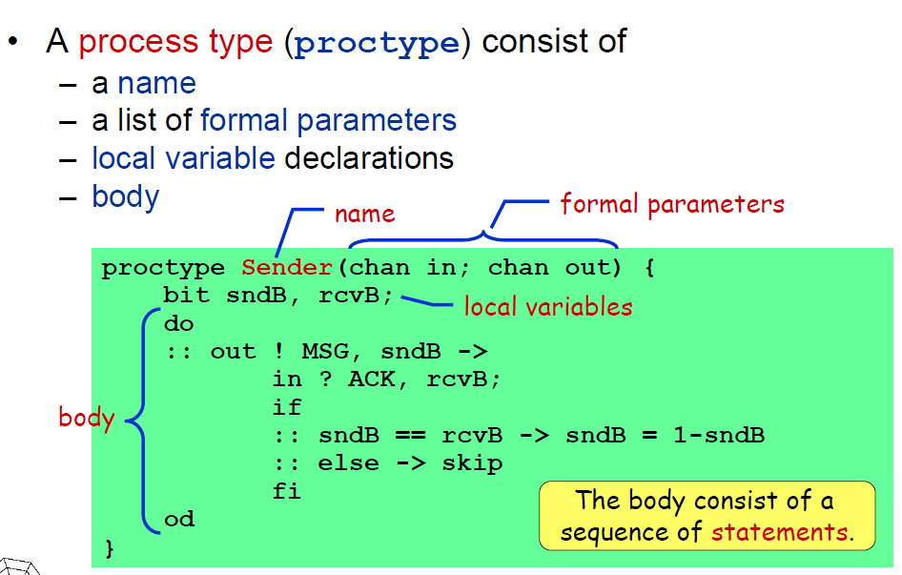
Promela process

Slide 23
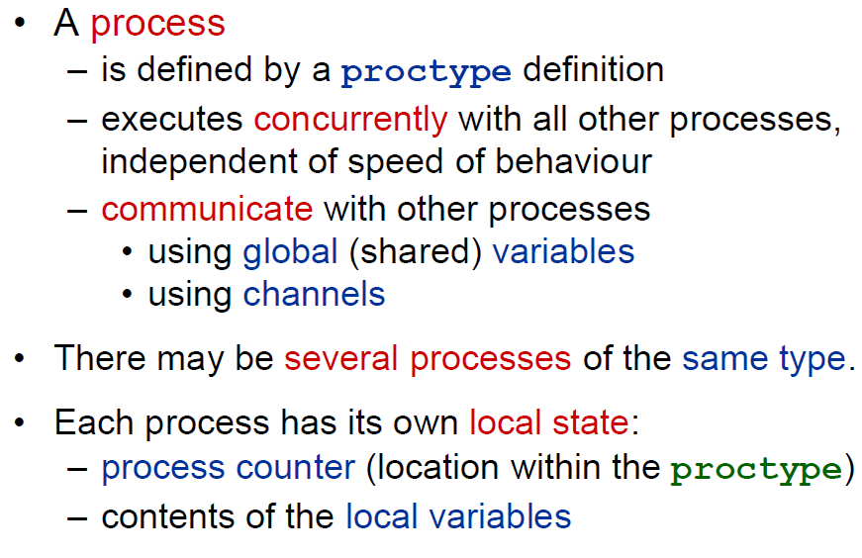
Promela process

Slide 24
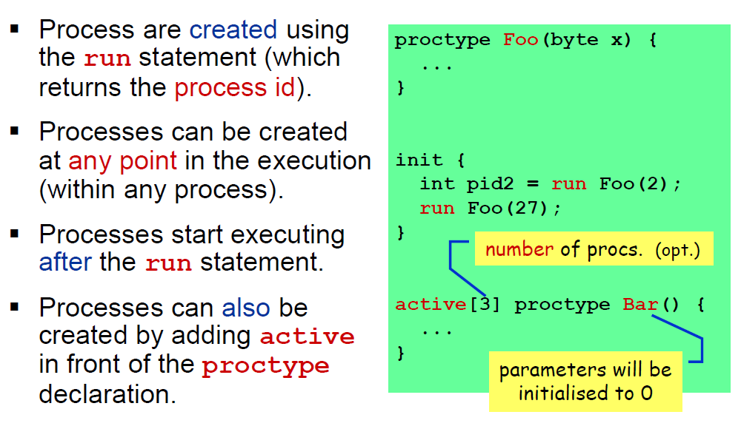
Promela process

Slide 25
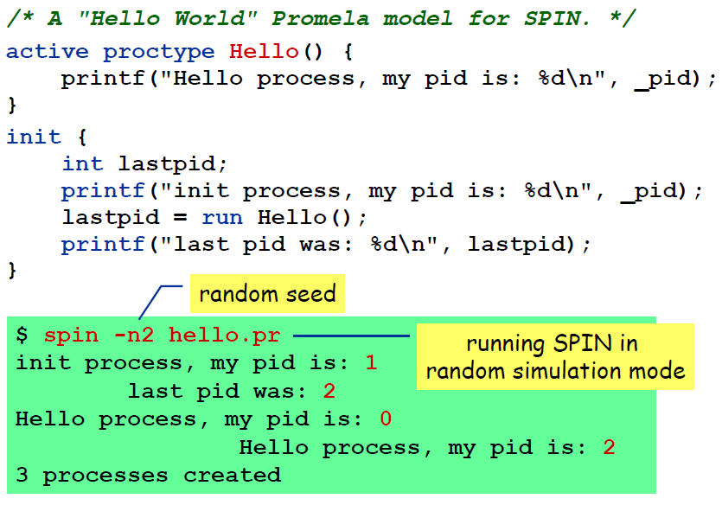
Promela process
Notes:
What is the order of creation of processes?

Slide 26
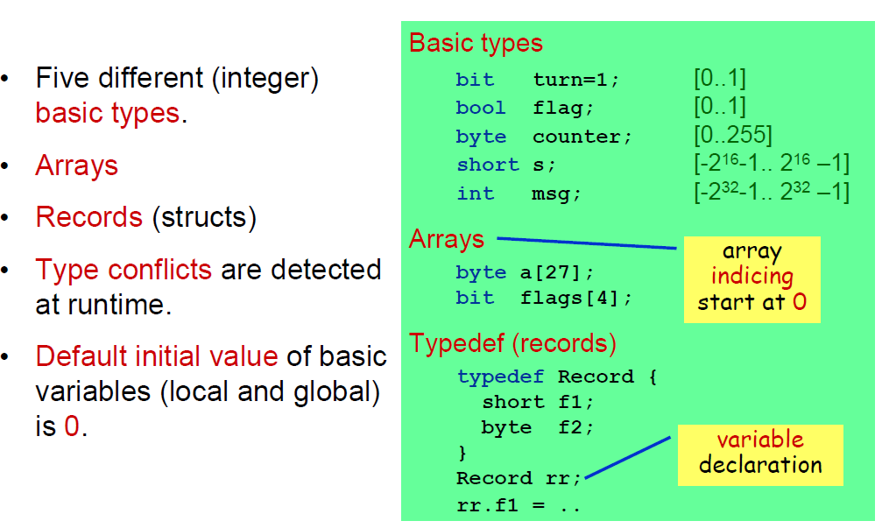
Variables and Types
Notes:
Why no float?

Slide 27
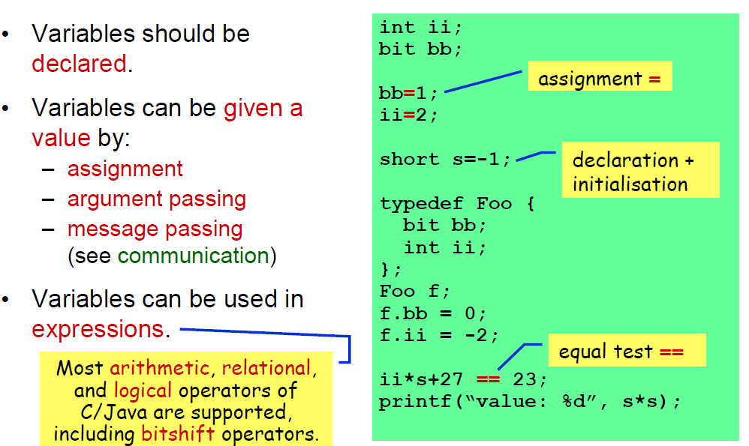
Variables and Types
Notes:
Why no float?

Slide 28
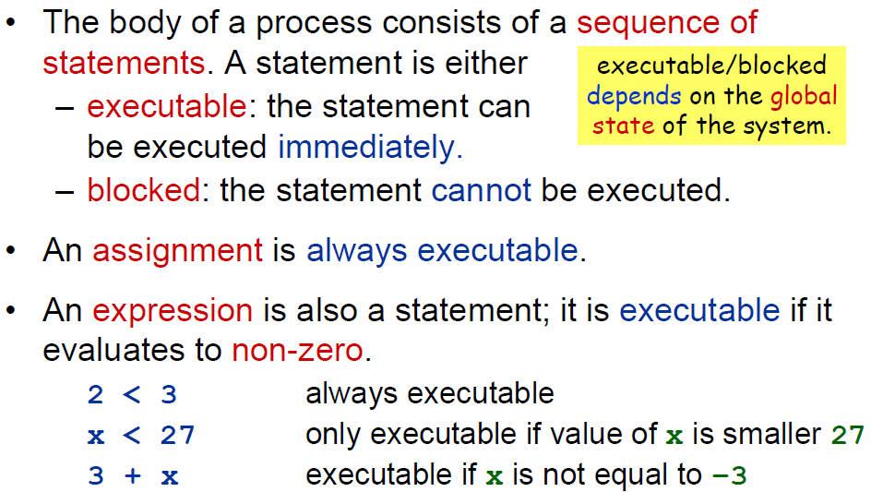
Promela statements
Notes:
Why no float?

Slide 29
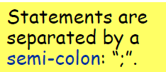
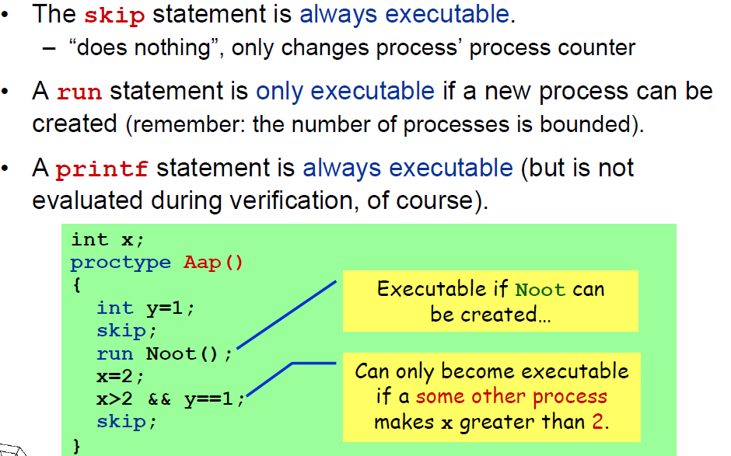
Promela statements
Notes:
Why no float?

Slide 30
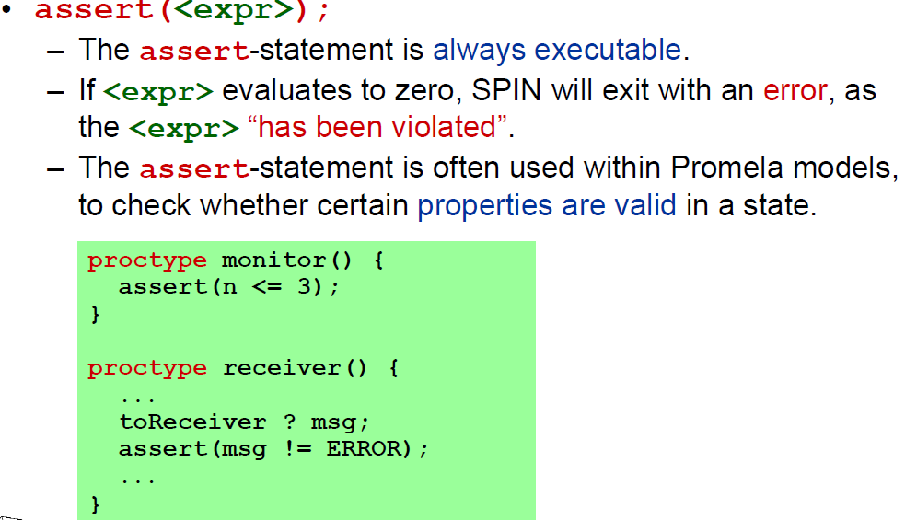
Promela statements
Notes:
Why no float?

Slide 31
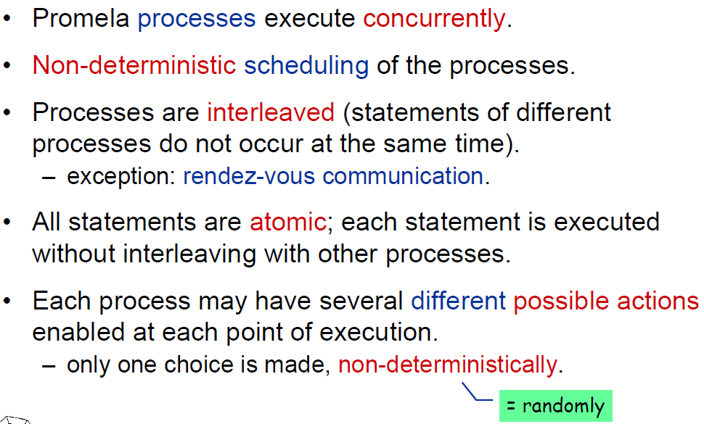
Promela semantics
Notes:
Why no float?

Slide 32
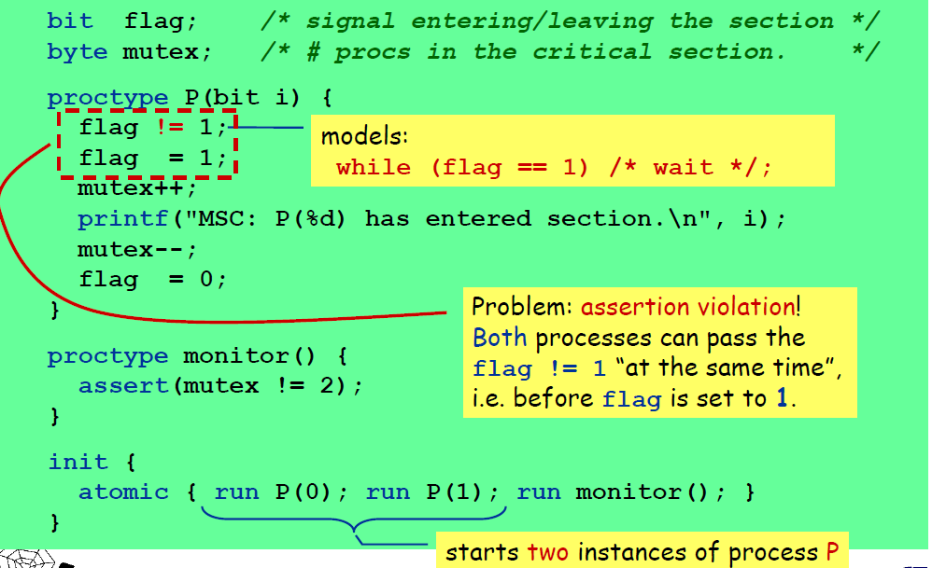
Promela example – mutual exclusion
Notes:
Will the assertion fail?
Describe why there is a problem!

Slide 33
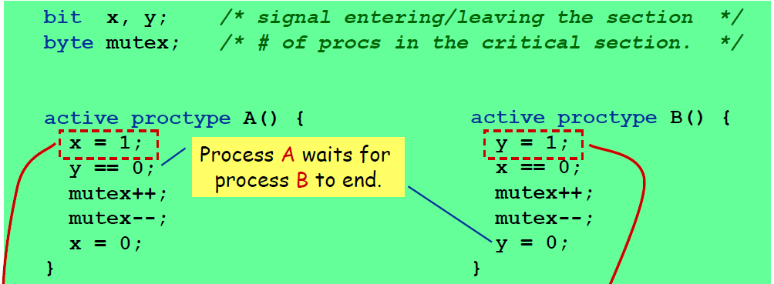
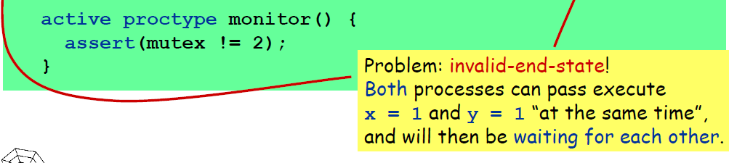
Promela example – mutual exclusion
Notes:
Will the assertion fail?
Describe why there is a problem!

Slide 34
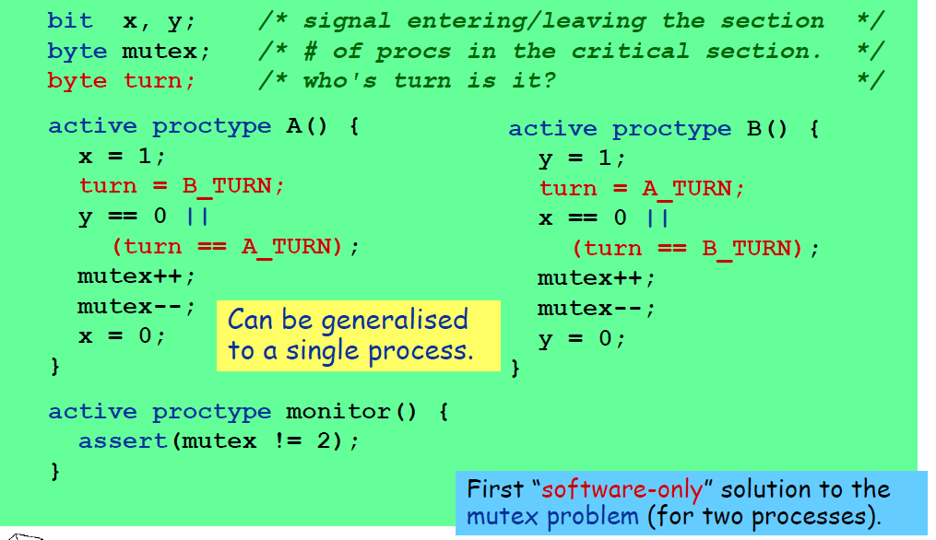
Promela example – mutual exclusion
Notes:
Will the assertion fail?
Describe why there is a problem!

Slide 35
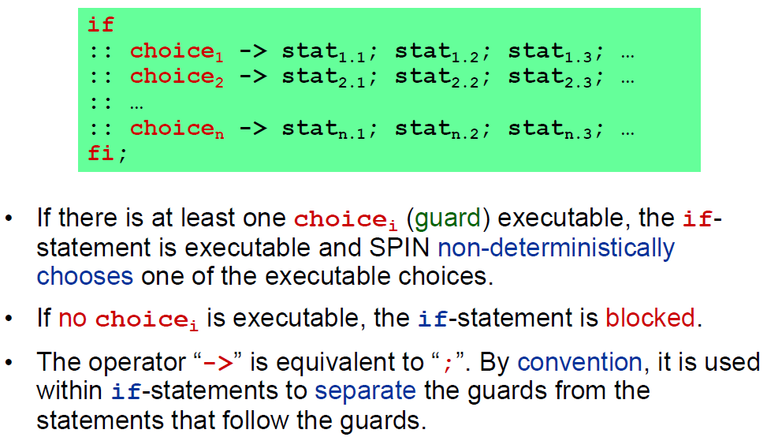
Promela If-statements
Notes:
Will the assertion fail?
Describe why there is a problem!

Slide 36
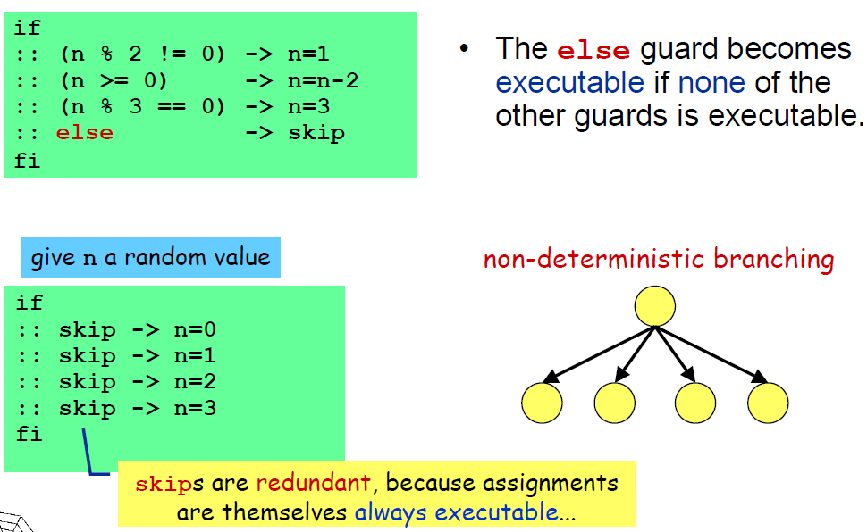
Promela If-statements
Notes:
Will the assertion fail?
Describe why there is a problem!

Slide 37
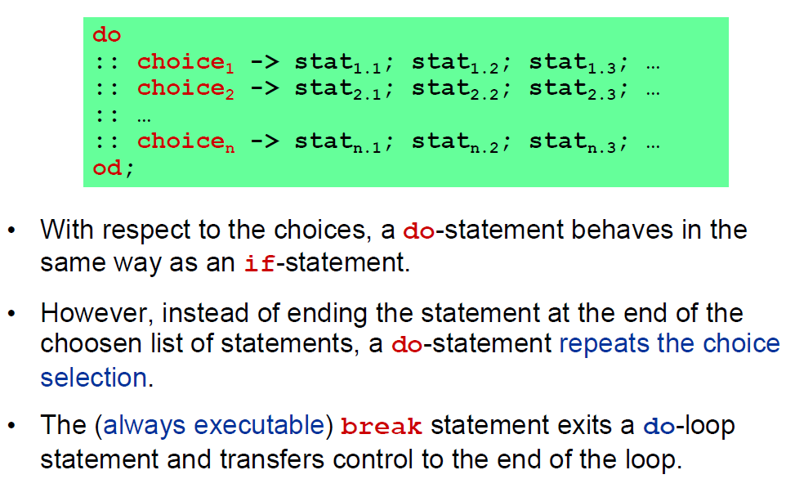
Promela do-statement (loop)
Notes:
Will the assertion fail?
Describe why there is a problem!

Slide 38
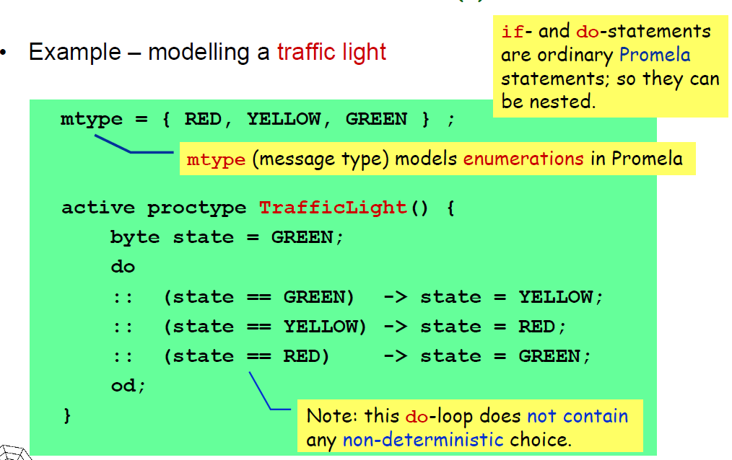
Promela do-statement (loop)
Notes:
Will the assertion fail?
Describe why there is a problem!

Slide 39
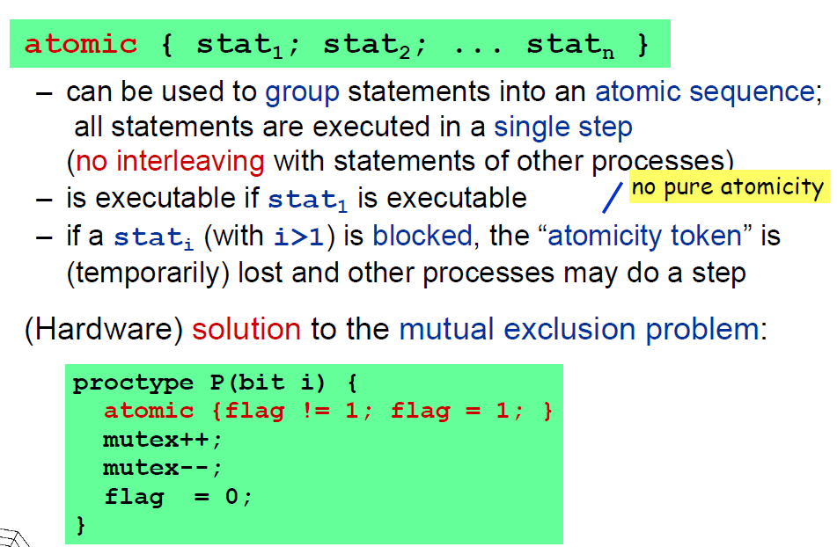
Promela atomic-statement
Notes:
Will the assertion fail?
Describe why there is a problem!

Slide 40
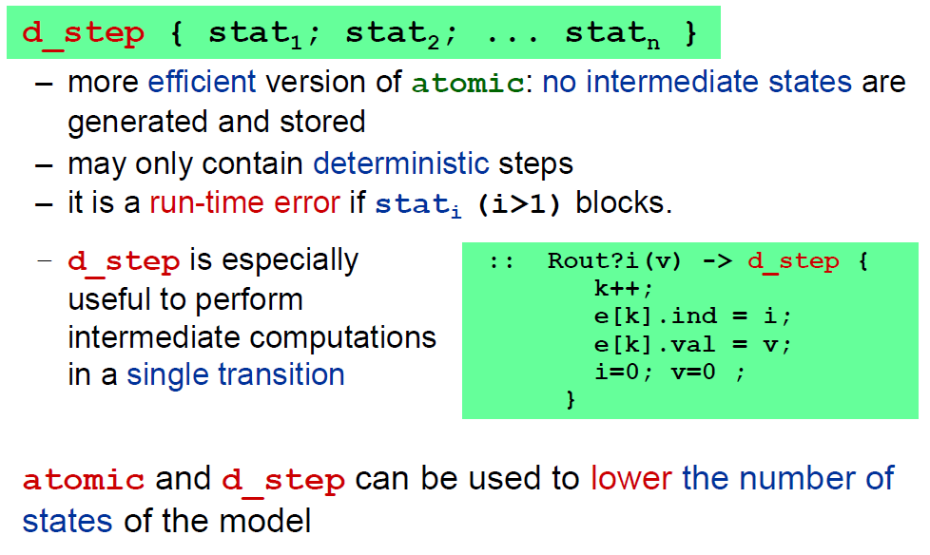
Promela d_step-statement
Notes:
Will the assertion fail?
Describe why there is a problem!

Slide 41
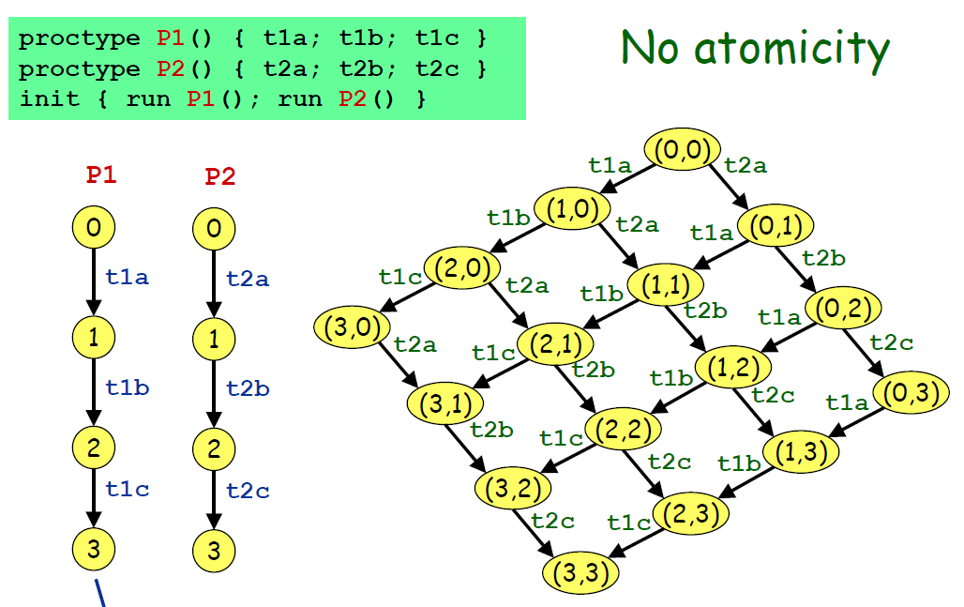
Promela atomic/d_step-semantics
Notes:
Will the assertion fail?
Describe why there is a problem!

Slide 42
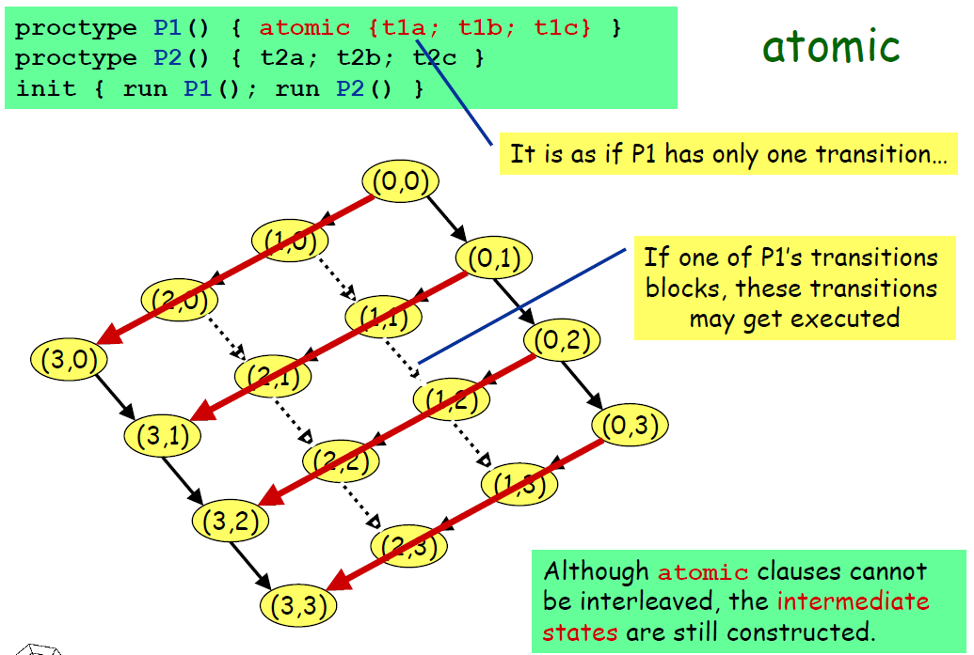
Promela atomic-semantics
Notes:
Will the assertion fail?
Describe why there is a problem!

Slide 43
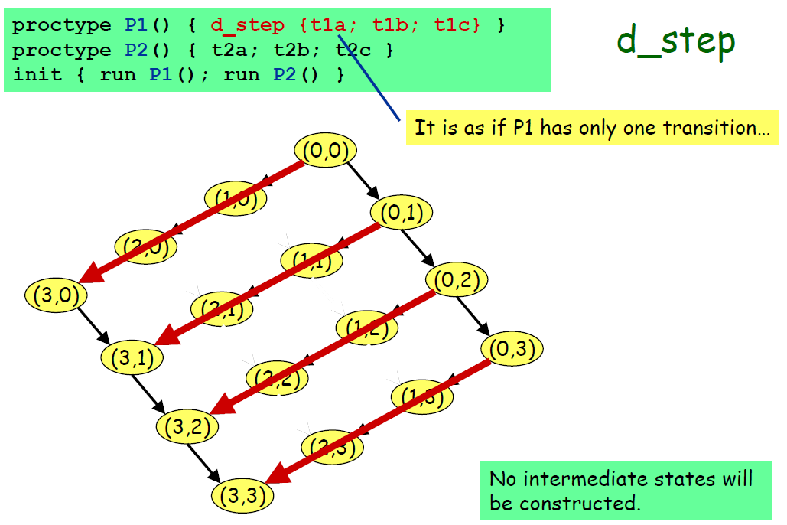
Promela d_step-semantics
Notes:
Will the assertion fail?
Describe why there is a problem!

Slide 44
Promela LTL property specification
bit flag;
byte mutex;
proctype P(bit i) {
flag != 1;
flag = 1;
mutex++;
printf("MSC: P(%d) has
entered section.\n", i);
mutex--;
flag = 0;
}
proctype monitor() {
assert(mutex != 2);
}
init {
atomic { run P(0); run P(1); run monitor(); }
}
bit flag;
byte mutex;
ltl {[](mutex != 2)}
proctype P(bit i) {
flag != 1;
flag = 1;
mutex++;
printf("MSC: P(%d) has
entered section.\n", i);
mutex--;
flag = 0;
}
init {
atomic { run P(0); run P(1);}
}
Notes:
Will the assertion fail?
Describe why there is a problem!

Slide 45
Using interactive SPIN – spin
In the class!

Slide 46
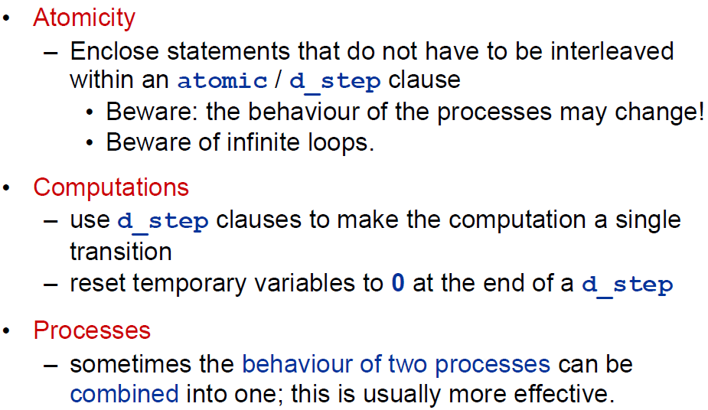
Some things to remember
Notes:
Will the assertion fail?
Describe why there is a problem!

Slide 47
Assignment problem update
Implement in Promela a simple mutual exclusion algorithm and verify properties on it.
Safety property (we have seen this) – 2 processes do not enter the critical section together.
Liveness property – if a process is waiting it will eventually get access to the critical section.
etc...
Notes:
Will the assertion fail?
Describe why there is a problem!

