Slide 1
Communication and Education

Slide 2
Participant Retirement Income Replacement
Focus is to move the population, so the majority are projected to be able to replace, on average, 70% of their final year’s salary
Will integrate with pension values, once available
56%
On average, HD employees contributing to the plan are likely to replace 56% of their final year’s salary
Income replacement % for final year’s salary
70%
45%
Number of Active Participants
This could be as low as 45% if the markets perform poorly
Data as of 10/24/2014

Slide 3

Hunter Douglas Participants versus Non-Participant Profile
2,448
1,749
Non-Participants
Participants
Average Age 44
2,100 + Over Age 40
Average Age 23
1,000 + Under Age 30
Non-participants tend to be younger, newer employees with lower incomes
Effective media and message are required to drive engagement and participation
Average Income $54,000
79% 6+ Years Tenure
Average Income
$28,000
78% 1–3Years Tenure

Slide 4

Voya’s 5 Steps to Improve Retirement Preparedness
Focus employees on moving through five key steps to effective financial wellness
5: DO A FINANCIAL PLAN
4: COORDINATE RETIREMENT WITH OTHER FINANCIAL GOALS
3: DO A RETIREMENT PLAN
2: ORGANIZE FINANCES AND HAVE A BUDGET
1: ENROLL – MAXIMIZE MATCH AND LEARN ABOUT RETIREMENT INCOME NEEDS

Slide 5
Areas of Focus for 2015-16
Goals
Understand employee perspective of retirement saving and investing, confidence, understanding of benefit
Increase the number of employees saving in the Plan, seeking a 5% gain
Have employees understand their retirement income needs and take appropriate actions to improve their outcome, seeking a 5% positive shift
Objectives
Build knowledge of retirement income needs and key action steps to improve outcomes
Support those nearing retirement
Support younger employees in understanding value of starting early
Measures of Success
Engagement:
open rates, clicks, workshop attendance, qualitative feedback
Acceptance:
generation of a plan either online or by phone
Actions:
enrollments, increased deferrals, managed accounts
Demonstrated:
income replacement gains

Slide 6
Key Overall Actions
Gain an improved understanding of employee perspective relative to the Plan benefit, retirement income awareness, barriers to participation, as well as what messaging and media would be most effective
Focus groups and survey
Build out baseline Plan education materials so employees have access to additional information and bring in the voice of an “hourly” pay group
eBook, Rollover in flyer, Nearing Retirement Guide, Termed Guide
Drive behavior changes with a Financial Wellness approach that uses a strong and engaging concept and segment messaging by employee age/life stage to make more relevant. Follow up with targeted campaigns to those who do not make a change.
Campaign takes place over several weeks/months
Make it fun with small messages that build over time
Focus on getting each employee to understand where they stand and what they need to do next – notify those with pension value that now can be incorporated into personal Plan
Drive the importance of having a plan for retirement: do it yourself online or call

Slide 7
Strategy-in-Action: Focus Groups
Focus groups will be conducted in April in Salt Lake City, UT and Cumberland, MD
Findings will allow us to:
Reboot the communications strategy and enliven our tactical approach
Review employee awareness of the 401(k) benefit, barriers to participation, creative approach
Rebrand communications materials to align with focus group findings
Segmentation & Questioning
 | < age 30 | > age 30
Non-Participants | Status (full time, part time) Benefit awareness Participation barriers Media preferences Opportunities for improvement | Status (full time, part time) Benefit awareness Participation barriers Media preferences Preparation for retirement
 | all age groups
Participants | Status (full time, part time) Enrollment experience Benefit awareness Why did you decide to join the Plan? Plan engagement (Plan website, mobile app, myOrangeMoney, etc.) Savings challenges Other

Slide 8
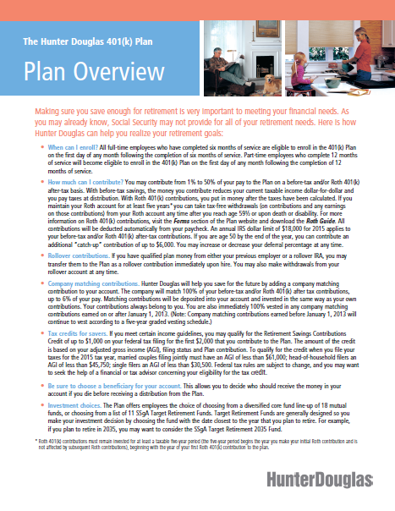
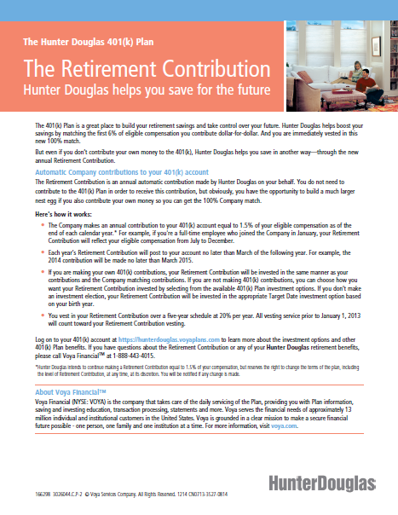
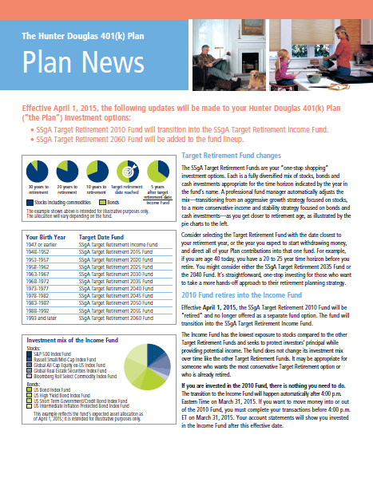
Strategy-in-Action: Progress to Date
New hire orientation materials replenished
SSgA fund change successfully communicated
Retirement Contribution mailing currently underway
Weekly communications calls scheduled through the end of May
Focus group preparation and execution
Baseline communication build out
Coordination of onsite education at Hunter’s 14 locations

Slide 9
2015 – 2016 Communication Calendar
2015
2016
Q1
Q2
Q3
Q4
Q1
Q2
Q3
Q4
Strategy
Planning
Measure/ Assess
Data Analysis
HR Webcast
Measure/ Assess
Focus Group & Survey Write Ups + Creative
Planning & Development
Planned
Communication
Activity
Financial Wellness Campaign
Year 1
Orientation Mailing
Catch Up Messaging
Financial Wellness Campaign
Year 2
Orientation Mailing
New Year Message
SSgA Fund Change
Plan Awareness Posters, eMail Workshops
Plan Awareness Posters, eMail Workshops
National Save for Retirement Week
National Save for Retirement Week
eBook, Rollover In, Nearing Retirement Materials
Ongoing: Newly Eligible Kit & Support Materials, General & Targeted Web Messages, Pointers Online, Global Webcasts

Slide 10
Appendix: Communication and Education

Slide 11
2015 – 2016 Communication Calendar
2015
2016
Q1
Q2
Q3
Q4
Q1
Q2
Q3
Q4
Strategy
Planning
Measure/ Assess
Data Analysis
HR Webcast
Measure/ Assess
Focus Group & Survey Write Ups + Creative
Planning & Development
Planned
Communication
Activity
Financial Wellness Campaign
Year 1
Orientation Mailing
Catch Up Messaging
Financial Wellness Campaign
Year 2
Orientation Mailing
New Year Message
SSgA Fund Change
Plan Awareness Posters, eMail Workshops
Plan Awareness Posters, eMail Workshops
National Save for Retirement Week
National Save for Retirement Week
eBook, Rollover In, Nearing Retirement Materials
Ongoing: Newly Eligible Kit & Support Materials, General & Targeted Web Messages, Pointers Online, Global Webcasts

Slide 12






Financial Wellness Campaign – Overview
May June July
HR Webcast
Preview of Program
Questionnaire
Employee Announcement
eMail
Postcard
Posters
CCTV
Personalized Retirement Evaluation
Education & Planning
Seminars
Drop-ins
1:1s or Phone-Based Advisors
Reminders
Nonparticipant
Below Match
One Fund
Nearing Retirement
Personalized
Non-Participant Campaign

Slide 13



Kick Start Program - Retirement Income Understanding
March – June 2015 Understand employee perspective on retirement while initiating campaign activity that begins to drive awareness of retirement income need and the value of the Plan
Objective | Assess employee understanding of retirement income needs, sources, and levels of confidence to establish platform for communication program and positioning of messaging for next 24 – 36 months In tandem, start to establish conversation so employees begin to get further engaged
Strategy | Focus groups and surveying Initiate awareness campaign and update communication materials
Tactics | January Statement Insert on myOrangeMoney Plan Awareness Flyer/Poster distributed at locations Plan Awareness eMail with link to survey and new eBook Focus Groups
Measures of Success | Click rates Attendance at focus groups Enrollments and deferral increases Utilization of PWeb, calls, services

Slide 14

Financial Wellness Campaign
July – September 2015 – Re-launch engagement campaign to get employees onboard with a focus understanding where they stand and what they need to do next
Objective | Raise awareness of retirement income need, show employees where they stand today, demonstrate what they need to do next to improve outcome Improve enrollment, deferrals, access to advice
Strategy | “Drip” marketing campaign with compelling proof points that are differentiated by audience that culminates with onsite education Segment message by audience/age Communicate on services, tools and resources
Tactics | HR Announcement- email and webcast Postcard followed by HTML eMail & Benchmark Survey – note that pension benefit is now included in advice Retirement Evaluation Posters and Workshop Registration Website Onsite Workshops and Webinars – Budgeting/Debt, Retirement Income, Financial Planning iPad drawings to gain attendance, ice cream social, etc. 1:1s for advice and financial planning Reminder notifications
Measures of Success | Opens and clicks Onsite attendance, webinar attendance, 1:1 meetings Enrollment, deferral increases and catch-up elections Advice access, managed accounts, holistic financial plans

Slide 15

National Save for Retirement Week
Fall 2015 Support of National Campaigns that will have general public awareness – simple reminders of the importance of saving – ties in with annual enrollment considerations
Objective | Leverage standard campaigns to remind employees of awareness of need to personally save
Strategy | Leverage National Save for Retirement Week campaign Host a week of 401(k) events
Tactics | HTML email Flyer/Poster distributed at locations Crossword puzzle handout in break rooms/cafeterias Plan website message Statement insert Voya Global Webcast Onsite drop by tables
Measures of Success | Opens and clicks Log in to Plan website Deferral increases and enrollment Webcast and onsite attendance

Slide 16
General Communication Support
Ongoing Continue to provide general communications support and enhance offering as appropriate
Objective | Update standard communications materials in a timely manner Support ongoing communications efforts, including Plan changes and enhancements
Strategy | Leverage Voya’s standard communication campaigns Identify additional communications gaps/opportunities discussed in bi-weekly call
Tactics | Plan Changes Pointers Online, Global webcasts Tools/resource enhancements Quarterly statement inserts Retirement Planning Guide Term Insert
Measures of Success | Opens and clicks Log in to Plan website Mobile app access

