Slide 1
Dark Sector Searches in LArTPC Experiments
APS April Meeting
April 11, 2015
Elizabeth Himwich
On Behalf of the MicroBooNE Collaboration
1
Notes:
Test NOTES

Slide 2
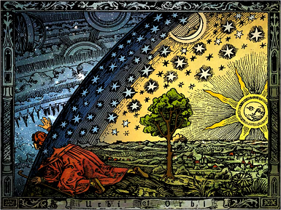
Dark Sector, not Dark Matter
Current Dark Matter searches
Future Dark Sector searches (non-WIMP)
- MeV-scale dark sector phenomena
- Not accessible by direct detection experiments
Leptophobic Dark Sector
Dark Sector
Standard Model
2
New Portal?
Notes:
“You've heard a lot about direct detection experiments” - these are looking for direct detection of dark matter above the Lee-Weinberg bound of 2 GeV
-We will be talking about searches for MeV-scale dark sector phenomena, the decay of a dark sector mediator particle and NOT direct detection of matter.
- This can be performed in Fixed-target experiments and analyzed in LArTPCS

Slide 3
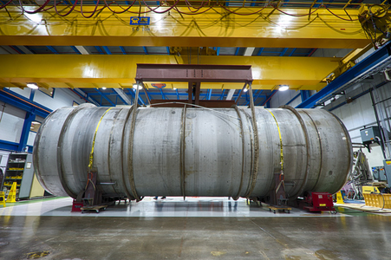
A New Window into the Dark Sector
High energy dark sector production signals
Where? High-intensity fixed-target experiments
Neutrino beams
8 GeV Booster Neutrino Beam (BNB) at Fermilab
LArTPCs
MicroBooNE, LAr1-ND
MicroBooNE
Cryostat
3

Slide 4
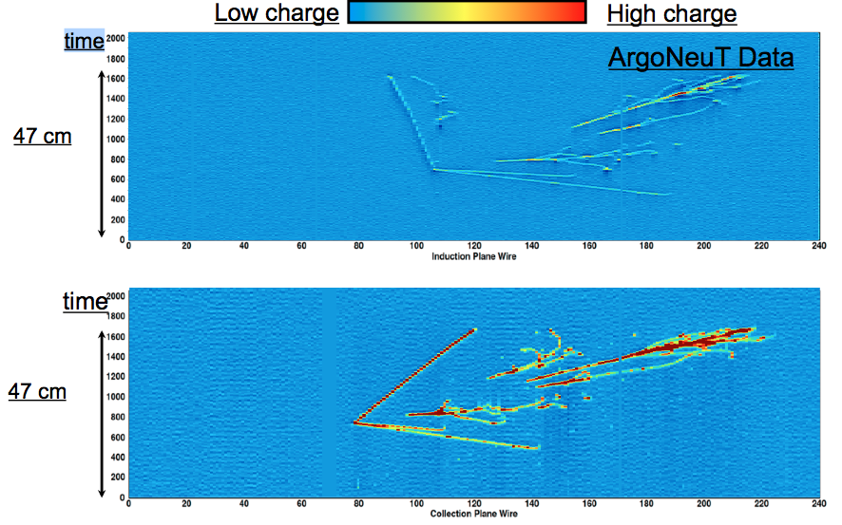
LArTPCs: Signature-Based Searches
LArTPC technology:
Ionization charge
Scintillation light
High resolution:
Millimeter distances
GeV energies
Spatial information: characterization of events by topology
Induction Plane Wire
Collection Plane Wire
4

Slide 5
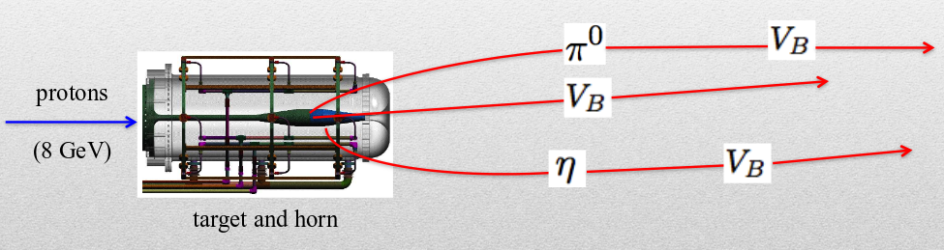
Leptophobic Dark Sector
Vector boson is a mediator between the dark sector and the Standard Model that couples dominantly to quarks
produced via meson decay and direct QCD production
Dark Sector Production in Booster Neutrino Beam (BNB)
Meson production in BNB is well-understood, so we can incorporate in production simulations
5

Slide 6
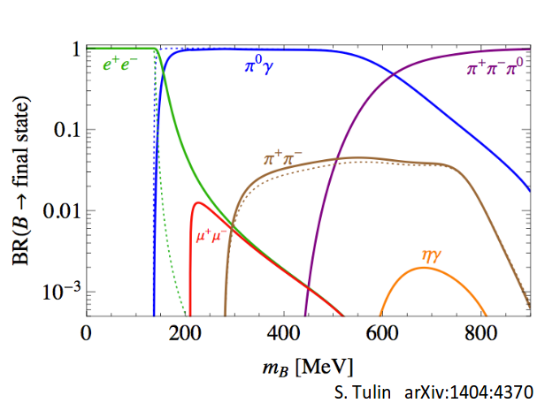
Vector Boson Visible Decay
Branching Ratios
6

Slide 7
Vector Boson Visible Decay
Branching Ratios
Focus on three-photon decay channel
Primary decay mode 140-620 MeV
Is faked by well-understood SM processes
7

Slide 8
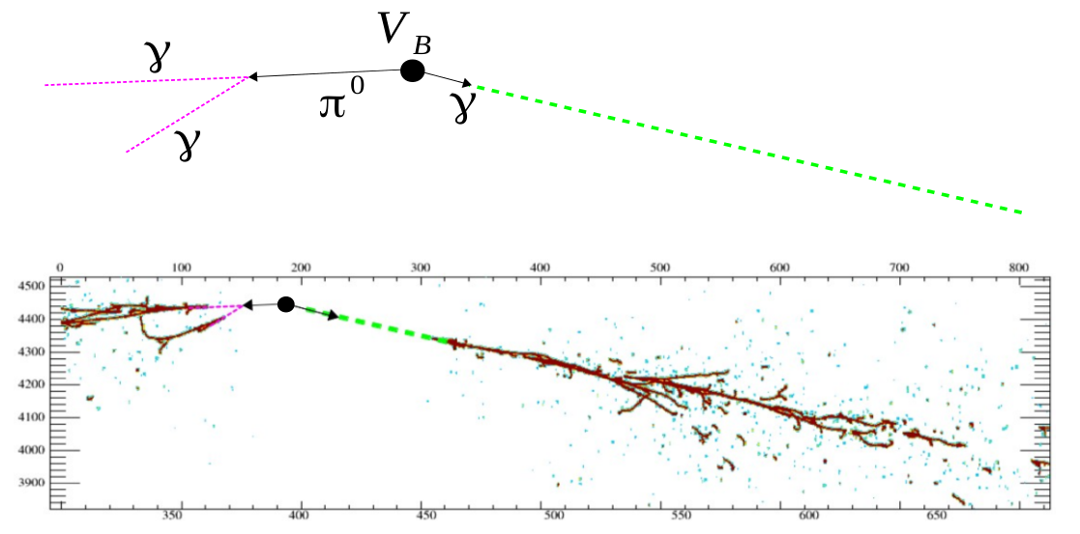
Three-Photon Signature in MicroBooNE
MicroBooNE Active LAr Volume:
2.5 x 2.5 x 10 m³
Time
Wire 300
Collection Plane Wire
Wire 700
Three-photon topological signature: photons can be traced back to a common point with no vertex activity (i.e. no hadronic interaction)
8

Slide 9
Background Analysis
Study three-photon channel in MC events
Goals:
Identify types of processes that fake the signal
Quantify their rate
Characterize their kinematics
Identify effective cuts to remove backgrounds
Approach:
Topology-based event search and characterization
Fiducial volume spatial cut
Cut based on photon energy and physical distribution
Optimize cuts
9

Slide 10
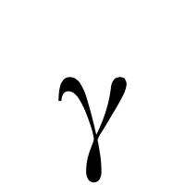
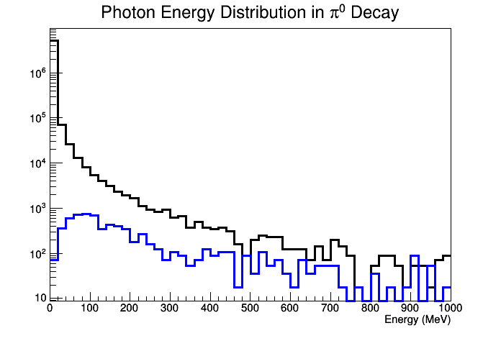
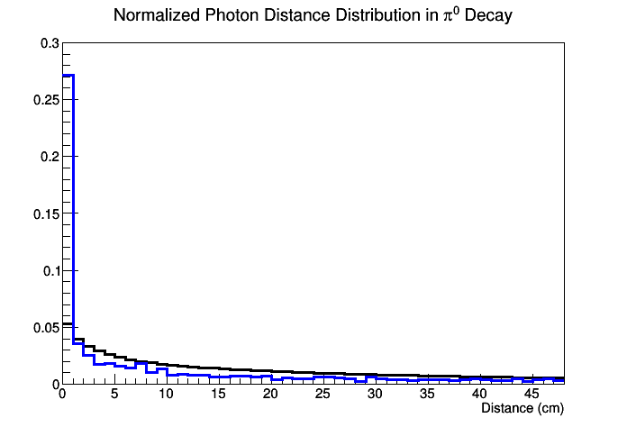
Background Event Characterization
In simulation of MicroBooNE's full exposure, 2% of events have ≥ 3 , including ≥ 2 from a πº
Blue: Photons from πº
Number of Photons
Black: Other photons in event
Number of Photon Pairs
Area Normalized
Distance Calculation:
Distance of Closest Approach
Lines do not necessarily intersect in 3D!
10

Slide 11
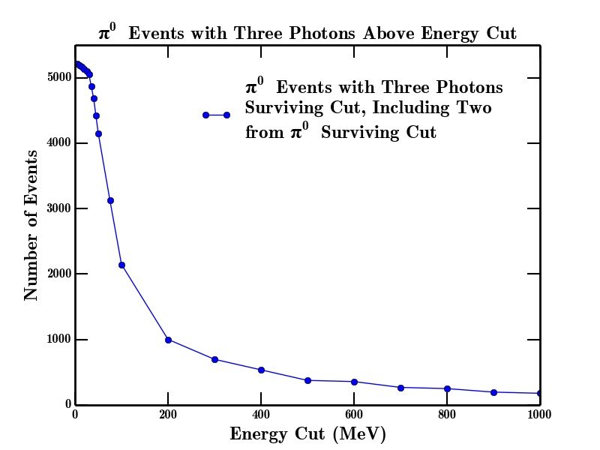
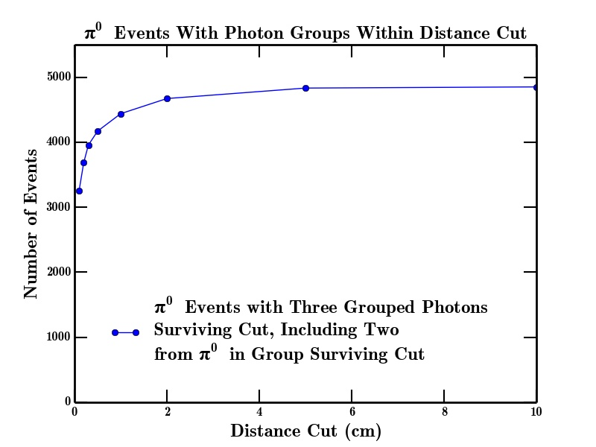
Cuts to Minimize Background
Distance Cut Visualization
13

Slide 12
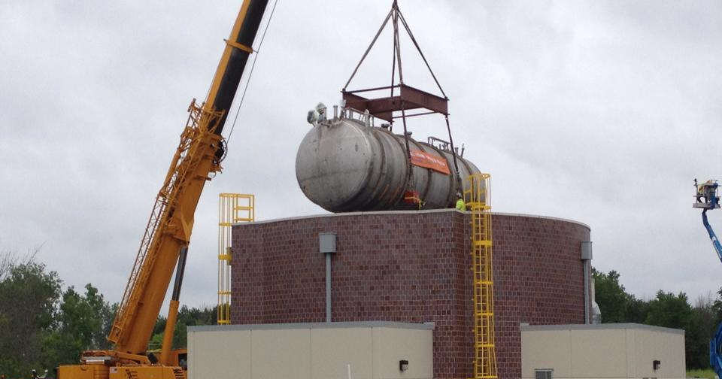
Plans for the Future
Use vector boson production statistics to optimize signal/background ratio
Apply energy and distance cuts simultaneously
Continue refining signal reconstruction
Extend analysis to other channels / models
Quantify signal detection efficiency
14

Slide 13
Backup Slides
15

Slide 14
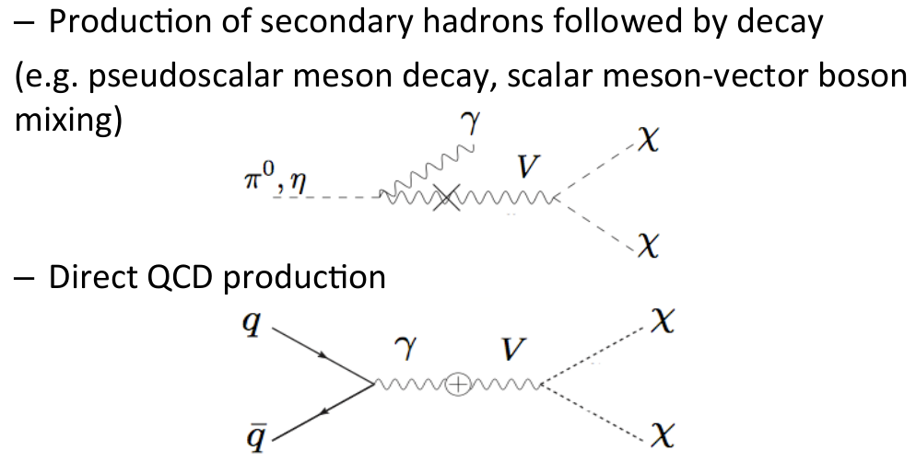
Production of Vector Bosons
16

Slide 15
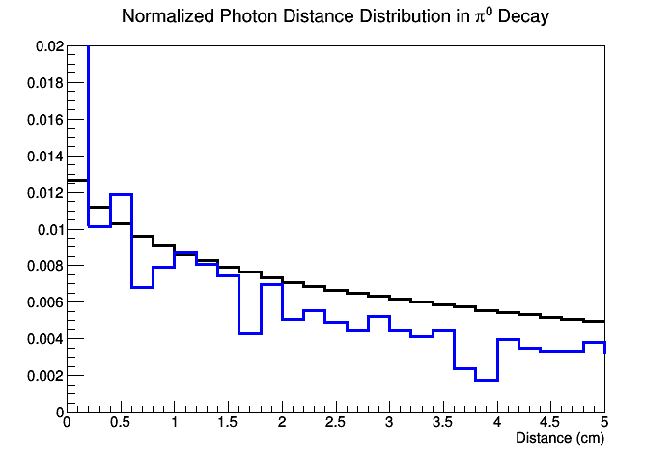
17

