Slide 1
Air Hockey AI
Aaron Brookhouse
CSE 472

Slide 2
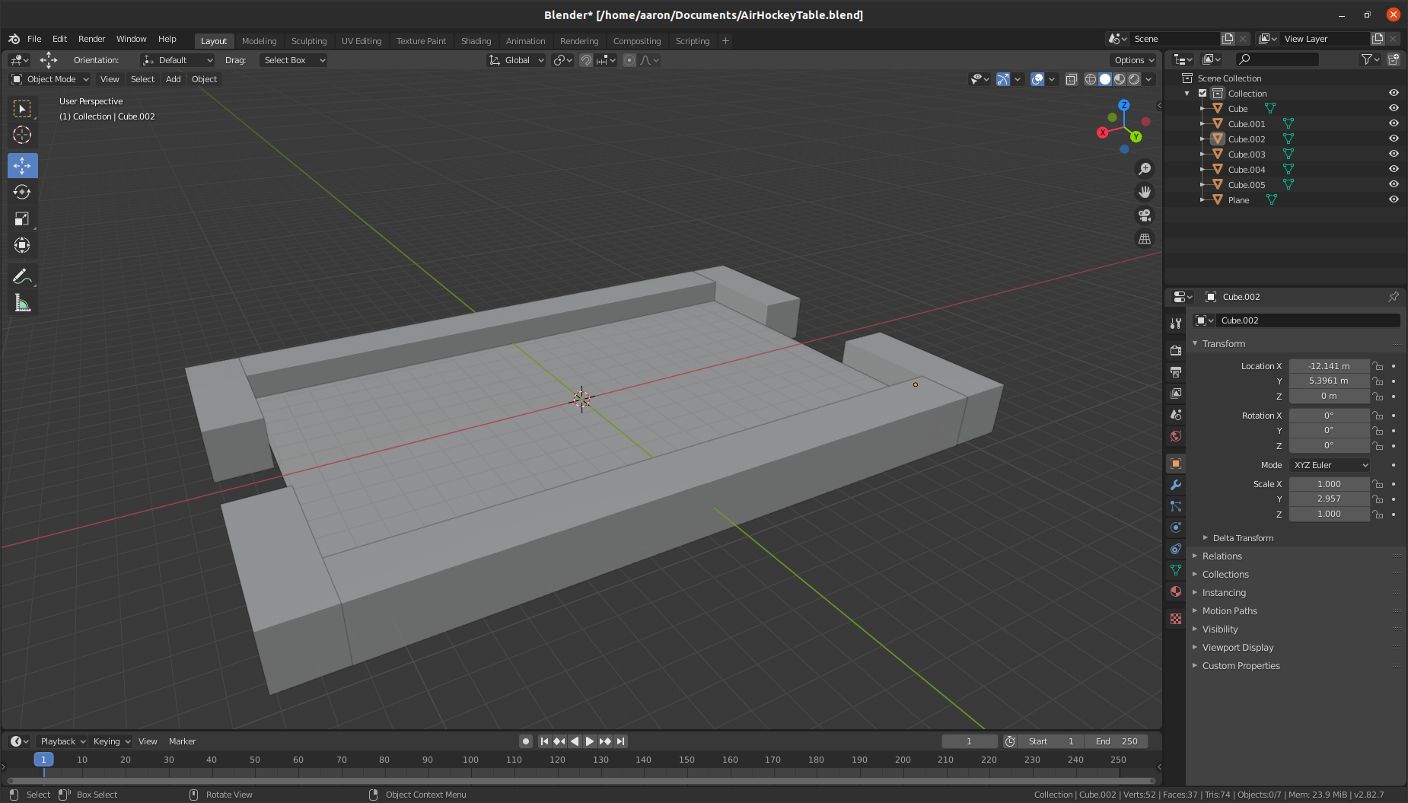

Slide 3
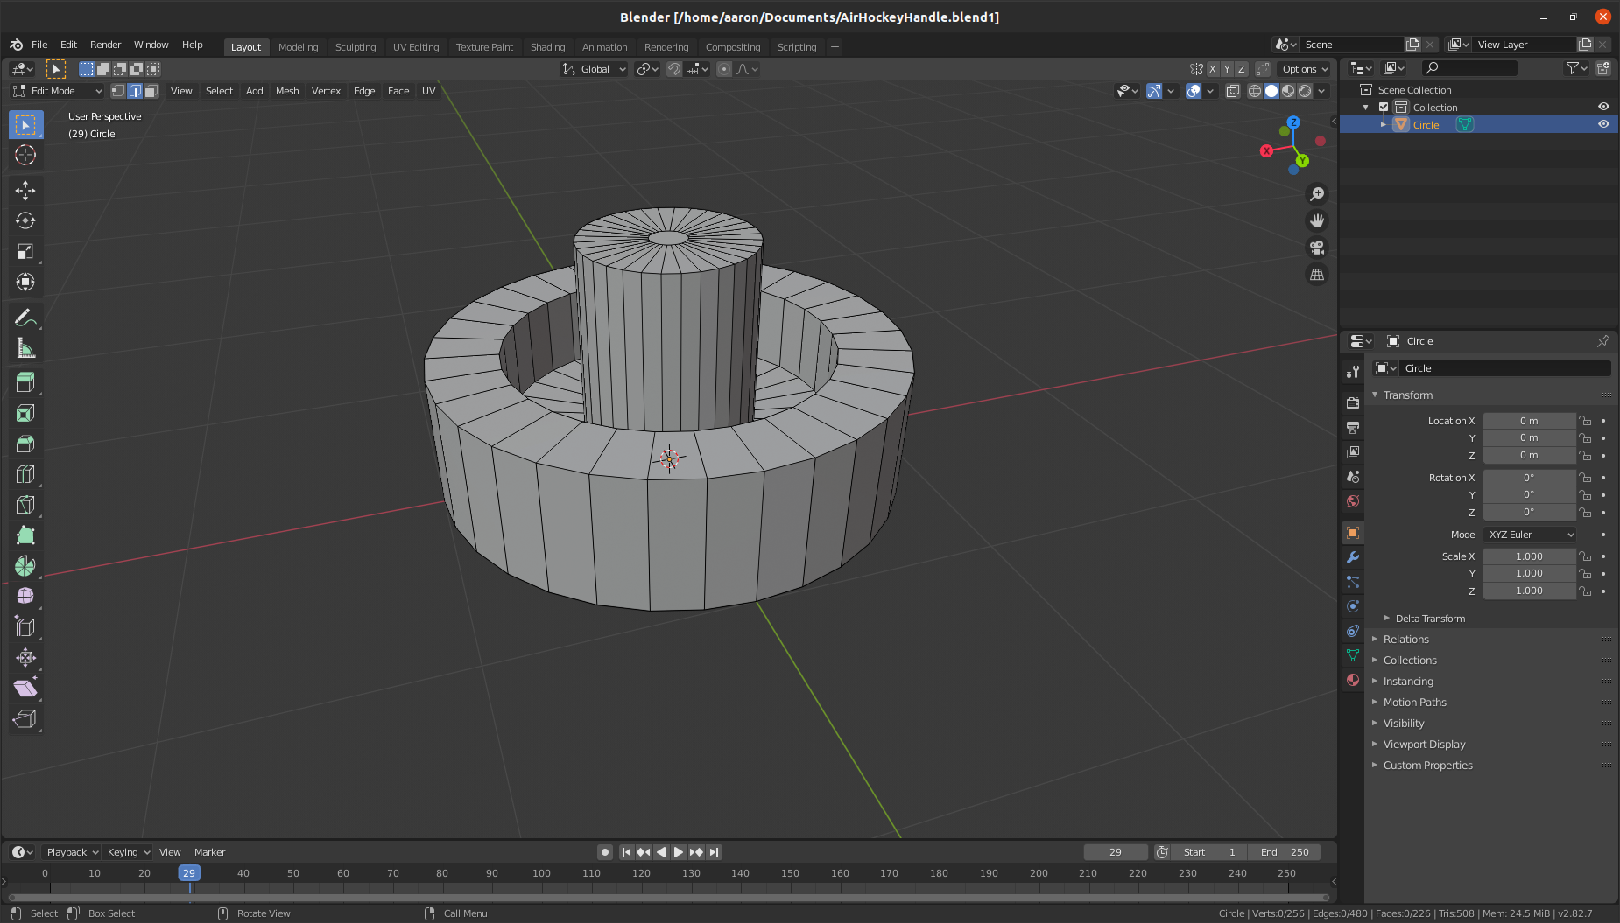

Slide 4
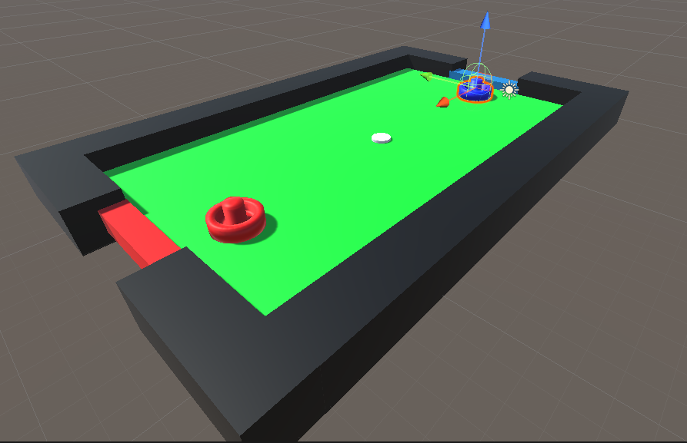

Slide 5
Reinforcement Learning
Normal Machine Learning
  Model learns to produce output y from input x, by learning from a bunch of previously made x,y pairs
Reinforcement Learning
  X is a series of observations made by your ‘agent’ (information from the surrounding environment)
  Y is a series of Rewards, that let the AI know if it is doing good or bad
  There are many parameters that control the training, such as one that controls whether the model should try what it thinks is the best solution, or something more random

Slide 6
My Model
X – Observations
  Location of Puck, location of self, location of opponent, velocity of puck, opponent, and self
  Also added these vectors relative to self. Ex Position – Self
  Raycasts in a circle around the agent
Y – Rewards
  15 for scoring, -15 for being scored on, 3.5 for hitting puck
  -1 per second if out of bounds, -.5 for second if not ‘behind puck’, and a positive range that is stronger when closer to the puck

Slide 7
Training
I trained it to play against a simple scripted AI that played defense by trying to stay in between the puck and the goal
  had a maximum movement speed that could not be surpassed.

Slide 8
Results
Learned to score a lot better than defend
When I leave the goal open it goes for very straight shots to the goal and scores quickly
When I defend the goal, it tries to come from the corners and bounce the puck off of me into the goal
Once you get used to playing against the AI, it is easy to ‘counterattack’ it

Slide 9
How to Improve
AI Self Play
  Train 2 AIs to play against each other, would get rid of some of the limitations of how I trained it
Make Several Scripted opponents for it to play against and alternate between them.

