Slide 1


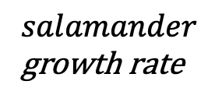

$frog$growth rate
$$r_{1}$$
Frogs
Salamanders
$$r_{2}$$
$salamander$growth rate

