Slide 1
Fundamentals of Ecology
Week 9, Ecology Lecture 8
Cara Brook
March 2, 2023

Slide 2
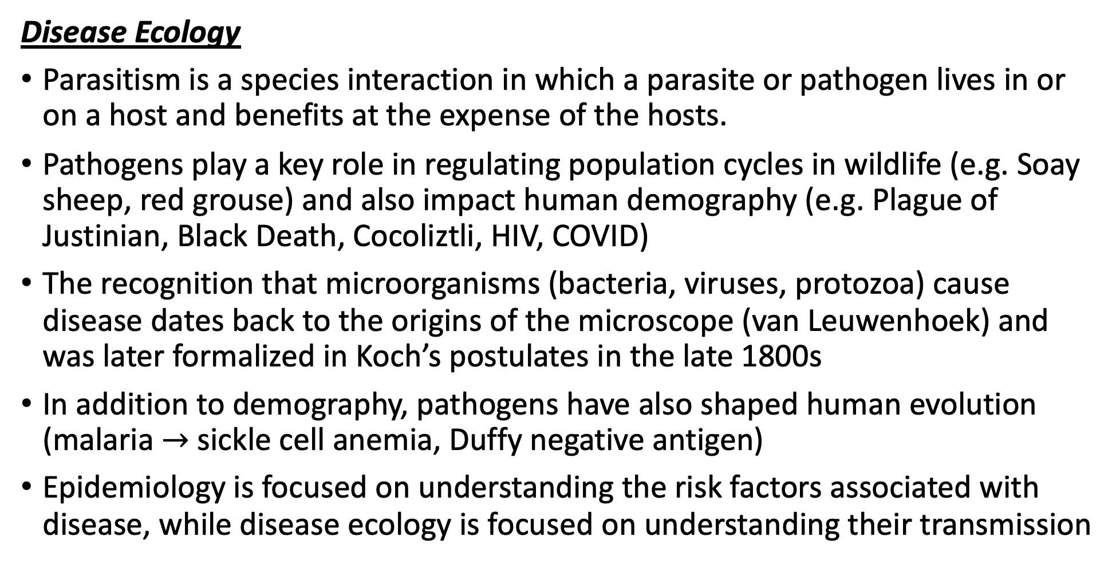
Let’s recap a bit!
Disease Ecology
Parasitism is a species interaction in which a parasite or pathogen lives in or on a host and benefits at the expense of the hosts.
Pathogens play a key role in regulating population cycles in wildlife (e.g. Soay sheep, red grouse) and also impact human demography (e.g. Plague of Justinian, Black Death, Cocoliztli, HIV, COVID)
The recognition that microorganisms (bacteria, viruses, protozoa) cause disease dates back to the origins of the microscope (van Leuwenhoek) and was later formalized in Koch’s postulates in the late 1800s
In addition to demography, pathogens have also shaped human evolution (malaria $→$ sickle cell anemia, Duffy negative antigen)
Epidemiology is focused on understanding the risk factors associated with disease, while disease ecology is focused on understanding their transmission
Disease Ecology
We learned about extensions to the SIR model that can be made to better represent diverse types of pathogens (e.g. dynamics different from classic measles).
These extensions included incorporating inherited maternal immunity into a disease model (important in the case of natural vs. vaccinated immunity in mothers), as well as modeling different types of pathogen transmission.
Environmental disease transmission occurs when the pathogen is maintained outside the host in an environmental reservoir. We learned a few approaches to modeling this type of pathogen. Example: cholera, with water-borne transmission.
Vertical transmission occurs when a pathogen is passed mother-to-infant in utero. We learned how to model this in the case of HIV- and also learned a few details about this pathogen.
Vector-borne transmission occurs when a pathogen is transmitted via blood-feeding arthropod (tick, flea, mosquito). We learned the specifics of how vector-borne disease are modeled in the case of malaria.

Slide 3
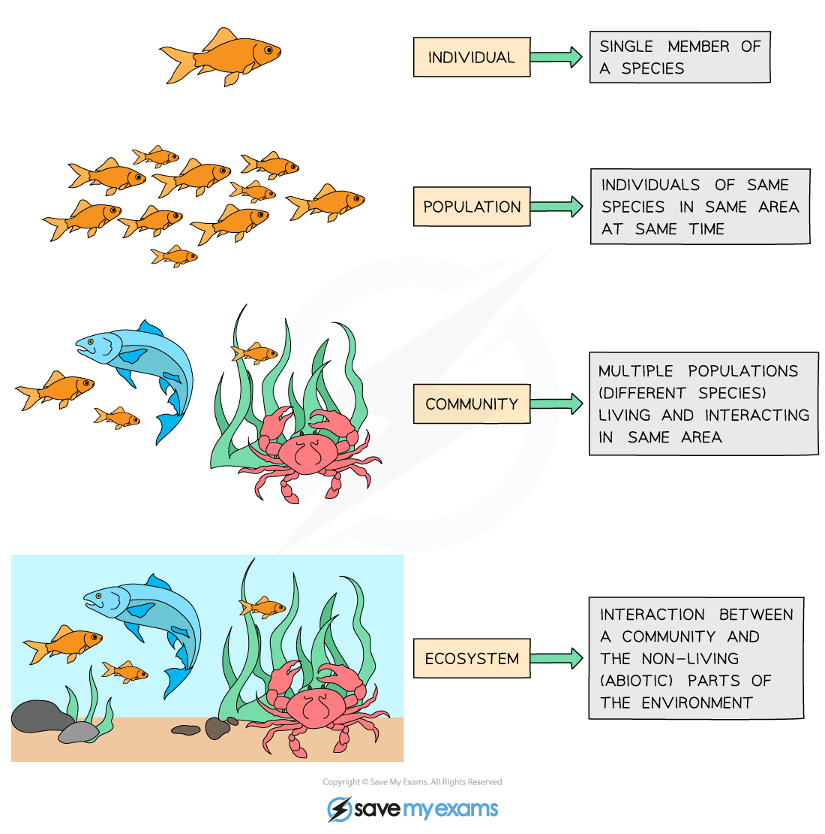
Ecosystem = communities interacting with the abiotic environment
individual
population
How do communities on different substrates assemble?
metapopulation
community
ecosystem
Notes:
At the bottom, there is the level of the individual. Since ecology concerns interactions of organisms with each other and the environment, here we means how an in individual interacts with the environment

Slide 4
Ecological succession was first described at the University of Chicago!
Succession is the process of change in the species structure of ecological communities with time.

Slide 5
Ecological succession was first described at the University of Chicago!
Succession is the process of change in the species structure of ecological communities with time.
Community begins with pioneer species, then develops with increasing complexity that self-reinforces to establish a climax community.

Slide 6
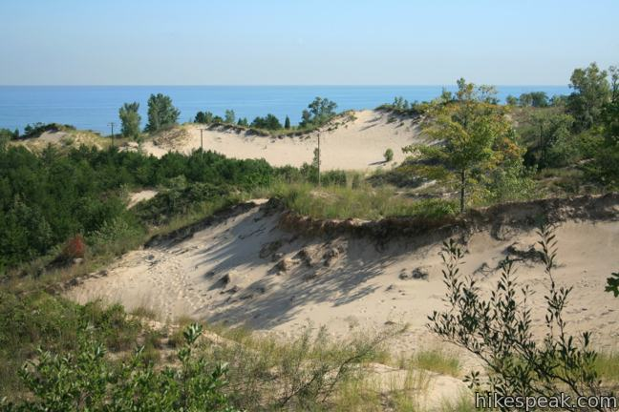
Ecological succession was first described at the University of Chicago!
Succession is the process of change in the species structure of ecological communities with time.
Community begins with pioneer species, then develops with increasing complexity that self-reinforces to establish a climax community.
Henry Chandler Cowles, a professor at the University of Chicago, developed the first formal concept of succession while observing vegetation on dunes of different ages at the Indiana Dunes.

Slide 7
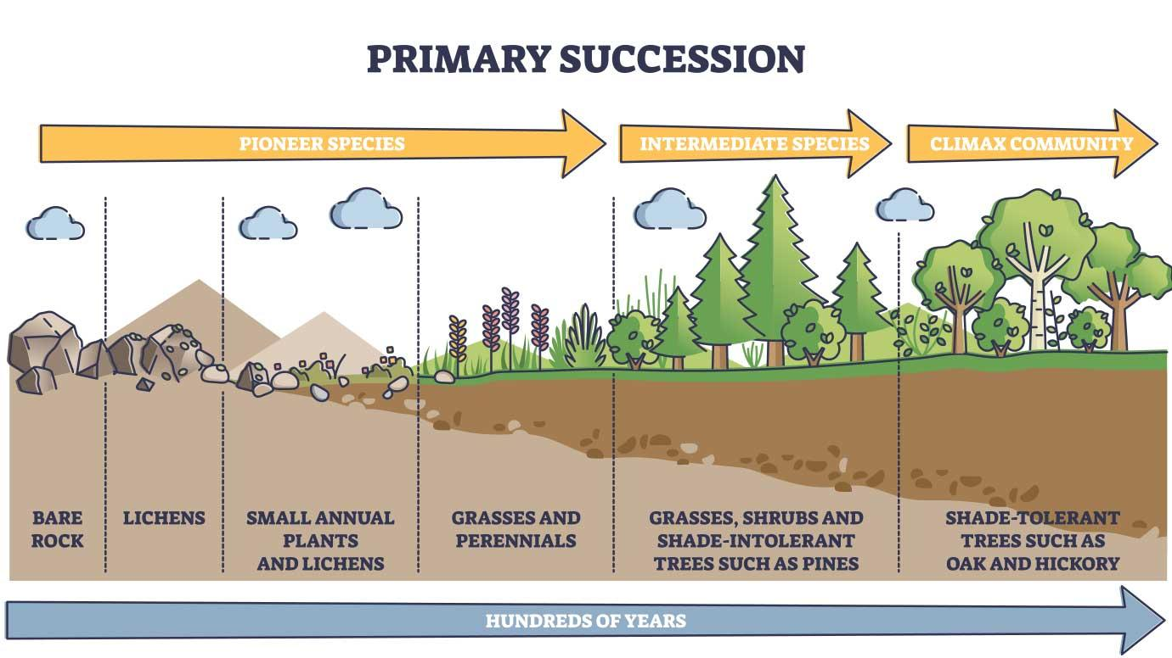
Primary succession occurs when species colonize a bare substrate.

Slide 8
Primary succession occurs when species colonize a bare substrate.
Continuum from “r-selected” $→$ “K-selected” species.

Slide 9
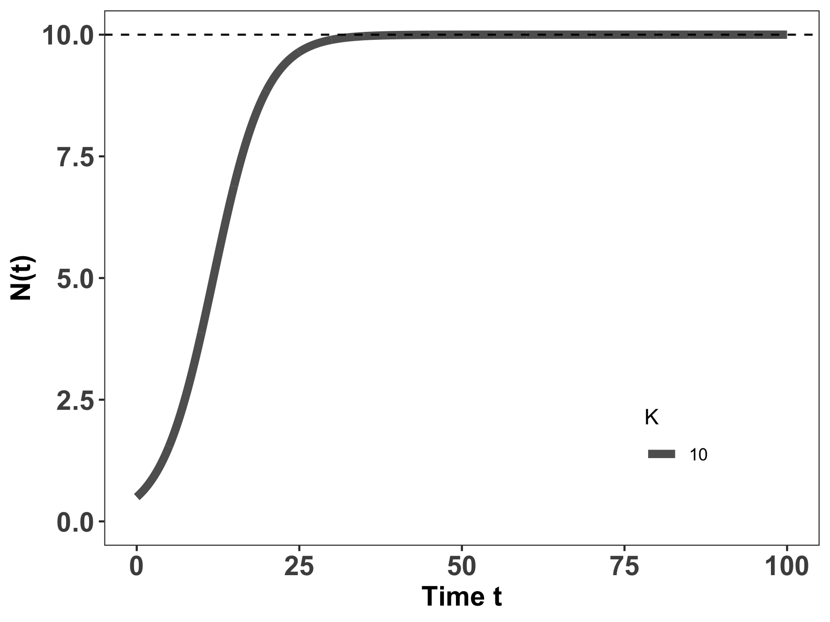
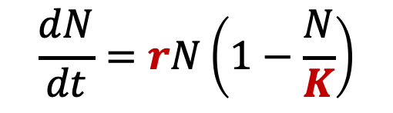
Primary succession occurs when species colonize a bare substrate.
K-selected species
r-selected species
$$\frac{dN}{dt}=rN\left(1−\frac{N}{K}\right)$$
Continuum from “r-selected” $→$ “K-selected” species.

Slide 10
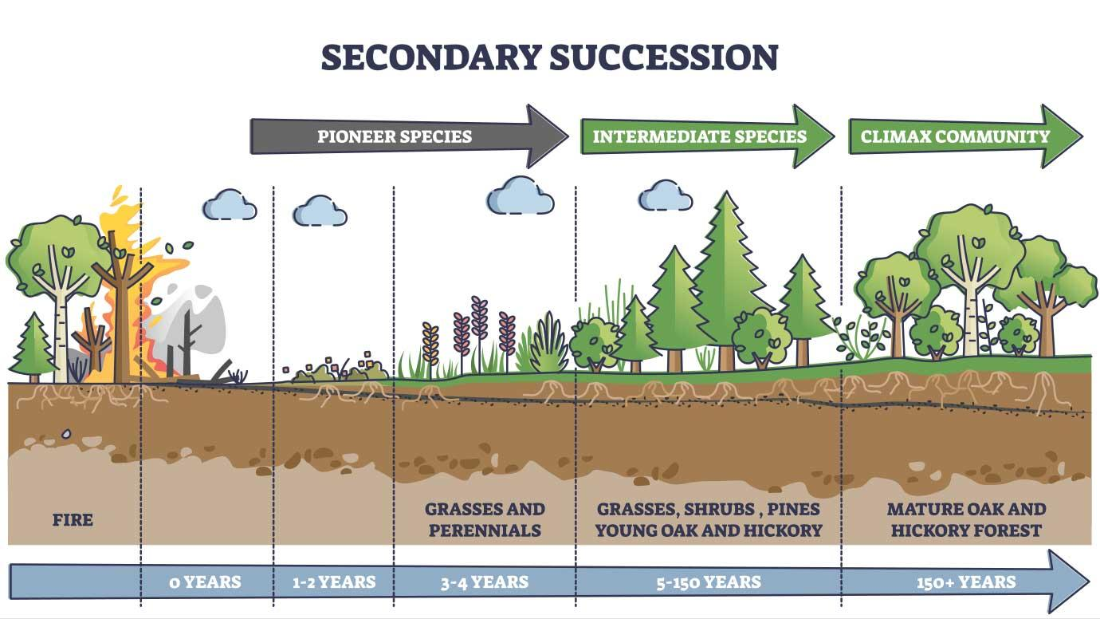
Secondary succession occurs when an environmental disturbance displaces a climax community, but soil and nutrients are still retained

Slide 11
Secondary succession occurs when an environmental disturbance displaces a climax community, but soil and nutrients are still retained
Continuum from “r-selected” $→$ “K-selected” species.

Slide 12
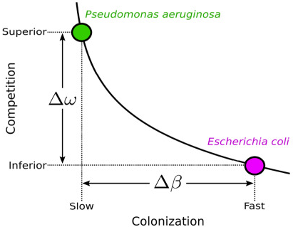
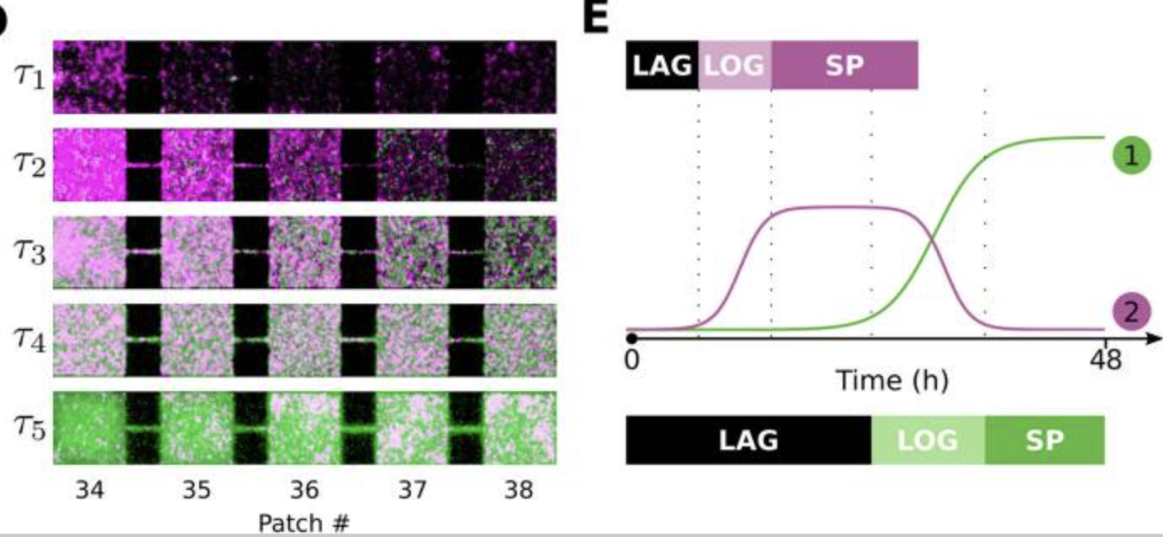
Succession also occurs in microbial systems.
Here, the “K-selected” superior competitor eventually replaces the “r-selected” fast colonizer.
Wetherington et al. 2022. BMC Biology

Slide 13
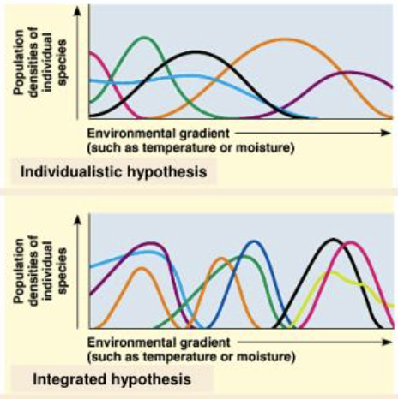
Superorganisms vs. Loose Collections of Species
Frederic Clements (1916) argued that community succession was predictable and deterministic, much like ontogenetic development in individual organisms, moving always towards some superorganism.
Priority effects: inhibitory or facilitative priority effects occur when one species ”prepares” the environment for the next species in succession
Henry Gleason (1926) argued instead that chance favored the dispersal of nearby species into available habitat for succession, leading to stochastic assembly of communities
Closer to Cowles’ original thinking

Slide 14
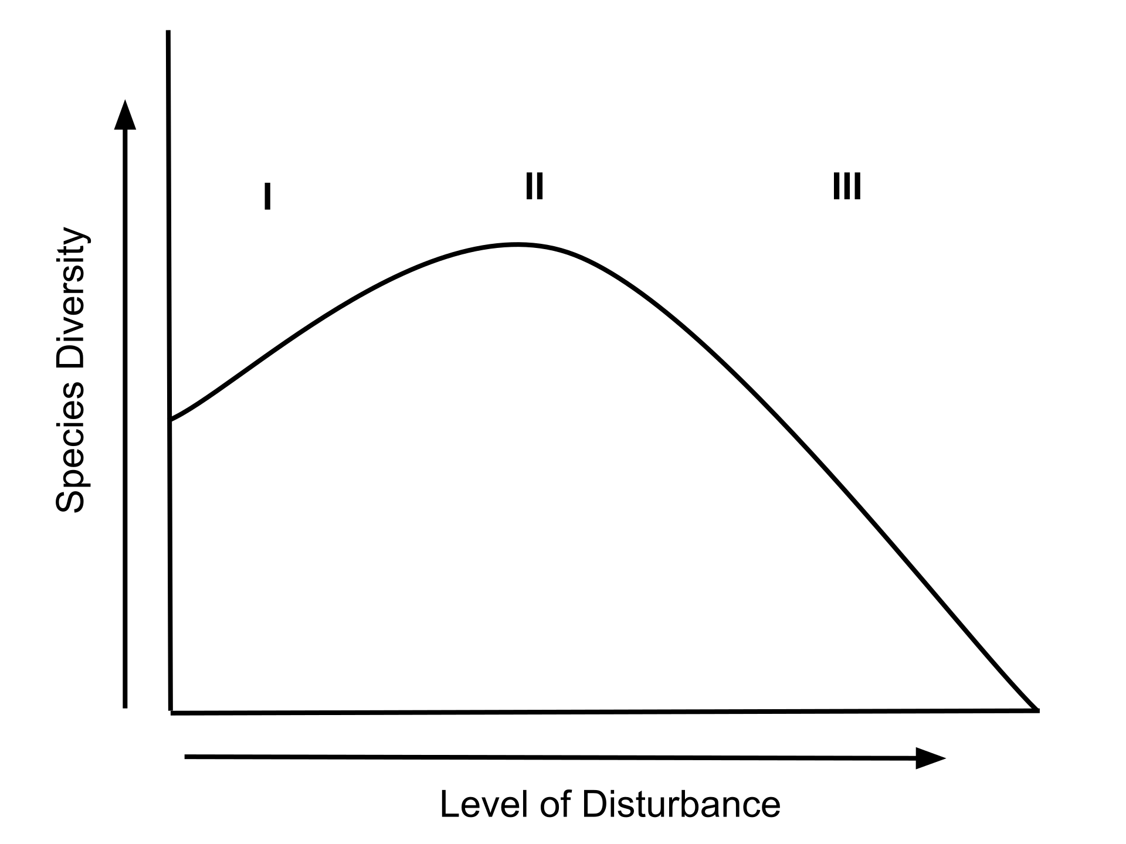
The Intermediate Disturbance Hypothesis states that species diversity should be maximized at levels of intermediate disturbance in which both r-selected and K-selected species can coexist.
K-selected species dominate
r-selected species dominate

Slide 15
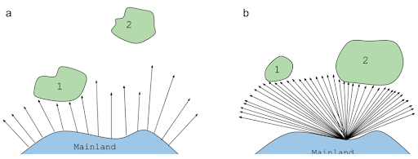
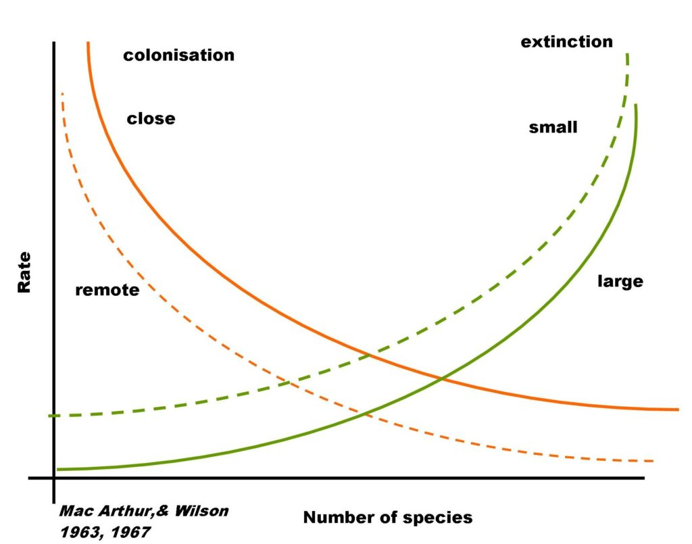
The MacArthur-Wilson theory of island biogeography offered a null model for the number of species found in a given habitat, based exclusively on their size and distance from a source

Slide 16
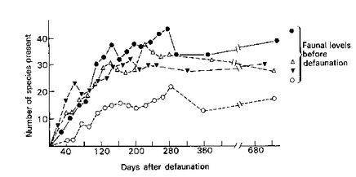
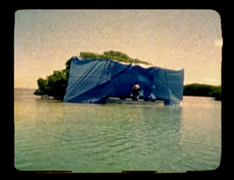
Wilson and Simberloff field-tested this theory in the Florida Keys

Slide 17
Diamond + reserve size

Slide 18
Janzen-Connell

Slide 19
Climate and disease

